Slide 1
East Coast Gas System Reforms
Stage 1 implementation – meeting 4

Slide 2
We acknowledge the Traditional Owners of country throughout Australia and recognise their continuing connection to land, waters and culture.
We pay respect to their Elders
past, present and emerging.

Slide 3
Meeting recording notice
Please note that this meeting will be recorded by AEMO and the recording may be made generally available and accessible on AEMO’s website as a resource. AEMO may also access and use the recording to take meeting notes.
By attending the meeting, you consent to AEMO recording the meeting and using the recording for these purposes.

Slide 4
AEMO Competition Law meeting protocol
AEMO is committed to complying with all applicable laws, including the Competition and Consumer Act 2010 (CCA). In any dealings with AEMO regarding proposed reforms or other initiatives, all participants agree to adhere to the CCA at all times and to comply with this Protocol. Participants must arrange for their representatives to be briefed on competition law risks and obligations.
Participants in AEMO discussions must:
  Ensure that discussions are limited to the matters contemplated by the agenda for the discussion
  Make independent and unilateral decisions about their commercial positions and approach in relation to the matters under discussion with AEMO
  Immediately and clearly raise an objection with AEMO or the Chair of the meeting if a matter is discussed that the participant is concerned may give rise to competition law risks or a breach of this Protocol
Participants in AEMO meetings must not discuss or agree on the following topics:
  Which customers they will supply or market to
  The price or other terms at which Participants will supply
  Bids or tenders, including the nature of a bid that a Participant intends to make or whether the Participant will participate in the bid
  Which suppliers Participants will acquire from (or the price or other terms on which they acquire goods or services)
  Refusing to supply a person or company access to any products, services or inputs they require
Under no circumstances must Participants share Competitively Sensitive Information. Competitively Sensitive Information means confidential information relating to a Participant which if disclosed to a competitor could affect its current or future commercial strategies, such as pricing information, customer terms and conditions, supply terms and conditions, sales, marketing or procurement strategies, product development, margins, costs, capacity or production planning.
For further information, please see the Competition and Consumer Act.

Slide 5
Online forum housekeeping
Please mute your microphone, this helps with audio quality as background noises distract from the information being shared.
Video is optional, but having it turned off helps with performance and minimises distractions.
We ask that you utilise the Chat function for any questions or comments you may have. This aids note keeping and keeps discussions flowing smoothly.
Raise your hand if you wish to speak to an item. This keeps conversations orderly.
If you have dialled in via phone, please email GasReform@aemo.com.au your name and organisation for our records.
If your name appears abbreviated on Teams or is otherwise not fully reflected in the app, please add your name and organisation to the chat for our records.
Be respectful of all participants and the process.
This is an industry forum for briefing participants, any media should contact AEMO’s Media team for information about events occurring in the market. Media enquiries can be made via media@aemo.com.au.
Please email GasReform@aemo.com.au with any questions/feedback post the meeting.

Slide 6
Agenda
Guidelines feedback received
Updates on Procedures feedback
Industry Readiness Plan

Slide 7
East coast gas system – Stage 1
Transparency
New and existing participant disclosure obligations to enable AEMO to assess the likelihood of threat to the reliability or adequacy of gas supply.
Signalling
Establishing a register of contacts to communicate information about risks or threats, including the ability to hold conferences.
Directions powers
AEMO can give directions to gas industry participants to resolve an identified risk or threat. This includes an interim compensation framework.
Trading
AEMO can trade in natural gas to maintain or improve the reliability or adequacy of gas supply in the east coast gas system. AEMO must establish a $35 million trading fund.
AEMO is on track to have the Procedures and systems in place for winter 2023.

Slide 8
Part 27 register of relevant entities
AEMO will notify an organisation when the register has been updated
Organisation must respond within 5 business days confirming contact details
AEMO will publish the register
AEMO will also maintain a list of jurisdictional representatives
Participants are required to keep contact details up to date
Most organisations have confirmed contact details for the register. AEMO will be following up in the coming weeks for any outstanding details.
  Not a registration activity, and the term “relevant entity” is broader than just those organisations that have been included on the register.

Slide 9
Procedure consultation
AEMO has published the following documents
  East Coast Gas System Procedures
  BB Procedures
  BB Submission Guide
  CEPA report – recovering the costs of ga directions and the trading fund
  Impact and Implementation Report
  Demand zone – pipeline connection point mapping
  https://aemo.com.au/consultations/current-and-closed-consultations/implementation-of-east-coast-gas-system-procedures

Slide 10
Guideline consultation
Draft decision for Guidelines currently out for feedback
https://aemo.com.au/consultations/current-and-closed-consultations/implementation-of-east-coast-gas-system-guidelines
Notes:
Guidelines follow a different process (Rule 8)
Timeline can be shortened

Slide 11
Industry feedback – Guidelines

Slide 12
General comments
  Directions and trading powers used as a last resort measure
    Consistent with Guidelines – will consider industry response before exercising powers.
  Lack of threshold for AEMO intervention
    There are limits to prescribing the threshold of a risk or threat.
  Potential for unnecessary AEMO intervention when existing market mechanisms may provide a more efficient outcome.
    Proposed approach is to allow existing market mechanisms to provide a response first.
  Post-intervention report should be published by AEMO sooner than 4 months
    Will use best endeavours to publish a preliminary report within 1 month and a final report within 4 months.

Slide 13
Conferences
  Attendance of assessment conferences too narrow
    Designed to allow AEMO to consult with relevant entities it considers can assist in the assessment of an identified risk or threat.
  Potential competition issues from assessment conferences
    Procedures amended: AEMO will publish a brief meeting note within 1 business day.
  More clearly defined protocol for making contact regarding short notice conferences
    Incorporated definition of ‘short notice’ - notice within 24 hours
    AEMO will request entity to confirm receipt of conference notice and will use best endeavours to ensure conference notice has been received.
Market sensitive or confidential information should not be disclosed during conferences.

Slide 14
Directions
  Pipeline operators may not be aware if the gas being transported by a third party is under long term LNG export contracts
    NGR limits AEMO’s ability to give a direction in relation to gas required to meet obligations under long-term LNG export contracts.
    Guidelines amended to extend this exclusion to the transport of long-term contract gas.
    Obligation to notify AEMO amended so that it applies to the extent a relevant entity is aware that gas falls within this exclusion.
  Clarification on whether AEMO would consider suspending other markets to preserve a direction.
    Part 27 prevails to the extent of any inconsistency with another rule.
    Market suspension for AEMO’s other functions covered by other rules under the NGR.

Slide 15
Trading
  Concerns around AEMO participating in a market that it operates
    AEMO will consider whether the gas or service AEMO is seeking to trade is likely to be provided by market participants without AEMO intervention.
    Preferred option to tender services from industry.
  Actions taken by AEMO and the associated costs are transparent
    Trading notice intended to provide industry with transparency, may include:
      Type of trade – procuring service, trading bilaterally, trading in market.
      Location of trade.
      Total cost of trade to the trading fund.

Slide 16
Updates to Procedures

Slide 17
Amendments to demand zones
  Clarification of specific Connection Point Identifiers (ConnectoinPointID) for GPG connections.
  Published document mapping pipeline connection points to demand zones.

Slide 18
Expanded criteria for risk or threat
AEMO will publish a risk or threat notice in respect of an identified risk or threat if AEMO considers that the identified risk or threat meets or exceeds the following criteria:
    the supply of gas in all or part of the east coast gas system may be inadequate to meet demand; or
    the supply of gas in all or part of the east coast gas system may not be relied upon to meet demand, including in circumstances where:
    supply reserves are insufficient to respond to an unplanned event; or
    gas supply, including gas storage, may be insufficient to satisfy seasonal demand requirements; and
    AEMO determines that alternative AEMO functions and powers such as STTM contingency gas or DWGM interventions are insufficient to mitigate the actual or potential risk or threat.

Slide 19
Total expected daily gas demand
Original requirement: Expected daily gas demand equal to sum of:
    the proportion of the expected daily gas demand that is to be purchased under a gas supply agreement based on the relevant entity’s reasonable expectation of existing and potential agreements;
    the proportion of the expected daily gas demand that is expected to be purchased from a gas trading exchange, including the Trading Location, administered by AEMO (including a gas trading exchange location outside of the demand zone);
    the proportion of the expected daily gas demand that is expected to be purchased from a market administered by AEMO, where that market is wholly or partly within the demand zone;
    the proportion of the expected daily gas demand that is expected to be purchased from a market administered by AEMO, where that market is outside of the demand zone;
Amended requirement: Expected daily gas demand equal to or less than the sum of the values. Account for when participants are short gas.

Slide 20
Procedures feedback under consideration
Clarification of domestic supply forecasts
  Swaps are included when being supplied
  Only initial sale is included in forecast
Clarification to definition of demand
  Part 27 non-NGL retailer definition to include concept of demand to end-user.
  Demand for retail contracts vs wholesale contracts
  Includes gas to storage but not to linepack or imbalances or park services.
  Doesn’t relate to in-pipe trades

Slide 21
Industry Readiness

Slide 22
Communications
Materials for participants will include:
This overview presentation pack
East coast gas system reforms
https://aemo.com.au/initiatives/major-programs/east-coast-gas-reforms
Frequently asked questions
Gas BB technical specification
East coast gas system procedures and BB data submission guideline
East coast gas system guidelines
API reference
Notes:
System submission demonstrations to participants

Slide 23
Timeline
Pre-production open for testing
Systems
Rules
Procedures/guidelines
Rule commencement (tbc)
Industry disclosure obligations
(2 months after Rule commencement)
Mar | Apr | May | Jun | Jul | Aug
Release1 : Registry & Notifications
Release 2: Submissions
Go Live
27/6 ECGS Guidelines Go-Live
1/6 Procedures effective date
Procedures/Guidelines | Date
Guidelines second round consultation commence Procedures second round consultation close Procedures notice of decision Guidelines second round consultation submissions Procedures effective date Guidelines final decision Guidelines effective date | 24 April 2023 28 April 2023 11 May 2023 16 May 2023 1 June 2023 13 June 2023 27 June 2023
Upcoming Activities | Date
Present industry readiness plan at working group Pre-production open for testing. AEMO presents testing plan. AEMO reconfirms Part 27 register contacts and formally requests outstanding contacts AEMO reconfirms any exemptions Production available for submissions | 27 April 2023 15 May 2023 From 1 June 2023 From 1 June 2023 22 June 2023

Slide 24
ECGS Stage 1 Industry testing
Prerequisites
  Organisations should validate that they have access to AEMO’s Market Portal
  Testing will not be possible without Market Portal access.
  Organisations that use APIs to validate that they can access and submit data on AEMO’s API end points for existing and new APIs
Environment: Pre-Production
Industry Testing Timeline: 15/05/23 to 02/06/23
AEMO intends to communicate to the East Coast Gas System Working Group distribution list. AEMO invites organisational I.T. contacts to be included on these communications.

Slide 25
Objective
Key focus is to provide participants the opportunity to test their processes for submitting data via the portal and directly through the API endpoints including the following APIs:
  Medium Term Capacity Outlook (Gas Bulletin Board facilities)
  Expected Daily Gas Demand (Part 27 Retailers, BB large user facilities and LNG export projects)
  Linepack forecast (Gas Bulletin Board pipelines)
  Domestic supply forecast (LNG export projects)
  Export forecast (LNG export projects)
Verify that the submissions work when subjected to conditions as close to production conditions as possible (e.g. submission file content, size and frequency).

Slide 26
Pre-production testing and readiness
The focus of the pre-production testing is to provide participants with the opportunity to test their processes and systems for submitting data to AEMO.
Prior to the testing, AEMO will present to industry the steps to take for submitting data
During the testing, AEMO will conduct weekly conferences, each Monday, and will track defects and issues raised by participants. AEMO will also track simple metrics covering participation in the trial.
Participants will be responsible for managing their own readiness

Slide 27
Pre-production testing
The testing period will be four weeks, during which AEMO will provide heightened support:
  First week for connectivity testing and testing transactions
  Second week functionally test all required submissions
  Third week ongoing testing and implementing defect fixes
  Fourth week for retesting any defect remediation
AEMO project support will be available within business hours
Pre-production environment will remain open after week four for any further testing but without the same level of heightened support

Slide 28
AEMO's collection of data
Short term
up to 1 week ahead
Medium term
from 7 days to 2 years
Existing data
Short term capacity outlooks
Additional data
Demand forecasts for all users
Facility nominations and forecasts
Linepack capacity adequacy
pipeline nominations by connection point
Linepack quantities for pipelines
Existing data
Medium term capacity outlook
Uncontracted capacity outlook
Additional data
QLD LNG projects forecast (domestic/export supply) out to 6 months ahead
Outlook period extended out to 2 years
Daily granularity out to 6 months ahead
Large user facilities
Recall times
Medium term capacity outlook enhancements

Slide 29
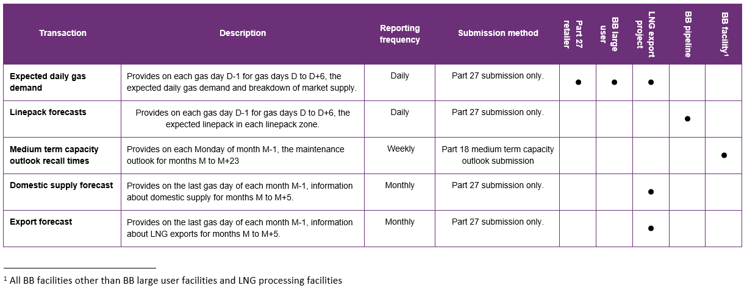
New submissions to test
Classification
Confidential
Confidential
Confidential
Confidential
Confidential
Four new submissions to test, and one modified submission.

Slide 30
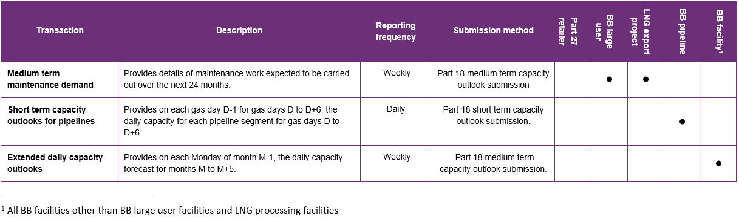
Existing submissions being utilised
Classification
Confidential for Large User facilities
Published
Published
Existing submissions being used but for different purposes (e.g., extended daily capacity outlooks) or required to be submitted by different submitters (e.g., BB large user facilities needing to submit medium term capacity outlooks).

Slide 31
How to raise an issue
During the testing: by email to bbo@aemo.com.au
After go-live: by email to support.hub@aemo.com.au or by phone 1300 236 600

Slide 32
Next steps

Slide 33
Coming up
Procedures – IIR consultation submissions due tomorrow 28 April 2023
Guidelines draft decision out for feedback now
One-on-one discussions
Preproduction to be available in May
Are there specific areas that industry would like to see more detail?

Slide 34
Links
East coast gas reforms
  https://aemo.com.au/initiatives/major-programs/east-coast-gas-reforms
Procedure consultation
  https://aemo.com.au/consultations/current-and-closed-consultations/implementation-of-east-coast-gas-system-procedures
Guideline consultation
  https://aemo.com.au/consultations/current-and-closed-consultations/implementation-of-east-coast-gas-system-guidelines
Background information
  https://www.energy.gov.au/government-priorities/energy-and-climate-change-ministerial-council/priorities/gas/proposed-regulatory-amendments-extend-aemos-functions-and-powers-manage-east-coast-gas-supply-adequacy

