Slide 1
5MS & GS
Systems Working Group #19
17 February 2020

Slide 2
Agenda
No | Time (AEDT) | Agenda item | Presenter
1 | 10:00 – 10:10 | Welcome, introduction and apologies | Graeme Windley
2 | 10:10 – 10:20 | Actions update | Anne-Marie McCague
3 | 10:20 – 10:25 | Program Update | Graeme Windley
4 | 10:25 – 10:30 | Staging environment | Graeme Windley
5 | 10:30 – 10:40 | Industry Test Working Group update | Tui Grant
6 | 10:40 – 10:45 | Readiness Working Group update | Greg Minney
7 | 10:45 – 10:50 | Procedures update | Simon Tu
8 | 10:50 – 10:55 | Forward meeting plan | Graeme Windley
Stream Updates
9 | 10:55 – 11:00 | Retail stream update | Jim Agelopoulos
10 | 11:00 – 11:10 | aseXML schema update | Paul Lyttle
11 | 11:10 – 11:20 | Retail Tech Spec updates | Simon Tu
12 | 11:20 – 11:25 | Dispatch stream update | Ian Devaney
13 | 11:25 – 11:30 | Settlements stream update | Mark Hillaby
14 | 11:30 – 11:35 | Settlements & Billing Tech Spec | Pierre Fromager
15 | 11:35 – 11:50 | Dispatch & Settlements Data Model | Sangeeta Pai
16 | 11:50 – 12:00 | Reallocations Deployment | Alex Alexander

Slide 3
Open actions
Item | Action required | Responsible | Action update | By
18.3.1 | AEMO to align Systems milestones with Readiness milestones. | AEMO | Milestones have been aligned and presented to the PCF in draft form. PCF is reviewing and will provide feedback. AEMO will finalised in advance of next PCF 5 Mar 20. | 18/02/2020
18.5.1 | AEMO to notify the SWG of the timeline for the ASWG consultation on the changes to the aseXML Schema once known. | AEMO | An update will be provided in SWG#19 | When available
18.5.2 | AEMO to circulate draft aseXML Schema when available from ASWG. | AEMO | Provided to SWG 12 Feb 20 | When available
17.5.1 | Participants impacted by the potential L2-M14, B2M via API Go- Live to email the 5MS program via the 5MS inbox in order for AEMO to set up a discussion. | Participants | Closed – no significant impacts identified.
17.8.1 | Participants to provide feedback via the 5MS inbox on making the reference field a mandatory ID, re 5MS rule change (3.13.4 (l1)) does not mention ‘ancillary service price’ and whether this is not necessary, and submissions being limited to one per second. | Participants | Update will be provided SWG#19
17.11.1 | AEMO to come back to Participants on the difference between the Tier 1 basic metering data delivery and the Ongoing Tier 1 basic metering data delivery. | AEMO | Update will be provided SWG#19
Notes:
Sammy - Add notes here on actions update
Ask Greg re reporting action

Slide 4
Program Update
Graeme Windley

Slide 5



Program update and current activities
AEMO program
Overall green. As reported B2M API Go-Live delayed. Proposal to be discussed within this session (see slide 26).
Realignment of key milestones post-Readiness work to be reviewed with PCF (see slide 7).
New Program Director, Rowena Leung, has joined the program from 10-Feb-20; replacing Sonja Nigmann.
Industry information session held 23-Jan-20, over 80 participants attending via the Webex.
Systems
Minutes for SWG#17 and SWG#18 may not be complete due to poor audio. Request participants advise of any updates missed & potential corrections.
5MS Staging Environment live with updates from all streams. Participant usage has increased since December, however still relatively low
The Settlements & Billing Tech Spec has been released to participants (20-Jan-20) and the Prudentials and Estimations Tech Spec has been released to participants (31-Jan-20).
Internal retail, dispatch and settlements workstreams systems development on track to meet 30-Jun-20 development completion date.
Readiness
Transition and Go-Live and Industry Testing and Market Trial strategies finalised
Metering Transition Plan (07-Feb-20) now finalised and MSP Accreditation Update Plan (target 13-Mar-20) to be finalised incorporating Industry feedback.
Draft Industry Contingency plan issued for Review
Initial Readiness Reporting survey issued 05-Feb-20.

Slide 6
Level 2 Milestones Exceptions (External)
Current as at 30-01-2020
Impact Assessment Required*: Participants to provide feedback by Friday 21 February of internal program impacts
ID | Stream | Milestone | Planned Date | Expected Date | % | Comments
New L2-M14 | Metering | B2M via API Go Live | 17-Mar-20 | 07-Dec-20 | 70% | AEMO has experienced delays establishing the MarketNet link to AEMOs new API Gateway in conjunction with the legacy SMP e-Hub API Gateway. AEMO proposes a new go-live date of 07-Dec-2020 which will align with the Milestone of the 30-min Metering solution go-live. This will allow time saving on additional testing, deployment and cutover activities required with two separate go-lives. Initially AEMO targeted a phased deployment from this activity, but due to the delay, advantages gained by this approach are minimal. Feedback received so far from market participants is that there is minimal advantage deploying this early (due to the low number of participants using the software). Presented to PCF 4 Feb.
*Slide is as presented to the PCF, note the proposal on slide 26

Slide 7
5MS Program Timeline (Jan ‘20 to Jul ‘21)
Level 1 and External Level 2 Milestones
DRAFT sent to PCF 7 Feb 2020
Back to Agenda

Slide 8
Staging environment
Graeme Windley

Slide 9
5MS Staging Environment Update
Dispatch | Settlements | Metering
DROP ONE – 29 November 2019 Submit 5-Min Bids, via new web interface, API and/or FTP Bidding Data Model changes as per technical specifications released July 2019 Case Loaders for PASA, Dispatch, 5-minute Pre-Dispatch & 30-minute Pre-Dispatch data | DROP ONE – 1 November 2019 Reallocations: available at both 30 and 5-min intervals New Web UI Calendar selection Alerts | DROP ONE – 1 December 2019 Test connection to Staging Test MDFF validations Validate data exchange
Status: Live Participant interaction: at least 6 participants accessing in January Issues: issues related to the tech specs, now addressed. API connectivity issues for some participants. | Status: Live Participant interaction: at least 6 participants accessing in January Issues: incorrect setup by participants of their user roles. | Status: Live Participant interaction: 2 participants accessing in January Issues: None identified
DROP TWO – 15 May 2020 | DROP TWO – 31 Jan 2020 | DROP TWO – 31 July 2020
Status: On track | Status: Data Model finalisation delayed to 20-Feb; UFE tables delivered with DROP THREE (SQL Server v Oracle environment delivery) | Status: On track
 | DROP THREE – 16 March 2020
 | Status: On Track (content on next slide)

Slide 10
Staging Environment Update
Settlements Package 3 is due to be deployed in the 5MS Staging Environment 16 March 2020.
The initial deployment will be configured for 30-minute settlement only, with transition to 5-minute trading intervals and global settlement to follow.
The functions being made available are:
  Prelim, Final, and Revision Settlements
  Invoicing (Tax Invoice, RCTI, Adjustment Note, etc)
  Reconciliation reports (SR, SS, etc)
  Data Interchange
  Settlements Direct (Production version, no API’s)
The environment will initially use a data snapshot from the EMMS Production system, to be taken in early February 2020. Integration with the Dispatch and Reallocations staging environment will not initially be on offer.
5-minute metering and UFE data will be artificially created for the staging environment.
Back to Agenda

Slide 11
Industry Test Working Group update
Tui Grant

Slide 12
Industry testing working group - update
Discussed bringing GS market test date forward. Consideration for the amount of data setup required by all parties if this date is brought forward does not provide as much benefit as leaving the testing in the currently scheduled date.
There was a request to provide more detail on the scope of the planned releases than what was available in the test strategy. It was explained that the detail is driven by the RWG and the approach taken to updating market data. Now that this is more defined, test plans can be developed with a more detailed scope and approach to testing outcomes.
Walk through of the schema changes and discussion on if/when this would be tested with the market and under which program.
Discussion on performance testing to be performed by AEMO for ehub.

Slide 13
Readiness Working Group update
Greg Minney

Slide 14
Readiness papers - timelines
Item | RWG/ITWG/FG engagement | Draft paper | Consultation | Comments due | Final paper
Industry test and market trial strategy | Jul-19 | 30-Sep | 4 weeks | 28-Oct | 29-Nov
Transition and go-live strategy | Jul-19 | 30-Sep | 4 weeks | 28-Oct | 29-Nov
Metering transition plan | Aug-19 onwards | 29-Nov | 3 weeks | 20-Dec | 7-Feb-20
Industry contingency plan | Nov-19 | 20-Dec | 6 weeks | 31-Jan-20 | 13-Mar-20
Industry readiness reporting plan | Sep-19 | 31-Oct | 3 weeks | 21-Nov | 13-Dec
MSP accreditation update plan | Oct-19 | 29-Nov | 11 weeks | 31-Jan-20 | 21-Feb-20
Major strategy positions established, workstream focus now on implementation of those strategies
Notes:
Focus of this update on readiness work stream activities (versus overall readiness milestones discussed in earlier sections))
Workstream – implementation of strategies and assessment of readiness

Slide 15
Workstream engagement
Contingency Planning
  Draft plan issued on 20th Dec, target final release 13th March
  Consultation Feedback
    Specification on key exception processes
    Duration and timing triggers for contingency
    Critical Mass Definition
  Contingency approaches have been aligned with identified Industry Risks
Readiness Reporting
  Initial (full) readiness survey distributed 5th Feb
  Will be distributed to RWG reps for submission
  Readiness Report available 28th Feb for review with RWG/PCF
  Reporting criteria differentiated by Participant type
Notes:
Update on number of responses etc

Slide 16
Workstream engagement
Metering Transition Plan
  Final Plan issued 7th Feb
  Key updates:
    Transition start dates for a number of activities
    Clarifications regarding “from” and “by” dates in rules, procedures and transition plan
  Activities will be managed through industry readiness reporting and establishment of metering transition focus group
Metering Accreditation Update Plan
  Feedback on Draft plan received 31st Jan, plan to be finalised 21st Feb
  Establishing level of change, timing requirements for accreditation updates
  Guidance questions issued to assist assessment of scale of change, and to assist in queue management and timing

Slide 17
5MS/GS procedures update
Simon Tu

Slide 18
Metering procedures update
ERCF
  Currently quarterly, then every two months in 2020
  Met on 21 November
  5MS/GS ICFs: RWD5; customer details on inventory table
  https://aemo.com.au/Stakeholder-Consultation/Industry-forums-and-working-groups/Retail-meetings/Electricity-Retail-Consultative-Forum
B2B
  Meets monthly (IEC meets quarterly)
  Met on 15/16 January
  Release v3.4 of B2B procedures commenced consultation. Considers:
    MDFF file size 10MB
    MDFF 1,000 transaction limit in file
    non-contestable unmetered loads – use of existing B2B transactions for this family of NMIs
  https://aemo.com.au/Stakeholder-Consultation/Industry-forums-and-working-groups/Retail-meetings/B2B-Working-Group

Slide 19
5MS/GS-related procedure change log
Procedure issue | Status
MDFF file size and transaction limit in file | Initial feedback to first stage B2B procedures consultation showed majority support for: MDFF file size 10MB MDFF 1,000 transaction limit in file non-contestable unmetered loads – use of existing B2B transactions for this family of NMIs
Proposed Procedural Change to MDFF Quality flag | AEMO will submit an ICF for ERCF consideration in February
Proposal for RWD | ICF considered at ERCF (21 Nov), to be progressed in 2020 as part of the MSATS standing data review (Feb to June 2020) with consideration of 5MS/GS metering transition activities.
Removal of end user details from inventory table | ICF considered at ERCF (21 Nov), to be progressed in 2020 with consideration of 5MS/GS metering transition activities
TNI 2 for cross-boundary meters | SWG has been briefed on requirements. While Participants don’t have to populate the TNI2 field (AEMO will, similarly to NSP2), they will have to ensure that their systems can receive TNI2. AEMO is preparing an ICF to include TNI 2 in the MSATS standing data review consultation (Feb to June 2020) with consideration of 5MS/GS metering transition activities.

Slide 20
Timeframes for prospective 5MS metering procedure changes
Issues:
Metrology procedures have a mandatory 3-month lead time from finalisation date to effective date
There may be a need to do a procedure change consultation for 5MS and GS metering procedures if issues emerge through readiness and implementation activities
There will be a need to do a “wash-up” consolidation of procedural changes for 5MS/GS and other changes separate to 5MS/GS
Approach:
“Wash-up’ consolidation can occur with a short-form consultation as each separate change will have already been consulted on.
If a full, 6-month consultation for 5MS and GS impacts to metrology procedures is required, then consultation needs to be complete by 1 April 2021 for a 1 July 2021 effective date
Therefore the latest AEMO can start a full procedure consultation is:
  1 Oct 2020 if including Metrology procedures
  1 Jan 2021 if not including Metrology procedures
AEMO and participants will monitor potential procedure changes via 5MS forums, B2B, ERCF and, importantly, via 5MS readiness reporting
If material procedure issues arise after 1 Sep 2020 then AEMO will do an impact assessment at the time to determine its approach in consultation with affected parties

Slide 21
Retail stream update
Jim Agelopoulos

Slide 22
Systems Workstream - Metering
1. Production date aligned with Production milestone “L2-M10 New MDFF format accepted by AEMO” tracked via Readiness Stream.
Current as at 10 Feb 2020
2. B2M via API User Guide release date adjusted from 17-Feb-20 to 31-Jul-20
5 MINUTE SETTLEMENT SYSTEMS TRACKING | TIMING
 | Internal HLIA | Focus/Group | SWG Engagement | External HLIA | Draft Tech Spec | Final Tech Spec | User Guides | 5MS Staging | Preprod | Production
METERING
PACKAGE 1 - Metering Data & Metrology
MDFF • MDFF Specification NEM12 NEM13 v20 | Aug-18 | Oct-18 | Oct-18 | Nov-18 | Jan-19 | Apr-19 | - | 1-Dec-19 | 22-Oct-20 | 01-Feb-21
PACKAGE 2 - MSATS & SLPs
Transition • MSATS Technical Specification | Aug-18 | Sep-18 | Aug-18 | Nov-18 | 31-May-19 | 30-Sep-19 | - | - | - | -
Meter Data - MDFF and MDMF • MDM File Format and Load Process (User Guide) • MSATS Technical Specification | Aug-18 | Oct-18 | Sep-18 | Nov-18 | 31-May-19 | 30-Sep-19 | - | 1-Dec-19 | 22-Oct-20 | 01-Feb-21
PACKAGE 3 – Miscellaneous
B2M via API • MSATS Technical Specification | Oct-18 | - | Apr-19 | 9-May-19 | 31-May-19 | 30-Sep-19 | 31-Jul-20 (TBC) | N/A | 22-Oct-20 (TBC) | 07-Dec-20 (TBC)
MSATS Browser (LVI) changes • MSATS Technical Specification | Aug-18 | - | May-19 | 9-May-19 | 28-Jun-19 | 30-Sep-19 | 31-Jul-20 | 31-Jul-20 | 22-Oct-20 | 07-Dec-20
MSATS Report changes • MSATS Procedures MDM Procedure • MDM File Format and Load Process (User Guide) • MSATS Technical Specification General Process & Document Clean-up | Oct-18 | - | Apr-19 | Apr-19 | 28-Jun-19 | 30-Sep-19 | - | 31-Jul-20 | 22-Oct-20 | 07-Dec-20
3. Pre-Production date(s) aligned with AEMO readiness milestone “L2-M12 Industry test preparation completed by AEMO for MDM and B2M Go-Live” tracked via Readiness Stream.
4. Production date(s) aligned with “L1-19 AEMO Metering Solution - Go-Live” milestone tracked via Readiness Stream.
5. Pre-Production date(s) aligned with AEMO readiness milestone “L2-M12 Industry test preparation completed by AEMO for MDM and B2M Go-Live” tracked via Readiness Stream.
Note: This may be brought forward to align with Customer Switching MSATS PrePod release in Q3 (TBC)
6. Production date(s) aligned with “L1-19 AEMO Metering Solution - Go-Live” milestone tracked via Readiness Stream. Note: This may be brought forward to align with Customer Switching MSATS Prod release early in Q4 (TBC)
Back to Agenda

Slide 23
aseXML schema update
Paul Lyttle

Slide 24
aseXML schema progress
  Technical design and schema drafts have been competed.
  ASWG meeting was held on the 7 February 2020
  ASWG consultation process will continue over the next 2-3 months
  Copies of the “DRAFT” schemas have been distributed with this presentation.
  Customer Switching change consultation to be completed March 2020.
Back to Agenda

Slide 25
aseXML Schema Changes – Schedule
Current Proposed schedule (updated) –
Apr – Jul
2020
AEMO Development / Testing / UAT
Q3
2020
Pre-Production - Market Testing of combined schema release
Q3 – Q4
2020
Production Go-Live – combined schema release
Participant Testing
7th Feb
2020
Schema Changes submitted to ASWG – Draft schemas provided
Feb- Apr
2020
ASWG review, consult and approve new schema
approx timeline 3 months
approx timeline – 4 months
Apr 2020
ASWG Consultation - Final Determination Published for 5MS and Customer Switching
Participants have certainty around solution
Includes Customer Switching changes.
[Note: Dates will be refined progressively]
Back to Agenda

Slide 26
Retail Tech Spec Updates
Simon Tu

Slide 27
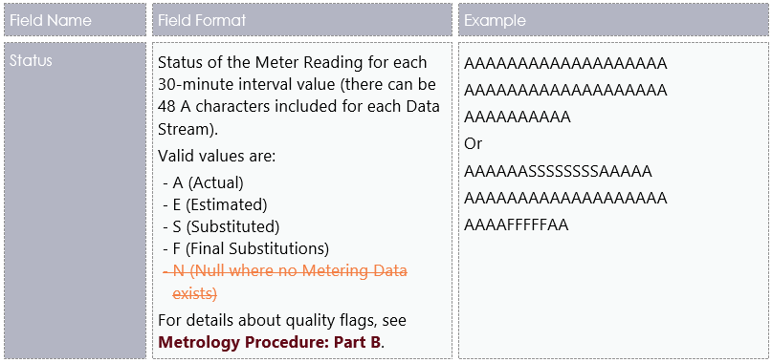
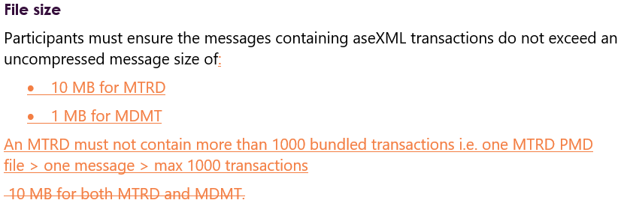
MDM File Format and Load Process
MDM File Format and Load Process v5.01 has been reopened for changes due to ERCF and B2B IEC working group consultation
  Pg 18: Update based on ERCF ‘Proposed Procedural Change to MDFF Quality flag’ item
  Pg 26: Update based on proposed B2B IEC ‘MDFF file size and transaction limit in file’ item
Back to Agenda

Slide 28
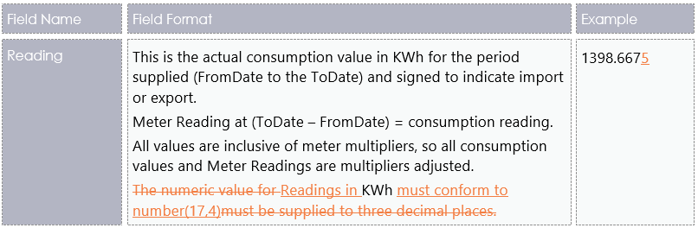
MDM File Format and Load Process
  Pg 16 and 18: Update to the MDMF CSVConsumptionData and CSVIntervalData Reading field format
  Pg 44 and 57: Clean up of the Appendix 1 Consumption Meter Data Record date relationship examples
Back to Agenda

Slide 29
Dispatch stream update
Ian Devaney

Slide 30
Systems Workstream – Dispatch & Operations
10:40 -10:45
Current as at 13 Jan 2020
5 MINUTE SETTLEMENT SYSTEMS TRACKING | TIMING
 | Internal HLIA | Focus/Group | SWG Engagement | External HLIA | Draft Tech Spec | Final Tech Spec | User Guides | 5MS Staging | Preprod | Production
DISPATCH and OPERATIONS
PACKAGE 1 - Bidding FTP and API
Transition | Aug-18 | Oct-18 | Aug-18 | Nov-18 | Dec-18 | 2-Apr-19 | 31-Oct-19 | 29-Nov-19 | Nov-20 | Mar-21
Bidding Data Model | Aug-18 | - | Sep-18 | Mar-19 | Dec-18 | 2-Apr-19 | 31-Oct-19 | 29-Nov-19 | Nov-20 | Mar-21
Bidding Format | Aug-18 | - | Sep-18 | Nov-18 | Dec-18 | 2-Apr-19 | 31-Oct-19 | 29-Nov-19 | Nov-20 | Mar-21
PACKAGE 2 - Bidding Web UI
Bidding Web UI and APIs | Aug-18 | Nov-18 | Dec-18 | Jan-19 | Mar-19 | 31-Jul-19 | 16-Dec-19 | 29-Nov-19 | Nov-20 | Mar-21
PACKAGE 3 - Dispatch, Pre-dispatch and PASA
Dispatch | Aug-18 | - | Oct-18 | Nov-18 | Oct-18 | 2-Apr-19 | - | 29-Nov-19 | Nov-20 | Mar-21
Predispatch P30/7DAY | Aug-18 | - | Oct-18 | Nov-18 | Oct-18 | 2-Apr-19 | - | 29-Nov-19 | Nov-20 | Mar-21
Predispatch P5 | Nov-18 | Oct-18 | Nov-18 | TBC | TBC | TBC | - | TBC | Nov-20 | May-21
ST and PD PASA | Aug-18 | - | Oct-18 | Nov-18 | Oct-18 | 2-Apr-19 | 31-Oct-19 | 29-Nov-19 | Nov-20 | Mar-21
PACKAGE 4 - Pricing and Miscellaneous
Trading Price / Price Revision | Aug-18 | - | Feb-19 | Nov-18 | Mar-19 | 31-Jul-19 | - | 15-May-20 | Nov-20 | May-21
Administered Pricing and CPT | Aug-18 | - | Feb-19 | Dec-18 | Mar-19 | 31-Jul-19 | - | 15-May-20 | Nov-20 | May-21
Suspension Pricing | Sep-18 | - | Feb-19 | Dec-18 | Mar-19 | 31-Jul-19 | - | 15-May-20 | Nov-20 | May-21
Negative Residue Management | Sep-18 | - | Feb-19 | Dec-18 | Jun-19 | 31-Jul-19 | - | 15-May-20 | Nov-20 | May-21
RERT | Oct-18 | - | - | - | - | - | - | - | - | -
PACKAGE 5 - Full Data Model
Full Data Model | Sep-18 | Ongoing | Ongoing | Apr-19 | Ongoing | 31-Jan-20 | 31 Mar 20 | 29-Nov-19 | Nov-20 | May-21
Data Model Scripts will now be available on the 31st of March
Back to Agenda

Slide 31
Format and Validation for Energy, FCAS, and MNSP Bids and Offers
Pierre Fromager

Slide 32
Bids submission by FTP
Throttling – 1 file per second?
FTP File server address to be updated Prod and/or Preprod (currently, both are the same).
Reference ID was changed to be optional but the document (and the JSON schema in particular) still show this as mandatory.
Back to Agenda
Notes:
Participant Bid submission limits are a feature from the initial data model.
The constraint is due to the Oracle field used to record Participant submissions (ParticipantFileTrk.OfferDate, BidDayOffer.OfferDate, BidPerOffer.OfferDate). As presented previously, the 5MS project will alleviate this restriction by expanding the field to store seconds to a precision of 3 decimal places.
AEMO are obliged to maintain compatibility with the current AND the legacy versions of the data model,
which precludes AEMO from immediately effecting this change (as the upgraded field is incompatible with the legacy variant).
Once the 5MS data model has progressed to legacy status, AEMO will be in a position to engage with Participants on an increased Bidding frequency.
[Pause]
The correct FTP file server addresses are provided in the Tech spec and will be updated in this document in the next version.
[Pause]
In the SWG in December, AEMO proposed to make the reference ID optional. We have not received any objections so this is going ahead. Some of the technical documentation (the JSON schema in particular) is yet to be updated and will be changed in the next version.

Slide 33
Settlements stream update
Mark Hillaby

Slide 34
Systems Workstream - Settlements
Current as at 10 Feb 2020
Back to Agenda

Slide 35
Settlements & Billing
Tech Spec updates
Pierre Fromager

Slide 36
Settlements & Billing Tech Spec
Settlements Direct, as mentioned in the Tech Spec, “allows participants to access data, subscriptions, message delivery logs and calendars to the EMMS Wholesale Market System”.
It “is a web-publishing application providing participants with access to reports and statements published by AEMO. The primary delivery for your settlement statements is the Participant File Server— retrieving information from Market Direct is an additional resource for your convenience.
APIs are an added convenience. They are not replacing the participant file server or the Data Interchange.
Back to Agenda
Notes:
One participant asked what the Settlements Direct APIs were offering.
Settlements Direct allows participants to retrieve reports and statements in particular.
APIs allow participants to automate retrieving these reports. They do not replace the participant file server or the data interchange.

Slide 37
Data model for Dispatch & Settlements
Version 5.0
Sangeeta Pai

Slide 38
Data model for Dispatch
AveragePrice30 table is removed from v4.30 release and added in the latest v5.0.0.1 release.
Billing and Settlements data model changes will be added to v5.0.0.1 alter script.
PeriodID column is removed from DISPATCHLOAD and DISPATCHREGIONSUM data model tables.
There are other changes:
  BIDOFFERPERIOD :
    DUID – change to VARCHAR2(20)
    All fields in this table with datatype NUMBER(6) – change to NUMBER(8,3)
  MNSP_BIDOFFERPERIOD:
    LINKID – change to VARCHAR2(20)
    All fields in this table with datatype NUMBER(6) – change to NUMBER(8,3)
Back to Agenda

Slide 39
Data model for Dispatch
To align the capability of Oracle installations with SQLServer the new fields BidOfferPeriod.OfferDateTime and MNSP_BidOfferPeriod.OfferDateTime are defined as data type ‘TIMESTAMP(3)’
For this to be effective we must also change the OfferDate fields from ‘DATE’ to ‘TIMESTAMP(3)’ in the existing tables:
  BidOfferFileTrk
  BidDayOffer
  MNSP_DayOffer
This change will apply to existing tables. Participants must be aware of this and manage their Bids transition from 30-minute to 5-minute.
For participants using pdrLoader v7.4.1 or previous version and using Oracle Installation should add below statement in pdrLoader.properties
  db_conn_init_sql=ALTER SESSION SET NLS_TIMESTAMP_FORMAT='YYYY/MM/DD HH24:MI:SS.FF3'
Back to Agenda

Slide 40
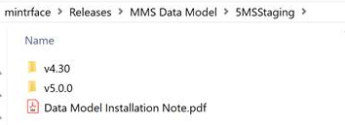
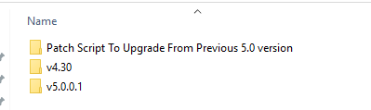
Data model incremental releases
Current Release:
Incremental Releases:
Participants currently on v5.0.0 and do not wish to reinstall the data model will have to manually run the patch script for every release from the “Patch Script To Upgrade From Previous 5.0 version” folder.
v4.30 folder will be deleted from the Staging after this version is released in production.
New Participants will have to then install release v4.30 from the Production Releases folder.
Back to Agenda

Slide 41


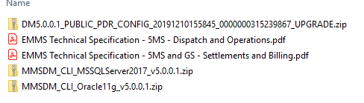
Data model incremental releases
The Patch folder will have 2 sub folders as below:
Each sub folder will have the incremental patch scripts which participants will have to run manually on their staging database.
The main latest folder version will be incremented with every release. Participants setting up their staging environment for the first time should use the release from this main folder.
v5.0.1 release will include Dispatch and Bidding changes as well and Billing and Settlement changes.
Back to Agenda

Slide 42
Reallocations Deployment
Alex Alexander

Slide 43

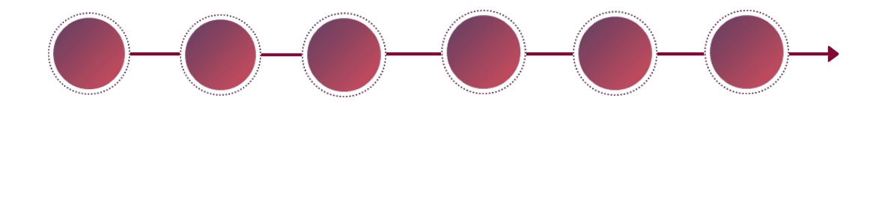






5MS Release 1: Reallocations
Staging
Training
AEMO UAT
Industry Test
Go Live
BAU
From 01 Nov 2019
01 Nov 2020
Jan 2020
26 Feb 2020
1 Apr 2020
From 01 Apr 2020
Software published and available for participants to interact with.
Industry-discovered defects submitted via Support Hub.
Tech Spec published and available for participants
User Guide published and available for participants
Internal AEMO testing, only a few P4s (cosmetic) defects remaining.
AEMO business has accepted the results of testing.
Deployment in pre-PROD with software available for participants to test (note, there is no co-ordinated Market Trial of the software).
Deployment in PROD environment. There is no participant impact as part of the cutover.
Market Participants can submit reallocations with a 5-min cadence for the time period from 00:00:00 01-Jul-2021

Slide 44
Forward meeting plan
Graeme Windley

Slide 45
Proposed upcoming SWG meeting content
Date | Meeting | Proposed content
Mon 16 Mar 2020 | SWG #20 | Topics tba
Mon 20 Apr 2020 | SWG #21 | Topics tba
Back to Agenda

Slide 46
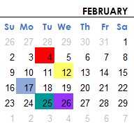
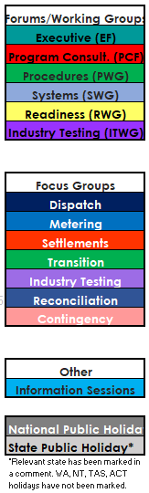
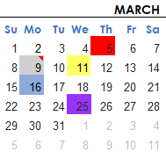
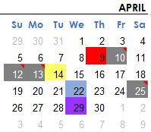
Upcoming meetings
https://aemo.com.au/initiatives/major-programs/nem-five-minute-settlement-program-and-global-settlement
Current as at 29/01/2020

