Slide 1
5MS & GS Readiness Working Group Retail Cutover Run-Through
Wednesday, 2 June 2021
This meeting is recorded for the purpose of minute taking.
Please disconnect from your workplace VPN for the WebEx call

Slide 2

AEMO Competition Law
Meeting Protocol
AEMO is committed to complying with all applicable laws, including the Competition and Consumer Act 2010 (CCA). In any dealings with AEMO regarding proposed reforms or other initiatives, all participants agree to adhere to the CCA at all times and to comply with this Protocol. Participants must arrange for their representatives to be briefed on competition law risks and obligations.
Participants in AEMO discussions must:
Ensure that discussions are limited to the matters contemplated by the agenda for the discussion
Make independent and unilateral decisions about their commercial positions and approach in relation to the matters under discussion with AEMO
Immediately and clearly raise an objection with AEMO or the Chair of the meeting if a matter is discussed that the participant is concerned may give rise to competition law risks or a breach of this Protocol
Participants in AEMO meetings must not discuss or agree on the following topics:
Which customers they will supply or market to
The price or other terms at which Participants will supply
Bids or tenders, including the nature of a bid that a Participant intends to make or whether the Participant will participate in the bid
Which suppliers Participants will acquire from (or the price or other terms on which they acquire goods or services)
Refusing to supply a person or company access to any products, services or inputs they require
Under no circumstances must Participants share Competitively Sensitive Information. Competitively Sensitive Information means confidential information relating to a Participant which if disclosed to a competitor could affect its current or future commercial strategies, such as pricing information, customer terms and conditions, supply terms and conditions, sales, marketing or procurement strategies, product development, margins, costs, capacity or production planning.

Slide 3
Agenda
NO | Indicative Time | AGENDA ITEM | Responsible
1 | 10:00 – 10:05 | Welcome and Introduction | Greg Minney
2 | 10:05 – 10:25 | Cutover Timings | Greg Minney
3 | 10:25 – 10:35 | Rollback and fix on Fail | Greg Minney
4 | 10:35 – 10:40 | B2M Metering Delivery Restart | Greg Minney
5 | 10:45 – 10:50 | aseXML Schema Changes | Paul Lyttle
6 | 10:55 – 11:00 | r35 Report Requests | Paul Lyttle
7 | 11:00 – 11:05 | Delivery Data to NEMMCO | Paul Lyttle
8 | 11:05 – 11:10 | Next Steps and General Business | Greg Minney
9 | 11:30 | Meeting Close | Greg Minney

Slide 4
Welcome
Greg Minney

Slide 5
Cutover Timings
Greg Minney

Slide 6
Cutover Phases - B2M and B2B Service State
Internal activities – not listed in plan
External facing activities – listed in plan
 |  | 06:00 | 08:00 | 10:00 | 12:00 | 14:00 | 16:00 | 18:00 | 20:00 | 22:00 | 24:00 | 02:00 | 04:00 | 06:00 | 08:00 | 10:00 | 12:00 | 14:00 | 16:00 |  | 18:00 | 20:00 | 22:00 | 24:00 | 02:00 | 04:00 | 06:00 | 08:00 | 10:00
 |  | Saturday |  |  |  |  |  |  |  |  |  | Sunday |  |  |  |  |  |  |  |  |  |  |  |  | Monday
Cutover Phases
Service State
Data Migration
Deployment
TVT
IVT
BVT
PVM
Sun 20/6, 9:45
Start TVT
Go Decision
Sun 20/06, 14:30
Start IVT
Sun 20/06, 17:00
Start BVT
B2B Active
B2B Stopped
B2B Active
B2M Stopped
B2M Restart with Participants Inactive except NEMMCO, and PV participant
  B2M active for all participants
Sat 19/06, 6:00
Notify Stop
B2M
+
Sat 19;06, 6:00
B2M Batch
Handlers Stopped
Sat 19/06, 6:00
Access to MSATS
Browser Stopped
Sun 20/6, 14:00
Access to
Participant
File Share
Sun 20/06, 7:00
Notify/
Stop B2B
Mon 21/06, 08:00
Latest B2M go
Notify All Participants
Sun 20/06
14:00
B2B restart & Start B2M Batch
Handlers
Mon 21/06, 4:00
B2M Re-start
with all
Participants

Slide 7
Industry Go-Live Schedule
NB Timeframes and timings provided in the Cutover Schedule are based on best available estimates, but may vary during cutover execution
# | AEMO actions | Industry Impacts and actions | Notes | Planned Start Time (Market Time, Approximate only) | Communication Channel
 |  | Specific Role | All Roles
1 | AEMO performs preparatory migration activities in readiness for the retail platform cutover | n/a | Participants to ensure MSATS B2M setting reflects schema preferences are set by Tuesday 15th June. See section 3.6. | Tue 8/06/21 | Support Hub notice of planned outage provided.
2 | AEMO notifies participants that B2M transactions will not be processed from 19th June 2021 6am market time. | n/a | Participants to complete B2M transactions by 6am. Note that AEMO will not be processing B2M transactions from 6am 19 June until go-live. | Friday 18/06/21 | 5MS Mailbox
3 | MDP Participants advised to stop sending meter data to VPXP | MDP ONLY - VICTUOS participants to stop sending meter data to VPXP | n/a | Sat 19/06/21 06:00 | 5MS mailbox
4 | AEMO stops B2M batch handlers and confirms processing halt to participants AEMO stops participant inbox (6.00am) | n/a | - No processing of meter data and CRs from this point onwards. Files will recommence processing once restarted. - B2B still operating - Stop sending B2M transactions - Acknowledge messages and clean out Inbox | Sat 19/06/21 06:00 | Support Hub Notice (forwarded by 5MS mailbox)
5 | AEMO stops access to the MSATS Browser | n/a | - All access to the MSATS Browser is stopped. No read access available, including NMI Discovery | Sat 19/06/21 06:00 | Support Hub Notice (forwarded by 5MS mailbox)

Slide 8
Industry Go-Live Schedule
# | AEMO actions | Industry Impacts and actions | Notes | Planned Start Time (Market Time, Approximate only) | Communication Channel
 |  | Specific Role | All Roles
6 | AEMO stops the ability for participants to acknowledge B2M Response messages sent by NEMMCO in outbox AEMO moves any unacknowledged B2M Response messages still in the participant outbox to archive folder |  | B2M Response messages delivered by NEMMCO to participant outbox can no longer be acknowledged. | Sat 19/6/21 07:00
7 | AEMO data migration commences | n/a | n/a | Sat 19/06/21 07:00 | n/a
8 | AEMO provides cutover progress notification during Data migration Process |  |  | Sat 19/06/21 12:00 | 5MS Mailbox
9 | AEMO provides cutover progress notification during Data migration Process |  |  | Sat 19/06/21 18:00 | 5MS Mailbox
10 | AEMO notifies participants that B2B transactions will not be processed from 20 June 2021 7 am market time. | n/a | - Participants prepare to stop sending automated B2B transactions. Note that AEMO will not be processing B2B transactions from 7 am 20 June 2021 until go-live. In flight transactions will not be cancelled, but held and processed once the system is restarted. | Sun 20/06/21 07:00 | Support Hub Notices (forwarded by 5MS mailbox)
11 | AEMO stops B2B batch handlers | n/a | - Stop sending automated B2B transactions - Participants to make arrangements for emergency B2B transactions during outage period - Acknowledge messages and clean out Inbox | Sun 20/06/21 07:00
12 | AEMO commences deployment updates to market applications | n/a | n/ a | Sun 20/06/21 08:00 | n/a

Slide 9
Industry Go-Live Schedule
# | AEMO actions | Industry Impacts and actions | Notes | Planned Start Time (Market Time, Approximate only) | Communication Channel
 |  | Specific Role | All Roles
13 | AEMO re-establishes access to participant file share AEMO restarts B2M and B2B batch handlers and updates access for NEMMCO and PVM participants B2B processing (except metering data delivery to NEMMCO) available |  | Participant access to file share re-established. B2B processes restarted. Participants continue to hold B2M transactions | Sun 20/6/21 14:00 | 5MS Mailbox
14 | AEMO provides cutover progress notification |  |  | Sun 20/6/21 14:30 | 5MS Mailbox
15 | AEMO provides cutover progress notification |  |  | Sun 20/6/21 18:30 | 5MS Mailbox
16 | AEMO provides cutover progress notification |  |  | Sun 20/6/21 22:00 | 5MS Mailbox
17 | Advise selected participants PVM can start | Selected MDP to provide sample MDMT / MTRD files to confirm end to end ingestion processing | Continue Hold on Business 2 Market transactions(B2M) until notified of go-live decision - | Sun 20/06/21 22:00 | Mail from 5MS cutover team to selected participants
18 | AEMO performs PVM following deployment of Retail Platform See section 3.8 | Select MDP participants perform PVM with AEMO | - | Sun 20/06/21 22:00 | n/a

Slide 10
Industry Go-Live Schedule
# | AEMO actions | Industry Impacts and actions | Notes | Planned Start Time (Market Time, Approximate only) | Communication Channel
 |  | Specific Role | All Roles
19 | AEMO informs participants of Full Market Go-live – including any restrictions on processing and issues that may impact participant processing identified during PVM This timing may be extended by the program to allow remediation of issues to support a Delayed go-live – in preference to Rollback and reschedule See section 3.5 Communication of expected go-live communication provided via In the event of a rollback, please see section 3.4.2 | n/a | MSATS Browser available | Mon 21/06/21 04:00 | 5MS mailbox / support Hub Bulletin
20 | AEMO recommences processing and monitors B2M transactions -AEMO updates access for all participants B2M batch Handlers | MDP restart B2B metering Data delivery processing MDP restart B2M metering Data Delivery- initial delivery of Friday and Saturday Metering Data to be delivered to support Tuesday settlement run. MDP delivery to be staggered to ensure backlog processing is effective | - Processing of B2M/ transactions restarts MSATS Browser Available - | Mon 21/06/21 04:00 | 5MS mailbox

Slide 11
Industry Go-Live Schedule
# | AEMO actions | Industry Impacts and actions | Notes | Planned Start Time (Market Time, Approximate only) | Communication Channel
 |  | Specific Role | All Roles
21 | AEMO notifies participants that R39_p1 schema has been implemented See section 3.7 | n/a |  | Mon 21/06/21 04:00 | 5MS mailbox
22 | MDP Participants advised to change to party participant from VPXP to NEMMCO See section 3.6 | MDP ONLY - VICTUOS participants change destination from VPXP to NEMMCO | n/a | Mon 21/06/21 04:00 | 5MS mailbox
23 | AEMO provides general updates, including periodic updates on B2M and B2B transaction data backlog processing | n/a | n/a | Daily from 21/06/21 | 5MS mailbox

Slide 12
Rollback and Fix on Fail
Greg Minney

Slide 13
Extension to cutover timings – Fix on Fail
In the event of issues during the cutover, the project team may delay the notification of go-live and extend the B2M outage on Monday 21st June to resolve the identified issues.
This is based on the principle that B2B services have been restored by 22:00 Sunday 20th June. Progress updates will be provided via 5MS mailbox, including expected time of B2M go-live
  Extension of Cutover window to allow resolution of outstanding cutover issues in preference (under fix-on-fail)
  Industry indication that management of regulatory and operational requirements requires (at least) B2M availability by 8.00am Monday for recommencement of normal processing
Rollback decision made in the event of unrecoverable issue
  Program intent Rollback is used as last resort
  Will necessitate a rescheduling of cutover with consequent knock impacts to over all implementation schedule
Decision to Rollback made (approx. ) 22:00 Sunday 20th
  Issues that cannot be resolved via Fix on Fail approach
  B2B and B2M (including MSATS Browser access) processing unavailable for period of Rollback
Expected return to service post Rollback Monday 21st 13:00

Slide 14
Rollback
# | AEMO actions | Industry Impacts and actions |  | Potential Start Time | Communication Channel
 |  | Specific Role | All Roles
16B | AEMO informs Participants of the Revert decision AEMO: - halts access to MSTATS Browser , including NMI Discovery - halts access to participant file shares Stops B2B batch Handlers B2M batch handlers remain stopped | n/a | - Ensure that systems can be compatible with AEMO’s retail platform pre-cutover. Prepare to resend market transactions since cutover commencement - Participants continue to utilise emergency B2B processes during B2B outage | Sun 20/06/21, 22:00 | Support Hub Notices (forwarded by 5MS mailbox)
17B | AEMO performs Restoration and technical verification | n/a | n/a | 20/06/21, 22:00 | n/a
18B | AEMO notifies stakeholders of completion of rollback | n/a | - Resume market operations | Mon 21/06/21, 13:00 | 5MS mailbox
19B | AEMO informs participants that have conducted market transactions outside of market systems to process and acknowledge transactions via B2M to update market | n/a | - Participants will have to be prepared to manage and process transactions after system restart. | Mon 21/06/21, 13:00 | 5MS mailbox
20B | AEMO provides general updates, including periodic status on B2M and B2B transaction data backlog processing | n/a | n/a | daily from 21/06/21 | 5MS mailbox

Slide 15
B2M Metering Delivery Restart
Greg Minney

Slide 16

B2M Data Delivery Restart
Processing of B2M delivery backlog to:
  Meet key compliance timeframes
  Management of volumes
  Backlog expected for weekend processing
Principles:
  Understanding of MDP plans / capability for restart
    Files generated per reading day, or all reads per nmi/meter for delivery
    Processing in chronological order
    Capability to stagger file delivery or all files delivered at once
AEMO to monitor throughput and provide update to MDPs
re backlog

Slide 17

MDM Restart principles
MDP’s to prioritise delivery of metering data for Friday / Saturday of previous settlement week
Once delivered to resume processing of daily files
AEMO to monitor backlog and liaise directly with MDPS for volume management

Slide 18
aseXML Schema Changes
Paul Lyttle

Slide 19
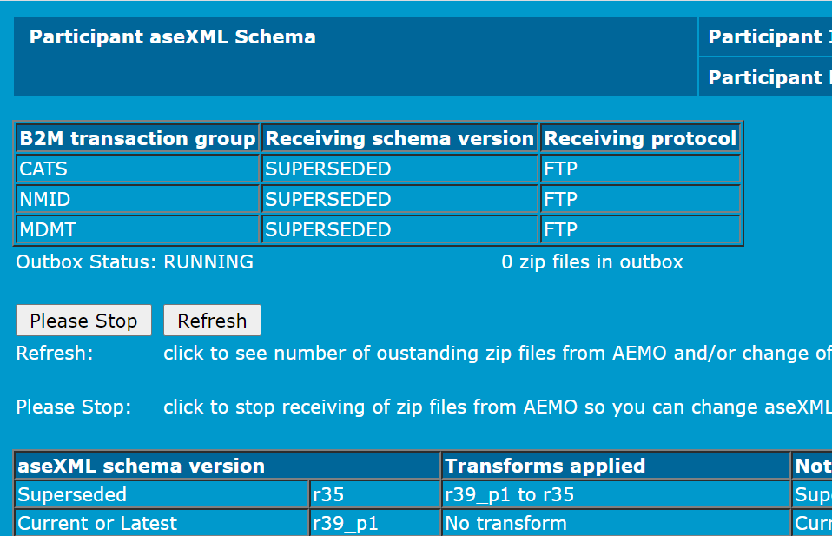
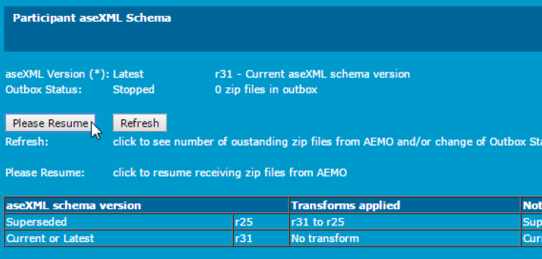
aseXML Schema Changes
AEMO supports both the latest and immediately superseded versions of the B2M aseXML schema.
  Only one past (superseded) version is supported, so participants need to keep up-to-date with aseXML schema changes.
AEMO allows a period of time for participants to transition to the Current schema version so they can schedule their own update without forcing a compromise between their peers and AEMO to agree a single transition time.
Moving forward Participants will be able to select schema and protocol by B2M transaction group

Slide 20
aseXML Schema Changes
Receiving schema version must be finalised through the MSATS Browser by Monday 14th June COB.
Participant updates can be completed in MSATS now.
Before 5MS cutover |  |  | During cutover | After 5MS cutover
Receiving Schema version | MSATS Browser setting |  |  | Receiving Schema version |  | MSATS Browser setting
r35 | LASTEST | Participants that can handle both r35 and r39_p1 should have their MSATS Brower setting set to this. | AEMO transitions participants on the Latest setting to r39_p1 so they are always compliant. | CATS | r39_p1 | LATEST
 |  |  |  | NMID | r39_p1 | LATEST
 |  |  |  | MDMT | r39_p1 | LATEST
r35 | CURRENT | Participants that can only handle r35 should have their MSATS Brower setting set to this. | Participants on the Current setting r35 remain on r35, with setting changed to Superseded. Participants can choose when to transition to the new Current/Latest setting. | CATS | r35 | SUPERSEEDED
 |  |  |  | NMID | r35 | SUPERSEEDED
 |  |  |  | MDMT | r35 | SUPERSEEDED
r31 | SUPERSEEDED | Participants that can only handle r31 should have their MSATS Brower setting set to this. | AEMO transitions participants on the Superseded version r31 to the new Superseded version r35. r31 and earlier versions are unsupported all responses will be returned in version r35 | CATS | r35 | SUPERSEEDED
 |  |  |  | NMID | r35 | SUPERSEEDED
 |  |  |  | MDMT | r35 | SUPERSEEDED

Slide 21

aseXML Schema Changes
The LATEST aseXML schema version changes r39_p1 supports the following:
Supports new reports for Meter Data reconciliations (RM37, RM38, RM39).
Supports new reports for UFE (RM43, RM46).
Provides the complete set of report results without the need for participants to request results to support file sizes. This enhancement removes the need to populate the last sequence number for an RM report request. The field is set to optional to enable backward compatibility.
Ensures participants receive all messages an x of y message numbering is introduced. Where x is the message number and y is the message total.
Assists LNSPs with the requirement to store a second TNI for cross-boundary NMIs.
Support Customer Switching changes for the MSATS 46.99 release.

Slide 22
r35 Report Requests
Paul Lyttle

Slide 23

r35 Report Requests
Where participants chooses to remain on aseXML schema version r35 the following items apply:
Participants will not be able to request new reports (RM37, RM38, RM39, RM43, RM46) via API/FTP.
If a participant requests a new reports via the MSATS Browser the report will be delivered in r39_p1 schema format.
The following RM reports have been and will no longer be available (RM7, RM8, RM10, RM12, RM14, RM15, RM18, RM19, RM23, RM24)
All other RM reports can be requested.
Each RM report request will provide the complete set of report results without the need for participants to request results to support file sizes. The population of the last sequence number will not be used to restrict RM report request.

Slide 24
Delivery Data to NEMMCO
Paul Lyttle

Slide 25
Delivery Data to NEMMCO
Meters not being converted to 5-minute reads
Delivery of meter reads via MDMT file format to NEMMCO will not change.
Meters being converted to 5-minute reads
Delivery of meter reads will need to be transitioned from MDMT format (30-minute reads) to MDFF format
(5-minute reads) to NEMMCO for settlements prior to 5MS start.
Meters used for Vic TUoS billing.
Delivery of meter reads will need to be transitioned from MDMT format (30-minute reads) to MDFF format
(5-minute reads) to NEMMCO for settlements prior to 5MS start.
Delivery of MDFF files to VPXP will cease from 19th June and files will need to be sent to NEMMCO from 21 June
  These Vic TUoS changes impact 3 MDPs only – Mondo, PlusES, Yurika

Slide 26
Next steps and General Business
Greg Minney

Slide 27
Next steps and General Business
Outstanding questions on Retail Go-live approach to 5MS mailbox
Retail platform status and go decisions communicated via established timelines
The AEMO 5MS Program will be providing a heightened level support post Retail go-live to ensure that any issues encountered are investigated in a timely manner and that the appropriate course of action is determined and carried out
This heightened level of support will continue until there is tangible evidence that the Retail solution is in a stable state e.g. number of issues being raised is within normal BAU volumes
Should you encounter any issues post go-live, please contact AEMO’s Support Hub

Slide 28
Questions

