Slide 1
5MS & GS Program Consultative Forum #37
Thursday, 16 September 2021
This meeting is recorded for the purpose of minute taking.
Please disconnect from your workplace VPN for the WebEx call​

Slide 2

AEMO Competition Law
Meeting Protocol
AEMO is committed to complying with all applicable laws, including the Competition and Consumer Act 2010 (CCA). In any dealings with AEMO regarding proposed reforms or other initiatives, all participants agree to adhere to the CCA at all times and to comply with this Protocol. Participants must arrange for their representatives to be briefed on competition law risks and obligations.
Participants in AEMO discussions must:
Ensure that discussions are limited to the matters contemplated by the agenda for the discussion
Make independent and unilateral decisions about their commercial positions and approach in relation to the matters under discussion with AEMO
Immediately and clearly raise an objection with AEMO or the Chair of the meeting if a matter is discussed that the participant is concerned may give rise to competition law risks or a breach of this Protocol
Participants in AEMO meetings must not discuss or agree on the following topics:
Which customers they will supply or market to
The price or other terms at which Participants will supply
Bids or tenders, including the nature of a bid that a Participant intends to make or whether the Participant will participate in the bid
Which suppliers Participants will acquire from (or the price or other terms on which they acquire goods or services)
Refusing to supply a person or company access to any products, services or inputs they require
Under no circumstances must Participants share Competitively Sensitive Information. Competitively Sensitive Information means confidential information relating to a Participant which if disclosed to a competitor could affect its current or future commercial strategies, such as pricing information, customer terms and conditions, supply terms and conditions, sales, marketing or procurement strategies, product development, margins, costs, capacity or production planning.

Slide 3
Agenda
# | Time | Topic | Presenter
1​ | 10:00 – 10:05​ | Welcome​ | Peter Carruthers​
2​ | 10:05 -10:10 | Actions from Previous Meetings​ | Anne-Marie McCague​
3​ | 10:10 – 10:15 | Program Update | ​Rowena Leung
4 | 10:15 – 10:25 | Essential Meter Capability | Blaine Miner
5​ | 10:25 – 10:40 | AEMO and Participant Readiness | Greg Minney
6 | 10:40 – 10:45 | Actions in the Lead up to 1 October | Anne-Marie McCague​
7​ | 10:45 – 11:05 | 1 October Cutover Plan | Greg Minney & Graeme Windley
8 | 11:05 ​- 11:15 | Post 1 October Support | Anne-Marie McCague
9 | 11:15 - 11:20 | Forward Meeting Plan | Anne-Marie McCague​
10 | 11:20 – 12:00 | General Questions​ | Peter Carruthers​
11 | 12:00 | Meeting Close​ | Peter Carruthers​

Slide 4
Purpose of today’s session
October 1st Readiness Focus
Review the status and key risks that were discussed at the Executive Forum:
  Essential Meter Capability
  AEMO readiness
  Participant readiness
Discuss the preparations for 1 October including the 5MS Industry Go-Live Plan and the support arrangements from 1 October.

Slide 5
Welcome
Peter Carruthers

Slide 6
Actions from Previous Meetings
Anne-Marie McCague

Slide 7
PCF Actions
No. | Status | Action | Comment
36.5.1 | Closed | AEMO to send PCF invite out for 26 August. | Complete
36.5.2 | Closed | AEMO to consider an earlier PCF if there is a no-go decision – currently the PCF is scheduled for 16 September | Not required

Slide 8
Program Update
Rowena Leung

Slide 9
5MS Program Timeline
Readiness and Go-Live
Current as at 01-09-2021
Industry Go-Live Plan has been circulated and will be discussed during this session.
Overall Market Trial status is Amber and “improving”. Market Trial has been extended to 17-Sep to provide for further participant testing, additional settlement runs and intervention pricing.
5MS start notice has been circulated informing participants of AEMO’s advice to proceed with 1 October. Risk management through mitigations and contingencies is in place.

Slide 10
Essential Meter Capability
Blaine Miner

Slide 11
Tranche 1 Meters Overview
(As at 13 September 2021)
Installation/reconfiguration
  40 essential meters are still not 5min capable, comprising:
    23 ‘Active’ meters (12 of which are at one site)
    17 ‘Non-active’ meters (meters with a NMI status of Greenfield, De-energised or Non-market)
  MP Contingency plans have been established for any meters at-risk of not being compliant by 1 October 2021
Metering data delivery
  3 out of 6 MDPs, servicing essential meters, are now delivering 5min metering data to AEMO
  Contingency plans are being finalised for those MDPs who have not commenced delivering 5min metering data

Slide 12
Tranche 1 Overview
(Based on MSATS RTCs Only)
Category | NMI Class | # of meters | With 5min RTC | % with 5min RTC | RTC still to be updated
Essential | Bulk | 2,466 | 2,363 |  | 103
 | Interconnector | 9 | 6 |  | 3
 | Market Generators | 845 | 759 |  | 86
 | NREG | 977 | 954 |  | 23
 | Market Customers | 39 | 39
 | Cross Boundary | 35 | 33 |  | 2
 | Small | 1 | 1
 | Essential Totals | 4,372 | 4,155 | 95.04% | 217
Non-essential | Large | 14,678 | 13,381 |  | 1,297
 | Small | 351 | 296 |  | 55
 | Market Customer | 2 | 2
 | Non-essential Totals | 15,031 | 13,679 | 91.01% | 1,352
 | Tranche 1 Grand Total | 19,403 | 17,834 | 91.91% | 1,569
Note: Updates to NMI Classification Codes and meter statuses in MSATS will change reported volumes week to week

Slide 13
Tranche 1 Overview
(Post MP Update)
Category | NMI Class | # of meters | 5min Capable | Scheduled for Sept | Greenfield/ De-energised, Non-market
Essential | Bulk | 2,466 | 2,452 | 14
 | Interconnector | 9 | 9
 | Market Generators | 845 | 843 | 1 | 1
 | NREG | 977 | 954 | 8 | 15
 | Market Customers | 39 | 39
 | Cross Boundary | 35 | 34 |  | 1
 | Small | 1 | 1
 | Essential Totals | 4,372 | 4,332 | 23 | 17
Non-essential | Large | 14,678 | 13,381 | 1,278 | 19
 | Small | 351 | 296 | 47 | 8
 | Market Customer | 2 | 2
 | Non-essential Totals | 15,031 | 13,679 | 1,325 | 27
 | Tranche 1 Grand Total | 19,403 | 18,011 | 1,348 | 44

Slide 14
AEMO and Participant Readiness
Greg Minney

Slide 15
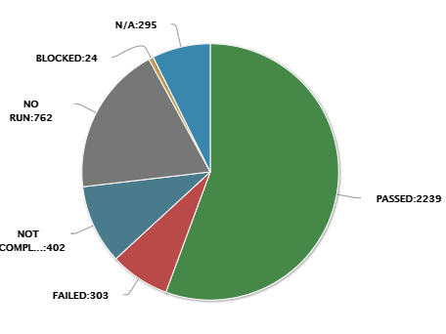
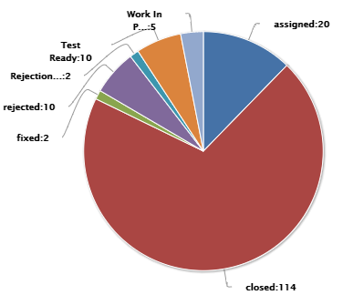
Overall Status as at 14 September 2021
Click here for PractiTest Dashboard
Overall RAG Status
Test Case Summary
Defects Summary
Status is improving with only a few RM issues outstanding. AEMO is considering performing further settlement runs for validation and participant testing.
80% of total scenarios are either completed or in progress.
Preliminary invoice for week 36 issued on 10 Sep.
Final invoice for week 34 on track for release 15-Sep
5-min profiled bids continue to be submitted.
Majority of failed tests scenarios are Settlements related
AEMO undertaking an outreach to participants with failed scenarios. Retesting of failed scenarios is determined by the participant.
Next release is scheduled for 14 Sep and will address 1 defect – PractiTest defect 198.
See slide 5 for details
Key Risks – no change
Key Issues – see slide 4
Heightened risk of issues occurring early in the Market Trial as a result of:
Testing of production defects in pre-prod
Unexpected data/environment issues encountered following the refresh has required time to resolve
Conflicting resource demands based on production support, Market Trial preparations and completion of testing including edge case
No critical capability issues for market start have been identified
Uses of estimated meter read data and participant input test data may impact data quality which will be reflected in Market Trial outcomes. This is not impacting generation of invoices. (Issue 5)
Participant test execution is lower than expected – participants are asked to ensure PractiTest is up to date to provide an accurate view of test progress. (Issue 9)

Slide 16
AEMO Essential Capability Market Trial Scenarios
Essential Capability | Scheduled | Available | Comment
Transition Week 31 Prelim | 6-Aug | 9-Aug | Content ok, estimates delay
5m Preliminary Wk 32 | 13-Aug | 13-Aug | Content not ok, data quality issues
5m Preliminary Wk 33 | 20-Aug | 22-Aug | Content ok, RM report delays
Transition Week 31 Final | 25-Aug | 25-Aug | Content ok, RM report delays
5m Preliminary Wk 34 | 27-Aug | 27/28 Aug | Content ok, timing ok
5m Final Wk 32 | 1-Sept | 1-Sept | Content ok, Timing ok, All RM reports confirmed
5m Preliminary Wk 35 | 3-Sept | 3-Sept | Content ok, Timing ok, All RM reports confirmed
5m Final Wk33 | 8-Sept | 8-Sept | Content ok, Timing ok, All RM reports confirmed
5m Preliminary Wk 36 | 10-Sept | 10-Sept | Content ok, Timing ok, All RM reports confirmed
5m final Wk 34 | 15-Sept | 15-Sept
5m Preliminary Wk 37 | 17-Sept
Settlement runs and associated RM reports produced on time for last 4 settlement runs during extension period
  Confirmation of delivery of all required RM reports
Early issues encountered with metering data quality and preparation, have been addressed.
Where data input has been reasonable, AEMO is satisfied with commercial outcomes of settlements runs.
Main outstanding defect will be resolved with release of RM report reconciliation fix (raised in production). See Defects slide 18.
RM report distribution and receipt:
  AEMO has confirmed all RM reports being successfully distributed and available for participants
  File size for RM16 file size in 5-minute settlement may be an issue for individual participant(s)

Slide 17
Participant Readiness / Scenario Execution
Test Case execution as at 14/9
Participant execution of trial cases as at 14/9 reflects increased successful execution rates across all participant classes
Small participants who were not covered in initial scenarios provided opportunity to conduct some further testing with partners
Retesting and update of failed scenarios is responsibility of participants
No run cases includes participants who have not undertaken any recorded testing
Defect rates reflect successful execution of key scenarios

Slide 18
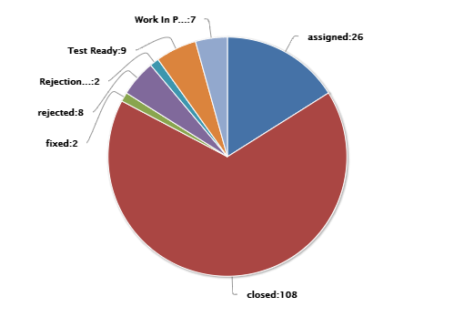
Market Trial Insights – Defects
Market Trial Defect as at 13/9
No show-stopper defects outstanding
High priority defect rating provided by participant when raised
  Bidding defect relates to interpretation of error code in API scenario
  CATS defect relates to LNSP processing of CS changes to CR10XX notifications
  RM Reports Issue is under investigation – relates to reconciliation for some TNIs between RM and Settlement reports
RM Reports issues have been identified and will be actioned
  RM report reconciliation defect #5616 raised in Production failed AEMO testing. AEMO targeting readiness for 1st Oct in Prod with a Pre-Prod deployment 21st Sept in Pre-Prod. Delivery of Prelims and Finals will be extended in Pre-Prod.
  Participant raised Incident re settlement on RM16 report with Settlement data for some TNIs which is under internal investigation, no defect has been raised yet .
  UFE Report subscription defect #5621 now released into Pre-Production and closed.
Known Defect walkthrough scheduled for 23rd Sept
Area | High | Medium | Grand Total
Bidding | 1 | 3 | 4
CATS | 1 |  | 1
Market Portal |  | 1 | 1
Meter Data |  | 2 | 2
Mkt Trial |  | 1 | 1
RM Reports | 1 | 8 | 9
Settlements |  | 8 | 8
Grand Total | 3 | 23 | 26
Open Defects with AEMO 13/9

Slide 19
Market Trial Conclusion
Market trial has stabilised and is operating reliably
Participants have taken advantage of the extra opportunity to exercise their systems against updated market systems
  Supported by level of scenario execution, including those participants included in 2nd round cases
All key Market Trial scenarios have now been successfully executed
  Noting extension of planned settlement runs
Key open defect is RM report reconciliation (#5616), will be fixed for 1 October
Pre-Prod environment remains open to participants
Further extension of Market Trial settlement scenarios requested by 3 participants, currently being considered

Slide 20
Actions in the lead up to 1 October
Anne-Marie McCague

Slide 21
Industry Sessions prior to 1 October
Date | Session | Purpose
Daily until 17-Sep | 5MS Market Trial | Support for Market Trial. Will be on Tues and Thurs for 20 – 30 Sep
7-Sep | RWG | Walk-through of 5MS Industry Go-Live Plan including participant support arrangements
8-Sep | Q&A | Open agenda for participant queries
9-Sep | TFG
15-Sep | RM Reports | Overview of key RM report changes and transition week arrangements
16-Sep | PCF
17-Sep | Q&A | Open agenda for participant queries
23-Sep | Q&A | Focus on known defects for 1 Oct
27-Sep | Executive Forum | Final status and support arrangements
29-Sep | Q&A | Focus on 5MS Industry Go-Live Plan and support
30-Sep | Q&A | Open agenda for participant queries

Slide 22
1 October Cutover Plan
Greg Minney & Graeme Windley

Slide 23



Go-Live Timing Overview
Refer next slide for a breakdown of activities for 30-Sep & 1-Oct
 | Email – 5MS mailbox
 | Support Hub Bulletin
 | 5MS Support Room
 |  |  | September |  |  |  |  | October
 |  |  | 1-5 | 6-12 | 13-19 | 20-26 | 27-30 | 1-3 | As per Week 40 Settlement Calendar | In line with Settlement Calendar
AEMO Actions |  | AEMO | 1-Sep: AEMO provides Market Start Notice recommending 1-Oct ’21 rule start date | n/a | 15-Sep: AEMO notifies participants of planned upgrade for MSATS (46.99) | n/a | 30-Sep b/w 19:30-23:30: AEMO performs MSATS 46.99 & assoc. eMDM release & communicates completion. 30- Sep at 23:30: AEMO opens 5MS Support Room. Support Hub phone line remains available. | 1-Oct at 00:0:1 AEMO confirms Commencement of 5-minute bidding Customer Switching processing implemented for transactions effective | AEMO produces preliminary settlement statements for the “transition week” for settlement week 40 in line with Settlement Calendar | AEMO produces first RM UFE reports for distribution
Industry Impacts & Actions | Retail Roles |  | Participants to ensure individual readiness plans for rule commencement are in place |  |  |  | MSATS and B2M outage during cutover 23:30: Processing of Retail transactions resumes. | All retail roles process CR transactions with changes introduced for Customer Switching | Settlement cases for transition week include 5 days of 30-minute settlement and 2 days of 5-minute settlement | Participants to subscribe or request required RM UFE reports
 | Wholesale Roles |  | Participants to ensure individual readiness plans for rule commencement are in place. |  |  |  |  | Participants can commence submitting 5-minute profile offers Participants submitting 30-minute offers will have those offers rejected
“Transition Week” Preliminary
MSATS/ eMDM Release
30/9/21 19:30 – 23:30

Slide 24
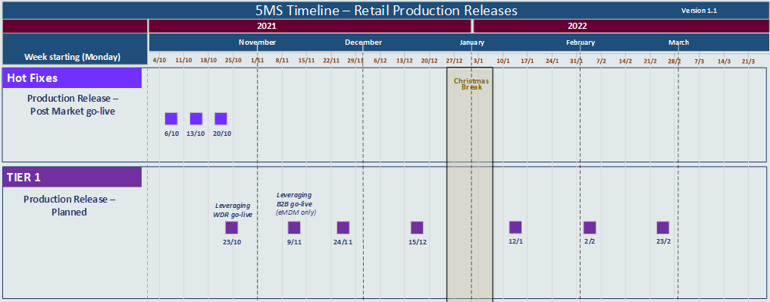
Defect Management - release schedule post 1 October
Planned deployments into pre-production for participant testing 2 weeks prior to production. This may be compressed where it is necessary to expedite an issue.
Emergency releases will be planned as required outside of this schedule.
Retail Production Support meetings will continue as part of the daily 5MS Support calls from 1 October.

Slide 25
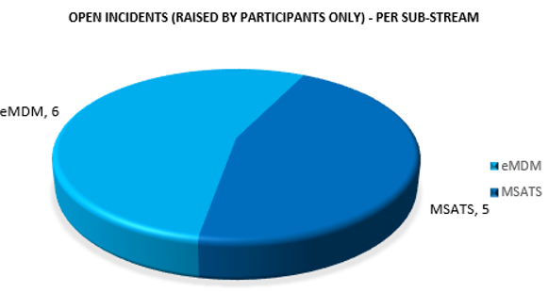
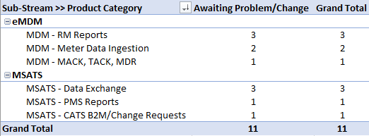
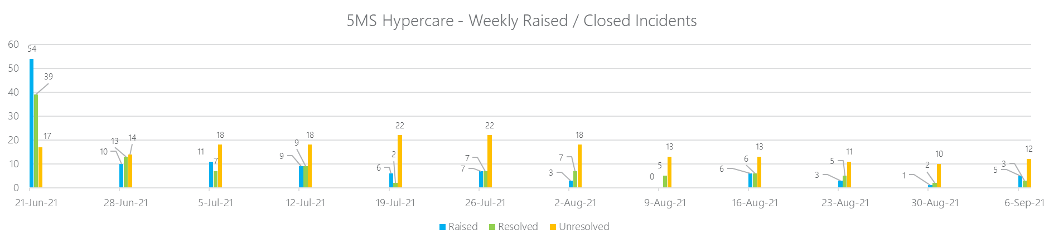
Product Category of Unresolved Incidents : 13 Sep @ 10:00 AM

Slide 26
Post 1 October Support
Anne-Marie McCague

Slide 27
Participant Support Arrangements post 1 October
Support Room: 30-Sep 23:30 (outage complete) to 01-Oct 03:00
  Link will be issued – please forward to the relevant people in your organisation
Daily (business days) Q&A sessions: 10:00 commencing 1 Oct
Proposed checkpoints:
  Daily first 2 weeks
  3 days/week for remainder Oct
  2 days/week for Nov
  1 day/week for Dec
  BAU from January
  This approach will be considered in line with the defect trends and will be adjusted to suit circumstances
Daily (business days) Issues log – updated directly on 5MS webpage
  Frequency to be considered in line with approach to daily Q&A sessions
All issues/defects/incidents should be raised through AEMO Support Hub

Slide 28
Forward Meeting Plan
Anne-Marie McCague

Slide 29
High-Level Plan for 2021
This table provides a list of key topics. The normal updates will also be provided at each PCF. This table will evolve as the year progresses.
Month | Topics | Month | Topics
January | AEMO go-live decision making process Risk Review Readiness and go-live dashboard | 17 June | Market Trial prep status Retail Cutover Preparation Status Contingency Planning
18 February | Retail Solution Status Exec Forum Agenda | 23 July | Market Trial progress Readiness Reporting #8 Debrief on Retail Go-Live Contingency Planning
18 March | Dispatch Cutover Preparation Status Readiness Reporting #6 Retail Checkpoint Criteria – assessment and outcomes Retail Pre-prod – status and go/no-go date Retail Production go-live – checkpoint date and criteria Settlements Certification Process Conclusions | 19 August | Market Trial progress Risk Review – focus on rule commencement Exec Forum Agenda 5MS start assessment
23 April | Debrief on Dispatch go-live Settlements Cutover Preparation Status Risk Review Retail Checkpoint Criteria – assessment and outcomes Retail Production go-live – confirmation of go/no-go date | 16 September | Results of Market Trial Preparing for 1 Oct – Industry Go-Live Plan review Readiness Reporting #9 – covered through 5MS start notice process
19 May | Readiness Reporting #7 Exec Forum Agenda Retail Production: Confirming go/no-go Contingency Planning | 22 October | Debrief of 5MS rule commencement Confirmation of approach for Global Settlements (WG structure)

Slide 30
Upcoming Meetings
Current as at 14/09/2021
AEMO | Program Calendar and Timelines

Slide 31
General Questions
Peter Carruthers

Slide 32
Meeting Close
Peter Carruthers

