Slide 1
5MS & GS Program Consultative Forum #31
Thursday, 18 March 2021
This meeting is recorded for the purpose of minute taking.

Slide 2
AEMO Competition Law
Meeting Protocol
AEMO is committed to complying with all applicable laws, including the Competition and Consumer Act 2010 (CCA). In any dealings with AEMO regarding proposed reforms or other initiatives, all participants agree to adhere to the CCA at all times and to comply with this Protocol. Participants must arrange for their representatives to be briefed on competition law risks and obligations.
Participants in AEMO discussions must:
Ensure that discussions are limited to the matters contemplated by the agenda for the discussion
Make independent and unilateral decisions about their commercial positions and approach in relation to the matters under discussion with AEMO
Immediately and clearly raise an objection with AEMO or the Chair of the meeting if a matter is discussed that the participant is concerned may give rise to competition law risks or a breach of this Protocol
Participants in AEMO meetings must not discuss or agree on the following topics:
Which customers they will supply or market to
The price or other terms at which Participants will supply
Bids or tenders, including the nature of a bid that a Participant intends to make or whether the Participant will participate in the bid
Which suppliers Participants will acquire from (or the price or other terms on which they acquire goods or services)
Refusing to supply a person or company access to any products, services or inputs they require
Under no circumstances must Participants share Competitively Sensitive Information. Competitively Sensitive Information means confidential information relating to a Participant which if disclosed to a competitor could affect its current or future commercial strategies, such as pricing information, customer terms and conditions, supply terms and conditions, sales, marketing or procurement strategies, product development, margins, costs, capacity or production planning.

Slide 3
Agenda
# | Time | Topic | Presenter
1​ | 10:00 – 10:05​ | Welcome​ | Peter Carruthers​
2​ | 10:05 | Actions from Previous Meetings​ | Anne-Marie McCague​
3​ | 10:05 – 10:20 | Program Update​ | ​Rowena Leung & Graeme Windley
4 | 10:20 – 10:50 | Retail Reporting | Multiple
5​ | 10:50 – 11:10 | Readiness Working Group Update​ | Greg Minney​
6 | 11:10 – 11:25 | Settlements Certification Process Conclusions | Stuart Thorncraft, IES
7​ | 11:25 – 11:30 | Forward Meeting Plan | Anne-Marie McCague​
8​ | 11:30 – 11:40 | General Questions​ | Peter Carruthers​
9​ | 11:40 ​ | Meeting Close​ | Peter Carruthers​

Slide 4
Welcome
Peter Carruthers

Slide 5
Actions from Previous Meetings
Anne-Marie McCague

Slide 6
PCF Actions
No. | Status | Action | Comment
 |  | No actions recorded from previous PCF and no open actions on log

Slide 7
Program Update
Rowena Leung & Graeme Windley

Slide 8
Program Update and Timeline
Current as at 05-03-2021
Retail: System Integration Testing (SIT) and User Acceptance Testing (UAT) in progress. ​
Settlements: UAT and Performance Testing in progress. ​
Bidding: SIT and UAT Complete. Performance Testing is in progress.
Industry Go-Live Plan final version for Dispatch & Bidding is planned to be available on 19/03/21
Settlements Industry Test on track to commence 22-Mar-21
5-min Bidding Phased Go-Live on track for 01-Apr-21

Slide 9
5MS Program – IT Systems Status
 | Go-live date impacted
 | At risk
 | On schedule
Stream | Status | Commentary
Retail |  | More detailed status provided in next section
Dispatch |  | On schedule for 01-Apr-21 go-live Industry Test period completed Industry go-live plan finalised
Settlements |  | On track for pre-production and the commencement of the Settlements industry test period 22nd March Additional testing of the new Settlements solution with the current MDM solution progressing Overall, no significant defects or issues, high level of confidence in product for 30-minute functionality - progressive testing on 5-minute functionality continuing Independent certification of settlements calculations and Parallel run complete Performance testing and cutover activities are underway.
Overall AEMO Status |  | Overall, the AEMO 5MS program remains Amber. Although good progress has been made across all workstreams and we are tracking to the re-baselined schedule, the Retail workstream remains Amber.

Slide 10
Retail Reporting
Multiple

Slide 11



Approach to Retail Status Updates
19-Apr
Retail Industry Testing Commences
31-May
5MS Retail/ Metering
Solution Go-Live
12-May [TBC]
Retail Go/No-Go Communicated to PCF via email
Key milestones
08-Apr
Pre-Prod Go/No-Go email
18-Feb PCF
Forward Planning for Retail
Update on Interim Checkpoint Criteria Status
23-Apr PCF
April Checkpoint Criteria - assessment and outcomes
Go/No-Go – confirm date
19-May PCF
Confirming Go/No-Go
Issue management
Replanning (if necessary)
18-Mar PCF
March Checkpoint Criteria – assessment and outcomes
Pre-prod – status and go/no-go date
Production go-live – checkpoint date and criteria, go/no-go date
Communication timeline

Slide 12
March checkpoint status
Criteria | Status | Commentary
Enterprise Azure migration successfully completed |  | Successfully completed.
Build for critical defects completed | Target achieved | Build/test for known/back-log critical defects completed on schedule Focus is now on fixing defects as they arise.
Target execution of test cases achieved, with no critical defects that cannot be remedied for 31 May go-live | Open | UAT testing has progressed but is behind target Blockers encountered during February, but have now been cleared and E2E operation is stabilising
Successful completion of Dress Rehearsal (DR2B) |  | Successfully completed
Pre-Production environment established |  | Successfully completed.
Performance remediation for RM11 & RM16 completed, no new performance blockers | Open | Remediation of RM11/16 satisfactory for go-live completed. Remediation of internal operational reports underway.
Overall |  | AEMO is satisfied that the checkpoint criteria have been sufficiently progressed to maintain a Retail go-live target date of 31-May-21 and 21 June fallback date. Pre-prod deployment is on track for 19-Apr-21. Go/No-Go email will be issued 08-Apr-21. Checkpoint path will continue to be followed with the next checkpoint at PCF on 23-Apr-21

Slide 13
Retail Testing Progress
Retail test metrics for 31 May go-live are provided for additional level of transparency and will help participants understand AEMO’s Retail platform progress towards 31 May.
 | As at 18-Feb |  |  | As at 12-Mar
 | % Executed | % Executed Passed | % Total Pass | % Executed | % Executed Passed | % Total Pass
System Test | 100 | 100 | 100 | 100 | 100 | 100
System Integration Test | 94 | 97 | 91 | 96 | 98 | 93
User Acceptance Test | 77 | 85 | 65 | 89 | 90 | 81
Observations:
UAT progress has been made in both test case execution and pass levels
Nonetheless, progress has not met project targets in all areas, due to blocking issues encountered in environments, system software and data
Blocking issues now cleared and test execution productivity is improved
Target is for all test cases to be executed by end-March. Likely this will not be fully achieved due to delays encountered and residual test cases will continue into early April.
AEMO will move into pre-prod providing the end-to-end solution is stable and functional, and pre-prod is ready. There maybe a list of known defects.

Slide 14
April Retail Checkpoint Criteria
Criteria represent activities scheduled for completion by first week of April.
Aim is to fully meet all criteria. If criteria not met, remedies to be developed and implications assessed before any change to 31 May target go-live date.
Pre-prod go/no-go date is 8 April – industry to be notified via email.
Criteria​ | Description
Testing | All UAT test cases executed with no critical defects that cannot be remedied for 31 May go-live.
Solution Stability | End-to-end solution operating stably in Test with no process blockers or unexplainable pauses/interruptions to processing.
Remediation | Known remediation work (internal reports performance, business activity monitoring) completed and remediation for any new defects scheduled.
Performance | “Day in the Life Testing” completed with no performance issues identified that cannot be remedied for 31 May go-live.
Pre-Production | Data migration on track and no blockers to meeting criteria/schedule for pre-production deployment.
Industry Test | On track to commence Retail Industry Test on 19 April.

Slide 15
Readiness Working Group Update
Greg Minney

Slide 16
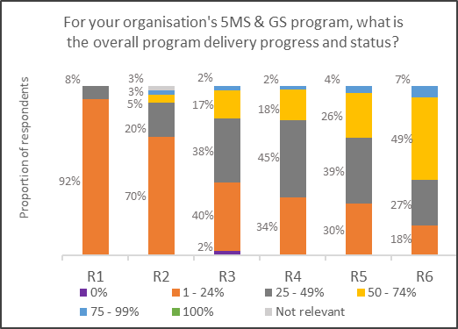
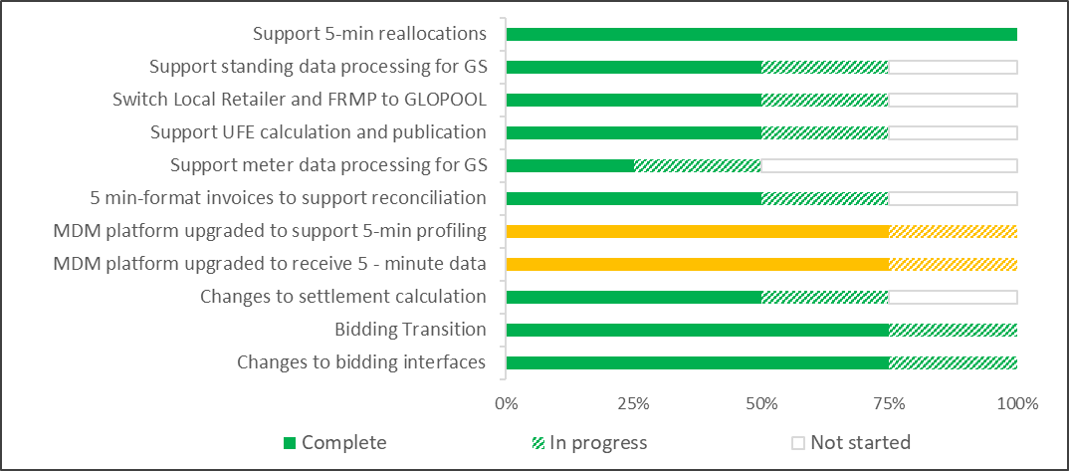
Summary of coverage, status and progress
Minor drop in response, with 45 respondents representing 87-100% of the industry. Response rate across all participant types provides representative industry coverage.
Half of participants have now commenced the testing phase of their program, increasing from 30% to 56% between rounds. All except three respondents noted that they are on track, 1 reporting "late" and 2 "at risk".
The AEMO Bidding Platform was deployed for industry test on schedule. The AEMO Retail Platform deployment was rescheduled to May 2021, and the AEMO Settlement platform go-live was rescheduled to May 2021. A heightened risk profile is reflected as a result of the Retail re-schedule.
Compared to the previous round of reporting, one participant was experiencing major changes in their ability to implement 5MS and GS due to COVID-19. Two other participants reported minor changes. The remaining participants reported no change. No impact was noted against overall program progression.

Slide 17
5MS Rule Commencement
Round 6
 | On track | On track for commencement date
 | Risk 1 – Risk to major milestones or deliveries | Remediation or contingency activation required to ensure on track delivery for Rule Commencement
 | Risk 2 – Risk to rule commencement | Cannot be addressed with available contingencies to be on track for commencement date
On track
Risk 1
Risk 2
Activity | Status | Comments
AEMO Business Readiness for 5MS and GS (Part A) |  | Bidding platform operating successfully in Industry test, on schedule for 1 April Go-live. Retail Platform go-live rescheduled to 31 May, Settlements platform rescheduled to 17 May. Rescheduling of platform deliveries is not expected to impact 5MS Rule commencement or 5MS market trials.
Essential Industry Capabilities for 5MS commencement (Part A) |  | On track for 1 Oct 21 commencement Metering Data Providers and MPs reporting on track with minor exceptions. Generators reporting on-track delivery.
Summary: 5MS Rule Commencement |  | Overall Industry and AEMO components of essential capability currently on track for 5MS Rule commencement.
Other industry capabilities for 5MS and GS (Part B) |  | Other Participant readiness activities proceeding in line with 5MS rule commencement. Individual participant readiness risks noted in regards Global Settlement population activities. No systemic issues noted
Risk 1
On track
On track
On track
*** round 6- as at 8/3

Slide 18
Part A 5MS Essential Capability
 | On track | On track for commencement date
 | Risk 1 – Risk to major milestones or deliveries | Remediation or contingency activation required to ensure on track delivery for Rule Commencement
 | Risk 2 – Risk to rule commencement | Cannot be addressed with available contingencies to be on track for commencement date
On track
Risk 1
Risk 2
Responsible Participant | Essential Criteria | Status | Comments
Generator | Generators and MNSPs are able to submit 5-min offers |  | 16/17 Generators representing 95% of NEM volume reporting on-track. 15/17 intend to participate in Market Trials. Average program completion in range 50-74%. 12/17 intend to commence 5 minute bidding within transition period.
MP, MC | All essential meters* are able to produce and store 5-min data |  | 9/10 MPs reporting on track, 1 MP reporting “late” with identified remediation Rollout plans received for 93% of Tranche 1 meters, with all plans indicating completion prior to 1 October, 25% of meters currently 5 minute capable
MDP | All essential meters* are able to deliver 5-min metering data |  | 3/3 MDPs for Essential meters are reporting programs on track. Rollout plans (due 1 May) to be used to validate responses
AEMO | The 5-minute bidding and dispatch solution, including the web bidding interface is deployed |  | AEMO platform deployed for Industry test, on track for 1 April production deployment.
 | The Metering Data Management (MDM) solution is deployed |  | Mitigation Action: Retail Platform Deployment rescheduled to 31 May, criteria rated Amber to reflect the increase in delivery risk
 | The 5-minute settlements solution is deployed |  | AEMO Settlement Platform deployment rescheduled to 17th May. Industry test period extended to reflect changed order of platform deployment. Certification testing of platform successfully completed
Summary - Essential Criteria | - | - | All components on track for delivery at 5MS rule commencement, AEMO Metering rating reflects shift in planned go-lives and subsequent compression of transitional activity.
On track
On track
On track
On track
Risk 1
On track
*** Round 6 – as at 8/3

Slide 19
Part B – Other Industry Capabilities
Responsible Participant | Criteria | Status | Comments
Retailer | Receive and process 5-minute metering data. Receive and process 5-minute settlement data. |  | All responding retailers (18, representing 95% of retail load) reporting ‘On track’. 17/18 retailers plan to participate in Market trials. 6/18 intend to perform in Bi-Lateral Testing. 18/18 ‘On-track’ for 5 min settlement data, with 2 late for UFE Allocation
DNSP | Receive and process 5-minute metering data. |  | 10/10 DNSPs reporting ‘On track’ to receive 5-minute data and planning on participating in market trials.
 | Provide GS metering and standing data updates (incl. NCONUML). |  | 10/10 DNSPs reporting ‘On track’ with average program completion of 50-74% GS Standing Data updates reported as ‘On track’ (including NCONUML). Type 7 Metering Data “On Track” 1 Participant reporting ‘At-risk’ for the delivery of NCONUML,
TNSP | Receive and process 5-minute metering data |  | 6/6 TNSPs reporting ‘On track' to receive 5-minute data 2/6 have the intention to receive 5-minute data prior to the Rule commencement date
 | Provide GS metering and standing data updates |  | 6/6 reporting ‘On track’.
MDP | Provide 5-minute metering data T1-3 distribution connected meters, type 7 meters. |  | 16/17 MDPs reporting ‘On track’, representing 100% coverage of Tranche 1 NMIS 1 participant ‘At risk’, recovery plan is in place 17/17 MDPs report ‘On track’ for the delivery of interval metering data by 1 October, including 1 MDP flagging “A risk” for delivery of T1-3 customer meters
 | Provide type 4, 4A, Vic Ami metering data at 5-minute granularity by 1 December 2022 |  | Majority of Roll-out scheduled to commence 3rd quarter of 2021. Rollout plans requested from impacted participants by 1 March 2021 100% of MDPs reporting ‘On track’ for interval meter delivery by Rule commencement.
 | Provide basic metering data for tier 1 NMIs to AEMO. |  | 3 MDPs reporting ‘Completed’, 6 MDPs reporting “On Track” 1 MDP reporting ‘Late’, with plan to commence delivery prior to 1 Oct
MP, MC | All T1-3,4* meters are able to produce and store 5-minute data. |  | 18 /19 MPs representing tranche 1 meters reporting ‘On track’, 1 reporting ‘Late’ with a stated remediation plan 16 Rollout plans covering 93% of tranche 1 meters received, 25% of tranche 1 meters currently 5 minute capable.
Summary | - | - | Overall summary “on track” , no systemic issues identified, individual exceptions noted
On track
On track
On track
On track
On track
On track
*** Round 6 – as at 8/3

Slide 20

Readiness Working Group Update
Bidding Service:
Go Live of 5MS Bidding Service 1 April
  No interruption to 30-minute bidding service
Industry Go-Live plan issued 8 March
  Communications Approach to Go-Live
  Interaction with Bidding Transition
  Support
  Post go-live support will be through AEMO Support Hub​
  As participants will commence using 5MS bidding at different times, AEMO will not establish a dedicated Q&A session at this time. However, these can be scheduled if the need arises. ​
  The monthly Q&A sessions will continue to be available ​
  Support will be provided to participants during their cutover through Support Hub. AEMO business and IT SMEs will be available
  through this medium.
Settlement Platform
Retail
Pre-prod Availability from 22 March
  Planned settlement runs communicated to ITWG for confirmation against current MSATS platform
  Further Settlement runs to be provided post deployment of retail Platform
Industry Go-live approach for 17 May outlined
  Participant access to settlement web pages unavailable during cutover period
Invitation Industry Test planning - Retail
  Scenarios distributed for consideration by participants, participants to reconsider availability for testing
  Planning for conduct will take place in ITWG and with focused sessions for participating organisations
  Practice Training sessions organised

Slide 21
Readiness Working Group Update
Market Trial Preparation​
Nominations for Market Trial Focus Group (MTFG) due by 12-Mar-21 ​
Terms of Reference have been circulated​
MTFG will develop test plans – will be circulated to ITWG for input and consideration​
Transition Focus Group / Metering Transition
TFG conducted 11th March
Metering Rollout Plans consolidated for Industry consideration
  Tranche 1 metering
  Tranche 2 Metering Data and Net to Register plans
  Nonconuml
Upcoming activities:
RWG:
Debrief on Bidding go-live ​
Debrief on Settlements Industry Test commencement​
5MS Market Trial – planning update​
Metering provider implementation planning​
ITWG:
  Planning for Invitation Industry Test – Retail
  Settlement Platform industry testing​
  Nomination for MTFG to define test approach for Market Trials​

Slide 22

Settlements Certification Conclusions

Slide 23
Objectives
Australian Energy Market Commission (AEMC) made rules changes back in 2017 and 2018 relating to 5-minute settlement in the National Electricity Market (NEM) and to move from the current ‘settlement by difference’ framework to a ‘global settlement’ framework, respectively
As part of the Australian Energy Market Operator’s (AEMO) obligations in NEM under Energy Legislation, it is required that the settlement and billing engines are independently certified, confirming they adhere to and calculate in accordance with the National Electricity Rules (NER)
The objective of the project was to provide software certification of:
  Settlement Calculation Engine (SCE)
  Billing Calculation Engine (BCE)
to ensure that the calculations implemented within these adhere to the NER (Chapter 2 & Chapter 3) and the associated AEMO Procedures, which have been amended to support 5-minute settlement & global settlement
IES was engaged by AEMO to conduct the software certification over the period from Sept. 2020 to Feb 2021

Slide 24
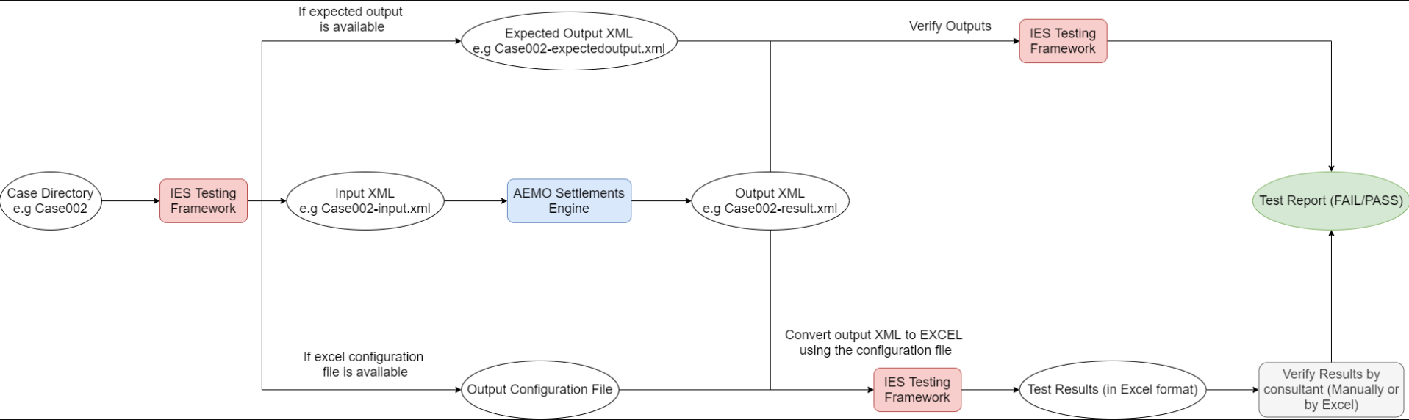
Software Certification Methodology:
Testing Framework
Black-box testing methodology for Settlement Engine & Billing Engine
IES independently determines test cases as XML input / XML output files
The XML input file is provided to AEMO to run through their software (Settlement or Billing Engine)
IES then compares the AEMO XML Output File to the IES XML Output File that contains expected result
If agreement to 6 decimal places – then test case passes, if not then investigate why & discuss with AEMO
Remedial actions include software fix, re-testing or it may relate to interpretation of the market rules
Where enhancements to software are required, we then re-test
Once all test cases pass, IES issues software certificates

Slide 25
Software Certification Methodology:
System for Ranking Findings
Result – Priority | Description
Pass | Settlement Calculation Engine or Billing Calculation Engine function is found to be consistent with the relevant rules and procedures with the test case agreeing with the independently determined and expected result
Fail – Low | Identified issue associated with the settlement or billing calculation function does not adversely impact the core calculation logic. However, it would be desirable to address these issues and can be accomplished in later revisions. Examples: missing error messages, additional validation checks, more “defensive coding” etc.
Fail – High | Settlement Calculation Engine or Billing Calculation Engine function found to be inconsistent with the expected result, hence inconsistent with corresponding market rules and/or AEMO procedures. The error must be corrected before certification can be given.

Slide 26
Results of Software Certification
No. | Component | Total Findings | Low Risk Issues | High Risk Issues | Overall Assessment | Comments on High-Risk Findings
1 | Base Energy Settlement Engine Calculations | 4 | 2 | 1 | Pass | Incorrect selection of TLF under global settlements (under specific circumstances) – which can have an impact on trading amounts (fixed)
2 | Ancillary Services | 3 | 3 | - | Pass | -
3 | Reallocations & Market Fees | 6 | 4 | 2 | Pass | TCP exclusions are not being applied for variable energy fees (fixed) Small generator energy amounts being doubled when applying market fees (fixed)
4 | Settlement Residue Auctions (SRAs) | 3 | 2 | 1 | Pass | Energy losses across interconnectors were always divided by 2 instead of by 2 for 30-minute, and by 12 for 5-minute settlement (fixed)
5 | Billing Engine Computations | 1 | 1 | - | Pass | -
Issues found were either immaterial (low-risk) or were rectified and confirmed to be addressed based on re-testing

Slide 27
Conclusion
Following updates to resolve identified issues, the entire library of tests cases was re-run
This confirmed that all test cases passed to IES satisfaction for:
  Software Calculation Engine:
    Base Energy Settlement Engine calculations
    Ancillary Services
    Reallocations & Market Fees
    Settlement Residue Auctions (SRAs)
  Billing Calculation Engine
As such IES has issued software certificates to AEMO for:
  Software Calculation Engine version 5.1.5
  Billing Calculation Engine version 5.1.5

Slide 28
Forward Meeting Plan
Anne-Marie McCague

Slide 29
High-Level Plan for 2021
This table provides a list of key topics. The normal updates will also be provided at each PCF. This table will evolve as the year progresses.
*Dates depend on April Checkpoint outcomes
Month | Topics | Month | Topics
January | AEMO go-live decision making process Risk Review Readiness and go-live dashboard | June | Market Trial prep status Debrief on Retail Go-Live*
18 February | Retail Solution Status Exec Forum Agenda | July | Market Trial progress Readiness Reporting #8
18 March | Dispatch Cutover Preparation Status Readiness Reporting #6 Retail Checkpoint Criteria – assessment and outcomes Retail Pre-prod – status and go/no-go date Retail Production go-live – checkpoint date and criteria Settlements Certification Process Conclusions | August | Market Trial progress Risk Review – focus on rule commencement Exec Forum Agenda
23 April | Debrief on Dispatch go-live Settlements Cutover Preparation Status Risk Review Retail Checkpoint Criteria – assessment and outcomes Retail Production go-live – confirmation of go/no-go date | September | Results of Market Trial Preparing for 1 Oct – Ind Go-Live Plan review Readiness Reporting #9
19 May | Readiness Reporting #7 Exec Forum Agenda Approach to Global Settlements engagement Retail Production: Confirming go/no-go Retail Cutover Preparation Status* | October | Debrief and reconfirmation of approach for Global Settlements

Slide 30
Executive Forum Agenda – 25-March
Pack to be circulated 19-Mar after PCF on 18-Mar
Proposed agenda:
  Readiness Dashboard – AEMO and Industry status, key issues or risks
  Retail status update
  Confirmation of Bidding go-live (01-Apr-21) and Settlements pre-prod release (22-Mar-21)

Slide 31
Upcoming meetings
https://aemo.com.au/initiatives/major-programs/nem-five-minute-settlement-program-and-global-settlement
Current as at 10/03/2021

Slide 32
General Questions
Peter Carruthers

Slide 33
Meeting Close
Peter Carruthers

Slide 34
Appendix

Slide 35
Readiness Dashboard Part A - Essential Capability
Status supporting evidence – Draft
Criteria | Capabilities | March | May | July | Sept
AEMO Capability | Metering: | Deployment of Metering Platform schedule | Metering Platform deployed for 30 Minute operation | Business Operations Stable | Market Trial Conducted successfully
 | Receive and Process 5 minute metering data | Metering Platform Industry testing Conducted | Business operations stable | 5MS Capability in place for Market Trial
 | Support 5 Minute Profiling |  |  | Market Trial Planned
 | Settlements: | Platform Industry testing underway | Platform deployed for 30 Minute operation | Business Operations Stable | Market Trial Conducted successfully
 | Support 5 minute Settlement processes | Platform deployment on track for scheduled date | Business operations stable | Capability in place for Market Trial
 |  |  |  | Market Trial Planned
 | Dispatch (Bidding): | Platform Industry testing underway | Platform deployed for Transition mode operation | Platform Stable | Market Trial Conducted successfully
 | Support 5 Minute bidding services | Platform deployment on track for scheduled date | Business operations stable | Capability in place for Market Trial | Bidding table updates in place
 | Provide 5 Minute web bidding interface | Bidding table updates in place | Bidding table updates in place | Market Trial Planned
 |  |  |  | Bidding table updates in place
Essential Bidding | Generators: | Testing of upgrades commenced | Testing of upgrades | Deployments of 5 Minute Capability (Transition mode) | Deployments of 5 Minute Capability (Transition mode)
 | generators representing at least 80% of load in each region are capable of providing 5 minute bids |  | Initial deployments of 5 Minute Capability (Transition mode) | Market Trial Participation Planned | Market Trial Participation Planned
Essential Metering | MP's upgraded ensured that essential meters are capable of providing 5 minute metering data | Metering rollout plans with reported progress versus MTP | Metering rollout plans with reported progress on track | Metering rollout plans with reported progress on track | Metering rollout plans Completed
 | MDPs are able to provide 5 minute metering data for essential meters for settlement | Metering rollout plans available Accreditation initial meetings held Program Progress being Reported on track | Accreditation Updates planned / Underway | Market Trial Participation | Market Trial Participation
 |  |  | Initial Delivery of 5 minute data for Settlement | Accreditation updates Achieved / Underway | Accreditation updates Achieved
 |  |  |  | Initial Delivery of 5 minute data for Settlement | Initial Delivery of 5 minute data for Settlement

Slide 36
Readiness Dashboard Part B - Participant Readiness
Status supporting evidence - Draft
Participant | Capabilities | March | May | July | Sept
Retailers | Receive and process 5 minute metering data |  | Planned participation in Market Trials | Participation in Market Trial | Market Trial successful participation
 | Receive and process 5 minute Settlement statements |  | Level of bi-lateral testing of B2B processes | Level of bi-lateral testing of B2B processes
DNSPs/ TNSPs | Receive and process 5 minute metering data | Published plans for Standing data and Metering upgrades | On track delivery against Standing Data and Metering Upgrades | On track delivery against Standing Data and Metering Upgrades | On track delivery against Standing Data and Metering Upgrades
 | Provide GS Metering and Standing Data updates (inc. NCONUML) |  |  | Market Trial Participation | Market Trial successful participation
MDPs | Provide 5 minute Data T1-3 Distribution connected metering data | Published plans for T1 Basic Meter Delivery, Accreditation Updates planned Rollout Plans for T1-3 4*, 7 - distribution connected | On track delivery for T1 Basic Meter Delivery | On track delivery for T1 Basic Meter Delivery | T1-3, Type 7 distribution connected meters providing 5 minute metering data for Settlement T1 Basic Meter Data completed
 | Provide T1 Basic Metering Data |  | Level of bi-lateral testing of B2B processes | Level of bi-lateral testing of B2B processes
 | Provide MDFF Interval Data / Inc |  | Ontrack for T1-3, 7 distribution connected metering data delivery | Ontrack for T1-3, 7 distribution connected metering data delivery
MDPs | Provide 5 Minute metering Data (4, 4A, VicAMI) | Rollout Plans Provided | Rollout Plans Provided | Market Trial Participation | All Interval Metering Data delivered via MDFF
MPs | T1-3 distribution connected metres capable of producing 5 Minute Data | Metering rollout plans with reported progress versus MTP | Metering rollout plans with reported progress on track | Metering rollout plans with reported progress on track | Metering Rollout Completed

