Slide 1
5MS & GS Program Consultative Forum #27
Thursday, 5 November 2020
This meeting is recorded for the purpose of minute taking.

Slide 2
AEMO Competition Law
Meeting Protocol
AEMO is committed to complying with all applicable laws, including the Competition and Consumer Act 2010 (CCA). In any dealings with AEMO regarding proposed reforms or other initiatives, all participants agree to adhere to the CCA at all times and to comply with this Protocol. Participants must arrange for their representatives to be briefed on competition law risks and obligations.
Participants in AEMO discussions must:
Ensure that discussions are limited to the matters contemplated by the agenda for the discussion
Make independent and unilateral decisions about their commercial positions and approach in relation to the matters under discussion with AEMO
Immediately and clearly raise an objection with AEMO or the Chair of the meeting if a matter is discussed that the participant is concerned may give rise to competition law risks or a breach of this Protocol
Participants in AEMO meetings must not discuss or agree on the following topics:
Which customers they will supply or market to
The price or other terms at which Participants will supply
Bids or tenders, including the nature of a bid that a Participant intends to make or whether the Participant will participate in the bid
Which suppliers Participants will acquire from (or the price or other terms on which they acquire goods or services)
Refusing to supply a person or company access to any products, services or inputs they require
Under no circumstances must Participants share Competitively Sensitive Information. Competitively Sensitive Information means confidential information relating to a Participant which if disclosed to a competitor could affect its current or future commercial strategies, such as pricing information, customer terms and conditions, supply terms and conditions, sales, marketing or procurement strategies, product development, margins, costs, capacity or production planning.

Slide 3
Agenda
# | Time | Topic | Presenter
1 | 10:00 – 10:05 | Welcome | Peter Carruthers
2 | 10:05 – 10:10 | Actions from previous meetings | Anne-Marie McCague
3 | 10:10 – 10:20 | Program Update | Rowena Leung
4 | 10:20 – 10:30 | Readiness Working Group Update | Greg Minney
7 | 10:30 – 10:40 | Initial look at Readiness Reporting #4 | Greg Minney
9 | 10:40 – 10:50 | Customer Switching Update | Neil Batie
11 | 10:50 – 10:55 | Forward meeting plan | Anne-Marie McCague
12 | 10:55 – 11:05 | General Questions | Peter Carruthers
13 | 11:05 | Meeting Close | Peter Carruthers

Slide 4
Welcome
Peter Carruthers

Slide 5
Actions from Previous Meetings
Anne-Marie McCague

Slide 6
PCF Actions
No. | Status | Action | Comment
25.6.2 | Closed | AEMO to confirm the update of Readiness Strategy documents to reflect changes due to the revised rule commencement dates and associated milestone updates. | The documents on the Readiness webpage have been updated. Please note that there may be links to old versions on other webpages. This is being worked through.
26.10.1 | Closed | Customer Switching to review stakeholder engagement strategy and to advise PCF on outcomes of this review in November. | To be discussed during this session.
26.10.2 | Closed | PCF to provide feedback on whether a Market Trial for Customer Switching was needed. Feedback should be sent to ERCF@aemo.com.au. | To be discussed during this session.
26.10.3 | Closed | PCF to provide feedback on proposed timelines to WDR and Customer Switching through WDR@aemo.com.au or ERCF@aemo.com.au. | All feedback received through the 5MS mailbox was forwarded to the relevant teams.

Slide 7
Program Update
Rowena Leung

Slide 8
5MS Program Timeline
Level 1 and External Level 2 Milestones 1/2
Current as at 16-10-2020

Slide 9
5MS Program Timeline
Level 1 and External Level 2 Milestones 2/2
Current as at 16-10-2020

Slide 10



Program update and current activities
AEMO program
Overall Program remains Green trending down. Delivery pressures remain.
The program continues to be in an intense period of delivery focusing on:
  Non-critical build items
  Testing
  Dress Rehearsal
  Certification
The Testing program remains in full flight, we have progressed further into the test program, with concurrent testing phases across all 3 releases.
AEMO internal readiness preparation activities for go-live also continue.
Systems
Testing and deployment work continues across all streams - no change to any upcoming Staging deployment, Pre-Production or Production deliveries.
Issues with performance testing of running >3 high-frequency RM reports (as reported at the PCF in October) not resolved, resolution work is continuing in November. Update to be provided to the December PCF.
Dispatch Pre-Prod deployment moved one day to complete by 30-Nov-2020 (was on a Sunday).
Upcoming SWG scheduled for 26-Nov-2020 focusing on system implications of volume of GLOPOOL. Combined with ITWG.
Readiness
Readiness Survey #4 conducted. Strong response from 44 participants. Essential Capability indicators stable.
Retail Platform go-live preparation in progress with invitation industry test planning and draft go-live plan
Consolidation of industry plans for metering activation indicate likely peak transactions 3rd quarter 2022. TFG to consider volume implications

Slide 11




AEMO IT Platform Deployment Status
 | Go-Live date will be impacted
 | At risk
 | On schedule
Stream | Build | AEMO Testing | Pre-prod | Cutover | Commentary
Retail | Non-critical build items in progress | SIT completed for Day 1 Go Live UAT for metering data ingestion completed UAT for profiling & Reporting in progress Performance Testing for Reporting in progress | On track for industry testing commencing 01-Feb-21 Invitation test planning underway | Dress Rehearsal 1 learnings Planning Dress Rehearsal 2 | Pressure remains on Retail delivery Issues encountered during perf testing require amendment Retail stream and testing activities have been realigned Consequently, no contingency remains for Retail stream If contingency is needed AEMO will deprioritise non-critical items and introduce a secondary drop in advance of Market Trials. This will maintain 09-Mar-21 Go-Live and 01-Oct-21 5-min market start
Dispatch | Complete | SIT completed for Day 1 Go Live UAT in progress | On track for industry testing commencing 30-Nov-20 | Cutover Planning in progress | Tracking towards deployment dates AEMO to conduct performance testing in Pre-Prod over summer period
Settlements | Complete | SIT completed for Day 1 Go Live UAT in progress | On track for industry testing commencing 17-Feb-21 | Cutover Planning in progress | Tracking towards deployment dates AEMO to conduct performance testing & parallel run in Pre-Prod over summer period (not noticeable to industry, date of 17-Feb-21 remains for Pre-Prod deployment).

Slide 12
AEMO Systems Deployment Cutover Risk - Update
Risk Description | Risk Assessment
The current Cutover approach has the 3 AEMO systems deployments in close succession. Retail Metering the largest, most technically complex and riskiest cutover going first on 9 March, then followed by both the Dispatch and Settlements systems deployments together 3 weeks later on 1 April. A go-live criteria for Settlements is a stable metering platform. The current timetable only allows one week for the Retail solution to be stabilised prior to commencing cutover activity for Settlements which is high-risk. | Inherent Likelihood | Inherent Consequence | Inherent Risk Rating
 | Possible | Major | Significant
 | Residual Likelihood | Residual Consequence | Residual Risk Rating
 | Unlikely | Moderate | Medium
AEMO has presented the proposal to change the deployment date for the Settlements solution to 19 April 2021 to the PCF (03-Sep and 01-Oct) and RWG (14-Sep and 13-Oct)
MSUG was held on 16-Oct-20 to discuss the 5MS and non-5MS impacts to the data model v5.0
Feedback was requested from RWG and PCF by 23-Oct-20. Feedback indicated that there was no impact to participants.
AEMO considers this approach to be confirmed and timelines will be updated with Settlements Go-live on 19-Apr-21

Slide 13
Dispatch Pre-Production Deployment
Industry test for Dispatch in the AEMO pre-production available to commence from 13:00 (AEST) 30-Nov-20
  NB provides for Industry test support during business hours from Monday 30-Nov
Support:
  Participant testing webpage – background information and FAQs
  Functionality Deployment Matrix – includes a list of the functionality that will be available in pre-prod
  The 5MS team will be available for a daily call for one week from 01-Dec. This can be extended/repeated in Jan. Invites will be sent to ITWG and RWG.
  Support is also available through AEMO Support Hub
Notes:
Highlight Availability for the commencement of testing for Industry Access
Updates and Support

Slide 14
Readiness Working Group Update
Greg Minney

Slide 15
Level 2 Milestones – Readiness
Current as at 16-10-2020
Domain | Initiative | 2019 |  |  |  |  |  |  |  |  |  |  |  | 2020 |  |  |  |  |  |  |  |  |  |  |  | 2021
 |  | Q1 |  |  | Q2 |  |  | Q3 |  |  | Q4 |  |  | Q1 |  |  | Q2 |  |  | Q3 |  |  | Q4 |  |  | Q1 |  |  | Q2 |  |  | Q3 |  |  | Q4
Readiness
 |  | Jan | Feb | Mar | Apr | May | Jun | Jul | Aug | Sept | Oct | Nov | Dec | Jan | Feb | Mar | Apr | May | Jun | Jul | Aug | Sept | Oct | Nov | Dec | Jan | Feb | Mar | Apr | May | Jun | Jul | Aug | Sept | Oct | Nov | Dec
L2-RE32
L2-M12
L2-RE29
L2-D8
L2-RE30
L2-RE11
L2-S12
L2-RE22
L2-RE18
L2-M11
L2-D7
L2-M24
L2-M10
Key Milestones (Program)
ID | Milestone | Target Date | Expected Date | Owner | Status
L2-RE11 | Metering Service Provider Accreditation Plan Finalised | 13-Mar-2020 | 18-Feb-2020 | AEMO | Complete
L2-S12 | Reallocations Go-Live | 01-Apr-2020 | 01-Apr-2020 | AEMO | Complete
L2-RE32 | Industry Test for Reallocations Concludes | 31-Mar-2020 | 31-Mar-2020 | AEMO | Complete
L2-RE22 | Industry Transition Plan – Dispatch​ final complete | 28-Aug-2020 | 28-Aug-2020 | AEMO | Complete
L2-M11 | Industry Test preparation completed by participants for MDM and B2M Go-Live | 01-Feb-2021 | 01-Feb-2021 | Participants
L2-M12 | Industry Test preparation completed by AEMO for MDM and B2M Go-Live | 01-Feb-2021 | 01-Feb-2021 | AEMO
L2-RE29 | Retail MDM (incl. B2M) Industry Test Commences | 01-Feb-2021 | 01-Feb-2021 | AEMO
L2-RE30 | Retail MDM (incl. B2M) Industry Test Concludes | 03-Mar-2021 | 03-Mar-2021 | AEMO
L2-RE18 | Industry Go-Live Plan Retail MDM finalised | 20-Nov-2020 | 20-Nov-2020 | AEMO
L2-M24 | B2M Go-Live | 09-Mar-2021 | 09-Mar-2021 | AEMO
L2-M10 | 5 minute files in MDFF accepted by AEMO | 01-Apr-2021 | 01-Apr-2021 | AEMO
L2-D7 | Dispatch Industry Test preparation completed by participants | 29-Nov-2020 | 29-Nov-2020 | Participants
L2-D8 | Dispatch Industry Test preparation completed by AEMO | 29-Nov-2020 | 29-Nov-2020 | AEMO
Milestone complete
Milestone on track
Milestone at risk
Milestone not achieved
Notes:
Upcoming – Commencement of Industry Test,
Industry Go-live plan for retail – mid decemeber – may require some updates to timings as dress rehersals are finalised

Slide 16
Level 2 Milestones – Readiness
Current as at 16-10-2020
L2-RE19
L2-RE24
Domain | Initiative | 2019 |  |  |  |  |  |  |  |  |  |  |  | 2020 |  |  |  |  |  |  |  |  |  |  |  | 2021
 |  | Q1 |  |  | Q2 |  |  | Q3 |  |  | Q4 |  |  | Q1 |  |  | Q2 |  |  | Q3 |  |  | Q4 |  |  | Q1 |  |  | Q2 |  |  | Q3 |  |  | Q4
Readiness
 |  | Jan | Feb | Mar | Apr | May | Jun | Jul | Aug | Sept | Oct | Nov | Dec | Jan | Feb | Mar | Apr | May | Jun | Jul | Aug | Sept | Oct | Nov | Dec | Jan | Feb | Mar | Apr | May | Jun | Jul | Aug | Sept | Oct | Nov | Dec
L2-S11
L2-RE328
L2-RE31
L2-RE25
L2-S10
L2-RE32
L2-RE23
L2-RE20
L2-D10
L2-D11
L2-RE21
Key Milestones (Program)
ID | Milestone | Target Date | Expected Date | Owner | Status
L2-S10 | Settlements Industry Test preparation completed by participants | 17-Feb-2021 | 17-Feb-2021 | Participants
L2-S11 | Settlements Industry Test preparation completed by AEMO | 17-Feb-2021 | 17-Feb-2021 | AEMO
L2-RE28 | Dispatch Industry Test concludes | 15-Mar-2021 | 15-Mar-2021 | AEMO
L2-RE32 | Settlements Industry Test concludes | 15-Mar-2021 | 15-Mar-2021 | AEMO
L2-RE19 | Industry Go-Live Plan Settlements, Dispatch & Bidding finalised | 19-Mar-2021 | 19-Mar-2021 | AEMO
L2-RE23 | 5MS Capability Market Trial preparation completed by participants | 05-Jul-2021 | 05-Jul-2021 | Participants
L2-RE24 | 5MS Capability Market Trial preparation completed by AEMO | 05-Jul-2021 | 05-Jul-2021 | AEMO
L2-RE31 | 5MS Capability Market Trial commences | 05-Jul-2021 | 05-Jul-2021 | AEMO
L2-RE20 | Industry Go-Live Plan – 5MS Capability final complete | 01-Aug-2021 | 01-Aug-2021 | AEMO
L2-D10 | 5MS Capability Market Trial concludes | 27-Aug-2021 | 27-Aug-2021 | AEMO
L2-D11 | 30-min Bidding no longer accepted by AEMO | 01-Oct-2021 | 01-Oct-2021 | AEMO
L2-RE25 | MDMT format no longer accepted by AEMO for interval meters | 01-Oct-2021 | 01-Oct-2021 | AEMO
L2-RE26 | GS Market Trial preparation completed by participants | 01-Feb-2022 | 01-Feb-2022 | Participants
L2-RE27 | GS Market Trial preparation completed by AEMO | 01-Feb-2022 | 01-Feb-2022 | AEMO
L2-RE21 | Industry Go-Live Plan – GS Capability final complete | 21-Dec-2021 | 21-Dec-2021 | AEMO
Milestone complete
Milestone on track
Milestone deferred
Milestone at risk
Milestone not achieved

Slide 17
Readiness Working Group Update
Retail Go-Live Plan:
Focus group conducted 16 October
Industry Feedback received 23rd October – 4 responses
Areas to be addressed:
  Confirmation of timings and approach for placing B2M and B2B transactions on hold while cutover occurs
  Detail confirmation re Vic TUOS migration
  Communication of Backlog processing timeframes
  Approach and involvement for Production Verification Monitoring
Transition Focus Group
Initial consideration of transaction volumes over time to support metering conversion
Guidelines for the establishment of cross boundary metering
Invitation Industry Test planning - Retail
Proposed test scenarios developed with ITWG
Participants considering scope and level of involvement they will support
Next steps will be to confirm data refresh approach and participant alignment
Notes:
Working through Feedback – confirming next draft release as work through technical approach to holding transactions
Will look to engange with those particpants regarding PVM
TFG – intinial transaction volumes – identification of areas where there are significant volume peaks , and potential overlaps with volumes from MSDR
Requested updates from a number of MDPS wher ethere are large volumes of tier 1 basic meters that require activiation – to refine likely volumes
Particpants considering their impacts
Invitation Industry Test – NB scenarios proposed – will be looking to confirm data timings in December

Slide 18
Readiness Working Group Update
Dispatch Industry Go-live Plan
Approach and scope of plan provided to RWG
Includes Participant Data model overlaps
Dispatch Industry Test
Following pre-prod deployment available for Industry test – 13:00 AEST 30/11
Upcoming activity
RWG consideration of readiness report
TFG – updates to rollout plans and volume management approaches
Initial engagement for Settlement and Dispatch Go-Live Plans
Updates Retail Industry go-live plan

Slide 19
Initial look at Readiness Reporting #4
Greg Minney

Slide 20
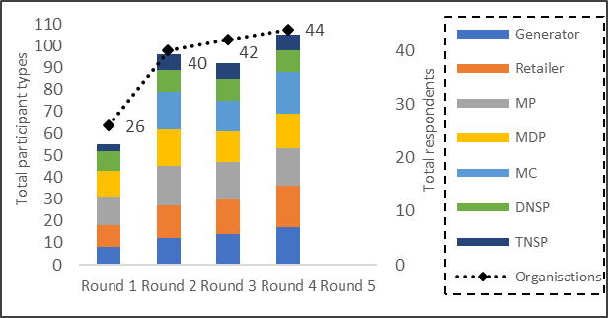
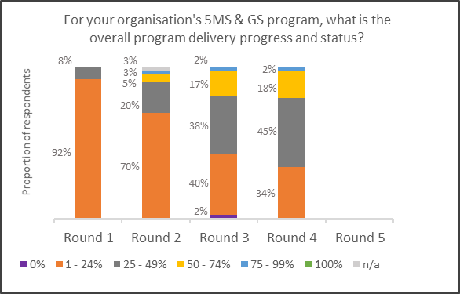
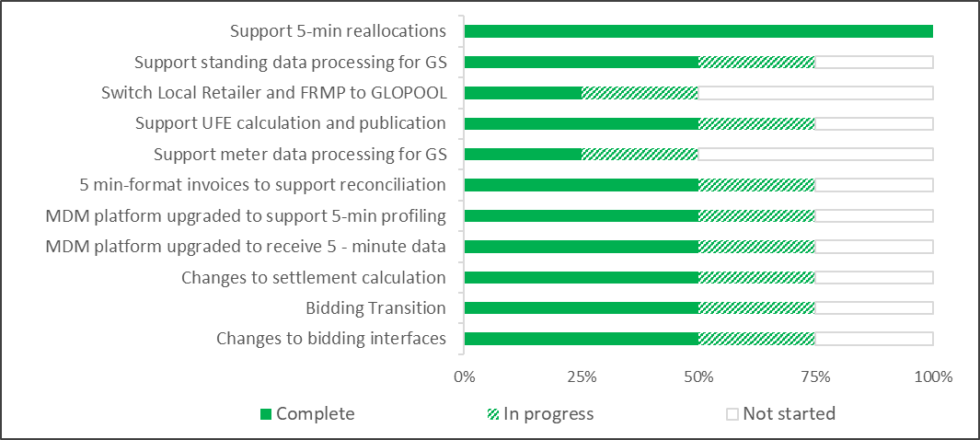
Initial look at Readiness Reporting #4
Participant Response
Program Progression
Increased response rate - small generators, small retailers
With noted exception increase in respondents for all relevant roles
Coverage range 95- 100% on volumes
One respondent reporting overall program as late with remediation plan for year end
95% of participant roles intend to participate in Market Trials
AEMO Specific Criteria
Notes:
Will consider with RWG how results are presented – given the level of establishment of programs -

Slide 21
Critical Capability leading Indicators
Generation:
Previous reported late participant – current report is on-track
Generators at risk and late – volume not required to meet regional capacity criteria, need for program remediation to be established
MDPS – reporting on track
MP – No response status being investigated to establish if remediation actions are required – to be addressed with RWG
AEMO capability on -Track
Notes:
Essential Capability No red flags
Generations leading indicators met – although noted a number of no response , at risk and late are beinig worked through – determine escalation or remediation plans
No red flags
Follow up in progress
MP responses – some inconsistencies of the 4 MP’s 1 has small number , 1 responded on track as MC / not MP, 1 previous response on track – 1 N/A – confirming addressed by other responses

Slide 22
Risk Summary
Covid-19:
Individual participants have highlighted increased impact of economic impacts of Covid-19 on LNSP services in Victoria and impact on 5MS timelines
No impact noted to program status or specific readiness activity
Retailer reports note regulatory roadmap impacts still exist
Delivery timing and impacts still being determined
Retailer reports highlight potential delays in x-Boundary metering (Victoria) has impact to accuracy of UFE at GS Soft Start
Notes:
Industry reisks – flagged and will be evaluated with the RWG

Slide 23
Customer Switching Update
Neil Batie

Slide 24
Action 26.10.2 – Feedback Received
Action 26.10.2: PCF to provide feedback on whether a Market Trial for Customer Switching was needed. Feedback should be sent to ERCF@aemo.com.au.
Feedback was received from two members in the PCF forum, requesting to incorporate the Customer Switching testing into the 5MS Market Trial
  Further detail was provided from one party with a request to focus the testing around the deprecated CRs and the 2 new CRs since their current internal processes and systems are built around CR’s that will be retired as well as the two new CR’s.
  The intent of aligning with the 5MS Market Trial would be to provide synergy and economy of preparation and testing effort in the July and August time period.
Further feedback was received from an additional participant requesting a Customer Switching focussed market testing period of 2 weeks in early September.
  Additional information was provided that the merging in with the 5MS Market Trial would cause them more complexity and timing issues
    Parties may not be ready for CS by early July 2021
    It is considerably prior to the 1 Oct 2021 go live.

Slide 25
Action 26.10.2 – review of feedback
Based on the feedback received, AEMO has reviewed the Market Trial requests and believe that the Industry test approach is the most pragmatic and cost effective one that also allows industry to test the MSATS change requests.
Additionally, aligning with the 5MS Market Trial would potentially not allow all participants to be ready with their required changes.
The Customer Switching functionality will be available for participants to undertake extended testing in Pre-Production from early July through to end of September – allowing for the variability in participant readiness.
A session is being scheduled in November for Q&A against the draft Customer Switching Technical Specification that we will also use to drill into testing implications and the opportunities for participants to test the various CR changes (unilaterally and bilaterally).
AEMO will also advise options where we believe we can reasonably provide assistance with that process.

Slide 26
Action 26.10.1 Update
Action 26.10.1: Customer Switching to review stakeholder engagement strategy and to advise PCF on outcomes of this review in November.
5MS alignment and further industry forums
Customer Switching Technical Specification session – 16th November
  To inform industry business and IT representatives of key parts of the Technical Specification, the testing approach and provide the opportunity for questions and answers.
  Take feedback on any further sessions required to facilitate the participant development process
Because Customer Switching changes will be in the Staging and Pre-Production environments in the same timelines as the 5MS project.
  Representatives from the Customer Switching project will join the 5MS forums when it is made effective in Staging so that there is a single entry point for participants to raise any questions or issues.
  Similarly, when Pre-Production is planned and enabled, this will be done with Customer Switching in the 5MS sessions for the same purpose.

Slide 27
Forward Meeting Plan
Anne-Marie McCague

Slide 28
Forward Meeting Plan
Next PCF: 01-Dec
Agenda topics:
  2021 Engagement Plan – calendar pdf will be circulated end of November
  Risks and Issues – preparation for Executive Forum
  WDR and Customer Switching Readiness Reporting action item

Slide 29
Proposed Executive Forum Agenda
Scheduled 10-Dec-20
Propose Agenda:
  Readiness Reporting Round 4
  AEMO Readiness including systems go-live updates
  Review of Critical Risks and Issues
    To be reviewed by PCF in advance on 01-Dec-20
  Regulatory Roadmap Update
  Exec Forum schedule for 2021

Slide 30
Upcoming meetings
https://aemo.com.au/initiatives/major-programs/nem-five-minute-settlement-program-and-global-settlement
Current as at 26/10/2020

Slide 31
General Questions
Peter Carruthers

Slide 32
Meeting Close
Peter Carruthers

