Slide 1
Five-Minute Settlement Program:
Program Consultative Forum 6
AEMO 5MS Program Team
Tuesday 4 December 2018
AEMO Offices:
Level 9, 99 Gawler Place, Adelaide
BRISBANE – NO ROOM AVAILABLE – USE DIAL IN FACILITY
Level 22, 530 Collins Street, Melbourne
LEVEL 2, 20 BOND STREET, SYDNEY
DIAL IN: 02 9087 3604 ACCESS CODE: 394-721-933

Slide 2
Agenda
NO | Time | AGENDA ITEM | Responsible
Preliminary Matters
1 | 10:00am – 10:10am | Welcome, introduction and apologies | Chris Muffett (AEMO)
2 | 10:10am – 10:20am | Minutes and actions from previous meeting | Chris Muffett (AEMO)
Matters for Noting
3 | 10:20am – 10:40am | Overview of DER Program | Chris Cormack (AEMO)
4 | 10:40am – 10:50am | Program update | Graeme Windley (AEMO)
5 | 10:50am – 11:00am | Industry risks & issues | Graeme Windley (AEMO)
6 | 11:00am – 11:10am | Procedures workstream update | Emily Brodie (AEMO)
7 | 11:10am – 11:20am | Systems workstream update | Hamish McNeish (AEMO)
8 | 11:20am – 11:30am | Stakeholder Update | Gary Eisner (AEMO)
Matters for Discussion
9 | 11:30am – 11:40am | Recap of technology update from EF | Graeme Windley (AEMO)
Other Business
10 | 11:40am – 11:50am | General questions | Chris Muffett (AEMO)
11 | 11:50am – 12:00pm | Forward meeting plan | Chris Muffett (AEMO)

Slide 3
Minutes and actions from previous meeting
Chris Muffett

Slide 4
Overview of DER Program
Chris Cormack

Slide 5
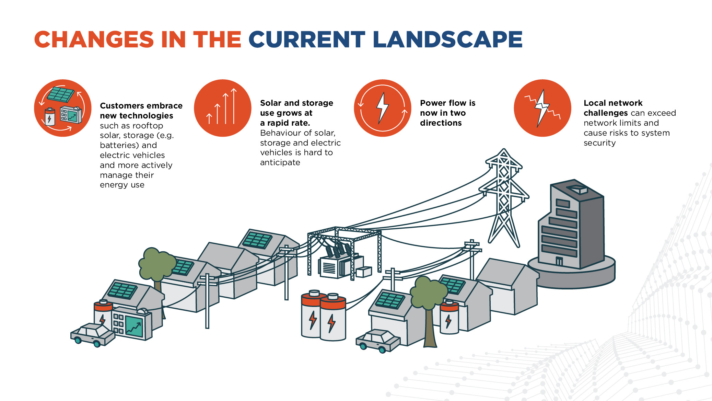

Slide 6
DER Program Context
Distributed Energy Resources (DER) are growing rapidly in the National Electricity Market (NEM), driven by increased consumer awareness and customer uptake. The AEMO DER program has been set up to help address the market opportunities and technical and operational challenges that increasing amounts of distributed resources are having on the NEM.
DER can refer to distribution level resources, which produce electricity or actively manage consumer demand e.g. solar rooftop PV systems, batteries, and demand response like hot water systems, pool pumps, smart appliances and air conditioning control. Increasingly, we recognise that these resources will be aggregated and actively managed. While these resources are located within the distribution network, there are system wide opportunities and challenges.

Slide 7
AEMO DER Program
Focus on 5 key areas – Pilots, Markets, Operations, Standards, Customer Data
Pilots:
- AEMO recently published the VPP Demonstrations consultation paper
Markets:
Working with the ENA on the Open Energy Networks project
Working with AEMC on the WDR rule change proposals
Operations
- Review inverter response to disturbances and reviewing EFCS and Cyber security risk assessment
Standards
Undertaking a review of AS4777 and supporting ENA common connection standards
Customer Data
Implementing the DER Register
In addition we are developing a DER Communication and Education Program

Slide 8
Program update
Graeme Windley

Slide 9
High-level status
Procedures work is progressing well, with most activities on track:
  Working groups and focus groups have been constructive
  Successful initial Settlements focus group and Dispatch focus group
Systems work continues to ramp up:
  Architecture, Requirements and Design work continuing
  Development work to commence in Q4 2018
Rule changes:
  5MS Drafting amendments Rule
  Global settlement rule determination due in 6 December 2018
  DER rule has been made – potential impact to 5MS solution design; however go live of 1 December 2019 may have a resourcing impact for participants
Stakeholder engagement is proceeding:
  Next EF meeting scheduled for early February

Slide 10
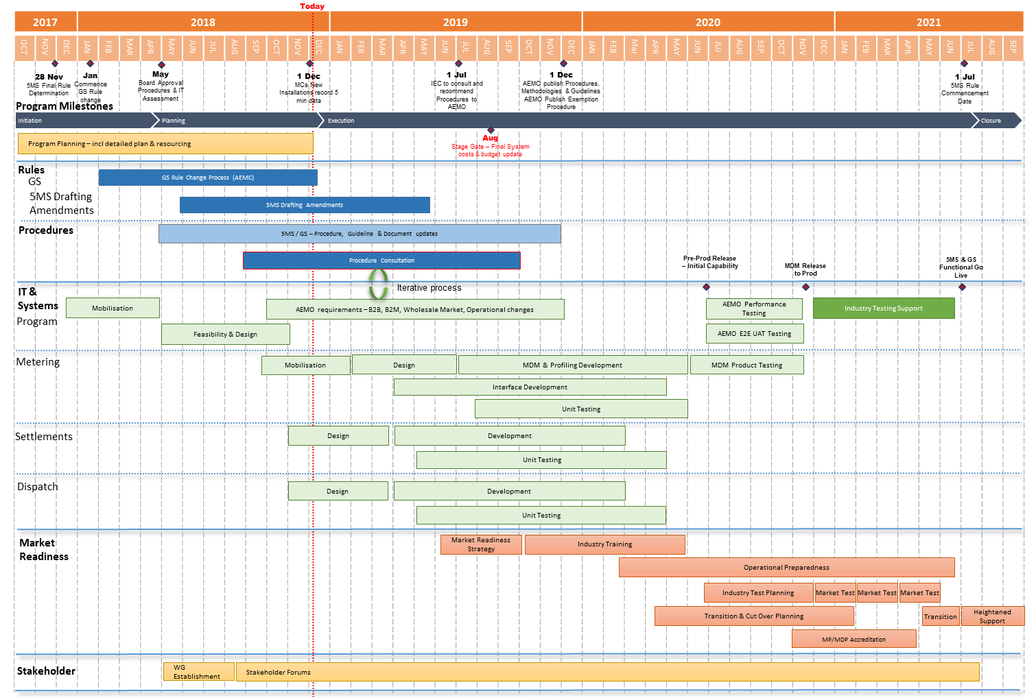
Program Conceptual Timeline

Slide 11
Industry risks & issues
Graeme Windley

Slide 12
Summary
Latest risk/issue register included with meeting pack
Risk/issue register is published on 5MS PCF page: http://www.aemo.com.au/Electricity/National-Electricity-Market-NEM/Five-Minute-Settlement/Program-Management/Program-Consultative-Forum
AEMO welcomes any feedback from the PCF on the risks & issues

Slide 13
Procedures workstream update
Emily Brodie

Slide 14
Procedures workstream update (1)
Procedure consultations http://www.aemo.com.au/Stakeholder-Consultation
Metering procedure changes – package 1
  proposed amendments to various metering procedures to support the implementation of the 5MS Rule
  Submissions on first stage consultation due 28 December 2018
NEM Settlement Estimates Policy
  Changes to the NEM Settlement Estimates Policy to implement the 5MS rule and accommodate any future Global Settlement rule, as well as general updates and improvements
  Submissions on first stage consultation due 21 January 2019
Focus groups - Expect to hold further focus groups in 2019 as required
PWG #6 - Thursday 13th December
Overview of Global Settlement final rule (expected publication Thursday 6 December)
Debriefs on Dispatch and Settlements focus groups
Discussions on metering package 2 and reallocations
DATE | FOCUS GROUP | MAIN TOPIC
Monday 26th November | Settlements | Transition to 5MS
Tuesday 27th November | Dispatch | Bidding web user interfaces

Slide 15
Procedures workstream update (2)

Slide 16
5MS Actions log - example
Background: stakeholders requested a simpler way to keep across the myriad of issues and actions coming out of the 5MS program
Purpose: one-stop shop for 5MS actions across the procedures and systems workstreams
Implementation: maintained by AEMO on the 5MS website
Feedback welcome via 5ms@aemo.com.au

Slide 17
Systems workstream update
Hamish McNeish

Slide 18
Systems workstream update (1)
5MS systems workstream status
Dispatch and settlement streams
  In requirements phase
  Development and test environments being confirmed
  Development expected to start Jan-19
Retail stream
  In requirements phase
  Solution decision expected December-18
  Development expected to start Feb-19
Current Focus Areas
  Bidding user interface and APIs
  Investigation into 5-minute pre-dispatch options
  AEMO metering solution options
  Reallocations scope for settlement

Slide 19
Systems workstream update (2)
Vendor Briefing
Tuesday 3rd December 2018
  Briefing to nominated vendors on AEMO’s 5MS program
  Overview of program/procedures and systems approach
  Overview of system changes
SWG#5
Monday 17th December 2018
  Provide updates to high-level impact assessment document (HLIA)
  Global Settlement impacts
  Settlements – Debrief from Focus Group
  Dispatch – Debrief from Focus Group

Slide 20
System Workstream - Metering
Current estimated timeline

Slide 21
System Workstream - Dispatch
Current estimated timeline

Slide 22
System Workstream – Settlement and Operations
Current estimated timeline

Slide 23
Stakeholder update
Gary Eisner

Slide 24
Stakeholder Update
  Fact sheets
    High-level overviews for 5MS and GS have now been published and can be found at: http://aemo.com.au/Electricity/National-Electricity-Market-NEM/Five-Minute-Settlement/Program-Information-and-Fact-Sheets
    1-on-1 summary is currently being finalised, and will be distributed shortly
  1 on 1 meetings
    Will start locking in dates for December/January this week
    Welcome any requests for 1-on-1 meetings
  Survey results…

Slide 25
Survey results
AEMO undertook a stakeholder survey in late October
Open for 2 weeks
7 questions asked
35 respondents
  Total individuals on 5MS mailing list – 303 (11.6% response rate)
  Total distinct organisations on 5MS mailing list – 114 (30.7% response rate)
Responses largely positive
Useful comments received
AEMO will look to address comments and suggestions in early 2019

Slide 26
Questions
Q1: How satisfied are you with the level of engagement by AEMO in relation to 5MS?
Q2: How well do the following forums meet the needs of your organisation in relation to 5MS?
  Program Consultative Forum
  Executive Forum
  Procedures Working Group
  Systems Working Group
  Dispatch Focus Groups
  Metering Focus Groups
Q3: How useful do you find the 5MS web pages?
Q4: How easy to navigate do you find the 5MS web pages?
Q5: How useful do you find the 5MS email update?

Slide 27
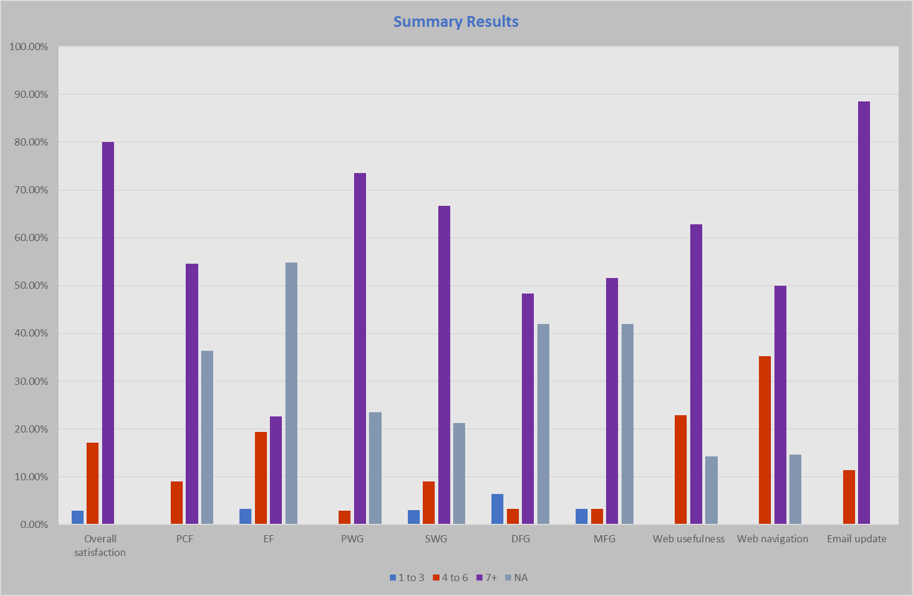

Slide 28
What is AEMO doing in response to this survey?
Updates to website:
  News section with current and previous email newsletters
  Simple access to all procedure consultations
  Easy to find information on systems workstream, including links to relevant procedures and technical documentation
More tailored one on one meetings with AEMO SMEs attending
Review of working group meetings to ensure optimal length, content and format
Review of mailing lists

Slide 29
Recap of technology update from Executive Forum
Graeme Windley

Slide 30
General questions
Chris Muffett

Slide 31
Further information
Global Settlement rule change:
  AEMC website: https://www.aemc.gov.au/rule-changes/global-settlement-and-market-reconciliation
AEMO 5MS Program contacts:
  Graeme Windley, 5MS Program Manager
  Chris Muffett, 5MS Business Lead
  Emily Brodie, 5MS Procedure Lead
  Hamish McNeish, 5MS Systems Lead
  Gary Eisner, 5MS Stakeholder Liaison
Contact details:
  5MS email: 5ms@aemo.com.au
  5MS webpage: http://www.aemo.com.au/Electricity/National-Electricity-Market-NEM/Five-Minute-Settlement

Slide 32
Forward meeting plan
Chris Muffett

Slide 33
Upcoming meetings
Program Consultative Forums:
  PCF #7: Friday 8 February 2019
Next Executive Forum:
  Tuesday 12 February 2019
Next Procedure Working Group:
  Thursday 13 December
Next Systems Working Group:
  Monday 17 December
Meetings and forum dates: http://www.aemo.com.au/Electricity/National-Electricity-Market-NEM/Five-Minute-Settlement

