Slide 1
Five-Minute Settlement Program:
Program Consultative Forum 1
AEMO 5MS Program Team
Friday 13 July 2018
AEMO Offices:
Level 9, 99 Gawler Place, Adelaide
Level 10, 10 Eagle Street, Brisbane
Level 22, 530 Collins Street, Melbourne
LEVEL 2, 20 BOND STREET, SYDNEY
DIAL IN: 1800 055 132 MEETING ID: 72174454

Slide 2
Agenda
NO | Time | AGENDA ITEM | Responsible
Preliminary Matters
1 | 10:00am – 10:10am | Welcome, introduction and apologies | Chris Muffett (AEMO)
2 | 10:10am – 10:20am | PCF objectives and expectations | Chris Muffett (AEMO)
Matters for Noting
3 | 10:20am – 10:30am | Program background | Graeme Windley (AEMO)
4 | 10:30am – 10:50am | Program update | Graeme Windley (AEMO)
5 | 10:50am – 11:10am | Procedures workstream update | Emily Brodie (AEMO)
6 | 11:10am – 11:30am | Systems workstream update | Hamish McNeish (AEMO)
 | 11:30am – 11:40am | Break
Matters for Discussion
7 | 11:40am – 12:10pm | Procedure Working Group approach | Emily Brodie (AEMO)
8 | 12:10pm – 12:30pm | Risk and issue management | Graeme Windley (AEMO)
Other Business
9 | 12:30pm – 12:50pm | General questions | Chris Muffett (AEMO)
10 | 12:50pm – 1:00pm | Forward meeting plan | Chris Muffett (AEMO)

Slide 3
PCF objectives and expectations
Chris Muffett

Slide 4
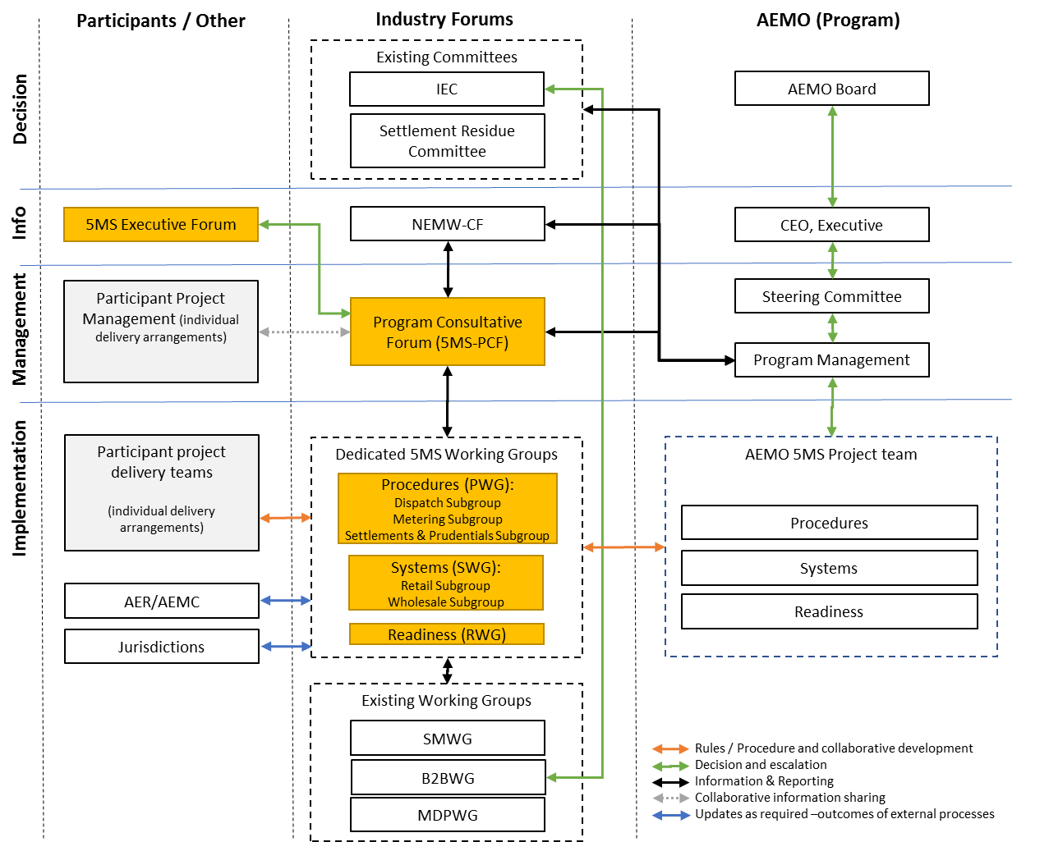
Program engagement structure

Slide 5
Program forums and groups
Group | Purpose | Timing
Program Consultative Forum (5MS-PCF) | The primary program coordination and communication between AEMO and industry program teams (meets monthly) | Monthly, starting July 2018
Executive Forum (5MS-EF) | Provide appropriate level of executive oversight and escalation of issues and concerns (meets quarterly) | Every 2 months, starting July 2018
Procedure Working Group (5MS-PWG) | To facilitate the consultation on procedures, with focus groups for dispatch, metering, and settlements | Monthly, starting July 2018 (focus groups as required)
Systems Working Group (5MS-SWG) | To facilitate design and implementation of systems and interfaces, with focus groups covering retail and wholesale interfaces | Monthly, starting August 2018 (focus groups as required)
Readiness Working Group (5MS-RWG) | Formed in the lead-up to industry readiness testing, to support the planning and execution of readiness activities | Monthly, starting mid-2019

Slide 6
PCF objectives
The Program Consultative Forum (PCF) is intended to support the planning and mobilisation of activities required to implement 5MS across AEMO and industry participants
It is expected to involve:
  Contribute to AEMO’s program planning
  Resolution of issues escalated from working groups
  Discussion on program and industry-wide risks and issues
  Participant resource allocation to working groups and focus groups
  Program status reporting
  Quality assurance of documentation
Terms of reference is available at: http://www.aemo.com.au/-/media/Files/Electricity/NEM/5MS/Program-Management/PCF/2018/Terms-of-Reference---Program-Consultative-Forum.docx

Slide 7
PCF expectations
Expected that the PCF will meet monthly:
  Proposing to be a 3-hour meeting
  Held by video conference in Brisbane, Sydney, Melbourne and Adelaide
  Tele-conference dial-in, however preference for attendance in person
PCF members are expected to represent their businesses in terms of:
  Accountability for planning and status of participant programs
  Mobilisation of resources
  Identification and reporting of issues and risks
However, the PCF is not a decision-making group
  No requirement to vote
  Contentious matters will be escalated within AEMO’s program and to the Executive Forum

Slide 8
Program background
Graeme Windley

Slide 9
5MS Summary
AEMC Decision
On 28 November 2017, the AEMC made a final rule change altering the settlement period to five-minutes (align with dispatch period). The industry go live is 1 July 2021. Purpose of rule change:
To remove the anomaly that exists between the five-minute dispatch and 30-minute settlement, which has been identified as a contributing factor to disorderly bidding.
To provide a clearer price signal for investment in fast response technology, including batteries and demand response.
Key functional implications of 5MS include:
Metering
Central systems acceptance of five-minute metering data from the market.
Adjusting interval meters to deliver data at five-minute intervals.
Re-accreditation of all MDPs and MPs intent on providing five-minute metering services.
Controlled Load Profile (CLP) and Net System Load Profile (NSLP) change from 30-minute to five-minute.
Potential changes to the frequency of which Metering Data is delivered.

Slide 10
5MS Summary
Settlement Calculation
Profiling algorithms introduced to derive five-minute energy data.
Transactions will need to be calculated for each five-minute period.
The process of settlement estimation will also calculate energy transactions for every five-minute period.
Inter-regional and intra-regional residue will be calculated on a five-minute basis.
A number of non-energy transactions, such as market ancillary services (i.e. FACS) and compensation recovery, will be completed using five-minute energy volumes.
Dispatch & Market Information
Daily bidding intervals to increase from 48 to 288. AEMO will create new data structures to receive, use and store five-minute bids and offers.
30-minute pre-dispatch and PASA processes that use bid information will be provided with five-minute data.
Market participant systems will need to be updated to submit and receive confirmations of five-minute bid and offer data.
AEMO will publish five-minute data.

Slide 11
Program Overview
Procedures – Market Go Live 1 December 2019
Detailed market design – detailing the operation of core market processes, roles and responsibilities, timelines and information flows.
Procedure development and engagement based on the rule change.
Procedure consultation with relevant industry participants, staggered approach.
Supporting documentation used internally by AEMO.
B2B procedures – support for B2B teams in case of change.
IT Delivery
Requirement drafting for 5MS & GS, application, interfaces & infrastructure.
Technical infrastructure build.
System development and delivery.
Internal AEMO Testing.
Performance Testing.
Pre-Prod and Prod system deployments.
Operational Support.

Slide 12
Program Overview
Readiness
Registration and Accreditation, including Meter Data Providers & Meter Providers
Market participant readiness monitoring
Industry Testing / Market Trial
AEMO Operating procedure review
Operational plan, including KPIs, SLAs, compliance register and risk register
Program communication
Industry cutover activities
Industry Groups and Forums
Numerous consultative groups to be set up
Detail to come in Stakeholder session

Slide 13
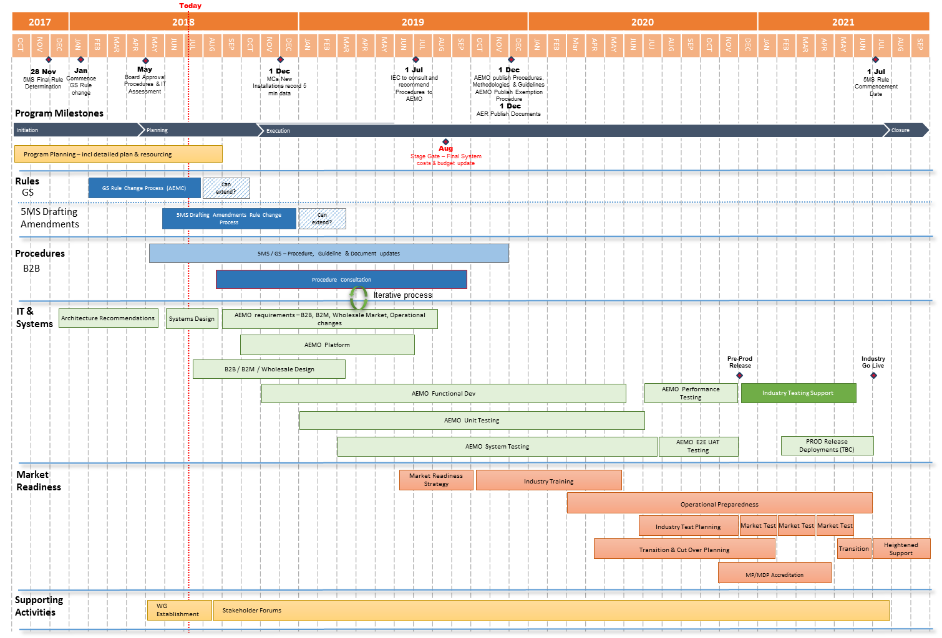
Program Overview

Slide 14
Program update
Graeme Windley

Slide 15
Program Status
Procedures stage on track, high-level impact assessments in progress. Delivery to complete by 1 December 2019.
Systems design & planning to Q3/Q4 2018:
  Impact of increase in data volumes
  Integration of industry initiatives:
    Global Settlement rule change; Distributed Energy Register; 3rd Party Access to data.
  Streamlining of internal processes
Stakeholder Engagement:
  Initial Procedures Working Group – 27 July 2018

Slide 16
Procedures workstream update
Emily Brodie

Slide 17
Procedures
NER requirement for AEMO to update procedures by 1 Dec 2019
Approximately 70 procedures and guides have been identified as directly impacted by 5MS, across the following areas:
  Metering
  Settlements (including prudentials)
  Dispatch
  Operations
Work packages will progressively be considered by the Procedure Working Group (PWG):
  AEMO will provide an impact assessment for each procedure, and the proposed approach and options for review and discussion
  Procedure changes will then be subject to formal consultation
Metering | Settlements | Dispatch | Operations
Metering data Metrology, MSATS procedures & service levels Miscellaneous | SRA Estimation Reallocations Prudentials Miscellaneous | Bids/Offers Spot market Pricing Specifications Miscellaneous | No packages – progressive release

Slide 18
Indicative prioritisation
 | PWG DATE | PACKAGE
2018 | 27 Jul 18 | Dispatch - Bids and offers Metering - Metering data Settlements - overview of SRA changes
 | 20 Aug 18 | Settlements - Estimation Dispatch - Pricing
 | 13 Sep 18 | Prudentials
 | 11 Oct 18 | Settlements - Miscellaneous Dispatch - Spot market
 | 16 Nov 18 | Metering – MSATS and SLPs
 | 13 Dec 18 | TBA
2019 | Feb 19 | Dispatch - Specifications Dispatch – Miscellaneous Metering - Miscellaneous
 | Mar 19 | Reallocations
 | Apr 19 | Operations – Miscellaneous Settlements – TNSP

Slide 19
Settlement residue auction package
Background
Settlements Residue Auctions (SRAs) give eligible Registered Participants access to inter-regional settlements residue (IRSR) by enabling them to bid for entitlements to a proportion of the total IRSR.
2021Q3 units will be the first to be affected by the change to 5MS. The auction for the first tranche of 2021Q3 units opens on 3 Sept 2018 and closes on 17 Sept 2018.
The Settlement Residue Committee (SRC) is providing comments on proposed changes to Guide to the SRA which remind participants of the impact of 5MS. The SRC is also considering other SRA issues associated with 5MS. The final version of the guide will be presented at the next SRC meeting (Fri 3 Aug), and published by Fri 10 Aug and the SRC will continue to consider associated issues.
Please contact your SRC industry representative for more information on the issues being considered or to provide feedback: http://aemo.com.au/Electricity/National-Electricity-Market-NEM/Settlements-and-payments/Settlements/Settlements-Residue-Auction/Settlement-Residue-Committee

Slide 20
Systems workstream update
Hamish McNeish

Slide 21
IT Workstream – Activities
Current SWG related tasks:
Working with Procedures stream to determine AEMO position on bidding and metering processes
Determining the proposed architecture for the bidding and metering interfaces
Request for SWG registration later this month
First SWG 24th Aug:
Review of SWG Terms of Reference (ToR)
Proposed forward schedule of SWG’s
Discussion on timeline for provision of information and releases
Provide AEMO’s current thinking on:
  meter data interfaces
  Bid and offer interfaces
Discuss approach of forming focus groups for detailed discussion on:
  Meter data interface changes
  Bid and Offer interface changes

Slide 22
IT Workstream Timeline – Indicative
Timeframe | Activity
1-Apr to 30-Sep | Feasibility Study
Aug-18 to Feb-21 | Monthly SWG’s and SWG Focus Groups as required
Oct-18 to Nov-20 | AEMO Development and Testing
2019 Q1 – Q4 | Technical Specifications (draft to final)
2020 Q3/Q4 | Industry Test Systems and AEMO software/guides available
2020 Q3/Q4 | Preproduction Release – Stage 1 - Early 5MS capabilities
2020 Q4 | Preproduction Release – Stage 2 - Full 5MS functionality
2020 Q4 | Production Release – Stage 1 - Early 5MS capabilities (support transition)
2021 Q2 | Production Release - Stage 2 - Full 5MS functionality

Slide 23
System Interface Changes - Retail
Electricity Retail (MSATS/B2M/B2B)
The expected changes are:
  Support 5 minute metering data submission to AEMO
  Either a new or use existing MDFF (NEM12/NEM13) format for 5 minute submission
  Changes to MDM profiling for settlement to support 30-minute, five-minute and accumulation meter data
Interfaces Impacted
  1. B2M metering submission to AEMO
    LVI, FTP and MSATS Web Services
  2. B2B metering to support 5 minute MDFF (likely more business process impact)
    LVI, FTP and B2B Web Services
  3. MDM reconciliation reports
    FTP B2M reports

Slide 24
System Interface Changes - Wholesale
Electricity Wholesale (EMMS)
The expected changes are:
  Submission of 5 minute bids/offers
  Changes to accommodate 30 minutes processes (e.g. pre-dispatch, PASA)
  Spot price will be applied at 5 minute interval
  Settlement and Prudential processes
  Bidding and settlement reports
Interfaces Impacted
  1. Bid and offer submission and response
    Web Portal, Data Interchange
  2. Bid/Offer, Settlement reconciliation reports
    Data Interchange
  3. Prudential systems
    Web Portal, Data Interchange

Slide 25
Procedure Working Group approach
Emily Brodie

Slide 26
Procedures – scope of consultation
AEMO needs to update around 70 procedures as part of 5MS implementation
Around 20 of these must go through the ‘rules consultation procedure’ (2 rounds of formal consultation)
Intending that the remaining ~50 procedures be released for comment

Slide 27
Procedures – approach to consultation
To facilitate consultation on procedure changes, AEMO proposes to establish a Procedures Working Group (PWG) - a forum to engage with industry stakeholders during the procedure development process.
At each meeting, AEMO will provide the PWG with an impact assessment for each procedure, and the proposed approach and options for review and discussion.
The PWG will consider:
  the content of the impact assessments for completeness
  the consultation approach for the different packages of procedures, particularly across dispatch, metering, settlements and prudentials
  forming or utilising existing focus groups specific to these functional areas, due to the specialised nature of knowledge and expertise required
Focus groups will be held face-to-face and provide technical input into procedure development
Procedure changes will then be subject to formal consultation

Slide 28
Indicative example – metering data procedures
AEMO provides PWG with high level impact assessments for metering data package of procedures, approach to consultation and suggested focus group activities
PWG considers impact assessment content, consultation approach and suitability of the focus group
Focus group members nominated
First focus group meeting/s held in August, outcomes fed into procedure development process
Formal consultation using the rules consultation procedure begins in September, concluding in January 2019

Slide 29
Discussion
Suitability of proposed approach to consultation via PWG, focus groups and formal consultation processes
Alternatives to proposed approach
Draft terms of reference for the PWG, available at: http://aemo.com.au/Electricity/National-Electricity-Market-NEM/Five-Minute-Settlement
Nominations process for focus groups – via PWG

Slide 30
Risk and issue management
Graeme Windley

Slide 31
Approach to Risks & Issues
Log maintained by AEMO, inputs by market participants including (where relevant) ownership, reviewed at each PCF, shared with EF.
Risks and Issues topics for inclusion:
  Impacts to AEMO & Industry participant delivery.
  Escalations from PWG, SWG & RWG.
  R&I with the integrated AEMO & Industry delivery plan i.e. software drops, environment availability, industry testing progression.
  Go Live risk reduction.
Risks and Issues not included:
  Impact of 5MS (& GS) on market behaviour – benefits and costs.
  Changes to program timeframes provided by the AEMC.
  Technical documentation.

Slide 32
General questions
Chris Muffett

Slide 33
Further information
Global Settlement rule change:
  AEMC website: https://www.aemc.gov.au/rule-changes/global-settlement-and-market-reconciliation
AEMO 5MS Program contacts:
  Graeme Windley, 5MS Program Manager
  Chris Muffett, 5MS Business Lead
  Emily Brodie, 5MS Procedure Lead
  Hamish McNeish, 5MS Systems Lead
Contact details:
  5MS email: 5ms@aemo.com.au
  5MS webpage: http://www.aemo.com.au/Electricity/National-Electricity-Market-NEM/Five-Minute-Settlement

Slide 34
Forward meeting plan
Chris Muffett

Slide 35
Upcoming meetings
Program Consultative Forums:
  PCF #2: Wednesday 8 August
  PCF #3: Monday 3 September
  PCF #4: Thursday 4 October
  PCF #5: Thursday 8 November
  PCF #6: Tuesday 4 December
Next Executive Forum:
  Wednesday 18 July
Next Procedure Working Group:
  Friday 27 July
Next Systems Working Group:
  Friday 24 August
Meetings and forum dates: http://www.aemo.com.au/-/media/Files/Electricity/NEM/5MS/5MS-2018-Industry-Meeting-Schedule---External-Version.xlsx

