Slide 1
5MS Industry Testing Working Group #13
Wednesday, 23 February 2021 10:00 – 12:00AM (AEDT)
By Webex

Slide 2
Agenda
No. | Time (AEDT) | Agenda item | Presenter
Preliminary matters
1 | 10:00 – 10:10 | Welcome | Tui Grant
2 | 10:10 – 10:30 | Pre-Production Release Dates | Greg Minney
3 | 10:30 – 10:45 | Age of the data in each system | Tui Grant
4 | 10:45 – 11:00 | Settlements Industry Testing | Tui Grant
5 | 11:00 – 11:10 | Retail Invitation Testing | Tui Grant
Matters for discussion
6 | 11:10 – 11:20 | Market Trail Test Preparation | Tui Grant
7 | 11:20 – 11.30 | Training | Tui Grant
8 | 11:30 – 11.35 | Forward Meeting Plan | Tui Grant
9 | 11:35 | Meeting Close | Tui Grant

Slide 3
Revised Testing and Deployment Dates
Greg Minney

Slide 4
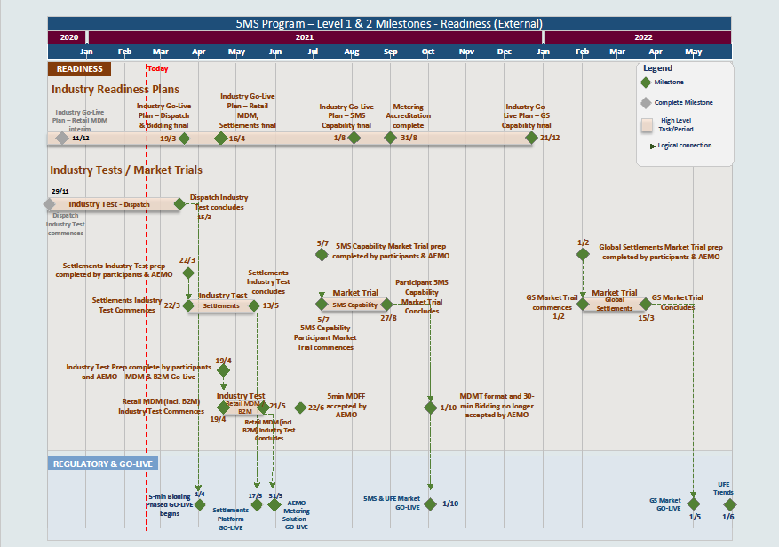
Rebaselined Industry Test and Deployment Dates

Slide 5
Pre Production Data
Tui Grant

Slide 6
Pre-Production Data
Dispatch and Bidding – The data associated with bids in Pre-production is up to date. If no new bid is received the last bid received is defaulted to the current date.
Settlements – The data in this environment was refreshed from Production late October 2020.
Retail – MSATS was refreshed from Production on the 7 December 2020.
Back to Agenda

Slide 7
Settlements Industry Testing
Tui Grant

Slide 8
Settlements- Industry Testing
The new settlement system will be available to industry in Pre-Production from the 22 March 2021.
This is an opportunity for participants to familiarise and verify the new invoice and reports are compatible with your systems before this goes into production on the 17 May.
There is no formal AEMO coordinated testing for this deployment beyond the publishing of select weeks as detailed below. Participants can choose if they wish to review the output or wait and simply receive it for the first time at go-live
If you do decide to test and encounter an issue you can email or contact AEMO Support Hub who will raise a service ticket. Any defects identified will be published on the weekly defect report sent out via the 5MS mailbox.
We will be using data from the Pre-Production instance of MSATS as input into settlements.
  NOTE: this is the current production version of MSTATS i.e. not 5MS
Participants will be able to use the RM reports from MSTATS for reconciliation purposes

Slide 9
Settlements - Industry Testing
3 settlement runs will be generated and made available on:
  23 March for Settlement week TBA
  26 March for Settlement week TBA
  30 March for Settlement week TBA
Post deployment of the new Retail solution 3 more settlement runs will be generated
  Will these be from newly generated data or will we use migrated data (prior settlement runs)?
The invoices will be thirty-minute invoices in line with what participants can expect at go-live of the new solution.
Five-minute testing will be conducted as part of Market Trials in July.

Slide 10
Retail Invitation Testing
Tui Grant

Slide 11
Retail Invitation Testing
The new retail solution will be available to industry in Pre-Production from the 19 April 2021.
This is an opportunity for all participants to familiarise and verify the changes to retail.
AEMO will be conducting coordinated testing (Invitation Testing) with a select number of participants before deployment into production. We will use the original participants who volunteered before the go-live date change.
If you do decide test and encounter an issue you can email or contact AEMO Support Hub who will raise a service ticket. Any defects identified will be published on the weekly defect report sent out via the 5MS mailbox.
We will generate data from the new retail solution in Pre-Production as input into 3 settlement runs.
Participants will be able to use the RM reports from MSTATS for reconciliation purposes

Slide 12
Retail Invitation Testing
Daily meetings will be conducted during the invitation industry testing period at 10:00am EST and will be open to all participants who wish to attend. The focus of these meetings will be on the progress of the formal test cases.
During this period a daily report will be sent with testing progress. This report will be sent to all parties registered with the ITWG but will only contain test outcomes for the coordinated testing effort.
A daily defect report will be sent during the test execution window to all parties.

Slide 13
Market Trail Preparation
Tui Grant

Slide 14
Market Trials – Industry Test Focus Group
Industry Test Focus Group will be a small group of ITWG participants representing various NEM roles.
Focus group will be responsible for defining the test coverage for the Industry Testing/Market Trials.
  Test scenario identification.
  Test case preparation.
  Data requirement definitions.
  Test execution timeframes.
  Consideration on defining the number of test cycles required.
Plans developed by the focus group will be circulated to the wider ITWG for input and consideration
Nominations will be called for parties interested in participating in the focus group by the 12 March.
Nominations / confirmations will also be called for those participants planning to participate in Market Trial execution as part of the planning process
In the lead up to Market Trials the pre-production systems will be refreshed form production. Date to be confirmed.

Slide 15
Training
Tui Grant

Slide 16
Training
MSATS Training
  Following on from the discussions at the last ITWG 2 training sessions will set up to provide participants who wish to attend an overview of MSATS.
    Session 1 - 22 March
    Session 2 - 5 April
Practitest Training for participants involved int the retail invitation testing will be conducted just prior to the start of testing.
    Session 1 - 5 April
    Session 2 - 7 April
Further training will be available in the lead up to Market Trials for Practitest.
Back to Agenda

Slide 17
Forward meeting plan
Tui Grant

Slide 18
Proposed upcoming ITWG meeting content
Date | Meeting | Proposed content
Tue 23 Mar 2021 | ITWG #14 | Update on Settlement Release Confirmation of Retail Test Participation Nomination for the ITFG to define test approach for Market Trials
Wed 27 Apr 2021 | ITWG #14 | Topics TBA
If you have any suggested agenda topics, please contact 5MS@aemo.com.au

