Slide 1
Special RWG/SWG and ITWG:
Participant Testing Environments
Thursday, 23 July 2020

Slide 2
Agenda
1 | 10:00 – 10:05 | Welcome | Greg Minney
2 | 10:05-10:10 | Purpose of this Session | Greg Minney
3 | 10:10-10:20 | Approach to Participant Testing | Greg Minney
4 | 10:20 – 12:00 | Functionality Deployment Matrix and Q&A | Tui Grant and All Participants

Slide 3
Purpose of the Session
Greg Minney

Slide 4
Objectives
To review the approach to participant testing of 5Ms and GS capability
Outline the new timeline for industry testing and market trial given the revised rule commencement dates
Walkthrough the Functionality Deployment Matrix
Provide an opportunity for participant questions regarding testing of capability in the various environments with a focus on immediate testing establishment
Outline the programs approach to the release of capability in the staging environment

Slide 5
Approach to Participant Testing

Slide 6
AEMO 5MS Testing Environments
5MS Staging Environment
  Provide software to enable early testing of functionality by participants
  Environment is not necessarily fully integrated
  Will be extended to support testing as part of deferred rule commencement dates
  MSATS data will be refreshed on 31 August 2020 with production data as at 30 July 2020
AEMO pre-production environment (pre-prod)
  Used for all market trials and formal industry testing
  Reflects production capability – and capability to be released during market trial and industry test period

Slide 7
Participant Testing Types
There are three types of participant testing:
Approach to participant testing was developed in consultation with industry and is captured in the Industry Test and Market Trial Strategy
Type | Definition | Environment | Example
Industry Testing | Self-testing of functionality such as connectivity, and/or coordinated multiparty testing of functional scenarios | Staging, pre-prod | Testing a change request (CR) or processing a reallocation
Market Trial | AEMO coordinated multi-party end-to-end testing of business process scenarios | Pre-prod | Meter exchange involving CRs, services orders and 5-minute meter reads
Invitation Industry Testing | AEMO coordinated testing of business process scenarios with a select number or subset of participants with systems ready for testing. | Pre-prod | Testing NMI transfer Process

Slide 8
Participant Testing Timeline
Greg Minney

Slide 9
5MS Program Timeline
Level 1 and External Level 2 Milestones 1/2
Current as at 09-07-2020

Slide 10
5MS Program Timeline
Level 1 and External Level 2 Milestones 2/2
Current as at 09-07-2020

Slide 11
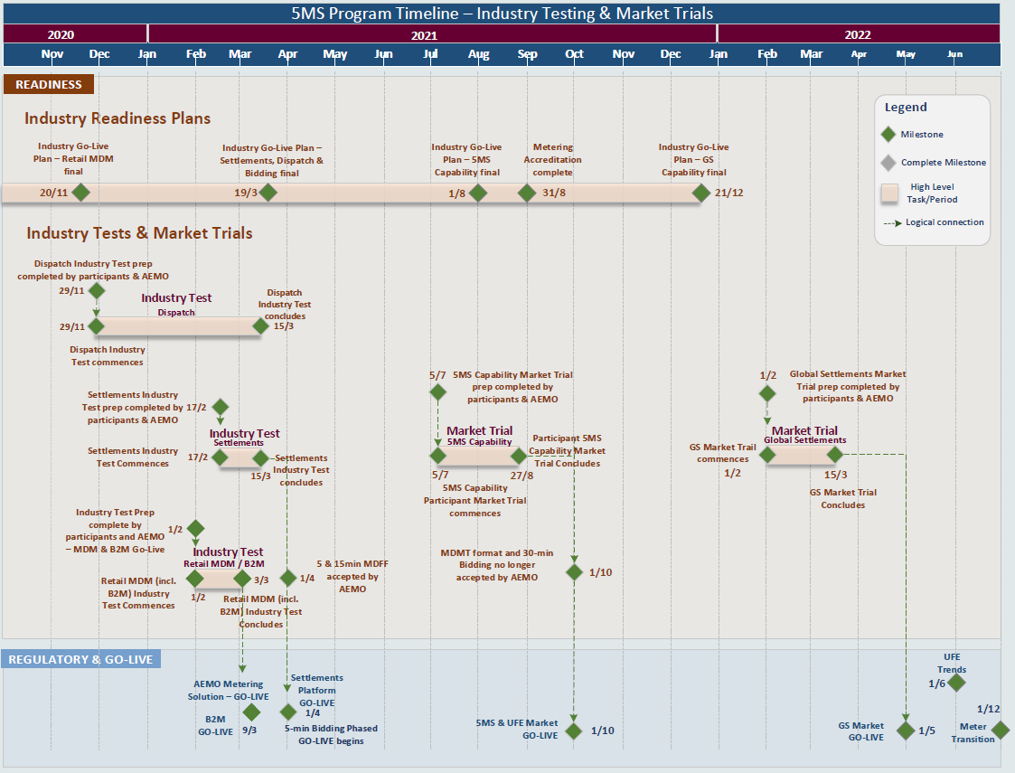
5MS Program Timeline
Level 1 and Level 2 Milestones relating to Readiness and Participant Testing

Slide 12
5MS and GS Industry Test and Market Trials
Industry Test and Market Trials strategy updates to reflect Industry Deferral
Testing to support platform go-lives as currently planned
Timings for Market Trials for 5MS and GS shift in alignment with new rule commencements
  Proposed 5MS market Trial 5/7/21 –> 27/08/21
  Proposed GS Market Trial 1/2/22 –> 15/03/22
GS Market Trial proposed dates avoid market trial over Christmas period
Separate market trials proposed for 5MS/ UFE reporting capability and GS to allow for industry population of required standing and tier 1 metering data

Slide 13
Functionality Deployment Matrix
Tui Grant

Slide 14
Key areas of discussion
The purpose of this section is for AEMO and participants to get a better understanding of:
  Approach to capability rollout in 5MS Staging Environment
  Level of B2B testing supported
  Timeframes for running of 5MS and GS
  Indication of what roles and participants will be using Staging and which applications within Staging

