Slide 1
5MS Industry Testing Working Group #7
Wednesday, 24 June 2020 10:00AM – 11:00AM (AEDT)
By Webex

Slide 2
Agenda
No. | Time (AEDT) | Agenda item | Presenter
Preliminary matters
1 | 10:00 – 10:10 | Welcome | Tui Grant
2 | 10:10 – 10:15 | Open Action Items | Tui Grant
3 | 10:15 – 10:45 | Proposed Industry Testing | Tui Grant
6 | 10:45 – 10:50 | Forward Meeting Plan | Tui Grant
7 | 10:50 – 11.00 | General Questions | Tui Grant

Slide 3
Open Actions
Item | Action required | Responsible | Action update | By
4.10.1 | AEMO to provide the updated dates for releasing IT test plans. | AEMO | Dates are updated in the Industry Test Strategy and it will be published by 19-Jun. | 15-May-2020
6.2.1 | AEMO to confirm if internal performance testing results will be shared. | AEMO | Investigated internally and confirmed that the internal performance testing details cannot be shared with Industry. | 15-Jun-2020
6.3.1 | AEMO to make arrangements to copy over the production data in staging for Prudentials. | AEMO | Done in Staging. | 8-Jun-2020
6.3.2 | AEMO to simulate the cut-over option for settlement invoices with 30-minutes followed by 5-minutes invoices. | AEMO | Done in Staging. | 8-Jun-2020
6.5.1 | Participants to get back with the expectations on Dispatch, Settlement and Retail system status in Pre-prod for Industry testing. | Participants | Low response to date from participants. | 19-Jun-2020
6.5.2 | AEMO to check with 5MS program to consider options to enable early bi-lateral testing for Retail release. | AEMO | Investigation underway to increase capacity of Staging environment to allow bi-lateral testing. | 19-Jun-2020
6.6.1 | AEMO to invite ITWG attendees to RWG. | AEMO | Done. | 15-Jun-2020
6.6.2 | AEMO to send the updated meeting pack with examples for the Industry testing related suggestions invited. | AEMO | This item is incorporated into the next ITWG pack. | 3-Jun-2020
6.6.3 | AEMO to provide a single-page view of the dates related to 5MS participant testing and go-live. | AEMO | Added in the ITWG #7 pack. | 15-Jun-2020

Slide 4
Proposed Industry Testing
Tui Grant

Slide 5
Approaches for testing
Assumes current timeframes:
  MDM release 9-Mar-21
  Dispatch and settlements releases 1 Apr 21
  5MS commencement 1 Jul 21
  GS commencement 6 Feb 22
Industry Testing and Market Trials Strategy: Updated in line with MDM deferral
Feedback sought on the recommended testing approach for platform deployments
Participants requested to nominate requirements for the proposed test approach to ensure industry testing can confidently be conducted
Next Steps:
Consolidate feedback when received
Confirm the preparation timeframes (based on feedback)
Confirm refresh dates for each release

Slide 6
Proposed market testing approach
Proposed go-live/ commencement | Current test approach | Proposed test approach | Proposed timeframe | Comments
Dispatch and Bidding 01-Apr-21 | Market trials: Both 5-min and 30-min functionality | Industry testing: 5-min functionality only | 29-Nov-20 to 1-Apr-21 (~18 weeks) | Participants will be able to access, test and develop against the new 5MS functionality.
Settlements 01-Apr-21 | Market trials: Both 5-min and 30-min functionality | Industry testing: 30-min only | 17-Feb-21 to 15 Mar-21 (~4 weeks) | AEMO will generate a full suite of invoices for 30 minute data Updated Prudential data will also be made available to allow participants to fully test their solutions.
MDM Platform 09-Mar-21 | Market trials: Both 5-min and 30-min functionality | Invitation industry Testing: 30-min only | 1-Feb-21 to 3 Mar-21 (~4 weeks) | Co-ordinated testing with MDP’s to validate MTRD and MDMT transactions. Available for all other participants to verify reports, API’s and schema testing.
5MS Commencement 01-Jul-21 | Market trials: 5-min capability across all streams | Market trials: 5-min capability across all streams | 6-Apr-21 to 31-May -21 (~8 weeks) | Co-ordinated testing of bidding, dispatch, settlements and metering with all participants who want to take part Consistent with current planned scope and timing of 5MS capability market trial
GS Commencement 06-Feb-22 | Market trials: GS with financial settlement | Market trials: GS with financial settlement | 1-Oct-21 to 15-Nov-21 (~6 weeks) | Co-ordinated testing of settlements and metering with all participants who want to take part Scope and timing as for the current approach

Slide 7
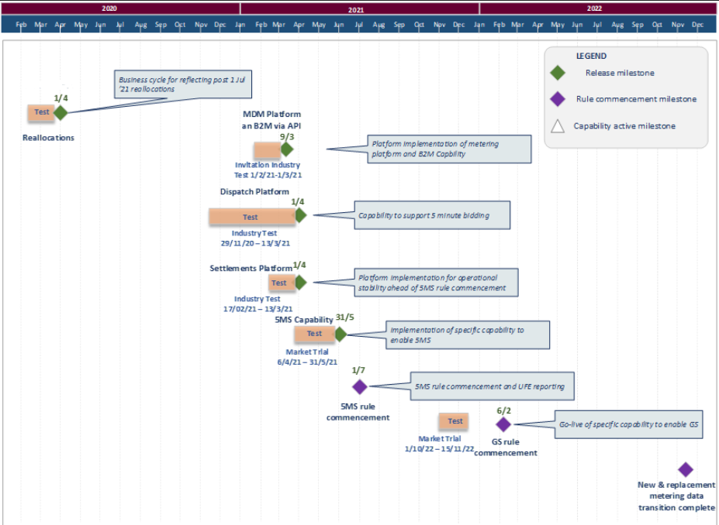
Industry Testing - Dates

Slide 8
Suggestions for Test Scope
Proposed go-live/ commencement of | Test approach | Dates
Dispatch and Bidding | Industry Testing: 5-min functionality only | From: 29-Nov-2020 To: 13-Mar-2021
Suggested Scope Transition state available for the period in the lead up to go-live.
Settlements | Industry Testing: 30-min only | From: 17-Feb-2021 To: 13-Mar-2021
Suggested Scope Integrated across reallocations, settlements and prudential Produce Invoices for 30 minute
MDM Platform | Invitation Industry Testing: | From: 01-Feb-2021 To: 09-Mar-2021
Suggested Scope Verification of B2B MDFF reads in 30, 15 and 5 minute format sent to participants. Verification of B2M MDFF reads in 30, 15 and 5 minute format sent to AEMO Verification of B2M MDMF reads sent to AEMO. Verification of interfacing protocols to support the submission of Inbox / inbound CATS, NMID and MDMT B2M messages and acknowledgments to AEMO by Participants. Verification of interfacing protocols for the delivery of Outbox / outbound CATS, NMID and MDMT B2M messages and acknowledgments to Participants by AEMO. The submission of CR1000, CR1030, CR3005, CR3091 and, CR3081 and CR5051. Verify the new schema and RM report features. Access MSATS browser via Market portal and also confirm MSATS Browser changes to allow Participants to: Manage their B2M Outbox protocol preference. Manage their B2M Outbound messages queued in their queue

Slide 9
Forward meeting plan
Tui Grant

Slide 10
Upcoming ITWG meetings: Proposed content
Seeking feedback for proposed content/topic areas
Meeting Date | Meeting | Proposed Content
Aligned with the proposed work group amalgamation |  | TBA

Slide 11
General questions
Tui Grant

