Slide 1
5MS & GS Executive Forum #11
Thursday 10 December 2020
PLEASE NOTE THIS MEETING WILL BE RECORDED FOR THE PURPOSE OF PREPARING MINUTES

Slide 2
AEMO
Competition
Law ​
Meeting
Protocol​
AEMO is committed to complying with all applicable laws, including the Competition and Consumer Act 2010 (CCA). In any dealings with AEMO regarding proposed reforms or other initiatives, all participants agree to adhere to the CCA at all times and to comply with this Protocol. Participants must arrange for their representatives to be briefed on competition law risks and obligations.​
Participants in AEMO discussions must: ​
Ensure that discussions are limited to the matters contemplated by the agenda for the discussion ​
Make independent and unilateral decisions about their commercial positions and approach in relation to the matters under discussion with AEMO​
Immediately and clearly raise an objection with AEMO or the Chair of the meeting if a matter is discussed that the participant is concerned may give rise to competition law risks or a breach of this Protocol​
Participants in AEMO meetings must not discuss or agree on the following topics:​
Which customers they will supply or market to​
The price or other terms at which Participants will supply​
Bids or tenders, including the nature of a bid that a Participant intends to make or whether the Participant will participate in the bid​
Which suppliers Participants will acquire from (or the price or other terms on which they acquire goods or services)​
Refusing to supply a person or company access to any products, services or inputs they require​
​
Under no circumstances must Participants share Competitively Sensitive Information. Competitively Sensitive Information means confidential information relating to a Participant which if disclosed to a competitor could affect its current or future commercial strategies, such as pricing information, customer terms and conditions, supply terms and conditions, sales, marketing or procurement strategies, product development, margins, costs, capacity or production planning.

Slide 3
Agenda
No. | Agenda Item | Presenter
1 | Welcome, Introductions and Apologies | Peter Geers
2 | Minutes and Actions | Peter Geers
3 | Program Update | Rowena Leung
4 | Readiness Reporting | Greg Minney
5 | Path to Market Commencement | Greg Minney
6 | AEMO IT Platform Go-Live | Greg Minney
7 | Regulatory Roadmap Update | Peter Carruthers
8 | Industry Risks and Issues | Peter Carruthers
9 | Industry Engagement | Anne-Marie McCague
10 | General Questions | Peter Geers
11 | Meeting Close | Peter Geers

Slide 4
Welcome
Peter Geers

Slide 5
Action Items
No actions recorded during Executive Forum on 30-Jul-20 and no open actions being carried forward from previous meetings.

Slide 6
Program Update
Rowena Leung

Slide 7
5MS & GS Program Timeline
Current as at 20-11-2020

Slide 8



Program update and current activities
AEMO program
Overall Program remains Green trending down. Delivery pressures remain particularly with the Retail workstream.
L2 Internal milestones have been re-baselined with no impact to external milestones.
Build is complete for all 5MS and GS functionality across all 3 releases, however development for non-critical items continue for the Retail release.
Full focus of the program will be on completing the Testing program for quality, function and performance.
AEMO internal readiness preparation activities for go-live continue.
Systems
Testing and deployment work continues across all streams - no change to any upcoming Staging deployment, Pre-Production or Production deliveries.
Dispatch Pre-Prod deployment on schedule, to complete by 30-Nov-2020.
Issues with performance testing of running >3 high-frequency RM reports now resolved. Some performance issues continue with some RM reports (in Databricks), the program continues to work through options.
UAT for Retail Day 1 due to complete early January, PCF to be informed via mail if significant issues are outstanding post-Christmas.
Readiness
Readiness Survey #5 issued 17th Nov, with surveys due 26th. Survey #4 trend indicates essential capability on Track
Metering Transition tasks reported on track, upcoming activity includes assessment of NCOUML profiles
Drafting of Industry Go-live plan for retail, with reissue of plan following confirmation of detailed timings in AEMO Dress Rehearsal

Slide 9




AEMO IT Platform Deployment Status
 | Go-Live date will be impacted
 | At risk
 | On schedule
Stream | Build | AEMO Testing | Pre-prod | Cutover | Commentary
Retail | Non-critical build items in progress | SIT completed for Day 1 Go Live UAT for metering data ingestion completed UAT for profiling & Reporting in progress, target completion early January 2021. Good Performance Testing results from initial re-writes, some poor performance from a few Databricks continues, considering options. | On track for industry testing commencing 01-Feb-21 Invitation test planning underway | Dress Rehearsal 1 learnings Planning Dress Rehearsal 2 | Pressure remains on Retail delivery Major issues encountered during perf testing amended, UAT & Performance testing is now continuing Still, no timeline contingency remains for Retail stream If contingency is needed AEMO will deprioritise non-critical items and introduce a secondary drop in advance of Market Trials. This will maintain 09-Mar-21 Go-Live and 01-Oct-21 5-min market start
Dispatch | Complete | SIT completed for Day 1 Go Live UAT in progress | On track for industry testing commencing 30-Nov-20 | Cutover Planning in progress | Tracking towards deployment dates AEMO to conduct performance testing in Pre-Prod over summer period
Settlements | Complete | SIT completed for Day 1 Go Live UAT in progress | On track for industry testing commencing 17-Feb-21 | Cutover Planning in progress | Tracking towards deployment dates AEMO to conduct performance testing & parallel run in Pre-Prod over summer period (not noticeable to industry, date of 17-Feb-21 remains for Pre-Prod deployment).

Slide 10
Readiness Reporting
Greg Minney

Slide 11
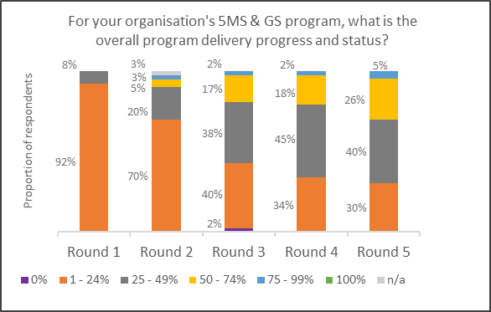
Readiness Report #5 – Summary Results
Analysis based on current survey responses.
Coverage of response remains strong against all roles
45 of 46 respondents overall reported programs on track
“late” response not critical to market share and same participant as previous survey
94% of participant roles intend to participant in Market Trial
3 at Risk/Late in preparation, 5 respondents marked as not relevant
No further adverse impact to programs due to Covid-19 responses noted, but remains on participant watch list
No new systemic risk escalations reported this round of reporting

Slide 12
Essential Criteria – Leading Indicators
Reporting against leading indicators of Essential Criteria for Rule commencement
MC/ MP response coverage for essential meters, with improved response from previous surveys
  MP/ MC “no response” to be escalated with participant management
Late Generation respondent has identified remediation plan for 1st Quarter 21
Generator “no response” do not impact load coverage criteria, response to future surveys will be sought
AEMO criteria – on track for rule commencement criteria
No further escalation currently required
Monitoring of progress will remain key aspect of readiness preparation, with increased focus on activity completion

Slide 13
Path to Market Commencement
Greg Minney

Slide 14




Path to Rule Commencement – 5MS & GS
GO
AEMO System Go-live
M
Market commencement
Readiness review (AEMO + industry)
Industry readiness – key outcome/activity
Industry test = system live for participants to access in AEMO Pre-Prod; support arrangements in place.
Jan – Mar
2021
Apr – Jun
2021
Jul – Sep
2021
Oct – Dec
2021
2022 - 23
Retail
01-Feb
09-Mar
01-Apr: AEMO starts accepting 5-min files
31-Aug: Metering accreditation complete
Industry test
GO
01-Oct: MDMT format & 30 min bidding no longer accepted by AEMO
30-Nov-2020
01-Apr
Industry test
GO
Dispatch & Bidding
17-Feb
17-Apr
Settlements
Industry test
GO
5MS Market - all participants (AEMO & industry)
Prep 5MS Market trials
01-July: 5MS market trial start
M
01-Oct: 5MS Market Start:
NEM begins operating on a five minute basis
1-Aug: Industry Go-live plan, 5MS Capability
Essential metering and meter data capability for 5MS (MP/MDP/MC)
5MS metering rollout
Bidding transition (generators) for 5MS
Retailer upgrades to 5MS & GS
Bi-lateral participant testing for 5MS & GS
Participant transition to settlement for 5MS & GS (Retailers, Generators, Market Customers)
Standing data, GS Metering, NCONUMAL (DNSP) – for GS
T1 Basic Metering Data – for GS
M
01-Oct: GS “soft start”: AEMO begins publishing UFE
Global Settlement
Prep GS market trials
01-Feb: GS market trial starts
01-May: Start of GS financial settlement
M
01-June:
AEMO publish UFE trends.
01-Mar-2023:
AEMO publish UFE reporting guidelines

Slide 15
AEMO IT Platform Go-Live
Greg Minney

Slide 16
Retail Go-Live
Implementation of retail platform scheduled for weekend of 6th and 7th of March
Platform cutover will undergo 3 Dress Rehearsals including for migration into pre-prod at the commencement of industry test period to confirm data migration and cutover activities
Pre-deployment system assurance forms a component of platform go-live criteria
Deployment approach designed to minimise impacts on participant business operations and 5MS implementation programs:
  Minimise market system down time through pre-migration of data and production environment preparation
    Holding of B2M and B2B transactions
    Restricted access to NMI discovery during Cutover
  Market Transactions held only for period of cut-over, no cancel of in-flight transactions required
  Participant interfaces and interactions with new MDM as for current systems
    New capability available but not required at go-live, participants can continue on like-for-like basis
    Minor exception for processing of VicTuos files
  Development of Industry Go-live plan in progress to confirm timings, impacts and communication approaches

Slide 17
Settlements and Bidding Platform Go-lives
Settlements platform go-live scheduled for the 19-Apr-21
5MS Bidding platform scheduled for go-live 01-Apr-21
Both deployments planned to minimise impact on participants business operations and 5MS implementation programs
  Settlement platform will support 30-minute settlement with no forced update to interfaces or reporting formats
  Bidding platform introduced as new service, allowing participants to continue with current platforms, until ready to upgrade to 5-minute solutions
    Participants may continue to submit 30-min bids or may submit 5-min bids during the bidding transition period (01-Apr-21 -> 01-Oct-21)
    5-min bids submitted during the bidding transition period must be submitted as six identical 5-min bids within a 30-min period. Effectively emulating a 30-min bid.
Industry go-live plans to be consulted with participants commencing in January 2021
Further update will be provided at the Executive Forum in March 2021

Slide 18
Regulatory Roadmap Update
Peter Carruthers

Slide 19
Regulatory Roadmap Update
Purpose of the Regulatory Implementation Roadmap
  Timeline for implementation of major regulatory/industry change
  Supports planning for AEMO, industry and regulators
  Updated periodically and reviewed for opportunities to enhance implementation efficiency
Most recent update in August 2020 (Version 3)
  Confirmed dates for Customer Switching, WDR, 5MS/GS deferral
Next update early 2021
  Review any confirmed and emerging changes eg. Stand-Alone Power Systems, Competition in Metering Review, Customer Data Rights
  With 2021 fully booked, roadmap will look ahead to 2022
Key Industry Challenge is managing scheduled 2021 changes ie Customer switching and WDR

Slide 20
Customer Switching – go-live 01-Oct-21
The Customer Switching functionality will be available for participants to undertake extended testing in Pre-Production from early July through to end of September – allowing for the variability in participant readiness.
Customer Switching Technical Specification session – 16th November: Complete
    This session was used to inform industry business and IT representatives of key parts of the Technical Specification, the testing approach and provide the opportunity for questions and answers.
    The session was successfully completed.
    The team will monitor a need for additional meetings as required. There are no further meetings scheduled at this stage.
Because Customer Switching changes will be in the Staging and Pre-Production environments in the same timelines as the 5MS project.
    Representatives from the Customer Switching project will join the 5MS forums when it is made effective in Staging (Jan 2021) so that there is a single entry point for participants to raise any questions or issues.
    Similarly, when Pre-Production is planned and enabled (May 2021), this will be done with Customer Switching in the 5MS sessions for the same purpose.
  Note: Customer Switching is following BAU Change Process at AEMO.

Slide 21
Wholesale Demand Response – go-live 24-Oct-21
WDR implementation approach (set in WDR Rule) designed to minimise system impacts to AEMO and participants
WDR release approach designed to dovetail with 5MS, GS and CS
WDR optional for most participants:
  DRSPs need to develop dispatch and settlement capability, and manage meter data
  Retailers can choose whether to make customised changes in their wholesale systems e.g. automated reconciliation processes​
  Changes may be required in B2B systems to accommodate the new DRSP role depending on participants’ systems configurability
  AEMO must have WDR systems capability ready for WDR commencement
AEMO’s WDR delivery​:
  Currently working through procedure changes and system requirements in consultation with industry
  Program is on track with no major delivery blockers
  WDR is planned to be available in pre-prod in September 2021

Slide 22
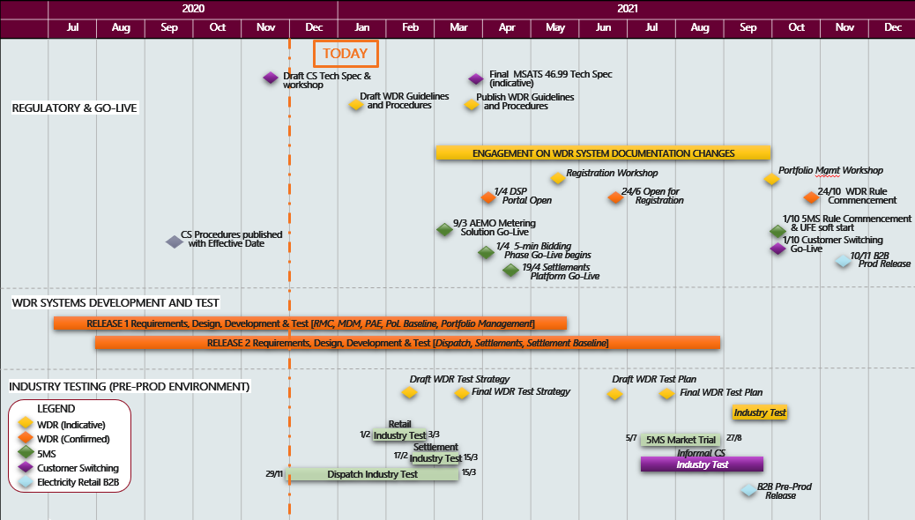
WDR & CS indicative timeline
*Current as of 01 Dec 2020*

Slide 23
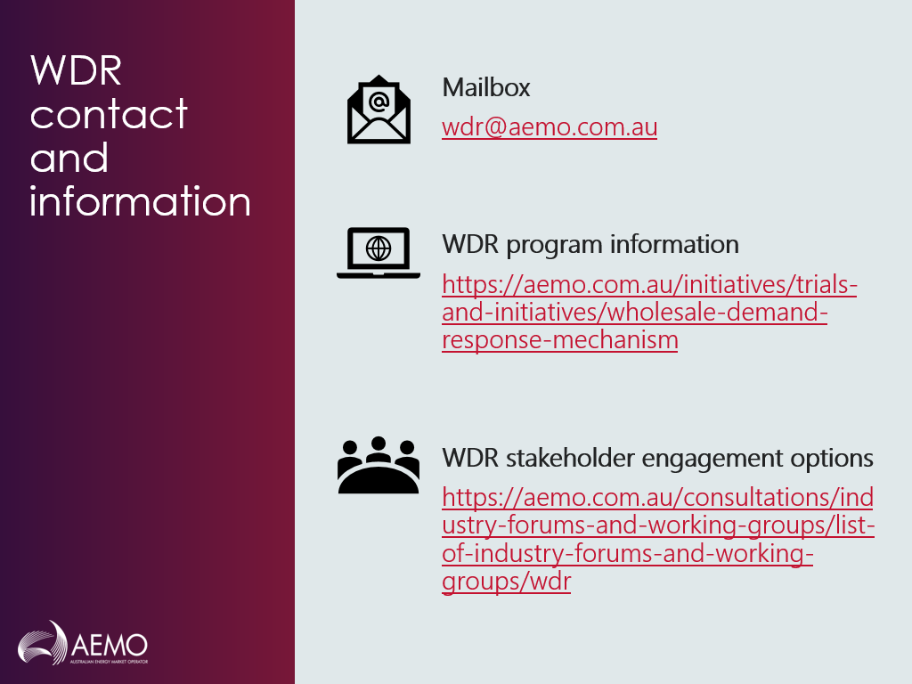
WDR Engagement
Broad engagement approach:
  Monthly WDR consultative group
  Ad hoc technical working group
  Workshops for DNSPs and retailers
  Q&A sessions
  Procedure consultations
  One-to-one meetings

Slide 24
Industry Risks and Issues
Peter Carruthers

Slide 25
Overview
The PCF has identified the following three overarching risks for discussion:
  No remaining contingency for Retail Solution deployment
  Volume of regulatory change
  Participant and AEMO readiness
The following slides present these topics and the associated risks from the Industry Risks and Issues Register.
There are no issues to be presented to the Executive Forum for this session

Slide 26
No Remaining Contingency for Retail Solution Deployment
​ | Improving​ ​ No Change /Stable​ ​ Worsened ​
Risk ID | Description | Inherent Risk Rating |  | Residual Risk Rating
NEW | No Remaining Contingency for Retail Deployment There is a risk that an issue may be identified through the remaining scheduled testing of the Retail IT Solution which could result in a delay to the release as there is no remaining contingency for AEMO’s release on 09-Mar-21 which could impact participant transition programs. | Inherent Likelihood | Possible | Residual Likelihood | Possible
 |  | Inherent Consequence | Major | Residual Consequence | Minor
 |  | Inherent Rating | Significant | Residual Rating | Medium
AEMO has identified two levels of mitigation actions:
Level 1:
AEMO has identified elements of the Retail IT Solution that are not required until market go live on 01-Oct-21. If this cannot be deployed or tested before the 09-Mar-21 go live it will be deployed into Pre-Production prior to the 5MS market trial scheduled for 05-Jul-21 and in Production prior to 01-Oct-21.
Level 2:
If Level 1 does not alleviate the time pressures, AEMO will move the go-live date from 09-Mar-21 that will minimise industry preparation activities for 5MS rule commencement, therefore before 01-Apr-21.
AEMO to impact readiness for 5MS rule commencement is minor as sufficient time remains for internal readiness activities post system go-live

Slide 27
No Remaining Contingency for Retail Solution Deployment
​ | Improving​ ​ No Change /Stable​ ​ Worsened ​
Risk ID | Description | Inherent Risk Rating |  | Residual Risk Rating
NEW | No Remaining Contingency for Retail Deployment There is a risk that an issue may be identified through the remaining scheduled testing of the Retail IT Solution which could result in a delay to the release as there is no remaining contingency for AEMO’s release on 09-Mar-21 which could impact participant transition programs. | Inherent Likelihood | Possible | Residual Likelihood | Possible
 |  | Inherent Consequence | Major | Residual Consequence | Minor
 |  | Inherent Rating | Significant | Residual Rating | Medium
AEMO has identified two levels of mitigation actions:
Level 1:
AEMO has identified elements of the Retail IT Solution that are not required until market go live on 01-Oct-21. If this cannot be deployed or tested before the 09-Mar-21 go live it will be deployed into Pre-Production prior to the 5MS market trial scheduled for 05-Jul-21 and in Production prior to 01-Oct-21.
Level 2:
If Level 1 does not alleviate the time pressures, AEMO will move the go-live date from 09-Mar-21 that will minimise industry preparation activities for 5MS rule commencement, therefore before 01-Apr-21.
AEMO to impact readiness for 5MS rule commencement is minor as sufficient time remains for internal readiness activities post system go-live

Slide 28
Volume of Regulatory Change
​ | Improving​ ​ No Change /Stable​ ​ Worsened ​
AEMO has continued to work with industry to understand the impacts of other market changes on participants’ 5MS Programs
AEMO understands that while this risk is still present it is more understood as a result of the Regulatory Change Roadmap, the joint 5MS, WDR and Customer Switching program timelines and the establishment of the WDR stakeholder engagement framework.
AEMO considers that the appropriate mitigation measures are in place and that this risk and its associated risks should continue to be monitored.
Risk ID | Description | Residual Rating | Comments
R06 | Interaction with other industry changes that have already been adopted through rule changes | Significant | This risk focuses on the demand on industry resources as a result of change programs such as WDR and Customer Switching. This risk is still present in working group discussions and further work is progressing on finalising details of the joint timeline. AEMO will be revising the regulatory roadmap in Jan-21.
R09 | Impact to 5MS from other rule changes that are being considered | Significant | Currently there are no further rule changes being considered that would impact 5MS. Given there are 10 mths until 5MS rule commencement, the likelihood of this risk has been reduced from “likely” to “possible” with an improving trend. This results in a residual risk rating of “Significant”
R30 | Risk that new 5MS and GS Go-Live dates could impact other industry change programs | Significant | Similar risk to R06 with the inclusion of risk to system stability. AEMO will continue to review this risk internally to identify the risks involved within the interactions between 5MS, WDR and Customer Switching.

Slide 29
Participant and AEMO Readiness
​ | Improving​ ​ No Change /Stable​ ​ Worsened ​
Overall, the risk that participants or AEMO would not be ready for 5MS Rule commencement is considered Medium. This risk is managed through Readiness Reporting. Essential capability indicators are reflecting on track delivery, all major participant groups have majority of programs on schedule, 95% of survey respondents indicate intention to participate in Market Trials.
Participants are not indicating any further impact on program readiness as a result of Covid-19 responses, although remains on risk list for a number of participants
AEMO is proposing that the risks as set in the register represent the current state and that these risks should be continued to be monitored through the existing mechanisms.
Risk ID | Description | Residual Rating
R11 | The AEMO business and operations are not ready for 5MS Rule Commencement on 1 Oct 21 | Medium | As reported through AEMO’s Readiness Report, AEMO is on track for the 5MS rule commencement on 01-Oct-21. It is noted that there is a risk for the Retail go-live solution, however this has minor impact on AEMO’s readiness for rule commencement.
R16 | Potential impacts from MSP accreditation resource and timing constraints | Medium | Managed through Metering Transition Plan.
R19 | Risk of a critical capability of participants not being ready at identified critical path milestones | Medium | Track and managed through Industry Readiness Reporting.
R26 | Impact of Covid-19 resulting in participants and / or AEMO being unable to meet 5MS Program timelines | Medium | The impact of this risk is different for all participants (e.g. those with offshore resources may be more, or less, impacted). However, responses to Readiness Reporting has shown that this risk has not changed.

Slide 30
Industry Engagement
Anne-Marie McCague

Slide 31
Indicative Executive Forum Plan for 2021
Month | Topics
25 March | Rule commencement decision making process Retail go-live debrief Settlements and Dispatch Go-Live update Readiness Reporting # 6
07 July TBC | Readiness Reporting #7 Market Trial Update against Rule Commencement criteria
02 September | Rule Commencement review Market Trial Results Summary Preparing for 1 Oct - Industry Go-Live Plan

Slide 32
Upcoming meetings
https://aemo.com.au/initiatives/major-programs/nem-five-minute-settlement-program-and-global-settlement
Current as at 03/12/2020

Slide 33
General Questions
Peter Geers

