Slide 1
Five-Minute Settlement Program: Executive Forum 3
AEMO 5MS Program Team
Tuesday 13 November 2018
AEMO Offices:
Level 9, 99 Gawler Place, Adelaide
Level 10, 10 Eagle Street, Brisbane
Level 22, 530 Collins Street, Melbourne
LEVEL 2, 20 BOND STREET, SYDNEY
DIAL IN: 02 9087 3604 ACCESS CODE: 575 501 049

Slide 2
Agenda
NO | Time | AGENDA ITEM | Responsible
Preliminary Matters
1 | 10:00am – 10:05am | Welcome, introduction and apologies | Peter Geers (AEMO)
2 | 10:05am – 10:10am | Minutes and actions from previous meeting | Peter Geers (AEMO)
Matters for Noting
3 | 10:10am – 10:20am | Program update | Graeme Windley (AEMO)
4 | 10:20am – 10:30am | Industry risks & issues | Graeme Windley (AEMO)
Matters for Discussion
5 | 10:30am – 11:00am | Technology approach | Joe Locandro (AEMO)
Other Business
6 | 11:00am – 11:10am | General questions | Peter Geers (AEMO)
7 | 11:10am – 11:20pm | Forward meeting plan | Peter Geers (AEMO)

Slide 3
Minutes and actions from previous meeting
Peter Geers

Slide 4
Previous meetings
Executive Forum met on Wednesday 18 July 2018
No actions identified during the meeting
Meeting scheduled for 10 September was not held, but meeting pack was distributed
Meeting pack and notes from meetings are published at: http://www.aemo.com.au/Electricity/National-Electricity-Market-NEM/Five-Minute-Settlement/Program-Management/Executive-Forum

Slide 5
Program update
Graeme Windley

Slide 6
High-level status
Procedures work is progressing well, with nearly all activities on track:
Working groups and focus groups have been constructive
Systems work continues to ramp up:
Architecture, Requirements and Design work underway
Development work to commence in Q4 2018
Rule changes:
Global settlement rule determination due in December 2018.
DER rule has been made – potential impact to 5MS solution design; however go live of 1 December 2019 may have a resourcing impact for participants
Stakeholder engagement is proceeding:
Next EF meeting scheduled for 13 November – AEMO CTO Joe Locandro to attend to discuss AEMO IT vision
1-on-1 discussions have been held and will continue on a rolling basis

Slide 7
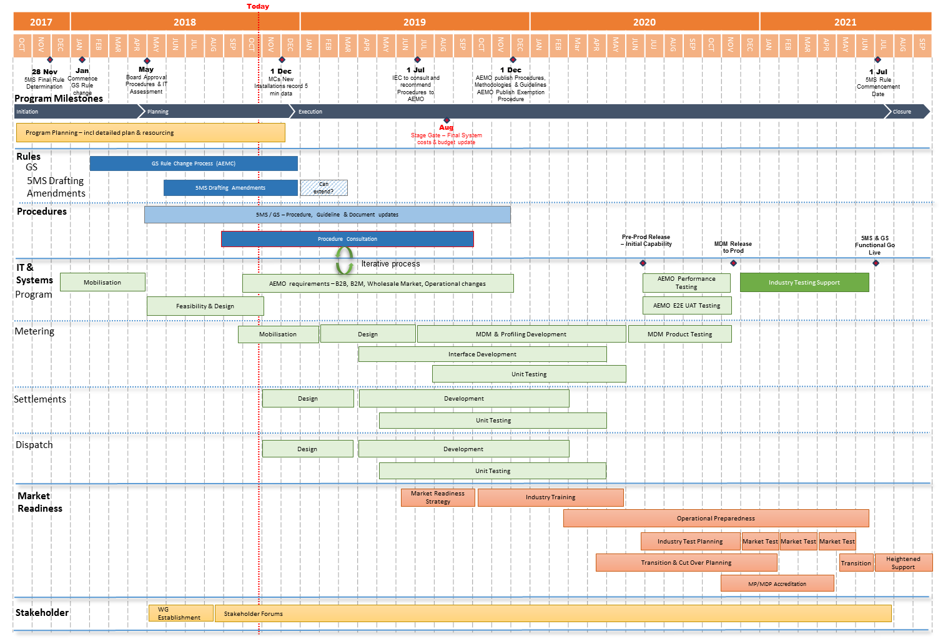
Program Conceptual Timeline

Slide 8
Industry risks & issues
Graeme Windley

Slide 9
Summary
Latest risk/issue register included with meeting pack
Risk/issue register is published on 5MS PCF page: http://www.aemo.com.au/Electricity/National-Electricity-Market-NEM/Five-Minute-Settlement/Program-Management/Program-Consultative-Forum
AEMO welcomes any feedback from the PCF on the risks & issues

Slide 10
Risk/issue updates
R10 – Vendor contract negotiation timelines was updated to include mention of the vendor briefing session as well as noting that AEMO would keep a list of vendors, supplied by participants
R06 – Mel Green no longer Risk Champion as role has changed – welcome any volunteers as new Risk Champion

Slide 11
Technology approach
Joe Locandro

Slide 12
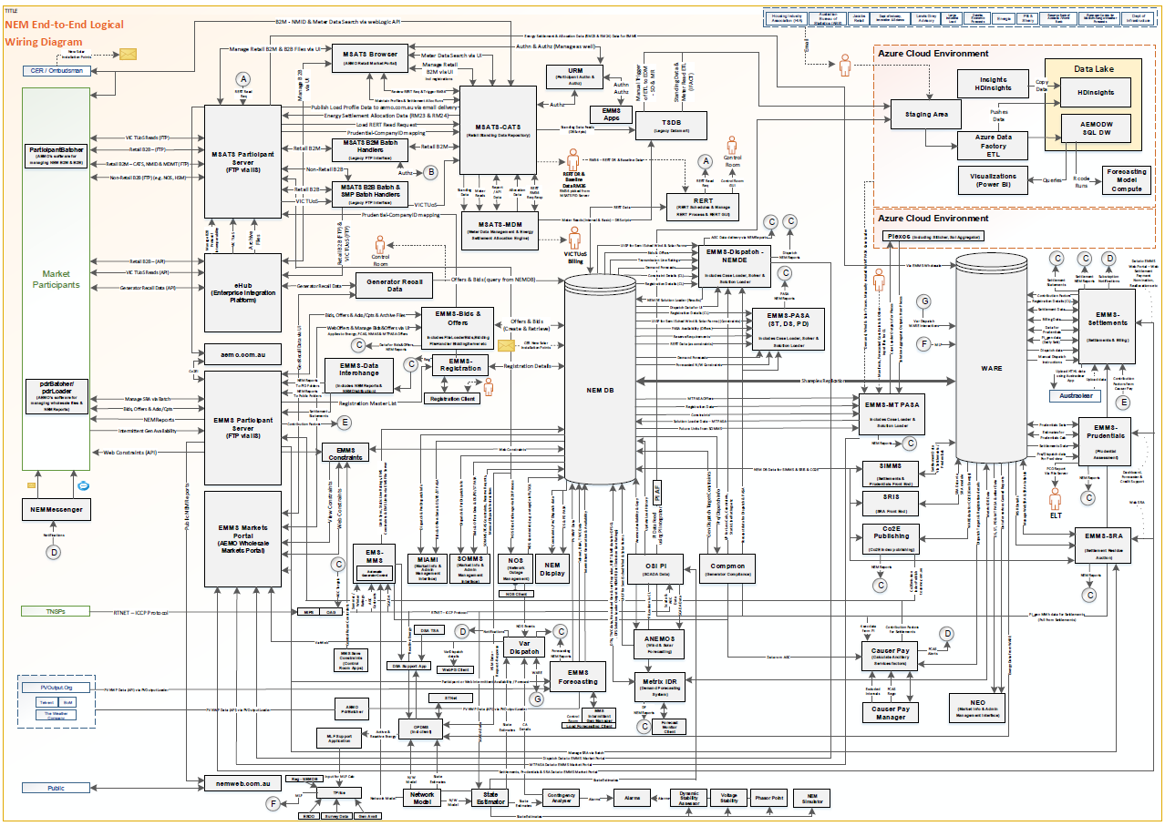
History of tactical delivery has led to significant technical complexity and cost
An example is the current application landscape for NEM, developed with a strategy focused on compliance and cost reduction
This is just one of many: Other markets have similar application landscapes and associated issues
DWGM
STTM
WEM
NEM
Complexity means every change needs more time to plan, build and test
Knowledge is in the heads of a few key personnel
Unstable foundations leads to more effort fixing the old than building new
Not designed for small scale distributed energy
Legacy technologies will lead to performance issues in the future
Has not leveraged modern concepts such as security by design
Will not support pace of change required
Fragmentation and duplication leads to high cost licensing & support

Slide 13
The Digital Platform will deliver the foundation of Australia’s energy ecosystem
Exchange Information
Enable Participants
Facilitate Grid Access
Support Web and Mobile Channels
Publish open data services
Settle gas and electricity markets
Provide Short and Long Term Forecasts
Integrate Distributed Energy Resources
Support Capacity Trading
Enable Grid Operations
SOLUTION
+
INFORMATIONAL USER EXPERIENCE
TRANSACTIONAL USER EXPERIENCE
DATA
Enterprise Data Platform (EDP)
Internet of Things (IoT)
Blockchain
AI & Machine Learning
COMPUTE
INFRASTRUCTURE | CLOUD | INTEGRATION | SECURITY | NETWORKS

Slide 14
Forward meeting plan
Peter Geers

Slide 15
Further information
Global Settlement rule change:
AEMC website: https://www.aemc.gov.au/rule-changes/global-settlement-and-market-reconciliation
AEMO 5MS Program contacts:
Graeme Windley, 5MS Program Manager
Chris Muffett, 5MS Business Lead
Emily Brodie, 5MS Procedure Lead
Hamish McNeish, 5MS Systems Lead
Gary Eisner, 5MS Stakeholder Liaison
Contact details:
5MS email: 5ms@aemo.com.au
5MS webpage: http://www.aemo.com.au/Electricity/National-Electricity-Market-NEM/Five-Minute-Settlement

Slide 16
Upcoming meetings
Next Executive Forum:
Tuesday 12 February 2019
Next Program Consultative Forum:
Tuesday 4 December
Next Procedure Working Group:
Monday 19 November
Next Systems Working Group:
Wednesday 21 November
Meetings and forum dates: http://www.aemo.com.au/Electricity/National-Electricity-Market-NEM/Five-Minute-Settlement

