Slide 1
Five-Minute Settlement Program: Executive Forum 1
AEMO 5MS Program Team
Wednesday 18 July 2018
AEMO Offices:
Level 9, 99 Gawler Place, Adelaide
Level 10, 10 Eagle Street, Brisbane
Level 22, 530 Collins Street, Melbourne
LEVEL 2, 20 BOND STREET, SYDNEY
DIAL IN: 1800 055 132 MEETING ID: 75185189

Slide 2
Agenda
NO | Time | AGENDA ITEM | Responsible
1 | 09:30am – 09:40am | Welcome, introductions and apologies | Peter Geers (AEMO)
2 | 09:40am – 09:50am | EF objectives and expectations | Peter Geers (AEMO)
3 | 09:50am – 10:10am | Program overview and update | Graeme Windley / Chris Muffett (AEMO)
4 | 10:10am – 10:20am | Program risk and issue management | Graeme Windley (AEMO)
5 | 10:20am – 10:40am | General questions | Peter Geers (AEMO)
6 | 10:40am – 10:50am | Forward meeting plan | Peter Geers (AEMO)

Slide 3
5MS Summary
AEMC Decision
On 28 November 2017, the AEMC made a final rule change altering the settlement period to five-minutes (align with dispatch period). The industry go live is 1 July 2021. Purpose of rule change:
To remove the anomaly that exists between the five-minute dispatch and 30-minute settlement, which has been identified as a contributing factor to disorderly bidding.
To provide a clearer price signal for investment in fast response technology, including batteries and demand response.
Key functional implications of 5MS include:
Metering
Central systems acceptance of five-minute metering data from the market.
Adjusting interval meters to deliver data at five-minute intervals.
Re-accreditation of all MDPs and MPs intent on providing five-minute metering services.
Controlled Load Profile (CLP) and Net System Load Profile (NSLP) change from 30-minute to five-minute.
Potential changes to the frequency of which Metering Data is delivered.

Slide 4
5MS Summary
Settlement Calculation
Profiling algorithms introduced to derive five-minute energy data.
Transactions will need to be calculated for each five-minute period.
The process of settlement estimation will also calculate energy transactions for every five-minute period.
Inter-regional and intra-regional residue will be calculated on a five-minute basis.
A number of non-energy transactions, such as market ancillary services (i.e. FACS) and compensation recovery, will be completed using five-minute energy volumes.
Dispatch & Market Information
Daily bidding intervals to increase from 48 to 288. AEMO will create new data structures to receive, use and store five-minute bids and offers.
30-minute pre-dispatch and PASA processes that use bid information will be provided with five-minute data.
Market participant systems will need to be updated to submit and receive confirmations of five-minute bid and offer data.
AEMO will publish five-minute data.

Slide 5
Program Overview
Procedures – Market Go Live 1 December 2019
Detailed market design – detailing the operation of core market processes, roles and responsibilities, timelines and information flows.
Procedure development and engagement based on the rule change.
Procedure consultation with relevant industry participants, staggered approach.
Supporting documentation used internally by AEMO.
B2B procedures – support for B2B teams in case of change.
Industry Groups and Forums
Numerous consultative groups to be set up
Detail to come in Stakeholder session

Slide 6
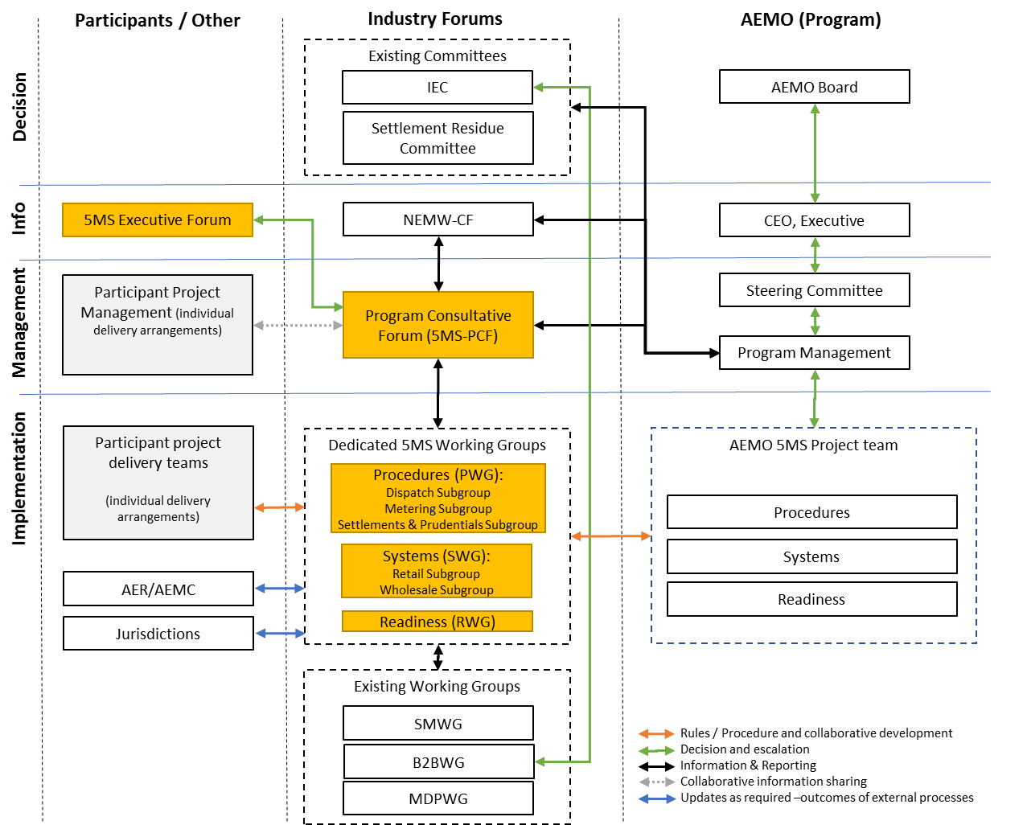
Program engagement structure

Slide 7
Program Overview
IT Delivery
Requirement drafting for 5MS & GS, application, interfaces & infrastructure.
Technical infrastructure build.
System development and delivery.
Internal AEMO Testing.
Performance Testing.
Pre-Prod and Prod system deployments.
Operational Support.
Readiness
Registration and Accreditation, including Meter Data Providers & Meter Providers
Market participant readiness monitoring
Industry Testing / Market Trial
AEMO Operating procedure review
Operational plan, including KPIs, SLAs, compliance register and risk register
Program communication
Industry cutover activities

Slide 8
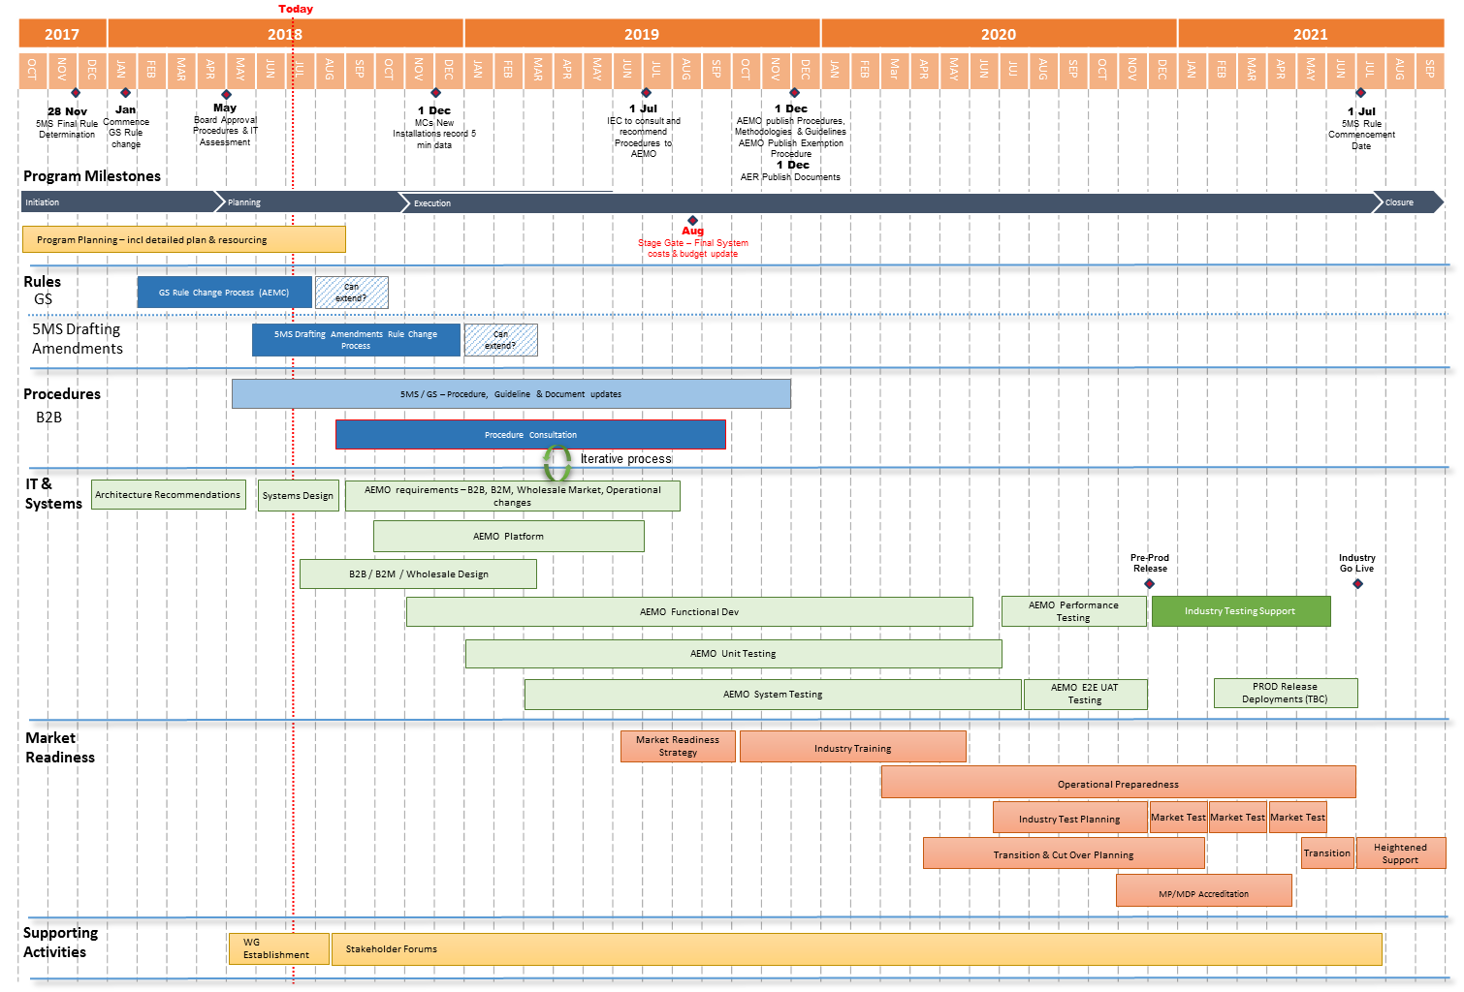
Program Overview

Slide 9
Program Status
Procedures stage on track, high-level impact assessments in progress. Delivery to complete by 1 December 2019.
Systems design & planning to Q3/Q4 2018:
Impact of increase in data volumes
Integration of industry initiatives:
Global Settlement rule change; Distributed Energy Register; 3rd Party Access to data.
Streamlining of internal processes
Stakeholder Engagement:
Initial Procedures Working Group – 27 July 2018

Slide 10
Approach to Risks & Issues
Log maintained by AEMO, inputs by market participants including (where relevant) ownership, reviewed at each PCF, shared with EF.
Risks and Issues topics for inclusion:
Impacts to AEMO & Industry participant delivery.
Escalations from PWG, SWG & RWG.
R&I with the integrated AEMO & Industry delivery plan i.e. software drops, environment availability, industry testing progression.
Go Live risk reduction.
Risks and Issues not included:
Impact of 5MS (& GS) on market behaviour – benefits and costs.
Changes to program timeframes provided by the AEMC.
Technical documentation.

Slide 11
General questions
Chris Muffett

Slide 12
Further information
Global Settlement rule change:
AEMC website: https://www.aemc.gov.au/rule-changes/global-settlement-and-market-reconciliation
AEMO 5MS Program contacts:
Graeme Windley, 5MS Program Manager
Chris Muffett, 5MS Business Lead
Emily Brodie, 5MS Procedure Lead
Hamish McNeish, 5MS Systems Lead
Contact details:
5MS email: 5ms@aemo.com.au
5MS webpage: http://www.aemo.com.au/Electricity/National-Electricity-Market-NEM/Five-Minute-Settlement

Slide 13
Forward meeting plan
Chris Muffett

Slide 14
Upcoming meetings
Executive Forums:
EF #2: Tuesday 11 September
EF #3: Tuesday 13 November
Next Program Consultative Forum:
Wednesday 8 August
Next Procedure Working Group:
Friday 27 July
Next Systems Working Group:
Friday 24 August
Meetings and forum dates: http://www.aemo.com.au/-/media/Files/Electricity/NEM/5MS/5MS-2018-Industry-Meeting-Schedule---External-Version.xlsx

