Slide 1
Changes to Reserve Level Declaration Guidelines
Stakeholder forum 12 October 2018
Jack Fox, Operational Forecasting

Slide 2
Agenda
Background
Review of performance of Guidelines
Proposed changes
Next steps
Questions
References

Slide 3
Background
Recent changes to the NER
  National Electricity Rule 4.8.4A/B published on 19 December 2017 requires AEMO to produce a probabilistic assessment of reserves and account for actual, forecast, environmental or other conditions when performing this assessment.
AEMO, in consultation with stakeholders, published the Reserve Level Declaration Guidelines which set out how AEMO performs this probabilistic assessment
  http://aemo.com.au/Electricity/National-Electricity-Market-NEM/Security-and-reliability/Power-system-operation
The methodology set out in the Guidelines came into effect on 15 February 2018.

Slide 4
Background – what sets the reserve requirement?
The reserve requirement for a region for a given forecast horizon interval is set by the higher of:
  The largest (or two largest) credible risk in the region i.e. the loss of the largest (or two largest) supply sources to a region; or
  The Forecast Uncertainty Measure (FUM)

Slide 5
Background – what sets the reserve requirement?

Slide 6
Background – how is the FUM determined?
The FUM is determined by taking into account historical forecasting uncertainty and the expected conditions of the relevant period in the forecast horizon
The historical forecasting uncertainty assesses:
  The available capacity of scheduled generating units
  The unconstrained intermittent generation forecast (semi-scheduled and significant non-scheduled generating units)
  The demand forecast
The expected conditions used to determine the FUM are:
  Forecast lead time
  Forecast temperature
  The current demand forecast error
  The forecast of intermittent generation

Slide 7
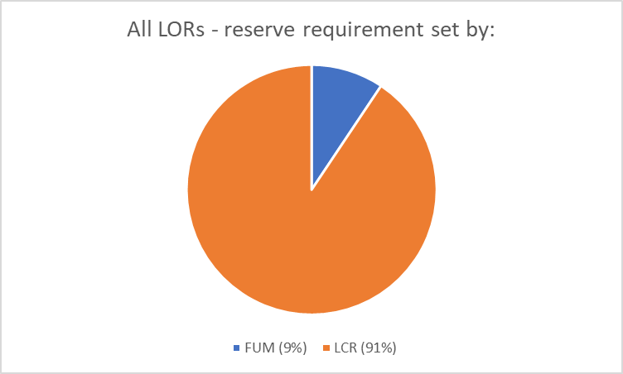
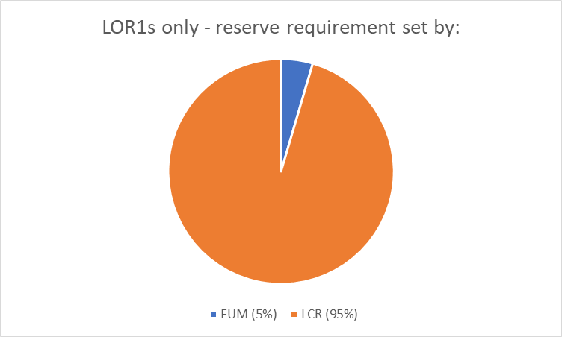
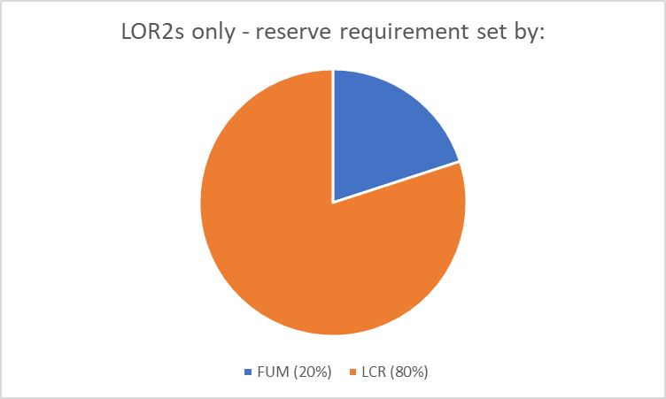
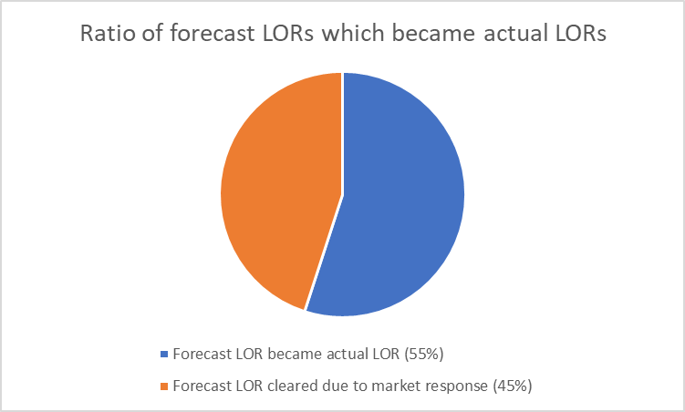
Review of performance of the Guidelines
For the period 15 February 2018 to 30 June 2018 there were 32 total lack of reserve conditions declared
AEMO did not intervene (through RERT, reliability directions or instructions) for any of the 32 LOR conditions
The 32 total lack of reserve conditions includes forecast or actual conditions and LOR1 or LOR2 conditions

Slide 8
Review of performance of the Guidelines
There are other forecasting uncertainties which contribute to the level of reserve forecasting uncertainty. These include how the PASA process accounts for:
  Network limitations, both inter-regional and intra-regional
  The supply-demand balance in neighbouring regions
  Energy limitations on scheduled generating units
These forecasting uncertainties are not taken into account in the current determination of the FUM
What is the impact of not taking into account these forecasting uncertainties?
  Overly conservative FUM values

Slide 9
Review of performance of the Guidelines
Overly conservative FUM values
  ‘Gatekeeper’ generator units which support interconnector flow – when a generating unit shares network capacity with an interconnector an un-forecast reduction in the availability of the generating unit is seen as a significant deterioration of reserve in the current determination of the FUM.
  The reduction in the availability of the ‘gatekeeper’ generating unit results in offsetting changes to the forecast flow on the interconnector. These changes offset the reduction in availability such that in normal situations the total reserve is unchanged.
  The proposed changes look to address this scenario by incorporating the interconnector flow forecast.
  This scenario is particularly evident in NSW and the proposed changes are expected to result in a significant decrease in FUM values for NSW.

Slide 10
Proposed changes
Update the model which determines the FUM values to incorporate other potentially significant components of forecasting uncertainty. These include how the PASA process accounts for:
  Network limitations, both inter-regional and intra-regional
  The supply-demand balance in neighbouring regions
  Energy limitations on scheduled generating units
Update the inputs used to inform the model of the expected conditions to:
  Forecast lead time
  Forecast temperature
  The current demand forecast error
  The forecast of intermittent generation
  Forecast solar irradiance
  The current scheduled generation fuel mix (coal/gas/hydro)

Slide 11
Proposed changes – expected impact
A reduction in FUM values – indicative amount below, see the Update Report for details
  Average FUM values:
Region | Forecast horizon (lead time) | Avg FUM values (existing) | Avg FUM values with proposed changes
NSW | 0-24hrs | 500-1400MW | 250-900MW
NSW | 24-72hrs | 1200-1800MW | 900-1200MW
QLD | 0-24hrs | 300-850MW | 250-650MW
QLD | 24-72hrs | 800-1100MW | 650-800MW
SA | 0-24hrs | 200-450MW | 150-250MW
SA | 24-72hrs | 350-600MW | 250-400MW
TAS | 0-24hrs | 130-230MW | 60-160MW
TAS | 24-72hrs | 160-250MW | 160-230MW
VIC | 0-24hrs | 300-900MW | 200-800MW
VIC | 24-72hrs | 900-1200MW | 800-1100MW
Based on backcast of proposed changes compared to existing method for period 15 Feb 2018 to 30 June 2018

Slide 12
Next steps
Milestone | Date
Update Paper and draft Guidelines published | 5 October 2018
Stakeholder forum | 12 October 2018
Submissions due on Update Paper and draft Guidelines | 24 October 2018
Final report and Guidelines published | 14 November 2018
Guidelines take effect | 3 December 2018 (indicative date)

Slide 13
Questions

Slide 14
References
Consultation webpage including Update Paper and draft Guidelines: http://aemo.com.au/Stakeholder-Consultation/Consultations/Changes-to-Reserve-Level-Declaration-Guidelines
Current Reserve Level Declaration Guidelines: http://aemo.com.au/Electricity/National-Electricity-Market-NEM/Security-and-reliability/Power-system-operation
Reserve Level Declaration Guidelines quarterly reports: http://aemo.com.au/Electricity/National-Electricity-Market-NEM/Security-and-reliability/Power-system-operation/NEM-Lack-of-Reserve-Framework-Quarterly-Reports
For further info contact the Operational Forecasting team
  Op.Forecasting@aemo.com.au

