Slide 1
Metropolitan Melbourne Voltage Management RIT-T
Project Specification Consultation Report Webinar
December 2023

Slide 2
We acknowledge the Traditional Owners of country throughout Australia and recognise their continuing connection to land, waters and culture.
We pay respect to their Elders past and present.

Slide 3
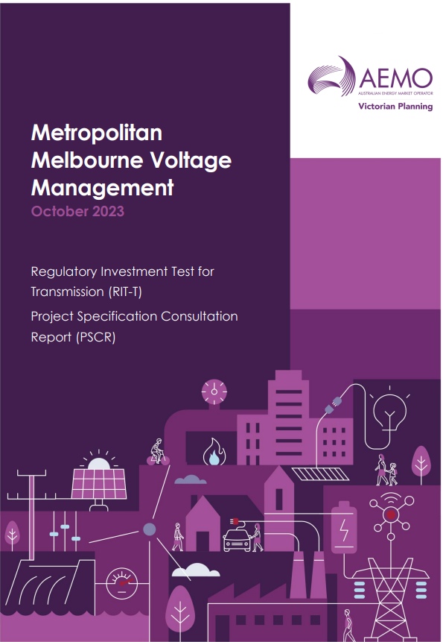

Objective
The purpose of this webinar is to summarise the Project Specification Consultation Report, with time for questions and discussion.
The report and RFI is available here

Slide 4
Agenda
Overview of the PSCR – Kirk Martel
Q&A – Kirk Martel; Jason Pollock; Ashley Lloyd

Slide 5
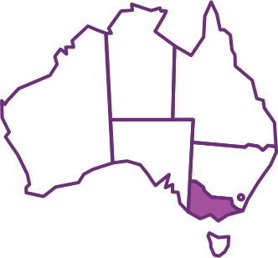
Victorian TNSP Requirement/Obligations for voltages
The NER requires AEMO Victorian Planning (AVP) as the Transmission Network Service Provider (TNSP) for Victoria to plan and design the Declared Shared Network (DSN) such that voltages:
  Are maintained within +/- 10% of the normal voltage level except as a consequence of a contingency event.
  For high voltages, following a credible contingency event, are managed within 10% of the normal voltage within 900 ms of the event
Following a credible contingency event, low voltages are allowed to the extent of the NER to fall to zero.
Many sites have limits tighter than the NER requirements due to site-specific limitations and the need to maintain voltage stability and quality of supply for downstream customers.

Slide 6
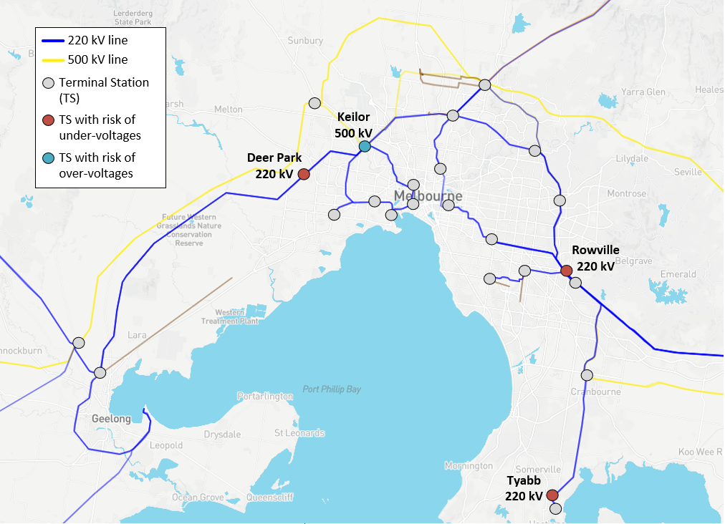
Objective of this RIT-T: to maintain voltages within limits in the metropolitan Melbourne area
In metropolitan Melbourne, voltage limits are at risk of being breached in the next decade.
There is both a risk of:
  (Pillar 1) Under-voltage exceedances during high demand conditions
  (Pillar 2) Over-voltage exceedances during low demand conditions
AVP is undertaking this Regulatory Investment Test for Transmission (RIT-T) to consider options that will address these pillars, at all sites, which maximize economic benefits and minimize the use of costly operational measures.

Slide 7
Identified Need Pillar 1: Need to manage under-voltages
Critical Site | Low voltage limit (kV) | Possible post-contingent voltage level (kV) in next 10 years
 |  | 2023-24 | 2024-25 | 2025-26 | 2026-27 | 2027-28 | 2032-33
Deer Park 220 kV | 209 | 208 | 195 | 194 | 192 | 191 | 123
Tyabb 220 kV | 209 | >209 | >209 | >209 | >209 | >209 | 203
Rowville 220 kV | 210 | >210 | >210 | >210 | >210 | >210 | 209
Under-voltages arise when there is a shortage of capacitance in the network (i.e. reactive demand outweighs reactive supply).
Low voltages may result in voltage collapse and may ultimately require load shedding if not remediated.
Drivers:
  High demand is forecast to increase over time in the next decade, resulting in increased reactive demand in the network.
  Existing capacitor banks with a total capacity of 650 MVARs are due to retire in 2027-28, resulting in less reactive supply.
Critical Site | Equivalent load reduction required (MW) to maintain voltages within limits
 | 2023-24 | 2024-25 | 2025-26 | 2026-27 | 2027-28 | 2032-33
Deer Park 220 kV | 20 | 70 | 80 | 90 | 100 | 150
Tyabb 220 kV | Nil | Nil | Nil | Nil | Nil | 120
Rowville 220 kV | Nil | Nil | Nil | Nil | Nil | <1
Critical Site | Equivalent reactive power supply required (MVAr) to maintain voltages within limits
 | 2023-24 | 2024-25 | 2025-26 | 2026-27 | 2027-28 | 2032-33
Deer Park 220 kV | +20 | +90 | +100 | +110 | +120 | +200
Tyabb 220 kV | Nil | Nil | Nil | Nil | Nil | +130
Rowville 220 kV | Nil | Nil | Nil | Nil | Nil | +30
Notes:
Kirk

Slide 8
Identified Need Pillar 2: Need to manage over-voltages
Over-voltages arise when there is excess capacitance in the network (i.e. reactive supply outweighs reactive demand).
High voltages may result in damage to equipment, and may ultimately require distributed PV tripping, directing on of expensive generation, or transmission line de-energisation which could have adverse market consequences.
Drivers:
  Low demand is forecast to decrease over time in the next decade, resulting in lightly loaded transmission lines which then generate capacitance (increasing reactive supply).
  Decreasing demand results in fewer generators capable of absorbing reactive power able to be online – reducing the available reactive demand in the network.
Critical Site | High voltage limit (kV) | Possible post-contingent voltage level (kV) in next 10 years
 |  | 2023-24 | 2024-25 | 2025-26 | 2026-27 | 2027-28 | 2032-33
Keilor 500 kV | 525 | <525 | 526 | 528 | 534 | 529* | 541
* In 2027-28, when Yallourn retires, the minimum synchronous generating combination of four Loy Yang units and one Newport unit is assumed, which improves transmission voltages and reduces the observed reactive shortfall. If this latter combination of synchronous generation is assumed for years 2024-25, 2025-26, and 2026-27, then the observed gap for the respective year would be less than as shown.
Critical Site | Equivalent reactive power demand required (MVAr) to maintain voltages within limits
 | 2023-24 | 2024-25 | 2025-26 | 2026-27 | 2027-28 | 2032-33
Keilor 500 kV | Nil | 150 | 270 | 460 | 310 | 750

Slide 9
Potential Options
Need | Type of option | High-level description of option to address the need
Identified Need Pillar One (maximum demand, under-voltages) | Non-network option | Demand side participation in the form of voluntary load reduction.
 | Non-network option | Pre- or post-contingent load reduction control schemes – these schemes would need to strategically comprise load blocks that relieve low voltages where there is a risk of limits being exceeded.
 | Network option | Investment sufficient to allow transmission system under-voltages to be managed – such as additional generating reactive support in the form of capacitors or dynamic reactive plant such as synchronous condensers, STATCOMs or SVCs.
 | Non-network option | Further BESS or generator grid connections in the right locations with available reactive support.
Identified Need Pillar Two (minimum demand, over-voltages) | Non-network option | Demand side participation in the form of voluntary load increases*.
 | Network option | Investment to upgrade existing transmission assets, such as the Keilor 500/220 kV transformers, that are currently limiting over-voltages levels below NER limits.
 | Network option | Investment sufficient to allow transmission system over-voltages to be managed, such as additional absorbing reactive support (in the form of reactors or dynamic reactive plant such as synchronous condensers, STATCOMs or SVCs.
 | Non-network option | Further BESS or generator grid connections in the right locations with available reactive support.
* This refers to the option “Directing on grid-scale storage (such as BESSs) to charge to increase operational demand” from Table 7 of the PSCR. This option is intended to represent the forming of contracts for demand side participation to increase operational demand.

Slide 10
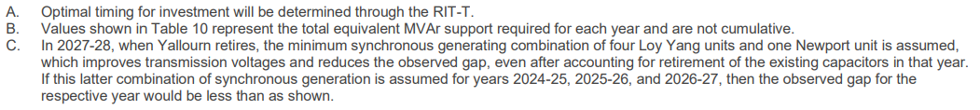
Indicative network reactive compensation solutions to meet the identified need
 | Need location | Technology type | Indicative MVAr support required
 |  |  | 2023-24 | 2024-25 | 2025-26 | 2026-27 | 2027-28 | 2032-33
Combination 1 | Deer Park 220 kV | Capacitor | +100 | +100 | +100 | +150 | +150 | +200
 | Tyabb 220 kV | Capacitor | - | - | - | - | - | +150
 | Keilor 500 kV | Reactor | - | -150 | -300 | -500 | -350 | -750
Combination 2 | Deer Park 220 kV | Dynamic reactive plant | ±100 | ±100 | ±100 | ±150 | ±150 | ±200
 | Tyabb 220 kV | Capacitor | - | - | - | - | - | +150
 | Keilor 500 kV | Reactor | - | -100 | -250 | -400 | -250 | -650
Combination 3 | Deer Park 220 kV | Dynamic reactive plant | ±100 | ±100 | ±100 | ±100 | ±150 | ±200
 | Tyabb 220 kV | Capacitor | - | - | - | - | - | +100
 | Keilor 500 kV | Dynamic reactive plant | - | ±100 | ±250 | ±400 | ±250 | ±650
These currently stand as the most effective locations for installing reactive compensation, based only on the technical ability to meet the need.
Different locations in the vicinity to these may come out as optimal based on other factors such as land and planning constraints.

Slide 11
Indicative non-network solutions to meet the identified need
Demand response and decentralised storage:
Additional reactive power support from grid-connected generators and BESSs, or distributed PV reactive power support:
Need Pillar being met | Critical Site | Load reduction requirement (MW) to meet the need
 |  | 2023-24 | 2024-25 | 2025-26 | 2026-27 | 2027-28 | 2032-33
1: need to maintain under-voltages | Deer Park 220 kV | 20 | 70 | 80 | 90 | 100 | 150
 | Tyabb 220 kV | Nil | Nil | Nil | Nil | Nil | 120
 | Rowville 220 kV | Nil | Nil | Nil | Nil | Nil | <1
Need Pillar being met | Critical Site | Reactive power requirement (MVAr) to meet the need
 |  | 2023-24 | 2024-25 | 2025-26 | 2026-27 | 2027-28 | 2032-33
1: need to maintain under-voltages | Deer Park 220 kV | +20 | +90 | +100 | +110 | +120 | +200
 | Tyabb 220 kV | Nil | Nil | Nil | Nil | Nil | +130
 | Rowville 220 kV | Nil | Nil | Nil | Nil | Nil | +30
2: need to maintain over-voltages | Keilor 500 kV | Nil | -150 | -270 | -460 | -310 | -750

Slide 12
Indicative Timeline
26 October 2023
Project Specification Consultation Report (PSCR) published
31 January 2024
PSCR submissions close
29 March 2024
Project Assessment Draft Report (PADR) expected release
28 June 2024
Project Assessment Conclusions Report (PACR) expected release
Q1 2025
Earliest that non-network options are expected to be delivered
Q4 2026 – Q2-2027
Earliest that network options are expected to be delivered

Slide 13
Next Steps
Submissions to the PSCR are due on 31 January 2024
All submissions or any general question are to be submitted to AVP_RIT-T@aemo.com.au
Submissions will be considered in the full options analysis for the PADR, which will identify a preferred option and timing.

Slide 14
Question & Answers
Ask your questions at www.Sli.do #AEMO
Questions are not considered as submission to the PSCR

