Slide 1
NEM Local Temperature Alerts 2023 Update
Thursday 26th October 2023

Slide 2
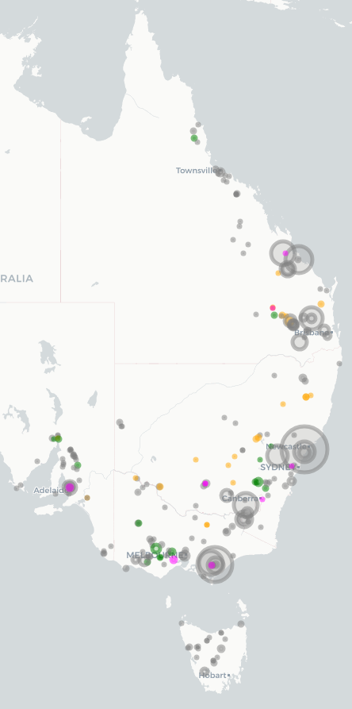
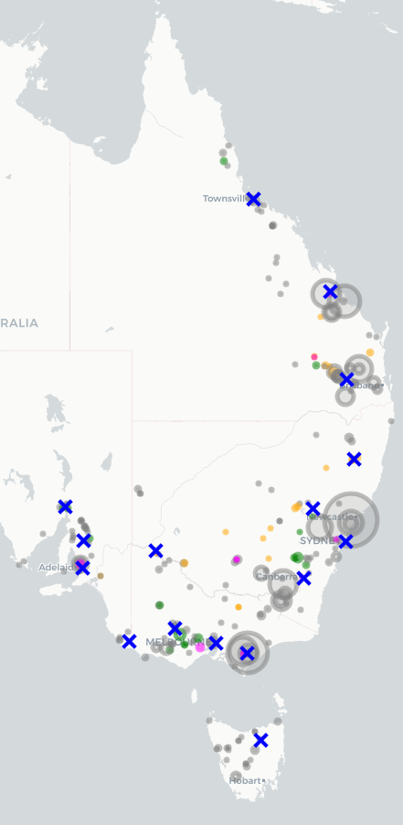
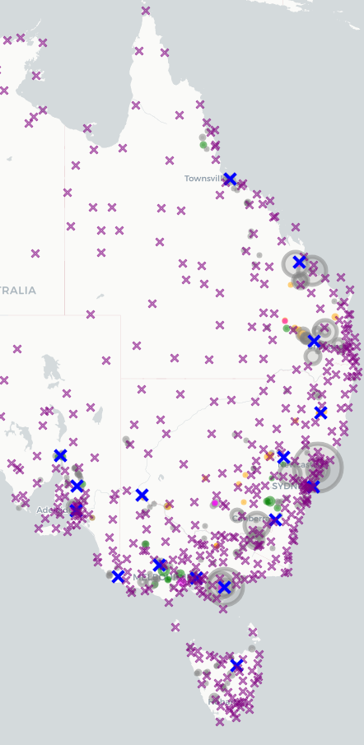
NEM Local Temperature Alert Review
(1) Generation changes
(2) Current weather stations
(3) Weather station review
(4) New stations selected
Generators connected at last review (grey) were mapped against generators connected since last review (coloured)
Current reference weather stations were mapped against previous and new generators
A review of all available weather stations was conducted to identify potential changes
New weather stations identified to represent new or existing generation clusters

Slide 3
NEM Local Temperature Alerts Updates
Region | Weather Station | Local Temperature Alert Level
TAS | Launceston (Ti Tree bend) | 33 °C
QLD | Dalby Airport | 37 °C
QLD | Rockhampton Airport | 39 °C
QLD | Townsville Airport | 39 °C
QLD | Mareeba | 39 °C
NSW | Armidale Airport | 39 °C
NSW | Yass | 39 °C
NSW | Mudgee Airport | 39 °C
NSW | Sydney Observatory Hill | 39 °C
Region | Weather Station | Local Temperature Alert Level
VIC/NSW | Mildura Airport | 39 °C
VIC | Ararat | 39 °C
VIC | Latrobe Valley Airport | 39 °C
VIC | Melbourne Olympic Park | 39 °C
VIC | Mortlake | 39 °C
SA | Mt Gambier Airport | 39 °C
SA | Adelaide West Terrace | 39 °C
SA | Clare High School | 39 °C
SA | Port Augusta Airport | 39 °C
New weather stations following 2023 review

Slide 4
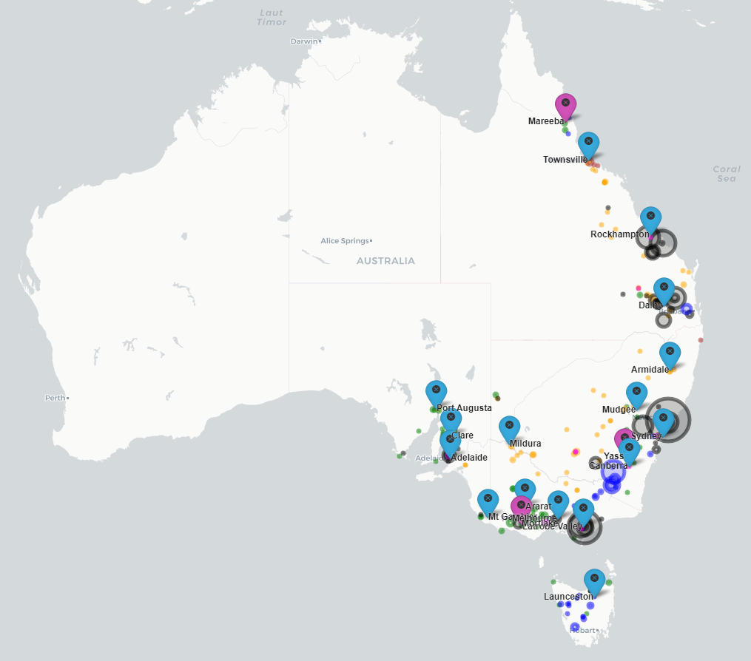
NEM
Fossil
Wind
Solar
Hydro
Battery
Other
Size indicates Capacity
Existing Weather Station
New Weather Station

Slide 5
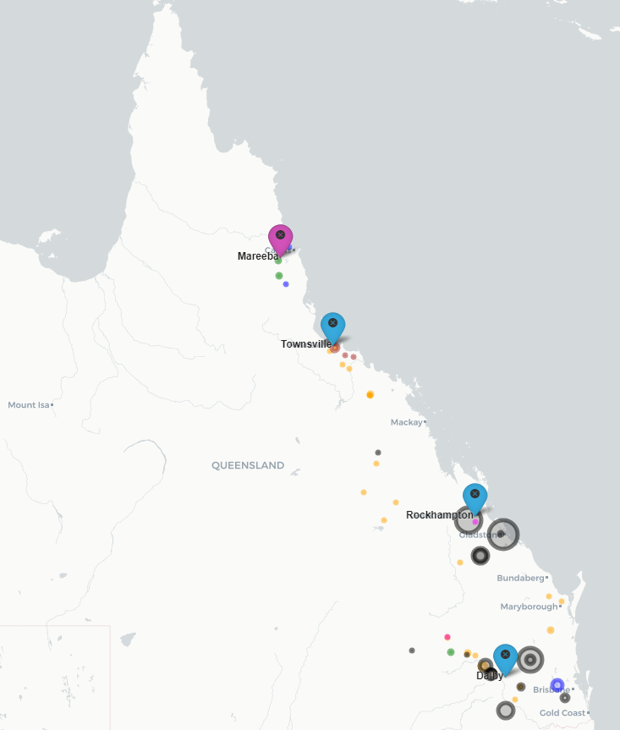
QLD
Fossil
Wind
Solar
Hydro
Battery
Other
Size indicates Capacity
Existing Weather Station
New Weather Station
2023 Update Introduction of Mareeba weather station for Far North Queensland generators

Slide 6
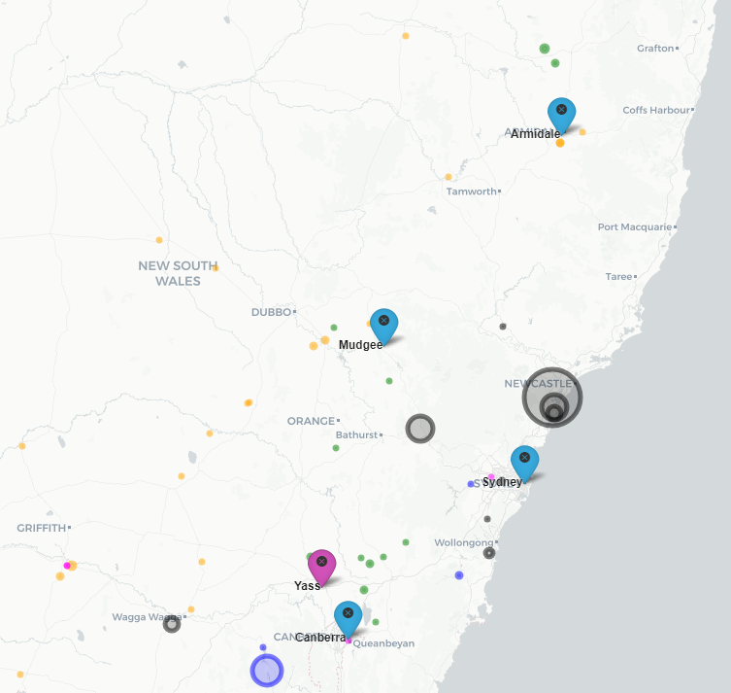
NSW
Fossil
Wind
Solar
Hydro
Battery
Other
Size indicates Capacity
Existing Weather Station
New Weather Station
2023 Update Canberra weather station moved to Yass to better represent the generation in that cluster

Slide 7
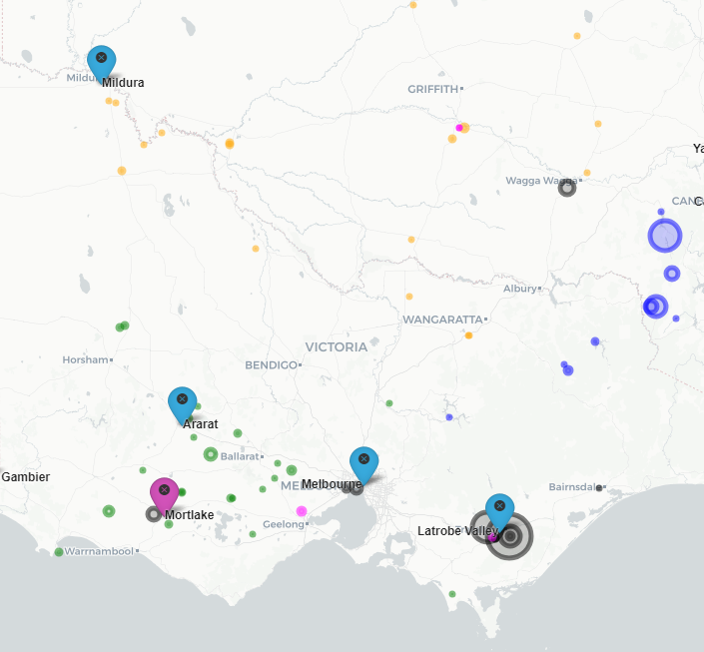
VIC
Fossil
Wind
Solar
Hydro
Battery
Other
Size indicates Capacity
Existing Weather Station
New Weather Station
2023 Update Introduction of Mortlake weather station for southwest Victoria generators

Slide 8
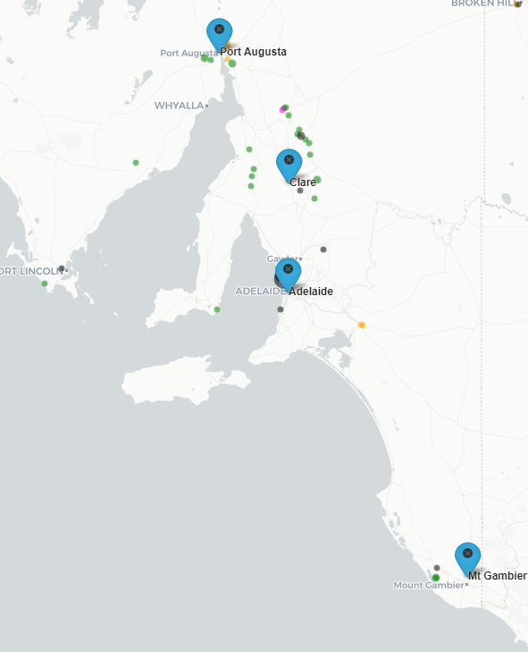
SA
Fossil
Wind
Solar
Hydro
Battery
Other
Size indicates Capacity
Existing Weather Station
New Weather Station

Slide 9
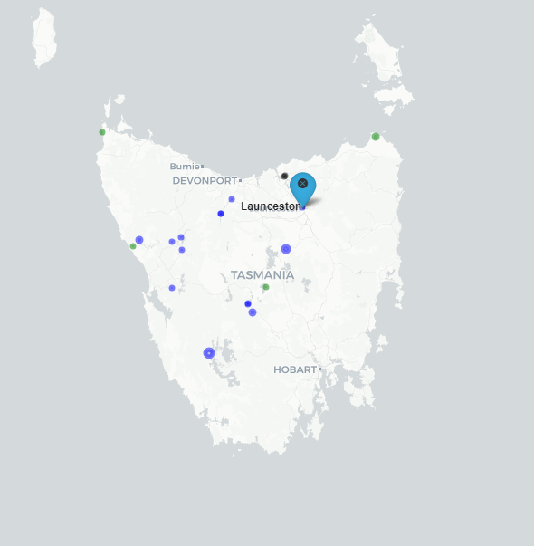
TAS
Fossil
Wind
Solar
Hydro
Battery
Other
Size indicates Capacity
Existing Weather Station
New Weather Station
Local Temperature Alert for Tasmania will be based on Basslink power transfer capability
Launceston (Ti Tree Bend) weather station is used for this purpose

Slide 10
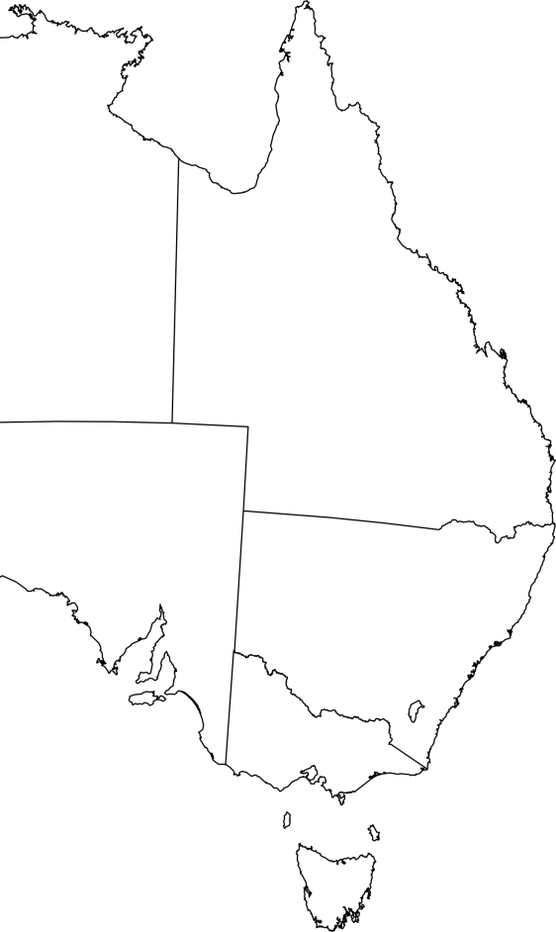
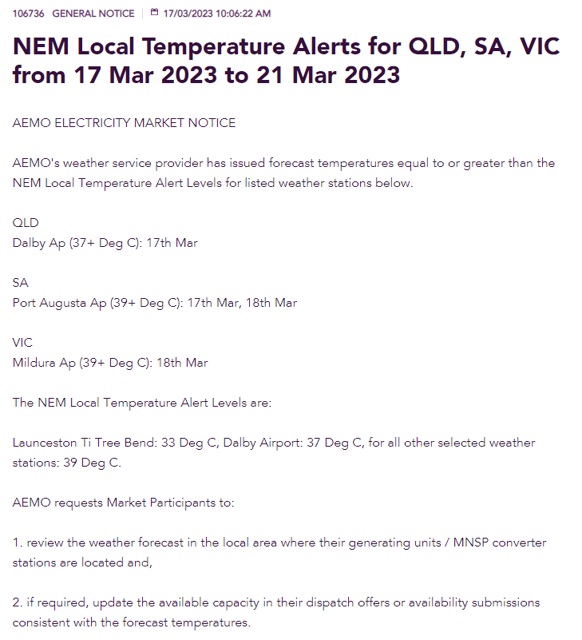
NEM Local Temperature Alert Market Notice
When forecast temperatures are equal to or greater than NEM Local Temp thresholds in the next five days, AEMO publishes a market notice.
The market notice reminds generators and/or the MNSP to review the available capacities in their dispatch offers or availability submissions consistent with the forecast temperatures.
Mareeba
Townsville
Rockhampton
Dalby
Port Augusta
Armidale
Clare
Mildura
Mudgee
West Terrace
Yass
Sydney
Ararat
Mt Gambier
Melbourne
Mortlake
Latrobe Valley
Current Weather station
New Weather station
Launceston

Slide 11
Further Information
Further information is available at:
https://aemo.com.au/energy-systems/electricity/national-electricity-market-nem/nem-forecasting-and-planning/forecasting-and-reliability/projected-assessment-of-system-adequacy https://aemo.com.au/energy-systems/electricity/national-electricity-market-nem/nem-forecasting-and-planning/forecasting-and-reliability/projected-assessment-of-system-adequacy/nem-local-temperature-alerts

