Slide 1
5 Minute Settlement & Global Settlement
Vendor Briefing Session #3
16 September, 2020

Slide 2
Welcome and Introduction
Graeme Windley

Slide 3
Agenda
# | Time | AGENDA ITEM | presenter
1 | 10:00 – 10:05 | Welcome and introduction | Graeme Windley
2 | 10:05 – 10:10 | 5MS and Global Settlement Rule Overview | Anne-Marie McCague
3 | 10:10 – 10:15 | Program status overview | Rowena Leung
4 | 10:15 – 10:20 | Systems and Technical Documents | Deborah Armenante
5 | 10:20 – 10:35 | Key Systems Changes for 5MS and GS | Graeme Windley, Mark Hillaby, Ian Devaney & Jim Agelopoulos
6 | 10:35 – 10:45 | Transition Plans | Greg Minney
7 | 10:45 – 10:55 | Plan for Industry Test and Market Trial | Greg Minney
8 | 10:55 – 11:05 | Approach to go-live plans | Greg Minney
9 | 11:05 – 11:15 | Industry Risks and Issues | Graeme Windley & Anne-Marie McCague
10 | 11:15 – 11:30 | Q&A Session on Functionality Deployment Matrix | Tui Grant
11 | 11:30 – 11:40 | Industry Readiness | Greg Minney
12 | 11:40 -11:45 | General Information Sources | Anne-Marie McCague
13 | 11:45 – 12:00 | Questions | Graeme Windley

Slide 4
Purpose of this session
To provide:
  An update on the current status of the 5MS Program
  An overview of industry testing
  An introduction to the approach to transition
  An opportunity for vendors to ask questions directly to the 5MS Program team

Slide 5
Meet the Team
Rowena Leung – Program Director
Graeme Windley - Senior Project Manager​
Ian Devaney – Dispatch Project Manager
Jim Agelopoulos – Retail Project Manager
Mark Hillaby – Settlements Project Manager
Greg Minney, Readiness Manager​
Tui Grant – Test Manager
Deborah Armenante – Senior Technical Writer
Anne-Marie McCague, Stakeholder Manager

Slide 6
5MS and Global Settlements rule overview
Anne-Marie McCague

Slide 7


Background to 5MS & GS
The 5MS Program is implementing two AEMC rules for the wholesale electricity market – requires changes to metering, retail & wholesale, settlement, bidding and NEM operational systems.
Why, What & When
Expected benefits
5MS
Settlement currently 30 mins, dispatch 5 mins.
Settlement period will change to 5 mins.
Commences 1 Oct 2021.
Removes anomaly by aligning settlement & dispatch period – efficiencies for NEM operations & investments, supports orderly bidding.
Better price signal for demand response, and for investment in fast response technologies
(e.g.: batteries, gas peaking generators).
Unaccounted for Energy (UFE) is currently charged to a limited number of ‘local retailers’.
With GS, all retailers share the cost of UFE.
UFE published by AEMO from 1 Oct 2021.
GS commences 1 May 2022.
Improved transparency, fewer settlement disputes and lower levels of UFE over time.
Competition on equal terms.
Improved risk allocation, enhanced incentives.
It’s efficient to implement GS within the 5MS Program, as it affects the same systems.
GS

Slide 8
AEMC Decision – three-month deferral
Activity | Original date | New date
Commencement of 5MS | 1 July 2021 | 1 October 2021
Commencement of “soft start” GS | 1 July 2021 | 1 October 2021
Commencement of financial settlement of GS | 6 February 2022 | 1 May 2022
Compliance date for all new and replacement metering installations (other than excluded metering installations) to be configured to record and provide 5-minute data | 1 December 2022 | 1 December 2022
AEMO required to publish UFE data report | 1 July 2021 | 1 October 2021
AEMO required to publish UFE report on unaccounted for energy trends | 1 March 2022 | 1 June 2022

Slide 9

AEMO’s implementation program remains unchanged
The Program is committed to meeting the original dates it set for IT systems development and deployment to allow market participants extra time to prepare and test their systems ahead of the new Industry go live dates.
1-Apr: 5-min Bidding Phased Go-Live begins
1 Apr: Settlement Platform Go-Live
1-Oct:Commencement of 5MS
(New date)
1-Jun: AEMO required to publish UFE data report on unaccounted for energy trends
Industry readiness*
(New date)
2021
2022
Mar
Apr
May
Jun
Aug
Sep
Nov
Jul
Oct
Dec
Jan
Feb
Mar
Apr
May
Jun
Jul
Aug
Sep
Oct
Dec
9-Mar: AEMO Metering Solution Go-Live
1-Dec: Compliance date
for all new and replacement metering installations
1-Oct: GS soft start
Industry readiness*
1-May: Commencement of financial settlement of GS
1-Oct: AEMO required to publish UFE data report
(New date)
(New date)
*Note: Industry readiness includes testing and market trials

Slide 10
Further Information
AEMC webpage for 5MS
AEMC webpage for GS
AEMC webpage for 5MS and GS implementation amendments
AEMC webpage for delayed implementation

Slide 11
Program status overview
Rowena Leung

Slide 12



Program update and current activities
AEMO program
Overall Program remains Green trending down
Milestones impacted by AEMC deferral decision have been re-baselined
Key L1-13 core functionality milestone was completed at the end of Aug, pressures remain with a very busy schedule.
Focus of the program is now on testing with all 3 workstreams in SIT.
AEMO business readiness, change mgt and cutover activity has also commenced.
Systems
Deployment for 3rd Staging drop for Retail in progress (verbal update to be provided).
Dispatch and Settlements System Testing completed. System Integration Testing is on track, target completion early October.
Defect fixing, fine tuning and solution optimization will continue.
Readiness
Industry Readiness Survey #3 conducted with 42 organisations providing responses. Report to be provided 3rd September
Metering Transition Plan updated for 3 month deferral following input from TFG and endorsement at RWG
Bidding Transition Plan finalised following industry consultation

Slide 13
5MS Program Timeline
Level 1 and External Level 2 Milestones 1/2
Current as at 21-08-2020

Slide 14
5MS Program Timeline
Level 1 and External Level 2 Milestones 2/2
Current as at 21-08-2020

Slide 15
Systems and Technical Documents
Deborah Armenante

Slide 16
Systems Technical Documents
https://aemo.com.au/initiatives/major-programs/nem-five-minute-settlement-program-and-global-settlement/systems-workstream/systems-technical-documents
Hi-level Impact Assessment
Assessment of the changes market-facing systems
5MS Systems High-Level Impact Assessment (HLIA)

Slide 17
Systems Technical Documents
Dispatch and Operations
EMMS 5MS Technical Specification - 5MS - Dispatch and Operations: changes for Dispatch and Bidding.
Format and Validation for Energy, FCAS, and MNSP Bids and Offers: describes the file format for energy, FCAS, and MNSP Dispatch bids and offers.
Guide to Energy and FCAS Web Bids: describes the Dispatch web bidding interface.
Guide to API Energy and FCAS Bids and Offers: how to build Dispatch bidding APIs.

Slide 18
Systems Technical Documents
Meter Data
MSATS 46.98 Technical Specification - 5MS - Meter Data: changes for Meter Data.
Guide to NEM Retail B2M APIs: how to build B2M APIs.
MDFF Specification NEM12 and NEM13: describes the MDFF format to support 5-minute meter data.
MDM File Format and Load Process: specifies the MDM format used by MDPs to provide Metering Data.
Meter Data Validation Matrix: describes B2M validation.
Guide to MSATS and B2B Terms: explains B2M and B2B terms.
Coming soon for MSATS
Guide to MSATS Web Portal: how to use the MSATS web interface.
Technical Guide to MSATS: A new guide which is a supplement to the MSATS B2M procedures, providing an understanding of MSATS functionality and business rules

Slide 19
Systems Technical Documents
Settlements and Prudentials
EMMS 5MS Technical Specification - 5MS - Settlements: changes for Settlement systems.
EMMS 5MS Technical Specification - 5MS - Prudentials: changes for Prudential systems.
Guide to Reallocation APIs: how to build Reallocations APIs.
Guide to Electricity Reallocations: how to use the Reallocations web interface.
Guide to Settlements Direct: how to use the Settlements publishing system.
Guide to NEM Prudential Dashboard: explains the prudential dashboard web interface.
Guide to NEM Prudential Forecast: explains the prudential forecast web interface.
Guide to NEM Credit Support: explains the credit support web interface.

Slide 20
Systems Technical Documents
Data Interchange and Data Model
EMMS Technical Specification - 5MS - Data Model v5.00: changes to participants’ Data Interchange (DI) environments.
Guide to setting up Data Interchange: how to set up a DI environment.
Guide to upgrading Data Interchange: how to upgrade a DI environment.
New online DI help
All DI documents in an online searchable format. Published Wed 23 September: www.aemo.com.au/www.aemo.com.au/energy-systems/electricity/national-electricity-market-nem/data-nem/nemweb-help
Other guide updates
Guide to User Rights Management: assists participant admins to provide access to AEMO's IT systems.
Connecting to AEMO's IT systems: assists participants to connect to AEMO's IT systems.

Slide 21
Key Systems Changes for 5MS and GS
Graeme Windley, Ian Devaney, Mark Hillaby & Jim Agelopoulos

Slide 22
Program Scope (Systems Focus)
Dispatch
Metering
Settlements
Function
Manages demand forecasting and the dispatch price every 5-minutes (and aggregates spot price every 30 minutes). Ensures electricity demand is met.
Function
Manages receipt and storage of market data (metering and standing data). Metering prepares data for market settlement and enables market reporting.
Function
Manages the calculation of financial liabilities and credits between market participants daily and settles all trade in the NEM on a weekly basis.
Systems Workstreams
Scope of change
Increase daily bidding intervals from 48 to 288.
New data structures required to receive, use and store five-minute bids and offers.
Changes required to calculate the floor price and price cap.
AEMO to publish five-minute data.
Scope of change
Enable receipt of metering data every 5 minutes.
Enable management of >2 trillion data points by 2028.
Change profiling algorithms to derive 5 minute energy data.
Enable energy allocation to be at 5, 15 and 30 minute intervals.
Scope of change
Enable settlement on 5 min granularity, 5 min price, and Marginal Loss Factors (MLF)
Settlement estimations will calculate energy transactions per 5 min period.
Additional calculations (i.e. market ancillary services, FACS), to be calculated with 5-minute data.
Solution Path
Enhance Legacy Systems
Solution Path
Build New Solution using Strategic Technologies
Solution Path
Enhance Legacy Systems
Program Management
Remainder 5MS & GS Program
Market Procedures, Stakeholder engagement and market/industry readiness
Process Mapping, Change and Training, Cutover and Transition
Infrastructure / External Web Development / Internal webMethods Integration

Slide 23
NEM Wholesale System Change Heatmap
DISPATCH
POWER SYSTEM
SETTLEMENT
Bids/Offers
Negative Residue Management
Settlement 5MS Calc.
Data Model
ST PASA
Settlement GS Calc.
Dispatch
RERT
Estimation and Prudentials
Predispatch (P5/P30s)
Data Model
Reallocations
Spot Price
MT PASA / EAAP
Data Model
Administered Pricing
Demand Forecasting
IRSR Calc.
Suspension Pricing
Generator Recall
SRA
Constraints
Wind/Solar Availability
Causer Pays Factors
Registration
VAR/MW Dispatch

Slide 24
NEM Retail System Change Heatmap
B2M / B2B Interfaces
CATS / MDM Processes
MSATS Browser / Reports
MDMT
Profiling
Meter Data screens
B2M aseXML schema
CATS Standing Data
RM21/27
NMID
Meter Data Validation
C1,4
CATS
Estimation / Substitution
RM11,12,13,14,16
RM17,18,19,20,22
MSATS B2M APIs
Energy Allocation
RM28,30,31,32
RM33
B2B Transactions
CR Processing
SDR
B2B aseXML schema
RM7,8,9,10
RM15,29
VIC TUoS
C2,3,6,7,9,10
C11,12,13

Slide 25
Transition Plans
Greg Minney

Slide 26
Transition Approach
Transition Approach:
Staged introduction of capability leading up to market commencements for both 5MS and GS
Platform implementation followed by 5MS and GS capability activation
Industry Test phases for participant confirmation of business interaction under new market procedures
Criteria for AEMO and Participant readiness ahead of Rule Commencements
Participant Vs Vendor Scope:
Participant scope and timeframes to address their program timeframes
  Advise from AEMO is Participant timeframes are likely to differ to AEMO timeframes
  Participant scope includes internal requirements for system upgrade and build

Slide 27
Bidding / Dispatch
Staging, Pre-production & Production timelines
For business continuity reasons, 30-mins offers and bids will be accepted until 01 Oct 21
STAGING
01 Oct 2021
PRE-PRODUCTION
29 Nov 2020
05 Jul 2021
PRODUCTION
01 Apr 2021
01 Oct 2021
LEGEND
LEGACY | BIDDING TRANSITION | 5MS RULE
30-minute bidding only via: FTP (txt) Web Bidding (Legacy) | 30-minute bidding via: FTP (txt) Web Bidding (Legacy) 5-minute bidding* via: FTP (JSON) Web Bidding (5MS) API *Each 5-minute bid within each half hour must be identical, giving the same effect as the submission of a 30-minute bid. | 5-minute bidding* only via: FTP (JSON) Web Bidding API *30-minute bid emulation restriction lifted

Slide 28
Settlements
Staging, Pre-production & Production timelines
Supports 30MS, 5MS and GS modes
Staging
1 Oct 2021
Incl. UFE Reporting from 05/07/21
Pre-production
17 Feb 2021
5 Jul 2021
1 Feb 2022
Production
1 Apr 2021
1 Oct 2021
1 May 2022
Legend
Legacy | New Settlement Platform | 5MS Rule | GS Rule
30-minute Settlements | 30-minutes settlement to 1 October 2021 | Five-minute settlement and Global Settlement soft-start - UFE Reporting | All Retailers become liable for UFE

Slide 29
Retail Metering
Staging, Pre-production & Production timelines
Date to be confirmed.
Staging
31 Oct 2020
1 Oct 21
GS from 1st quarter 2021 - TBC
Pre-production
1 Feb 2021
5 Jul 2021
1 Feb 2022
Production
9 Mar 2021
1 Oct 2021
1 May 2022
Legend
Legacy | 30MS with new platform | 5MS Rule | GS Rule
30-minute meter reads | 30-min settlement 5-min reads supported Standing data updates for GS | UFE calculation and 5-min settlement | LR updated to GLOPOOL

Slide 30
Plan for Industry Test and Market Trial
Greg Minney

Slide 31
AEMO 5MS Testing Environments
5MS Staging Environment
  Provide software to enable early testing of functionality by participants
  Environment is not fully integrated e.g. PAE runs to Settlement Statements
  MSATS data will be refreshed on 31 August 2020 with production data as at 30 July 2020
  Environment support for 30MS, 5MS, GS modes of operation over time
AEMO pre-production environment (pre-prod)
  Used for all market trials and formal industry testing
  Reflects production capability – and capability for upcoming release during market trial and industry test period
Functionality Deployment Matrix highlights functionality supported in test environments with planned release dates

Slide 32
Participant Testing Types
There are three types of participant testing:
Approach to participant testing was developed in consultation with industry and is captured in the Industry Test and Market Trial Strategy
Type | Definition | Environment | Example
Industry Testing | Self-testing of functionality such as connectivity, and/or coordinated multiparty testing of functional scenarios | Staging, pre-prod | Testing a change request (CR) or processing a reallocation
Market Trial | AEMO coordinated multi-party end-to-end testing of business process scenarios | Pre-prod | Meter exchange involving CRs, services orders and 5-minute meter reads
Invitation Industry Testing | AEMO coordinated testing of business process scenarios with a select number or subset of participants with systems ready for testing. | Pre-prod | Testing NMI transfer Process

Slide 33
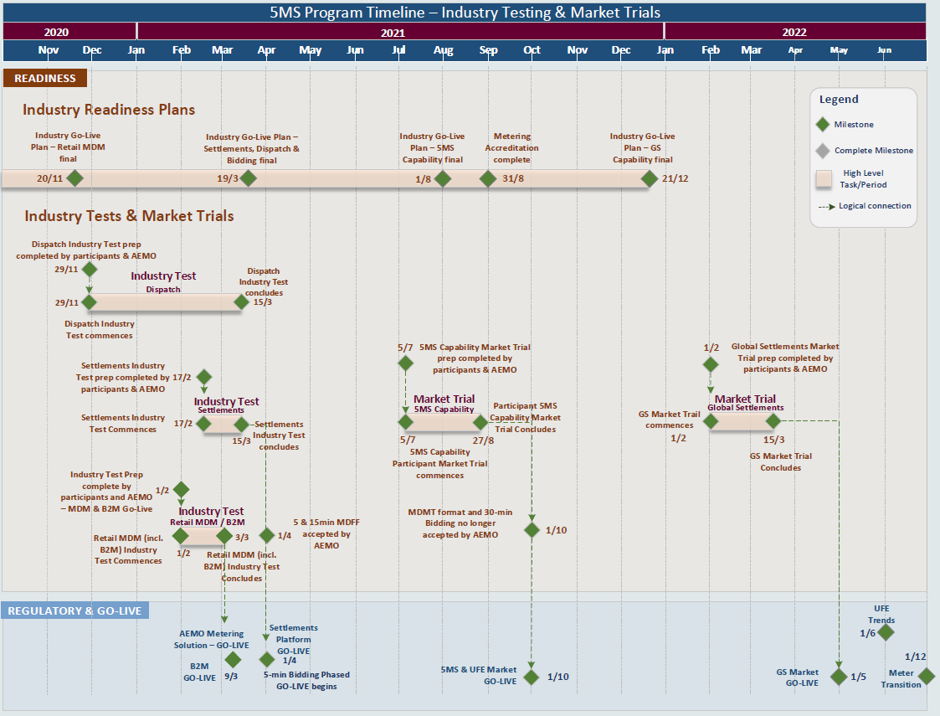
5MS Program Timeline
Level 1 and Level 2 Milestones relating to Readiness and Participant Testing

Slide 34
5MS and GS Industry Test and Market Trials
Industry Test and Market Trials strategy updates to reflect Industry Deferral
Testing to support platform go-lives as currently planned
Timings for Market Trials for 5MS and GS shift in alignment with new rule commencements
  5MS market Trial 5/7/21 –> 27/08/21
  GS Market Trial 1/2/22 –> 15/03/22
GS Market Trial dates avoid market trial over Christmas period
Separate market trials proposed for 5MS/ UFE reporting capability and GS to allow for industry population of required standing and tier 1 metering data

Slide 35
Further Reading
Industry test and market trial strategy
Industry Testing Working Group meeting packs and notes
5MS Staging Environment webpage
Participant testing webpage

Slide 36
Approach to go-live plans
Greg Minney

Slide 37
Approach to go-live plans
For each of the platform go-lives and industry go-live plan will be developed in consultation with the Readiness Working Group
In line with staged transition approach, AEMO platforms will be deployed on “like for like” basis to minimise participant dependencies:
  Participant upgrades will be scheduled in line with individual participant timeframes
Production outages will be minimised to support ongoing Business operations

Slide 38

Scope of Industry go-live plans
In scope
High level transition and cutover approach
Industry responsibilities and expectations, including connectivity testing
AEMO Platform deployment proceed decision criteria and timeframes
Industry Cutover schedule
Communication and notification plan
Contingency and restart process and notification
Out of scope
Participant deployment approaches
Participant roll-back plans

Slide 39
Industry Risks and Issues
Graeme Windley and Anne-Marie McCague

Slide 40
Managing Industry Risks and Issues
The 5MS Program maintains an Industry Risks and Issues Register with the 5MS Working Groups
The Program Consultative Forum (PCF) is the overall owner of the register and reviews it at least on a quarterly basis
Each Working Group identifies and manages risks and issues
The register is available on the 5MS website
The purpose of this section is to high-light the risks that may impact vendors

Slide 41
Risk of “Big Bang”
ID | Risk Description | Residual Rating | Mitigation
R04 | AEMO Big bang approach AEMO systems for bids/offers and meter data all going live at once on 1 Oct 2021, results in a failure of go live. | Significant | Early, staged deployment approach 5MS Staging Environment AEMO Readiness Reporting
R17 | Industry 'big bang' approach Potential for Participant systems to fail at go-live due to insufficient transitional provisions e.g. market trial participation and staged system implementation resulting in market disruption (meter data flows and standing data flows) | Significant | Transition Strategy Metering Transition Plan Bidding Transition Plan Industry Test and Market Trial Strategy Industry Readiness Reporting

Slide 42
AEMO Systems Deployment Cutover Risk
ID | Risk Description | Residual Risk Rating
R28 | The current Cutover approach has the 3 AEMO systems deployments in close succession. Retail Metering the largest, most technically complex and riskiest cutover going first on 9 March, then followed by both the Dispatch and Settlements systems deployments together 3 weeks later on 1 April. A go-live criteria for Settlements is a stable metering platform. The current timetable only allows one week for the Retail solution to be stabilised prior to commencing cutover activity for Settlements which is high-risk. | Medium
To mitigate this risk AEMO is proposing to move the Settlements go-live to 19 April 2021
Settlements deployment into pre-production remains 17 February 2021
The Dispatch and Retail Releases are required to facilitate 5MS market go live transitional activities (i.e. submit 5-min bids; deliver 5-min reads).
  go-live dates, pre-prod dates and transition plans remain as is (9 March 2021 for Retail and 1 April 2021 for Dispatch)
The Settlements solution platform go-live does not facilitate any 5MS industry go-live or transitional activities – it only must be deployed in Prod before 1 October 2021

Slide 43
Non-5MS Market changes not reflected in the 5MS Staging Environment
ID | Risk Description | Inherent Risk Rating
R31 | There is a risk that market changes from projects other than the 5MS and GS implementation that go-live during the extended 5MS and GS transition period will not be reflected in the 5MS Staging Environment which could mean that it is not an effective environment for participant testing. | Significant | This is being reviewed as part of the work on interactions with other market changes and 5MS Staging Environment and will be discussed with ITWG. Mitigation measures to be determined and risk to be updated with residual risk rating.
AEMO has carried out a review of the Regulatory Implementation Roadmap in consultation with industry
The updated roadmap takes into account a number of recent AEMC decisions including the 3-month deferral for 5MS and GS
AEMO is currently reviewing the interdependencies between the 5MS Program, Customer Switching and Wholesale Demand Response (WDR) and will communicate to participants through joint information session

Slide 44
Q&A session on Functionality Deployment Matrix
Tui Grant

Slide 45
Functionality Deployment Matrix
Functionality Deployment Matrix demo
Q&A Session
Matrix can be found on the 5MS website here: https://www.aemo.com.au/-/media/files/electricity/nem/5ms/program-management/aemo-5ms-functional-deployment-matrix.xlsx?la=en

Slide 46
Readiness Reporting
Greg Minney

Slide 47
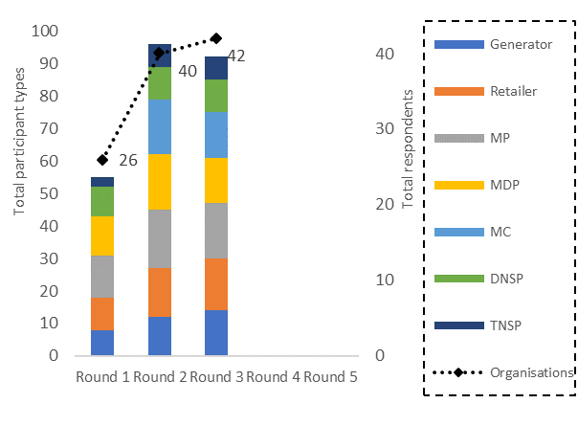
Readiness Reporting
Participant Response
Participant Progress
Readiness Reporting:
Regular survey of participant (and AEMO) progress towards 5MS and GS commencements
Provides consolidated assessment of Industry readiness and basis for individual participant comparison
Participant assessment of readiness :
Overall program status, including vendor provision
Role specific criteria
Metering transition activity
Industry risks and responses

Slide 48
General Information Sources
Anne-Marie McCague

Slide 49
5MS Website
Links to the Working Group pages available in diagram on main page
Participant implementation section added to provide guidance for:
  Metering participants
  DNSPs
  Retailers
  Generators
The following tools are available on the Program Management webpage:
Program Management Tool | Update Cycle
Program actions log | monthly
5MS Program document tracker | as necessary
Industry risks and issues register | as agreed with PCF and reviewed at least quarterly
5MS Functionality Deployment Matrix | as necessary
Program timeline | monthly

Slide 50
Upcoming meetings
https://aemo.com.au/initiatives/major-programs/nem-five-minute-settlement-program-and-global-settlement
Current as 14 Sep 2020

Slide 51
Questions?

Slide 52
Appendix: 5MS Architecture

Slide 53
5MS Architecture On a Page

