Slide 1
5MS & GS Vendor Briefing Session #2
16 October, 2019

Slide 2
Agenda
NO | Time (aedt) | AGENDA ITEM | Responsible
1 | 10:00am – 10:10am | Welcome and introduction | Graeme Windley
2 | 10:10am – 10:15am | 5 Minute Settlement (5MS) rule overview | Emily Brodie
3 | 10:15am – 10:20am | Global Settlement (GS) rule overview | Emily Brodie
4 | 10:20am – 10:25am | AEMO’s 5MS & GS Implementation Plan and Program Update | Graeme Windley
5 | 10:25am – 10:30am | AEMO’s 5MS & GS Readiness Approach and Update | Greg Minney
6 | 10:30am – 10:35am | Staging Environment | Graeme Windley
7 | 10:35am – 10:40am | Future Engagement opportunities | Monica Morona
8 | 10:40am – 11:10am | Dispatch | Shalindra Kulasuriya
9 | 11:10am – 11:40am | Metering | Simon Tu
10 | 11:40am – 12:10pm | Settlements & Reallocations | Pierre Fromager
11 | 12:10pm – 12:20pm | Questions | Graeme Windley
12 | 12:20pm | Meeting close | Graeme Windley

Slide 3
5MS rule overview
Emily Brodie

Slide 4
Background – current NEM dispatch and settlement arrangements
Settlement prices (spot prices) are calculated on a 30 minute basis – the average of 6 x 5 minute dispatch prices
  one high dispatch price in a 30 minute trading interval raises the spot price (and vice versa)
Different time periods for dispatch and settlement were adopted due to limitations in metering and data processing when the NEM started (1998).
Technology is now available which makes 5 minute settlement possible.

Slide 5
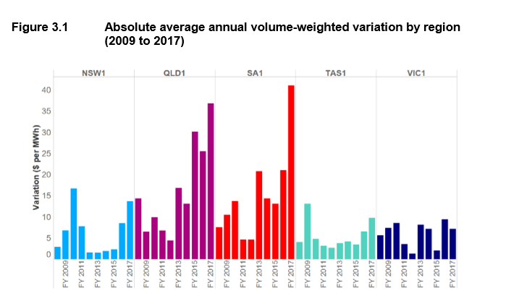
30-minute settlement
The AEMC:
  found evidence of ‘price distortions’ occurring across the NEM, with the trend most pronounced in Queensland and South Australia
  expected that these distortions would get worse in the future

Slide 6
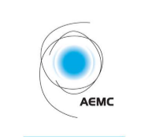
AEMC decision
In November 2017, the AEMC made a final rule change altering the settlement period to 5 minutes, aligning with dispatch period
The industry “go live” is 1 July 2021
Purpose of rule change is to:
  remove the anomaly that exists between the 5 minute and 30 minute periods, which has been identified as a contributing factor to disorderly bidding
  provide a clearer price signal for investment in fast response technology, including batteries and demand response
Key areas affected:
  Metering
  Settlement calculation
  Dispatch and market information

Slide 7
What is required to implement 5MS?
From 1 July 2021, following processes need to change to 5 minute basis:
  Bidding and offering into the NEM
  Settlement
  Intervention pricing
  Calculation of trading amounts and the cumulative price threshold
This means that AEMO and market participants will need to:
  upgrade metering to provide 5 minute data (where required)
  upgrade IT systems to store and process 5 minute data
  review/update existing contract terms and conditions
AEMO also has to update its procedures by December 2019

Slide 8
GS rule overview
Emily Brodie

Slide 9
Global settlement recap
On 6 December 2018, the AEMC finalised a rule to implement Global Settlement (GS)
GS is an alternative methodology for settling electricity within a distribution area. It will replace settlement-by-difference. GS will:
  remove any inequity between retailers
  provide visibility of the unaccounted for energy (UFE) within distribution areas
More information is provided in the Global Settlement fact sheet: http://www.aemo.com.au/-/media/Files/Electricity/NEM/5MS/Program-Information/2018/5MS_What-is-global-settlement.pdf

Slide 10
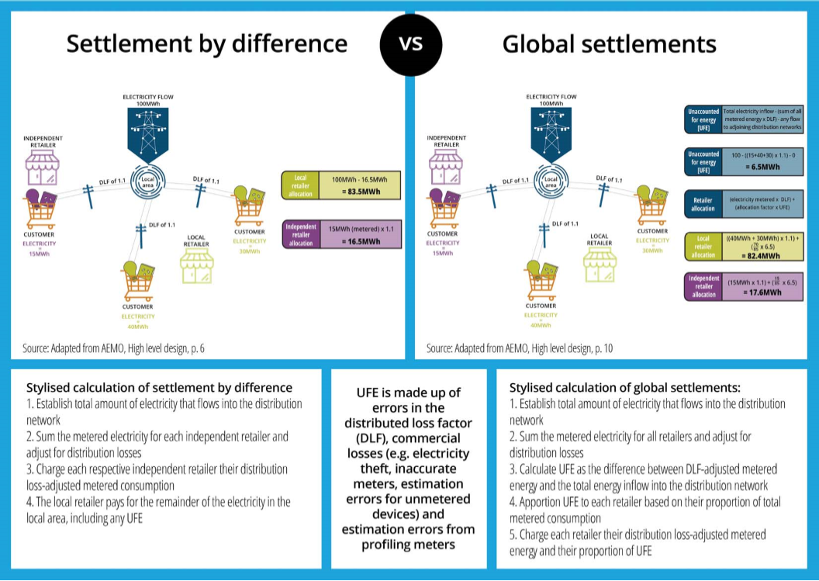
Settlements by Difference vs Global Settlements

Slide 11
Global settlement implementation timeline
1 December 2019
AEMO procedures updated for both 5MS and GS
1 July 2021
5MS begins
AEMO starts publishing UFE data (‘soft start’)
6 February 2022
GS begins
1 March 2022
AEMO’s first annual report on UFE trends
New procedure required
[NER 3.15.5(d) and 11.112.5]
New annual report
[NER 3.15.5B] and new reporting guidelines [NER 3.15.5B(d) and 11.112.6]

Slide 12
Key areas affected by global settlement
GS is being implemented in parallel with 5MS
Some market procedures – these have been consulted on as part of the metering and settlements packages
AEMO and participants’ IT systems – changes across both retail and wholesale systems
Additional data:
  NSPs/MDPs required to provide information on non-contestable unmetered loads
  MDPs required to provide metering data for all connection points
AEMO will begin publishing UFE from 1 July 2021:
  no financial impact to retailers from UFE allocation from 1 July 2021 to 5 February 2022
  UFE allocation will be financial from 6 February 2022

Slide 13
Program Update
Graeme Windley

Slide 14
5MS & GS Program Timeline
Current as at 30-09-2019

Slide 15
5MS Program Timeline (to July ‘20)
Level 1 and External Level 2 Milestones
Current as at 30-09-2019

Slide 16
Readiness Update
Greg Minney

Slide 17
5MS/GS Market Readiness Workstream Scope
Establishment of objective market readiness criteria,
Regular reporting by impacted participants
Analysis and assessment of reported results
Readiness issue and risk assessments
Readiness Reporting and Management
Industry Testing and Market Trials
Planning, execution and management of Market / Industry test activities
Environment support and availability
Market Transition Strategy which details the steps, activities and responsibilities in moving from current state to future state
Planning and monitoring of participant and AEMO transition activities
Systems cutover planning and execution - including industry co-ordination
Transition and Cutover
Metering Accreditation Updates
Identification of timing and scope of accreditation requirements
Accreditation Update approach

Slide 18
Staged Transition – System Implementations
(dates indicative)
Draft as at 30-09-2019

Slide 19
Staged Transition – Systems and Metering
(dates indicative)
Draft as at 30-09-2019

Slide 20
Market Readiness
AEMO Readiness Scope:
Staged introduction of capability leading up to market commencements for both 5MS and GS
Platform implementation followed by 5MS and GS capability activation
Industry Test phases for participant confirmation of business interaction under new market procedures
Criteria for AEMO and Participant readiness ahead of key deployments
Participant and Vendor Scope:
Participant scope and timeframes to be developed
  Advise to AEMO is that participant timeframes are likely to differ to AEMO timeframes and requirements
Participant internal requirements for system upgrade and build

Slide 21
How to Access Information and Engage
Monica Morona

Slide 22
AEMO Website
AEMO Website
https://www.aemo.com.au/Electricity/National-Electricity-Market-NEM/Five-Minute-Settlement
5MS & GS Technical Documents
https://www.aemo.com.au/Electricity/National-Electricity-Market-NEM/Five-Minute-Settlement/Systems-Workstream/Systems-Technical-Documents
5MS Mailbox
5ms@aemo.com.au

Slide 23
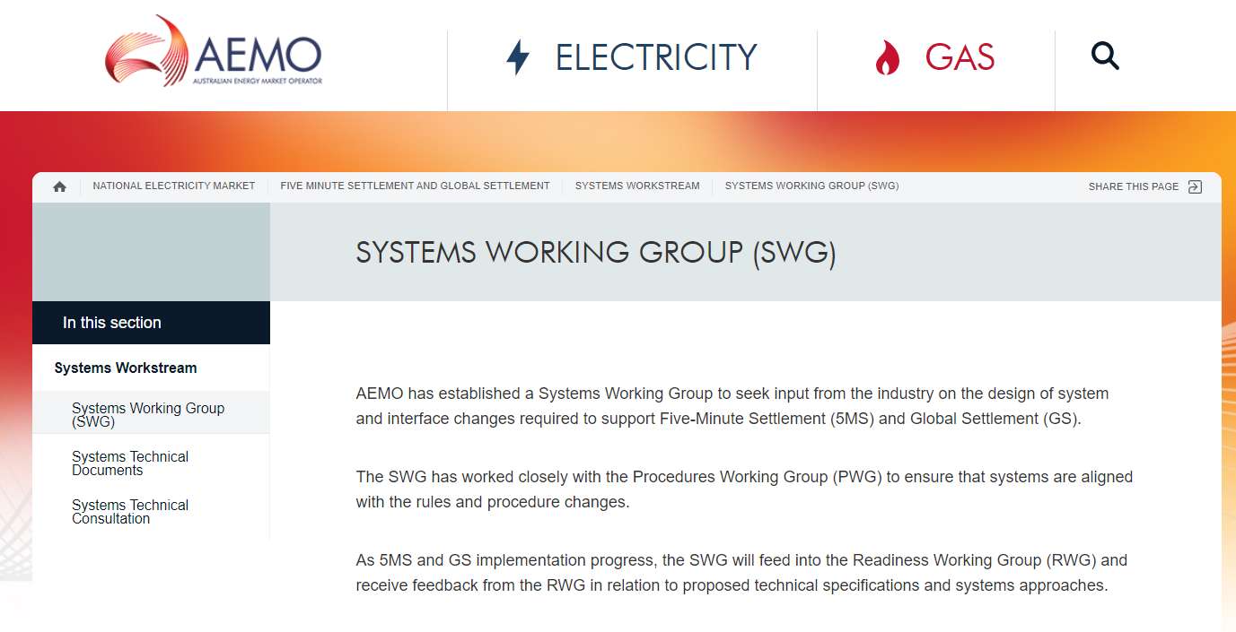
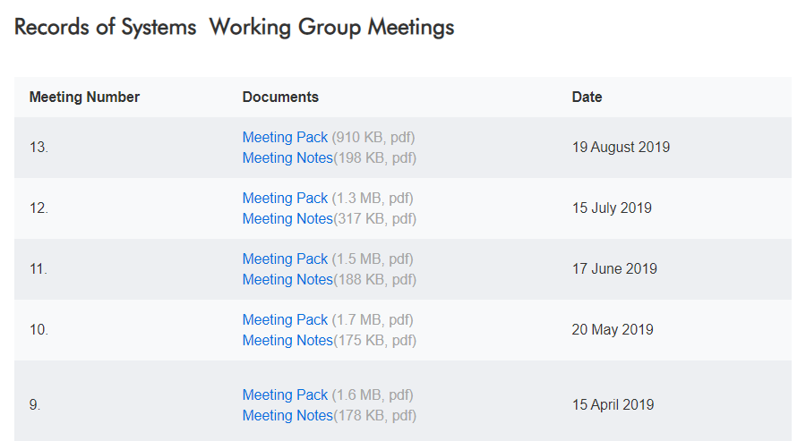
Working Group Records
All working group materials (packs and meeting notes) are available on the 5MS & GS website.
The SWG packs include details of technical specifications and outcomes of discussions with industry

Slide 24
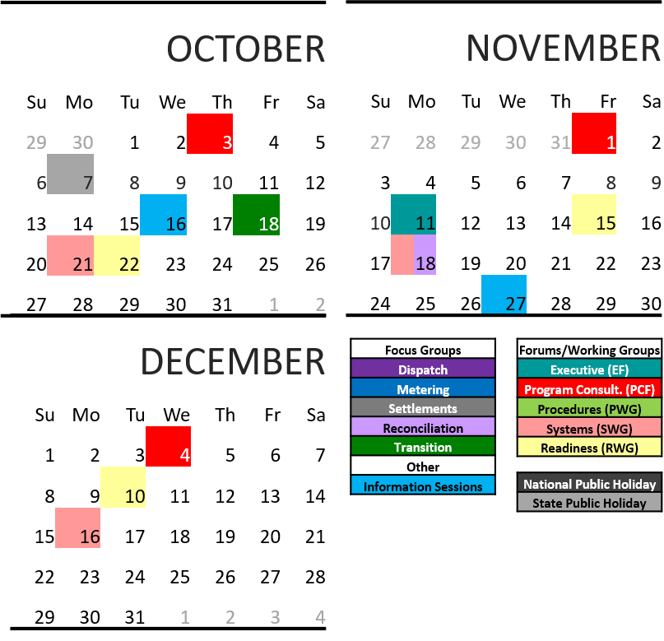
Upcoming information sessions calendar
Meetings and forum dates: http://www.aemo.com.au/Electricity/National-Electricity-Market-NEM/Five-Minute-Settlement

Slide 25
Staging Environment
Graeme Windley

Slide 26
5MS Staging Environment
What is the Purpose of the 5MS Staging Environment?
Assist participants building and testing their 5MS-related system changes.
Provide test environment for participants’ 5MS system testing:
  enable participants to test their interfaces with AEMO, and
  assist their development by being able to access early versions of screens, reports etc.
Supports AEMO in assessing product quality before it is released into pre-PROD & Market Trials.
What Functions will be Available in Staging?
Releases of various functions are scheduled from November 2019 to July 2020.
Relevant RM reports:
  Will be provided in 5MS format throughout Q2 & Q3 2020.
  Participants can request, via the 5MS Mailbox, reports that they would like to receive as early as possible. AEMO will consider what is feasible with respect to internal development constraints.

Slide 27
5MS Staging Environment
Expectation Setting:
Staging is not
  A Market Trial environment. There will be no co-ordination of Settlement Runs, Testing, Market Simulations, 7Day Pre-Dispatch, etc.
    The Market Trial approach and timing will be communicated with the Readiness approach.
  An end-to-End environment i.e. meter data information submitted won’t be reflected in a Settlement Run.
  A place to deploy functions that are not impacted by 5MS.
Performance is not guaranteed.
Defects can be raised, will be triaged and fixes scheduled into AEMO’s 5MS development work. There are no SLAs for updating software in Staging.
Input data (i.e. SCADA, demand forecasts) is likely to be static.
Access & Support
Participants arrange access to Staging by contacting AEMO Support Hub (5MS resolver group has been established in Service Now).
We encourage Participants to log defects via the AEMO Support Hub process too.

Slide 28
Dispatch
Shalindra Kulasuriya

Slide 29
5MS Staging Environment – Dispatch – Bidding API
Current
5-minute Settlements
API connections use SSL Certificate to secure transport layer
AEMO issues the SSL certificates to participants on request
Five Bidding API’s to support Energy, FCAS and MNSP bids.
POST API response will be compressed
Throttling on API calls to 1 call per second per participantID.
Participants required to change their systems to produce a JSON format for Energy, FCAS and MNSP bids, replacing the existing TXT format by 1 July 2021.
QUESTIONS ?

Slide 30
5MS Staging Environment – Dispatch – New Web Interface and FTP
5-minute Settlements
Supports both 30-mn and 5-mn bids.
Search and filtering to quickly locate DUID and ParticipantID info
Only accessible over MarketNet link
Supports CSV import and export of bids
5-minute bids must be in compressed JSON
Acknowledgements from AEMO for 5-minute bids will be in compressed JSON.
Supports JSON bid format for bid upload
MarketNet and Internet entry points
QUESTIONS ?

Slide 31
Bidding Data Model Changes
NEW FIELDS: (Page 43 of Tech Spec)
PACKAGE | TABLE NAME | DETAILS
BIDS | BIDOFFERFILETRK | Changes made to align with new API interface and improved Web bidding interface.
 | BIDDAYOFFER | Added fields to align with required rule rebidding fields
 | MNSP_DAYOFFER | New columns: REBID_EVENT_TIME, REBID_AWARE_TIME, REBID_DECISION_TIME, REBID_CATEGORY, REFERENCE_ID
NEW COLUMNS: BIDOFFERFILETRK
FIELD NAME | DATA TYPE | COMMENT
TRANSACTION_ID | VARCHAR2(100) | A GUID used to identify the submission transaction in AEMOs systems
REFERENCE_ID | VARCHAR2(100) | A participant provided reference, which is required to be unique per submission (for a PARTICIPANTID)
SUBMISSION_DATE | DATE | The participant provided date/time for the submission
COMMENTS | VARCHAR2(1000) | A participant provided comment

Slide 32
Bidding Data Model Changes
NEW FIELDS: (Page 43 of Tech Spec)
PACKAGE | TABLE NAME | DETAILS
BIDS | BIDOFFERFILETRK | Changes made to align changes made to support new API interface and improved Web bidding interface.
 | BIDDAYOFFER | Added fields to align with required rule rebidding fields
NEW COLUMNS: BIDDAYOFFER
FIELD NAME | DATA TYPE | COMMENT
REBID_EVENT_TIME | VARCHAR2(8) | The time of the event(s)/Other occurrence(s) as the reason for the rebid. Required for rebids, not required for fixed load or low ramp rates. Expected in the format: HH:MM:SS e.g. 20:11:00
REBID_AWARE_TIME | VARCHAR2(8) | Intended to support the AER Rebidding Guidelines. The time at which the participant became aware of the event(s) / occurrence(s) that prompted the rebid. Not validated by AEMO
REBID_DECISION_TIME | VARCHAR2(8) | Intended to support the AER Rebidding Guidelines. The time at which the participant made the decision to rebid. Not validated by AEMO
REBID_CATEGORY | VARCHAR2(1) | Intended to support the AER Rebidding Guidelines. A provided rebid category. Not validated by AEMO.
REFERENCE_ID | VARCHAR2(100) | A participants unique Reference Id

Slide 33
Bidding Data Model Changes
NEW TABLES: (Page 43 of Tech Spec)
PACKAGE | TABLE NAME | DETAILS
BIDS | BIDOFFERPERIOD | Stores 5-minute bid interval data Child table to BIDDAYOFFER
 | MNSP_BIDOFFERPERIOD | Stores 5-minute bid interval data Child table to MNSP_DAYOFFER
NEW COLUMNS:
BIDOFFERPERIOD (Page 47 of Tech Spec)
MNSP_BIDOFFERPERIOD (Page 51 of Tech Spec)

Slide 34
Pricing
5-minute Settlements
PRICING | DETAILS
ADMINISTERED PRICING | Energy prices are capped or floored based on a 5-minute Spot Price (not the 30- minute price).
 | The rolling-sum price calculation for Energy is now determined for 5-minute Spot Prices instead of 30-minute prices.
 | The Cumulative Price Threshold (CPT) is correspondingly increased to approximately six times the current value
MARKET SUSPENSION PRICING | AEMO applies the determined 30-minute suspension price as the associated 5-minute Spot Price.
NEGATIVE RESIDUE MANAGEMENT | No Change (as of September 2019)
QUESTIONS ?

Slide 35
Systems Workstream – Dispatch and Operations
Current as at 30-09-2019
5 MINUTE SETTLEMENT SYSTEMS TRACKING | TIMING
 | Internal HLIA | Focus/Group | SWG Engagement | External HLIA | Draft Tech Spec | Final Tech Spec | User Guides | 5MS Staging | Preprod | Production
DISPATCH and OPERATIONS
PACKAGE 1 - Bidding FTP and API
Transition | Aug-18 | Oct-18 | Aug-18 | Nov-18 | Dec-18 | 2-Apr-19 | 31-Oct-19 | 29-Nov-19 | Nov-20 | Mar-21
Bidding Data Model | Aug-18 | - | Sep-18 | Mar-19 | Dec-18 | 2-Apr-19 | 31-Oct-19 | 29-Nov-19 | Nov-20 | Mar-21
Bidding Format | Aug-18 | - | Sep-18 | Nov-18 | Dec-18 | 2-Apr-19 | 31-Oct-19 | 29-Nov-19 | Nov-20 | Mar-21
PACKAGE 2 - Bidding Web UI
Bidding Web UI and APIs | Aug-18 | Nov-18 | Dec-18 | Jan-19 | Mar-19 | 31-Jul-19 | 31-Oct-19 | 29-Nov-19 | Nov-20 | Mar-21
PACKAGE 3 - Dispatch, Pre-dispatch and PASA
Dispatch | Aug-18 | - | Oct-18 | Nov-18 | Oct-18 | 2-Apr-19 | - | 29-Nov-19 | Nov-20 | Mar-21
Predispatch P30/7DAY | Aug-18 | - | Oct-18 | Nov-18 | Oct-18 | 2-Apr-19 | - | 29-Nov-19 | Nov-20 | Mar-21
Predispatch P5 | Nov-18 | Oct-18 | Nov-18 | TBC | TBC | TBC | - | TBC | Nov-20 | May-21
ST and PD PASA | Aug-18 | - | Oct-18 | Nov-18 | Oct-18 | 2-Apr-19 | 31-Oct-19 | 29-Nov-19 | Nov-20 | Mar-21
PACKAGE 4 - Pricing and Miscellaneous
Trading Price / Price Revision | Aug-18 | - | Feb-19 | Nov-18 | Mar-19 | 31-Jul-19 | - | 15-May-20 | Nov-20 | May-21
Administered Pricing and CPT | Aug-18 | - | Feb-19 | Dec-18 | Mar-19 | 31-Jul-19 | - | 15-May-20 | Nov-20 | May-21
Suspension Pricing | Sep-18 | - | Feb-19 | Dec-18 | Mar-19 | 31-Jul-19 | - | 15-May-20 | Nov-20 | May-21
Negative Residue Management | Sep-18 | - | Feb-19 | Dec-18 | Jun-19 | 31-Jul-19 | - | 15-May-20 | Nov-20 | May-21
RERT | Oct-18 | - | - | - | - | - | - | - | - | -
PACKAGE 5 - Full Data Model
Full Data Model | Sep-18 | Ongoing | Ongoing | Apr-19 | Ongoing | 31-Jan-20 | 16 Mar 20 | 29-Nov-19 | Nov-20 | May-21

Slide 36
5MS Staging Environment - Dispatch
2019 |  |  | 2020
Oct | Nov | Dec | Jan | Feb | Mar | Apr | May | Jun | Jul
DROP ONE – 29 November 2019*
Submit 5-Min Bids, via new web interface, API and/or FTP.
Bidding Data Model changes as per technical specifications released July 2019
Participants can receive Dispatch, 5-minute Pre-Dispatch & 30-minute Pre-Dispatch data.
DROP TWO – 15 May 2020*
Trading data model changes
Administered pricing events
*Externally published deadlines. Additional features are likely to be released throughout the Staging period, and some may be earlier than the published dates.

Slide 37
Metering
Simon Tu

Slide 38
Metering
Objectives
Systems uplift (application, integration, data, infrastructure and security) to meet the 5MS and GS Rule Change requirements Non-functional requirements arising primarily due to increase in the volume of data (current and future volumes) and enriched data (e.g. MDFF data) Implement modern data exchange protocols (e.g. RESTful APIs) and formats (e.g. JSON) for the new functionalities and current functionalities where there are significant changes Provide support for legacy interfaces to support transition / contingency Minimise the impact to Participant’s systems and processes by aligning to existing processes by which Participants generate metering data and manage exceptions. Allow AEMO to reliably and accurately obtain settlement ready metering data and register level data to support the calculation of UFE. Improved system and operational efficiencies across the market by unifying the data formats across the industry.

Slide 39
Meter Data Delivery
Meter Data Notifications for Market Settlements
Existing MDMT Message Exchange patterns and Validations to be supported Acceptances of MTRD NEM12 and NEM13 for Market Settlements The MTRD shall support three distinct purposes B2B MTRD Meter Data Notifications – For Retail Settlements B2M MTRD Meter Data Notifications – For Transmission Use of System (TUoS) billing B2M MTRD Meter Data Notifications – For Market Settlements MDPs to identify MTRD Meter Data for Market Settlements ‘NEMMCO’ as the To Party Identifier in the aseXML Header record ‘NEMMCO’ as the Participant ID in the MDFF Header record (100) ToParticipant <SecurityContext> aseXML element is mandatory

Slide 40
Meter Data Delivery
Meter Data Notifications for Market Settlements
Message patterns for MTRD B2M Market Settlements shall mirror that described in the B2B Procedure Technical Delivery Specification

Slide 41
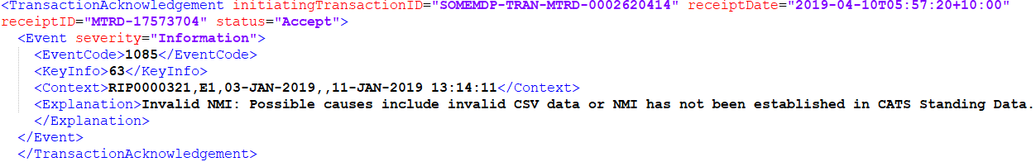
Meter Data Delivery
Meter Data Notifications for Market Settlements
AEMO to provide MDFF validations in the Transaction Acknowledgement AEMO to “Accept” reads where standing data has not been established Metering data for Data Streams and meter registers not in CNDS can load. NMIs not established in CATS NMI Data (CND) can load. Metering data sent by a participant not in the CATS NMI Participants Relationships (CNPR) role can load. Support for Net and Register level Data Streams: AEMO shall calculate Net from E’s and Bs where a net datastream is define in the CNDS table Delivered net data streams must be converted to register-level data streams for Types 1, 2, 3 and subset of Type 4 meters, in CNDS table by 1 July 2021 Meter data and data streams associated to reactive energy should be delivered to AEMO where the Q and/or K registers exist in the CRI table 10MB File Size AEMO shall support 10MB files for MTRD and MDMT Meter Data Notifications

Slide 42
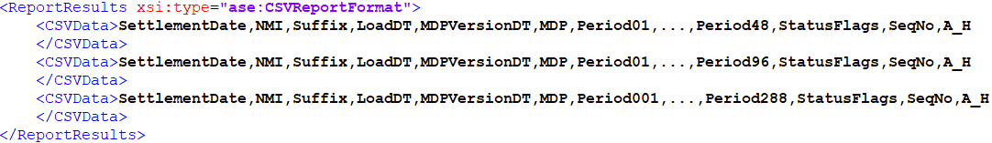
RM Reports
RM Reports
Reports to be Retired RM07 – MDP Data Delivery Report RM08 – Date PPS BMP Generated Report RM10 – Load Aggregation Error Report RM12 – Wholesale Maximum Value Report RM14 – MDP Data Version Comparison Report RM15 – Multiple Version Report RM18 – Electricity Interval Data Report RM19 – Aggregated Actual vs Estimate Report Existing Report Updates Existing Reports will be updated to reflect meter reads and settlement intervals 5 / 15/ 30 minutes from 1 July 2021 Reports that display Interval Data must include payloads with 48, 96 and 288 interval periods Existing Reports will include Tier 1 and Tier 2 meter data

Slide 43
RM Reports
RM Reports
New Meter Reading Reports RM37 – High Priority Missing Data Report – for Wholesale, generator and interconnector NMI’s RM38 – DataStream Missing Data Report – DataStream level (NEM12) missing readings to support ‘N’ settlement data streams RM39 – Mismatch Data Report – identifies where AEMO has received meter reads for E and B data streams that do not support ‘N’ data streams and do not match the NMI Data Stream standing data. Focus on Delivery of Reading to support Settlements RM37 – will be sent daily after meter data load RM38 – will be sent 1 day prior to each settlement run RM39 – will be sent 1 day prior to each settlement run New UFE Report RM43 – UFE Factor Values by Local Area – UFEF profile for each local area to assist in calculation of UFEA. Report Delivery All new reports will be pushed to subscribed Participants to allow: Delivery of meter reads prior to settlement run Remove the need for Participant to manually request reports

Slide 44
New NMI Classification Codes (1)
NMI Classification Codes | Description | Rule Requirement
WHOLESAL | Transmission Network connection point where energy is directly purchased from the spot market by a Market Customer Connection | No Rule requirement Provides the ability to distinguish between distribution and transmission market customers directly purchasing from the spot market
DWHOLSAL | Distribution network connection point where energy is directly purchased from the spot market by a Market Customer | No Rule requirement Provides the ability to distinguish between distribution and transmission market customers directly purchasing from the spot market
BULK | Connection point where a transmission network connects to a distribution network - also termed 'Bulk Supply Point' | To distinguish between bulk supply points and customers purchasing directly from the spot market. Under GS, no retailer has financial responsibility for a transmission/distribution boundary supply point.

Slide 45
New NMI Classification Codes (2)
NMI Classification Codes | Description | Rule Requirement
XBOUNDRY | Connection point where a distribution network connects to another distribution network | Supports the calculation of UFE (UFE = TME - DDME – ADME) DDME is the amount of electrical energy, expressed in MWh, flowing at each of the distribution network connection points in the local area which are connected to an adjacent local area
NREG | Connection point associated with a non-registered embedded generator, i.e. a generating unit that is not classified by a Market Generator, but may be classified by a Small Generation Aggregator as a market generating unit. | UFE is not to be allocated to embedded generators either when they have negative flows (net consuming) from the grid to their connection point or positive flows (net supplying) from their connection point to the grid.
NCONUML | Non-contestable unmetered loads | Non-contestable unmetered loads to be accounted for in settlement, removed from UFE calculated values and not included in FRC component of Participant Fees.

Slide 46
MSATS Web Portal
MSATS Web Portal Changes
B2B Functions Upload File – To upload and identify MTRDs for Market Settlements Hub Queue – To allow B2B API users to managed B2M MTRDs B2M Functions Metering Data Search – Changes to accommodate 5/15/30 minute metering reads as well as register level datastream MDM Reports – To include new reports Participant Hub Queue – To allow B2M via API users to manage undelivered B2M responses Participant aseXML Schema – To allow participants to set their preferred protocol, FTP or API

Slide 47
B2M Communications - B2M via API
Item | Discussion
Legacy B2M Web Services shall remain via MarketNet https://msats.prod.nemnet.net.au/msats/ws/ shall be extended for access via the Internet (VPN) B2M Message Submission via FTP via MSATS Browser via Internet (VPN) facing Push API B2M Message Response Participants to elect FTP or API by Transaction Group via Internet (VPN) facing Push API via Internet (VPN) facing Pull API | No further services outside of the legacy B2M Synchronous Web Services shall be developed Message Submission and Response protocols are independent API Message patterns (Internet) API modelled on SMP Asynchronous Push-Push API modelled on SMP Asynchronous Push-Pull Some variation message payloads to reflect the differences between B2M and B2B

Slide 48
B2M Communications - B2M via API
Item | Discussion
Additional Hub Message Managing APIs Flow Control Notification API Flow Message Acknowledgement Validation Failure Hub Flow Control Report | Extension of the SMP HMGT transaction group to B2M

Slide 49
Systems Workstream - Metering
Current as at 30-09-2019
5 MINUTE SETTLEMENT SYSTEMS TRACKING | TIMING
 | Internal HLIA | Focus/Group | SWG Engagement | External HLIA | Draft Tech Spec | Final Tech Spec | User Guides | 5MS Staging | Preprod | Production
METERING
PACKAGE 1 - Metering Data & Metrology
MDFF • MDFF Specification NEM12 NEM13 v20 | Aug-18 | Oct-18 | Oct-18 | Nov-18 | Jan-19 | Apr-19 | - | 1 Dec 19 | Sep-20 | Nov-20
PACKAGE 2 - MSATS & SLPs
Transition • MSATS Release Schedule & Technical Specification | Aug-18 | Sep-18 | Aug-18 | Nov-18 | 31-May-19 | 30-Sep-19 | - | - | - | -
Meter Data - MDFF and MDMF • MDM File Format and Load Process (User Guide) • MSATS Release Schedule & Technical Specification | Aug-18 | Oct-18 | Sep-18 | Nov-18 | 31-May-19 | 30-Sep-19 | - | 1 Dec 19 | Sep-20 | Nov-20
PACKAGE 3 - Miscellaneous
B2M via API • MSATS Release Schedule & Technical Specification | Oct-18 | - | Apr-19 | 9-May-19 | 31-May-19 | 30-Sep-19 | 31-Oct-19 | N/A | 17-Feb-20 | 17-Mar-20
MSATS Browser (LVI) changes • MSATS Release Schedule & Technical Specification | Aug-18 | - | May-19 | 9-May-19 | 28-Jun-19 | 30-Sep-19 | 31-Jul-20 | 31-Jul-20 | Sep-20 | Nov-20
MSATS Report changes • MSATS Procedures MDM Procedure • MDM File Format and Load Process (User Guide) • MSATS Release Schedule & Technical Specification General Process & Document Clean-up | Oct-18 | - | Apr-19 | Apr-19 | 28-Jun-19 | 30-Sep-19 | - | 31-Jul-20 | Sep-20 | Nov-20

Slide 50
5MS Staging Environment - Metering
2019 |  |  | 2020
Oct | Nov | Dec | Jan | Feb | Mar | Apr | May | Jun | Jul
DROP ONE – 1 December 2019*
Allow MDPs to confirm the connectivity of their test environments with the AEMO 5MS Staging Environment.
Allow MDPs to confirm that MTRD CSV MDFF created by their systems for Market Settlements are able to pass new AEMO validations (30 min and 5 min).
Allow MDPs to validate FTP hokey pokey protocol for MTRD exchange with the NEMMCO participant ID.
DROP TWO – 31 July 2020* (note some content will be delivered earlier)
Meter Data Ingestion of MTRD (NEM13) and MDMT
Support for API Meter Data Ingestion
MSATS Browser screens
B2M CATS, NMID, and MDM transactions and B2B message exchange supported
RM Reports
*Externally published deadlines. Additional features are likely to be released throughout the Staging period, and some may be earlier than the published dates.

Slide 51
Reallocations
Pierre Fromager

Slide 52
Reallocations
Available at both 30 min (for reallocations prior to 1/7/21) and 5-min intervals (for reallocations starting on or after 1/7/21)
New Web UI allowing upload of CSV reallocations
New APIs matching Web functions
Selection of a calendar for regional public holidays
Alerts for creation and changes to reallocations.
*Externally published deadlines. Additional features are likely to be released throughout the Staging period, and some may be earlier than the published dates.

Slide 53
Reallocations Web UI
Number of trading interval rows multiplied by 6 – total will be 288
  Introducing bulk edit, condensed view, grid view ($ & MWh only)
  Offering search facility
  Ability to download and upload to and from CSV file format
  Improved authorisation confirmation
  Authorising party can now reject a submitted reallocation
  Selection of a calendar for applicable Public holidays
  Reverse or duplicate a reallocation
Introducing warning dates (EADD WD and EPDD WD), 2 days prior to due date; this will be used in alerts
  Alerts are included for Staging Environment drop 1, but may be delayed due to testing impact
  Two new alerts: changes to reallocations and warning dates

Slide 54
Reallocations – functionality available in Staging
Objectives
  Allow participants to test submitting reallocation requests to AEMO from their systems via APIs
  Allow participants to use the new Reallocations Web UI and provide feedback

Slide 55
Reallocations – functionality available in Staging
Reallocations
Submit, authorise and view reallocations via Web UI
Submit or authorise a reallocation via APIs and receive acknowledgement
Retrieve reallocations via APIs
Retrieve support information (regions, calendars, participants) via APIs
Restrictions
  APIs may only be accessed from the internet.

Slide 56
Reallocations – functionality available in Staging
5min vs 30 min reallocations
Both the Web UI and the APIs will handle both 5 and 30min reallocations:
Reallocations spanning before the Commencement Date (1/7/2021) will expect and provide 48 intervals (i.e. 30min).
Reallocations spanning after the Commencement Date will expect and provide 288 intervals (i.e. 5min).
Reallocations will be rejected if they span across the Commencement Date.

Slide 57
Reallocations APIs – functionality available in Staging
New set of APIs to submit, authorise, search and retrieve reallocations.
Uses JSON files for input and output
Messaging – errors and acknowledgements
Core | Support
submitReallocation authoriseReallocation cancelReallocation getReallocation getReallocations | getAgreementTypes getCalendar getCalendars getParticipants getProfileTypes getReallocationSteps getRegions getMarketPriceCap

Slide 58
Settlements
Pierre Fromager

Slide 59
Settlements Calculations
Settlements
Receiving new NMI classes (discussed in Retail stream) to allocate UFE across all customers in a distribution network.
Calculations changed to be based on an trading ‘interval length’ variable (set to 30 then to 5). Settlements continue to handle 30-mn data during transition period.
Data Model
New tables reporting UFE figures for local areas.
Additional UFE columns in participants’ energy tables, at the TNI level.
*Externally published deadlines. Additional features are likely to be released throughout the Staging period, and some may be earlier than the published dates.

Slide 60
Settlements Calculations
Settlements
Receiving new NMI classes (discussed in Retail stream) to allocate UFE across all customers in a distribution network.
Calculations changed to be based on an trading ‘interval length’ variable (set to 30 then to 5). Settlements continue to handle 30-mn data during transition period.
Data Model
New tables reporting UFE figures for local areas.
Additional UFE columns in participants’ energy tables, at the TNI level.
*Externally published deadlines. Additional features are likely to be released throughout the Staging period, and some may be earlier than the published dates.

Slide 61
Billing & Invoicing: what’s changing
Billing
5MS does not directly impact Billing since it aggregates daily values. Billing should work seamlessly during transition week
Mandatory restrictions and smelter reduction line items are dropped
Invoicing
AEMO will make presentation changes to Settlement statements. These will be effective from release and occur prior to the commencement date
SR report includes DME and UFEA

Slide 62
UFE (Global Settlements)
GS introduces a new UFE calculation
UFE was assigned to the FRMP responsible for a local area
It is now allocated to all market participants within a distribution network
Metering will provide ‘NMI Net’ sums of customer energy (i.e. net of generated energy at a NMI level)
Distribution network is defined using NMI classifications
The SR report includes DME and UFEA
Settlement Data Extract file – includes DME and UFEA
Local Area UFE Data Extract file – new report

Slide 63
Settlements & Billing
Data Model – added columns
Billing_Run. Billing CP Data
  AFE
  DME
  UFEA
  UFEA Dollar Value
Settlements_Data. Set CP Data
  AFE
  DME
  UFEA
  AGE
Settlements_Data. Set Market Fees
  Fee Rate
  Fee Units

Slide 64
Settlements & Billing
Data Model – New tables
Settlements_Data . Set Local Area Energy
  Settlement Date
  Settlement Run No
  Local Area ID
  Period ID
  UFE
  DDME (cross-boundary energy)
  TME (= ADME + DDME + UFE)
  ADME (total ME * DLF)
  ADMELA (total DME)
  LASTCHANGED

Slide 65
Settlements & Billing
Data Model – New tables
Settlements_Data . Set Local Area TNI
  Settlement Date
  Settlement Run No
  Local Area ID
  TNI
  LASTCHANGED
  Relational table linking one or more TNIs to one LA

Slide 66
Systems Workstream - Settlements
Current as at 30-09-2019
5 MINUTE SETTLEMENT SYSTEMS TRACKING | TIMING
 | Internal HLIA | Focus/Group | SWG Engagement | External HLIA | Draft Tech Spec | Final Tech Spec | User Guides | 5MS Staging | Preprod | Production
SETTLEMENTS
PACKAGE 1 - Reallocations
Reallocations | Dec-18 | Nov-18 | Dec-18 | Mar-19 | 31-Jul-19 | 15 Oct 19 | 1-Nov-19 | 1-Nov-19 | 1-Mar-20 | 1-Apr-20
PACKAGE 2 - Settlements and Billing
Settlements | Oct-18 | Nov-18 | Dec-18 | Mar-19 | 30-Aug-19 | 20 Dec 19 | - | 16 Mar 20 | Nov-20 | May-21
Billing | Oct-18 | Nov-18 | Dec-18 | Mar-19 | 30-Aug-19 | 20 Dec 19 | - | 16 Mar 20 | Nov-20 | May-21
PACKAGE 3 - Prudentials and Estimation
Prudentials | Sep-18 | Nov-18 | Dec-18 | Mar-19 | 31-Oct-19 | 31 Jan 20 | 15 May 20 | 15 May 20 | Nov-20 | May-21
Estimation | Oct-18 | Nov-18 | Dec-18 | Mar-19 | 31-Oct-19 | 31 Jan 20 | - | 15 May 20 | Nov-20 | May-21
Full Data Model | Refer DISPATCH

Slide 67
5MS Staging Environment – Settlement
2019 |  |  | 2020
Oct | Nov | Dec | Jan | Feb | Mar | Apr | May | Jun | Jul
DROP ONE – 1 November 2019*
Reallocations: available at both 30 and 5-min intervals; new Web UI; Calendar selection; Alerts
DROP TWO – 31 January 2020*
Completed Data Model: New UFE tables, additional UFE columns.
DROP THREE – 16 March 2020* (note tracking ahead of schedule)
Settlements & Billing, including 5-min & Global Settlements. New invoice templates. Decommission of Mandatory Restrictions in NEM Settlements.
*Externally published deadlines. Additional features are likely to be released throughout the Staging period, and some may be earlier than the published dates.

