Slide 1
5MS & GS Program
General Information Session
31 July 2020

Slide 2
Welcome and Introduction
Peter Carruthers

Slide 3
Purpose of the Information Session
The general information session provides an opportunity for stakeholders who:
Are not directly engaged in the 5MS Program to receive an update on the Program’s progress and an insight into the key areas of focus.
Have not previously engaged with the 5MS Program to receive a high-level introduction to the Program.

Slide 4
Agenda
NO | Time | AGENDA ITEM | Responsible
1 | 10:00 – 10:05 | Welcome and introduction | Peter Carruthers
2 | 10:05 – 10:15 | What is the 5MS Program? | Peter Carruthers & Anne-Marie McCague
3 | 10:15 – 10:25 | Impact of 5MS and GS to NEM Systems | Graeme Windley
4 | 10:25 – 10:35 | Impact of AEMC decision to defer 5MS and GS rule commencement | Emily Brodie & Rowena Leung
5 | 10:35 – 10:40 | AEMO 5MS Program Update | Rowena Leung & Graeme Windley
6 | 10:40 – 10:50 | How does the 5MS Program interact with other market changes? | Peter Carruthers
7 | 10:50 -11:00 | Industry Readiness – how is the industry progressing? | Greg Minney
8 | 11:00 – 11:10 | Participant Testing – what, when and where? | Greg Minney
9 | 11:10 – 11:20 | Questions | All
10 | 11:20 | Meeting close | Peter Carruthers

Slide 5

The Speakers
AEMO 5MS & GS Program contacts:
  Chair: Peter Carruthers, Business Advocate
  Rowena Leung, Program Director
  Graeme Windley, Senior Project Manager
  Greg Minney, Readiness Manager
  Emily Brodie, Industry Readiness Manager
  Anne-Marie McCague, Stakeholder Manager

Slide 6

Questions & Feedback
Feel free to ask questions throughout the
session via:
WebEx comments
For more detailed questions, or for any further questions you may have after the session, or to provide engagement feedback, email:
5ms@aemo.com.au
Please note: this session will be recorded for internal use.

Slide 7
What is the 5MS Program?
Peter Carruthers & Anne-Marie McCague

Slide 8













5MS Roadmap
GS Market Trials
AEMO is working with industry to implement changes arising from an AEMC Final Determination to implement Five-Minute Settlement (5MS) and Global Settlement (GS) rules.
5MS Market Trials
GS 1-Feb to 15-Mar 2022
9 Mar 2021: MDM system go-live
5MS 5-Jul to 27-Aug 2021
Testing
29-Nov ‘20 to 15-Mar ’21
1-May: GS rule commencement
1 Apr 2020: Reallocations go-live
1-Oct: 5MS rule commencement
6-Dec 2018: AEMC made GS rule
1 Apr 2021: 5-minute Bidding & Settlement solution go-live
3-month deferral
May 2022
Mar 2022
Industry Working Groups established
9 Jul 2020: AEMC delayed both 5MS & GS rule by 3 months
Oct 2021
Aug 2021
8-Aug 2019: AEMC Amended the 5MS & GS rules to improve and clarify
Apr 2021
5MS Program established
Mar 2021
Jul 2020
Apr 2020
28 Nov 2017: AEMC made 5MS rule
Aug 2019
Dec 2018
Reference Key
July 2018
Early 2018
Icon | Decision-maker
 | Regulatory
 | AEMO/ 5MS Program
Nov 2017
8

Slide 9
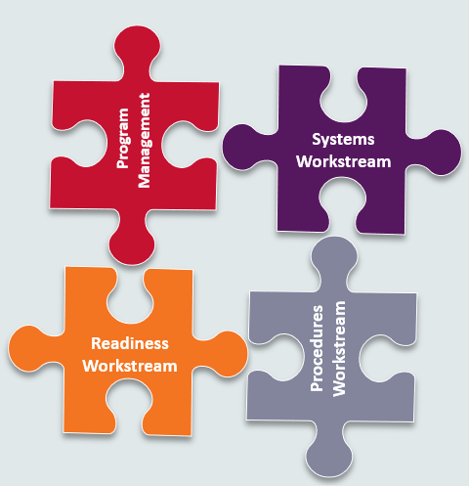

The 5MS Working Groups are AEMO’s framework to facilitate two-way communication with Industry
5MS Program
Who’s impacted:
  Generators
  Retailers
  Metering Providers (MP)
  Meter Data Providers (MDP)
  Metering Coordinators (MC)
  Distribution Network Service Providers (DNSP)
  Transmission Network Service Providers (TNSP)
5MS Working Groups

Slide 10
Industry Engagement framework
Engagement between AEMO and industry is crucial to the 5MS Program’s success, which is why each 5MS workstream has been aligned to an industry working group.
Executive
Forum (EF)
Program Consultative Forum (PCF)
Systems
Working Group (SWG)
Readiness
Working Group (RWG)
Procedures
Working Group (PWG)
Industry Testing
Working Group (ITWG)
EF: an information and discussion forum for executive-level representatives of interested organisations
PCF: provides review of relevant documentation and management oversight for 5MS working groups.
Now closed
Merged
RWG: coordinates readiness activities across the industry, particularly with respect to market testing and trials
SWG: seeks input from industry on system design and interface changes to support 5MS and GS implementation.
PWG: a forum to engage with industry stakeholders during the procedure development process.
ITWG: provides a forum for AEMO and industry stakeholders to engage in detail on testing matters related to the 5MS & GS implementation program.

Slide 11
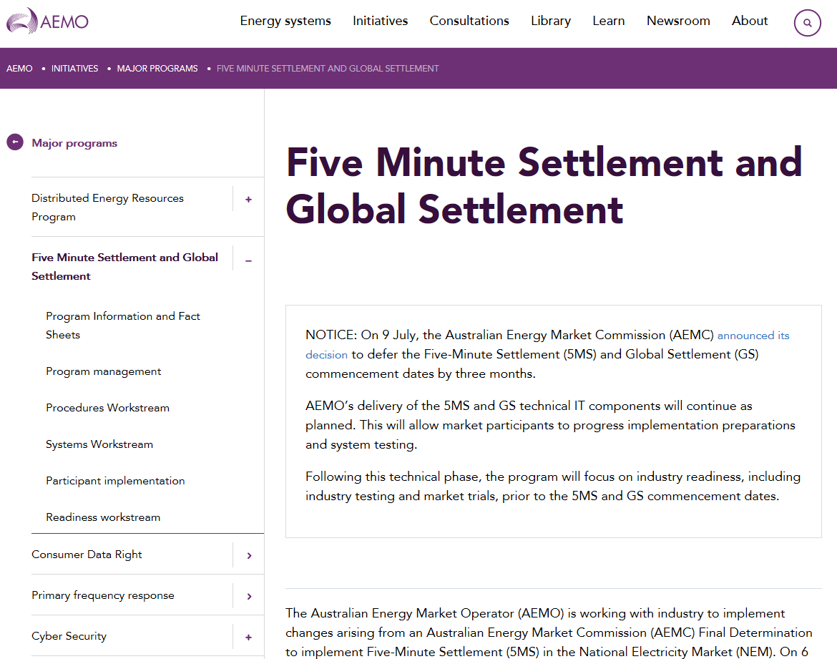


How can I learn more?
Key links:
5MS Rule
GS Rule
Rule Amendment
Deferral Decision
AEMO’s 5MS Program website
AEMC’s website
Contact the 5MS team at:
5ms@aemo.com.au

Slide 12
Impact of 5MS and GS to NEM Systems
Graeme Windley

Slide 13
Program Scope (Systems Focus)
Dispatch
Metering
Settlements
Function
Manages demand forecasting and the dispatch price every 5-minutes (and aggregates spot price every 30 minutes). Ensures electricity demand is met.
Function
Manages receipt and storage of market data (metering and standing data). Metering prepares data for market settlement and enables market reporting.
Function
Manages the calculation of financial liabilities and credits between market participants daily and settles all trade in the NEM on a weekly basis.
Systems Workstreams
Scope of change
Increase daily bidding intervals from 48 to 288.
New data structures required to receive, use and store five-minute bids and offers.
Changes required to calculate the floor price and price cap.
AEMO to publish five-minute data.
Scope of change
Enable receipt of metering data every 5 minutes.
Enable management of >2 trillion data points by 2028.
Change profiling algorithms to derive 5 minute energy data.
Enable energy allocation to be at 5, 15 and 30 minute intervals.
Scope of change
Enable settlement on 5 min granularity, 5 min price, and Marginal Loss Factors (MLF)
Settlement estimations will calculate energy transactions per 5 min period.
Additional calculations (i.e. market ancillary services, FACS), to be calculated with 5-minute data.
Solution Path
Enhance Legacy Systems
Solution Path
Build New Solution using Strategic Technologies
Solution Path
Enhance Legacy Systems
Program Management
Remainder 5MS & GS Program
Market Procedures, Stakeholder engagement and market/industry readiness
Process Mapping, Change and Training, Cutover and Transition
Infrastructure / External Web Development / Internal webMethods Integration

Slide 14
NEM Wholesale System Change Heatmap
DISPATCH
SETTLEMENT
POWER SYSTEM
Bids/Offers
Settlement 5MS Calc.
Negative Residue Management
Data Model
Settlement GS Calc.
ST PASA
Dispatch
Estimation and Prudentials
RERT
Predispatch (P5/P30s)
Reallocations
Data Model
Spot Price
Data Model
MT PASA / EAAP
Administered Pricing
IRSR Calc.
Demand Forecasting
Suspension Pricing
SRA
Generator Recall
Constraints
Causer Pays Factors
Wind/Solar Availability
Registration
VAR/MW Dispatch

Slide 15
NEM Retail System Change Heatmap
B2M / B2B Interfaces
CATS / MDM Processes
MSATS Browser / Reports
MDMT
Profiling
Meter Data screens
B2M aseXML schema
CATS Standing Data
RM21/27
NMID
Meter Data Validation
C1,4
CATS
Estimation / Substitution
RM11,12,13,14,16
RM17,18,19,20,22
MSATS B2M APIs
Energy Allocation
RM28,30,31,32
RM33
B2B Transactions
CR Processing
SDR
B2B aseXML schema
RM7,8,9,10
RM15,29
VIC TUoS
C2,3,6,7,9,10
C11,12,13

Slide 16
5MS Architecture On a Page

Slide 17
Impact of AEMC decision to defer 5MS and GS rule commencement
Emily Brodie and Rowena Leung

Slide 18
Rule change process
9-Apr-20
AEMO submits a rule change request to AEMC proposing a 12-month deferral to the 5MS and GS rule commencements, recognising the impact of Covid-19 on the industry.
14-May-20
AEMC publishes a consultation paper and seeks feedback on the proposed rule change over a four week period
The consultation is carried out under the expedited rule change process
9-Jul-20
AEMC publishes final determination and rule
5MS and GS rule commencements deferred by three months

Slide 19
AEMC Decision – three-month deferral
Activity | Original date | New date
Commencement of 5MS | 1 July 2021 | 1 October 2021
Commencement of “soft start” GS | 1 July 2021 | 1 October 2021
Commencement of financial settlement of GS | 6 February 2022 | 1 May 2022
Compliance date for all new and replacement metering installations (other than excluded metering installations) to be configured to record and provide 5-minute data | 1 December 2022 | 1 December 2022
AEMO required to publish UFE data report | 1 July 2021 | 1 October 2021
AEMO required to publish UFE report on unaccounted for energy trends | 1 March 2022 | 1 June 2022

Slide 20

AEMO’s implementation program remains unchanged
The Program is committed to meeting the original dates it set for IT systems development and deployment to allow market participants extra time to prepare and test their systems ahead of the new Industry go live dates.
1-Apr: 5-min Bidding Phased Go-Live begins
1 Apr: Settlement Platform Go-Live
1-Oct:Commencement of 5MS
(New date)
1-Jun: AEMO required to publish UFE data report on unaccounted for energy trends
Industry readiness*
(New date)
2021
2022
Mar
Apr
May
Jun
Aug
Sep
Nov
Jul
Oct
Dec
Jan
Feb
Mar
Apr
May
Jun
Jul
Aug
Sep
Oct
Dec
9-Mar: AEMO Metering Solution Go-Live
1-Dec: Compliance date
for all new and replacement metering installations
1-Oct: GS soft start
Industry readiness*
1-May: Commencement of financial settlement of GS
1-Oct: AEMO required to publish UFE data report
(New date)
(New date)
*Note: Industry readiness includes testing and market trials

Slide 21
AEMO 5MS Program Update
Rowena Leung and Graeme Windley

Slide 22


Six months looking back
The 5MS Program achieved some significant milestones during the year, including the first system go-live on 1 April with the Reallocations solution.
This solution provides the capability to receive reallocations at five-minute intervals in preparation for commencement of the 5MS rule.
31-Jan: Settlements Package 1 in Staging
15-May: Settlements Package 3 in Staging
26-Feb: Reallocations I Pre-Production
15-May: Dispatch Package 2 in Staging
16-Mar: Settlements Package 2 in Staging
15-Jun: Staging Retail Release 2
1-Apr: Reallocations Go-Live
Jan-Jun 2020
Jan | Feb | Mar | Apr | May | Jun
7-Feb: Final Metering Transition Plan
Reference Key
 | Readiness activity
 | System activity
 | System go-live
18-Feb: Final MSP Accreditation Update Plan
7-May: Readiness Reporting Round 2 Results
28-Feb- Readiness Reporting Round 1 Results

Slide 23

A forward view: 2020-2021
31-Aug: AEMO Internal Development complete
1-Apr: 5-min Bidding Phased Go-Live begins
1 Apr: Settlement Platform Go-Live
31-Aug: Staging Retail Release 3
9-Mar: AEMO Metering Solution Go-Live
1-Oct:Commencement of 5MS
1-Oct Soft start of GS
Jul-Dec 2020
Jan-Dec 2021
Jul | Aug | Sep | Oct | Nov | Dec
Jan | Feb | Mar | Apr | May | Jun | Jul | Aug | Sep | Oct | Nov | Dec
9-Jul: AEMC announces deferral decision
Dispatch Testing
29-Nov: Dispatch Industry Test starts & 15 Mar concludes
10-Dec: Readiness Reporting Round 5 Results
5MS
Market Trial
24-Jul: Special Readiness Survey Results
20-Nov: Final Industry Go-Live Plan – Retail MDM
Settlem’ts
Testing
MDM/B2M
5-Jul:5MS Market Trial starts
27-Aug:5MS Market Trial concludes
Reference Key
 | Readiness activity
 | System activity
 | System go-live
 | Rule commencement
28-Aug: Final Industry Transition Plan – Bidding
29-Oct: Readiness Reporting Round 4 Results
17-Feb: Settlements Industry Test starts & 15-Mar: concludes
3-Sep: Readiness Reporting Round 3 Results
1-Feb Retail MDM/B2M starts & 3-Mar: concludes
Readiness reporting
Dates TBA

Slide 24
A forward view: 2022
1-May: Commencement of financial settlement of GS
1-Dec: Compliance date
for all new and replacement metering installations
1-Jun: AEMO required to publish UFE report on unaccounted for energy trends
Jan-Dec 2022
Jan | Feb | Mar | Apr | May | Jun | Jul | Aug | Sep | Oct | Nov | Dec
GS
Market Trial
1-Feb:5MS
Market Trial
starts
15-Mar:5MS Market Trial Concludes
Reference Key
 | Readiness activity
 | Compliance activity
 | Rule commencement

Slide 25
How does the 5MS Program interact with other market changes?
Peter Carruthers

Slide 26
Interaction with other market changes
Regulatory Implementation Roadmap
  Holistic view of the industry-wide program for implementation of regulatory change initiatives
  Initiated following Executive Forum discussion and Market Bodies regulatory prioritisation review
Version 1 of roadmap
  Developed and consulted on by AEMO in April/May
  Go-live date assumptions for key initiatives 5MS and WDR
Go-Live dates for WDR and 5MS have now been finalised
Key issue will be co-ordination of regulatory implementation in 2H 2021
  5MS – 1 October 2021
  WDR – 24 October 2021
  Customer switching – 3Q 2021
  Other initiatives originally flagged including NMI Standing Data Review, Metering Co-ordinator Planned Interruptions and Stand-Alone Power Systems.

Slide 27
Interaction with other market changes
Regulatory Implementation Roadmap Update
  Currently being updated by AEMO
  Will be released to industry and consulted on
  Includes any newly confirmed initiatives/dates and identifies where flexibility exists
Timeline for release and consultation
  4 Aug - Updated roadmap released
  10 Aug – Stakeholder briefing session
  17 Aug – Stakeholder feedback closes
  31 Aug – Version 2 Roadmap released
Likely consultation questions
  Customer Switching – mid-July 2021 or October 2021?
  Timing of MSATS Standing Data Review and MC Planned Interruptions
  Timing of Proposed B2B changes
Recognise need for integrated implementation timeline, once dates confirmed

Slide 28
Industry Readiness – how is the industry progressing?
Greg Minney

Slide 29


Readiness approach
AEMO's Readiness Workstream is responsible for activities in preparation for transition to and commencement of the 5-Minute Settlements and Global Settlement rules. Activities include:
Industry readiness reporting
Industry testing & Market trials
Market Readiness Strategy
Market trial/ Industry test plans
Industry transition & Go-live
Transition plans
Cut-over plans
Industry contingency
Metering service provider accreditation update
Notes:
Scope of the readiness Program:
In line with the program progression:
Approach to readiness reporting agreed and in progress – overview on the next couple of slides
Strategies and phasing for market trials and industry testing has been agreed – timings of those phases outlined above
Will talk more about in next section
Industry transition and go-live – overall transition strategy encompassing a phased go live strategy has been agreed
delivery of market capability as early as possible to allow particpants to undertake prepatory activities – eg rollout of 5 minutes , updates to standing data
pahsed delivery also looks to minimise the risk of all market going live at rule commencement date
As key mtering transition plan – covering the metering changes required for 5MSand GS agreed – currently working through to reflect impact to programs of the 3 month deferral in rule commencement – UFE – Tranches of meters
similarly Bidding transition plan is currently being consulted with Industry
Willl be working with tindustry in developing the Industry go-lives plans to support each on the platform go-lives
Metering Service Provider accreditation update:
program where those metering service providers who are making changes to systems and processes have their accreditation updated – level of impact dependent on the extnent of change they are making
essentially a BAU process but has impact on 5MS due to potential extent of changes

Slide 30
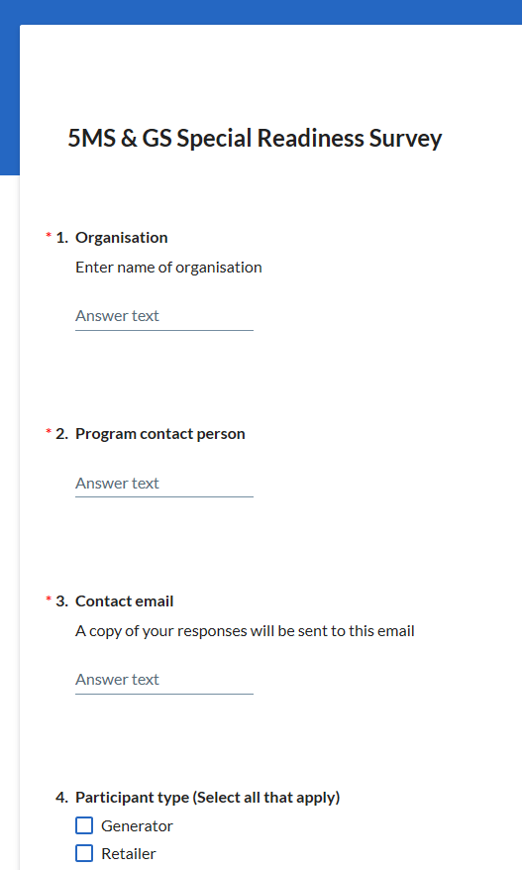

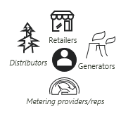


Readiness reporting approach
Readiness reporting is voluntary
We encourage open and honest self-assessment
Responses are confidential (although we do publish a list of respondents)
Results are aggregated to produce a report
Results are discussed with our RWG and together we identify any actions that need to be taken
Online Participant survey
Full Report
Discuss results at working groups
Targeted action
Notes:
Objective:
To facilitate readiness reporting throughout the implementation phase of 5MS and GS so that AEMO, NEM participants and other interested stakeholders have an accurate assessment of industry’s readiness for the various 5MS and GS market system “go-lives”, transitional activities and commencements.
Key Principles:
Industry participation in the readiness reporting process is voluntary but strongly encouraged and in the interest of all participants.
Participants are responsible for establishing their own appropriate project schedule baselines and reporting their status against these.
Participants will submit open and honest self-assessments of their readiness status, following a framework and format set out in the Industry readiness reporting plan.
Readiness reporting information will be collated and submitted by an authorised person on behalf of their organisation.
AEMO will develop and seek input from the RWG on readiness reporting criteria.
Readiness reporting will be on a regular basis, following a defined calendar developed in collaboration with the RWG. In developing the reporting calendar, the effort of reporting will be balanced with the value of reporting.
As far as practicable, changes to the readiness survey questionnaire will only occur where further detail is required on key criteria.
AEMO will aggregate survey responses and prepare a Market Readiness Report following the approach defined in the readiness reporting plan
All responses will be treated as strictly confidential in-line with AEMO policies. The results from any analysis will be reported in aggregate and no individual organisations will be identified or identifiable.

Slide 31
Reporting Criteria
General Readiness Criteria
Specific Readiness Criteria
Metering Transition Plan monitoring
Program establishment and progress
Overall governance
Common to all participants
Implementation of capability for 5MS/GS
Specific to participant type, including AEMO
Required for the successful operation of the market in 5MS/GS scenario
Monitors the status of metering transition activities defined in the Metering transition plan
Notes:
Reporting Split to tailor reponses for each participant group – enable better understanding and visibility for all particpants of progress and issues
General Criteria – Program establishment / funding / overall progress
Sepcfic Criteria by Participant type – what are the key things those group need to have in place for 5MS and GS
eg Generator vs Retailer vs DNSP
Metering Transition Plan – similar to specific criteria – progress reporting aganst the detailed activities (by participant type) in MTP – physical updates

Slide 32
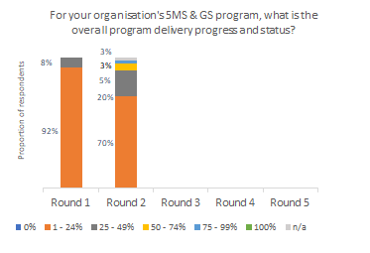
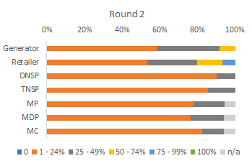
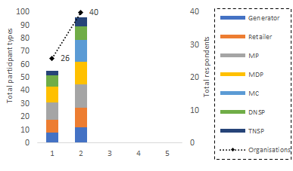
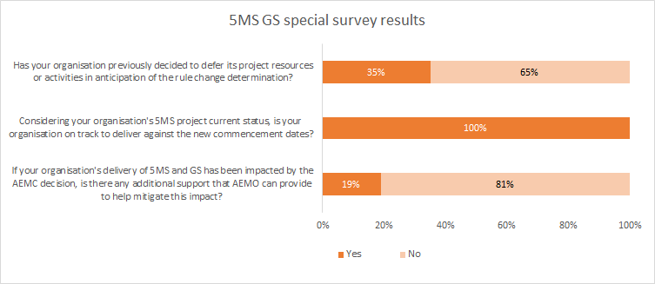
Summary of results so far
Overall Participant Delivery progress
Overall Delivery progress by Participant type
Overall Participation by Participant type
Industry Deferral Survey Participant impact summary
Notes:
Full reports published on website
Indications of results so far:
Progress of progress through programs – and by participant areas
Increase in participantion rate between surveys
Initial rreaction to deferral – via special surevy
About to undertake 3rd round
If your organisation is not represented – and is impcted encourage contact through 5MS mailbox – important as industry that broad understanding of preparedness is understood

Slide 33
Participant Testing – what, when and where?
Greg Minney

Slide 34
AEMO 5MS Testing Environments
5MS Staging Environment
  Provide software to enable early testing of functionality by participants
  Environment is not fully integrated across all applications
  Will be extended to support testing as part of deferred rule commencement dates
AEMO pre-production environment (pre-prod)
  Used for all market trials and formal industry testing
  Reflects production capability – and capability to be released during market trial and industry test period

Slide 35
Participant Testing Types
Type | Definition | Environment | Example
Industry Testing | Self-testing of functionality such as connectivity, and/or coordinated multiparty testing of functional scenarios | Staging, pre-prod | Testing a change request (CR) or processing a reallocation
Market Trial | AEMO coordinated multi-party end-to-end testing of business process scenarios | Pre-prod | Meter exchange involving CRs, services orders and 5-minute meter reads
Invitation Industry Testing | AEMO coordinated testing of business process scenarios with a select number or subset of participants with systems ready for testing. | Pre-prod | Testing NMI transfer Process
Approach to participant testing was developed in consultation with industry and is captured in the Industry Test and Market Trial Strategy

Slide 36
5MS Program Timeline
Level 1 & Level 2 Milestones relating to Readiness and Participant Testing
29-Nov: Dispatch Industry Test starts
15-Mar: Dispatch Industry Test concludes
Dispatch Testing
17-Feb: Settlements Industry Test starts & 15-Mar: concludes
Industry Testing
Settlem’ts
Testing
1-Feb Retail MDM/B2M starts & 3-Mar: concludes
2020
2021
MDM/B2M
2022
Nov | Dec
Jan | Feb | Mar | Apr | May | Jun | Jul | Aug | Sep | Oct | Nov | Dec
Jan | Feb | Mar | Apr
GS
Market Trial
5MS Market Trial Plan
Sept20: 5MS Market Trial Plan through to May21
5MS
Market Trial
1-Feb:5MS
Market Trial
starts
15-Mar:5MS Market Trial Concludes
5-Jul:5MS Market Trial starts
27-Aug:5MS Market Trial concludes
Market Trials
GS Market Trial Plan
Reference Key
 | Readiness activity
Sep21: GS Market Trial Plan Sep through to Dec 21

Slide 37

5MS Staging Environment Release Timetable
2019 |  |  | 2020
Oct | Nov | Dec | Jan | Feb | Mar | Apr | May | Jun | Jul | Aug | Sep | Oct | Nov
S
D
R
S
S
D
R
R
R
Workstream | Date | Capability available for participants in staging
Settlements | 1 Nov 2019 | Reallocations at both 30 and 5-min intervals; new Web UI; Calendar selection, alerts
 | 31 Jan 2020 | Completed Data Model; New UFE tables; additional UFE columns.
 | 16 Mar 2020 | Settlements & Billing, including 5-min & Global Settlements; new invoice templates; Decommission of Mandatory Restrictions in NEM Settlements; Prudentials & Settlements estimation
 | 15 May 2020 | Prudential functionality and Settlements Direct; includes the NEM Prudential Dashboard and Prudential Forecast, new web pages and APIs for NEM Prudential Dashboard, NEM Prudential Forecast, Credit Support and Settlements Direct
Retail (Metering) | 1 Dec 2019 | Test connection to Staging; Test MDFF validations; Validate data exchange
 | 15 Jun 2020 | B2M via API (API Push) & All Meter Data Ingestion scenarios (MDFF NEM12 and NEM13, MDMF)
 | 31 Aug 2020 | Retail functionality for 30 Minute settlement including RM Reports, B2M, meter data ingestion (for 5, 15 and 30 minute reads), New Standing Data
 | 31 Oct 2020 | Retail functionality for 5 minute settlement including RM Reports, UFE Reports 5 minute Settlement run and rejection logic for MDMT files for interval meters
Dispatch (Bidding) | 29 Nov 2019 | Submit 5-Min Bids, via new web interface, API and/or FTP; Bidding Data Model changes as per technical specifications released July 2019; Case Loaders for PASA, Dispatch, 5-minute Pre-Dispatch & 30-minute Pre-Dispatch data
 | 15 May 2020 | Trading data model changes; Administered pricing events
S
R
D
Delivered
Notes:
Dispatch and Settlements capability to support 5MS / GS available for participant testing
Delivery upcoming on 31 August - retail upgrade – last major delivery of AEMO system capability – with system configured to the mode of operation for 30Minute settlement –
Once opportunity for particpants to test against that configuration – 5 minute settlement capability made available – planend from 31 Oct
Significant proportion of the Market system cinteractin capability in place to support the inintial testing of particpants systems – build up over time

Slide 38
Questions?

