Slide 1
Five-Minute Settlement Program:
Information Session 1
AEMO 5MS Program Team
THURSDAY, 24 MAY 2018
AEMO Offices:
Level 9, 99 Gawler Place, Adelaide
Level 10, 10 Eagle Street, Brisbane
Level 22, 530 Collins Street, Melbourne
LEVEL 2, 20 BOND STREET, SYDNEY
DIAL IN: 1800 055 132 MEETING ID: 37512286

Slide 2
Introduction, agenda & housekeeping
Welcome to the 5MS program!
Agenda:
Questions from the floor after speakers onsite.
Mail 5ms@aemo.com.au questions from phone participants – to be answered at the end.
On the phone please mute microphones throughout!
Item | Time | Topic | Responsible
 | 9:30 am – 9:40 am | Welcome and introduction | Chin Chan (AEMO)
1 | 9:40 am – 10:10 am | Program overview | Graeme Windley (AEMO)
2 | 10:10 am – 10:30 am | Procedure Workstream overview | Chris Muffett (AEMO)
3 | 10:30 am – 11:00 am | Systems Workstream overview | Hamish McNeish (AEMO)
 | 11:00 am – 11:10 am | Break
4 | 11:10 am – 11:30 am | Stakeholder engagement overview | Chris Muffett (AEMO)
5 | 11:30 am – 11:50 am | Global settlement update | Lee Brown (AEMO)
6 | 11:50 am – 12:30 pm | Questions | Graeme Windley (AEMO)
 | 12:30pm | Meeting close | Graeme Windley (AEMO)

Slide 3
Five-Minute Settlement Program
Program Overview – Graeme Windley

Slide 4
5MS Summary
AEMC Decision
On 28 November 2017, the AEMC made a final rule change altering the settlement period to five-minutes (align with dispatch period). The industry go live is 1 July 2021. Purpose of rule change:
To remove the anomaly that exists between the five-minute and 30-minute periods, which has been identified as a contributing factor to disorderly bidding.
To provide a clearer price signal for investment in fast response technology, including batteries and demand response.
Key functional implications of 5MS include:
Metering
Central systems acceptance of five-minute metering data from the market.
Adjusting interval meters to deliver data at five-minute intervals.
Re-accreditation of all MDPs and MPs intent on providing five-minute metering services.
Controlled Load Profile (CLP) and Net System Load Profile (NSLP) change from 30-minute to five-minute.
Potential changes to the frequency of which Metering Data is delivered.

Slide 5
5MS Summary
Settlement Calculation
Profiling algorithms introduced to derive five-minute energy data.
Transactions will need to be calculated for each five-minute period.
The process of settlement estimation will also calculate energy transactions for every five-minute period.
Inter-regional and intra-regional residue will be calculated on a five-minute basis.
A number of non-energy transactions, such as market ancillary services (i.e. FACS) and compensation recovery, will be completed using five-minute energy volumes.
Dispatch & Market Information
Daily bidding intervals to increase from 48 to 288. AEMO will create new data structures to receive, use and store five-minute bids and offers.
30-minute pre-dispatch and PASA processes that use bid information will be provided with five-minute data.
Market participant systems will need to be updated to submit and receive confirmations of five-minute bid and offer data.
AEMO will publish five-minute data.

Slide 6
Program Overview
Procedures – Market Go Live 1 December 2019
Detailed market design – detailing the operation of core market processes, roles and responsibilities, timelines and information flows.
Procedure development and engagement based on the rule change.
Procedure consultation with relevant industry participants, staggered approach.
Supporting documentation used internally by AEMO.
B2B procedures – support for B2B teams in case of change.
IT Delivery
Requirement drafting for 5MS & GS, application, interfaces & infrastructure.
Technical infrastructure build.
System development and delivery.
Internal AEMO Testing.
Performance Testing.
Pre-Prod and Prod system deployments.
Operational Support.

Slide 7
Program Overview
Readiness
Registration and Accreditation, including Meter Data Providers & Meter Providers
Market participant readiness monitoring
Industry Testing / Market Trial
AEMO Operating procedure review
Operational plan, including KPIs, SLAs, compliance register and risk register
Program communication
Industry cutover activities
Industry Groups and Forums
Numerous consultative groups to be set up
Detail to come in Stakeholder session

Slide 8
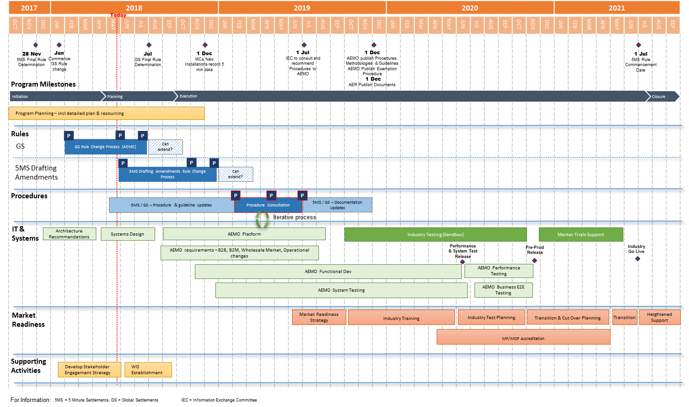
Program Overview

Slide 9
Next steps
Procedures stage progressing, delivery by 1 December 2019.
Systems design & planning to Q3/Q4 2018:
  Impact of increase in data volumes
  Integration of industry initiatives:
    Global Settlement rule change; Distributed Energy Register; 3rd Party Access to data.
  Industry requirements
    Combined planning approach to begin June 2018
    Mail key requirements / concerns to 5ms@aemo.com.au

Slide 10
Five-Minute Settlement Program
Procedures Workstream – Chris Muffett

Slide 11
Procedure background
The five-minute settlement rule requires AEMO to amend a number of specified procedures prior to 1 December 2019:
  Credit limit procedures
  Spot market operations timetable
  Dispatch and pricing procedures
  Reallocation procedures
  Settlement residue auction rules
  RERT and intervention pricing
  Minimum services specification
  Meter churn procedures
  Metering data provision procedures
  MSATS procedures
  Metrology procedures
  Service level procedures
  B2B procedures (subject to IEC approval)
There are also a large number of procedures and guides that are impacted by changes in terminology

Slide 12
Procedure approach
Approximately 70 procedures and guides have been identified as directly impacted by 5MS, across the following areas:
  Metering
  Settlements (including prudentials)
  Dispatch
  Power system
Preliminary approach is to address these in packages, with 15 work packages being identified
Work packages will progressively be considered by the Procedure Working Group (PWG):
  AEMO will provide an impact assessment for each procedure, and the proposed approach and options for review and discussion
  Procedure changes will then be subject to formal consultation

Slide 13
Procedure work packages (preliminary)
Metering | Settlements | Dispatch | Power system
Metering data Metrology MSATS procedures Service levels Miscellaneous | SRA Estimation Reallocations Prudentials Miscellaneous | Bids/Offers Spot market Pricing Specifications Miscellaneous | No packages – progressive release

Slide 14
Next steps
AEMO is currently working through the impact assessment for procedures
Detailed list of impacted procedures/guides will be provided to the PCF
  Feedback will be sought on the scope and packaging approach
PWG to be established, with working group meetings aiming to start in July 2018
  Initial focus is on SRA, with changes required prior to September 2018 (subject to SRC approval)
  Priority to packages that involve key system changes for AEMO and industry, such as metering data and bids/offers

Slide 15
Five-Minute Settlement Program
IT Workstream – Hamish McNeish

Slide 16
IT Workstream - Engagement
AEMO’s Systems Workstream is responsible for the development and testing of systems to support the 5 Minute Settlement (5MS) changes to rules and procedures.
A Systems Working Group (SWG) will be established to:
1. Inform and consult with participants on the technical aspects of these changes
2. Provide and discuss information on AEMO’s technical solution relevant to participants
3. Provide a contact point for participants to engage on any technical questions
4. Meet regularly during the 5MS program. The timetable is still to be confirmed – this is expected to be at least monthly.

Slide 17
IT Workstream – SWG Deliverables
System Workstream updates – regular updates will be provided in the System Working Group
Technical specifications – will provide sufficient detail for participants to understand the required changes to their own systems/processes that interface with AEMO and timelines.
Focus Groups – may be held to discuss a specific design area – or determine recommendations on solution design.
Likely Focus Groups:
    Meter Data submission
    Energy/FCAS bidding functions
    Metering Reconciliation (B2M)
    Settlement Reconciliation (Data Interchange)
System implementation timeline –timeline of when environment/system capability will be available to participants

Slide 18
System Interface Changes - Retail
Electricity Retail (MSATS/B2M/B2B)
The expected changes are:
  Support 5 minute metering data submission to AEMO
  Either a new or use existing MDFF format for 5 minute submission
  Changes to MDM profiling for settlement to support 30-minute, five-minute and accumulation meter data
Interfaces Impacted
  1. B2M metering submission to AEMO
    LVI, FTP and MSATS Web Services
  2. B2B metering to support 5 minute MDFF
    LVI, FTP and B2B Web Services
  3. MDM reconciliation reports
    FTP B2M reports

Slide 19
System Interface Changes - Wholesale
Electricity Wholesale (EMMS)
The expected changes are:
  Submission of 5 minute bids/offers
  Changes to accommodate 30 minutes processes (e.g. pre-dispatch, PASA)
  Spot price will be applied at 5 minute interval
  Settlement and Prudential processes
  Bidding and settlement reports
Interfaces Impacted
  1. Bid and offer submission and response
    Web Portal, Data Interchange
  2. Bid/Offer, Settlement reconciliation reports
    Data Interchange
  3. Prudential systems
    Web Portal, Data Interchange

Slide 20
IT Workstream Timeline – Indicative
Timeframe | Activity
1-Apr to 30-Sep | Feasibility Study
Sep-18 to Feb-21 | Monthly SWG’s and SWG Focus Groups as required
Oct-18 to Nov-20 | AEMO Development and Testing
2019 Q1 – Q4 | Technical Specifications
2020 Q3/Q4 | Industry Test Systems and AEMO software/guides available
2020 Q3/Q4 | Preproduction Release – Stage 1 - Early 5MS capabilities
2020 Q4 | Preproduction Release – Stage 2 - Full 5MS functionality
2020 Q4 | Production Release – Stage 1 - Early 5MS capabilities (support transition)
2021 Q2 | Production Release - Stage 2 - Full 5MS functionality

Slide 21
Five-Minute Settlement Program
Stakeholder Engagement – Chris Muffett

Slide 22
Purpose of engagement
The 5MS program is engaging with the industry for the purpose of:
  Informing stakeholders and the wider industry on the details of AEMO’s implementation program for 5MS and GS, and how they can become further involved
  Consulting with stakeholders to seek input on the changes to procedures necessary to give effect to 5MS and GS
  Involving stakeholders throughout the process to ensure that their ideas and concerns are understood and considered
Continuous engagement will be critical to successful implementation of 5MS and GS

Slide 23
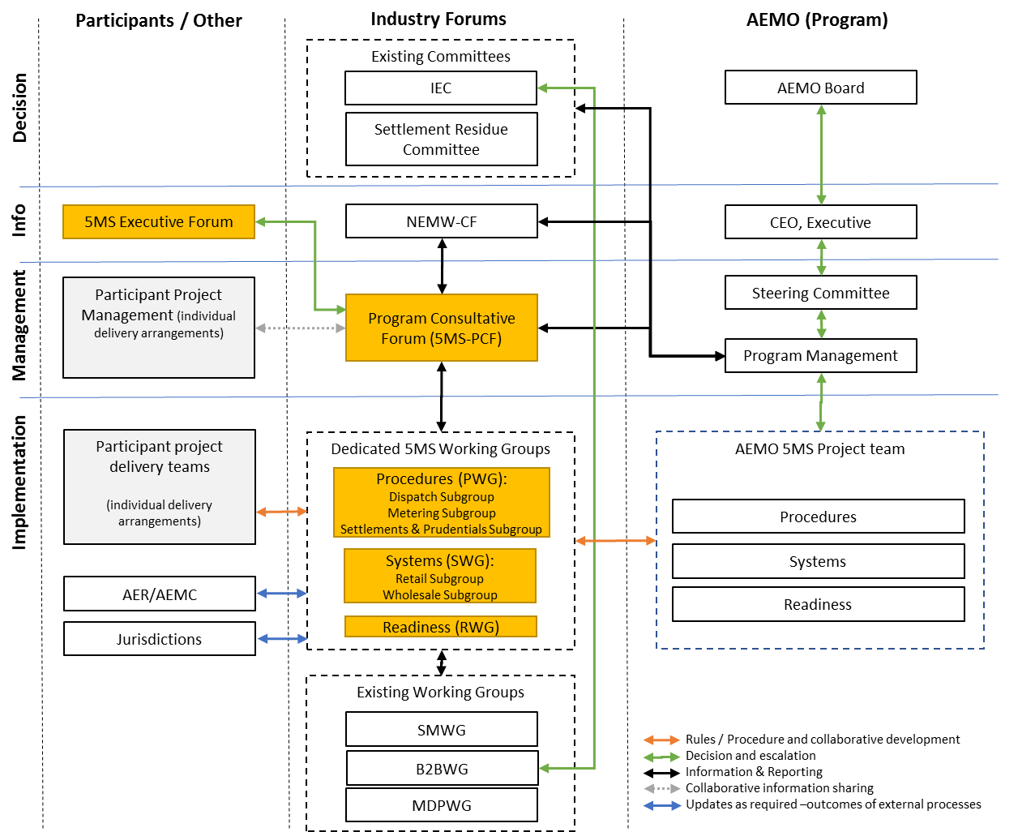
Program engagement structure

Slide 24
Program forums and groups
Group | Purpose | Timing
Program Consultative Forum (5MS-PCF) | The primary program coordination and communication between AEMO and industry program teams (meets monthly) | Monthly, starting June 2018
Executive Forum (5MS-EF) | Provide appropriate level of executive oversight and escalation of issues and concerns (meets quarterly) | Every 2 months, starting July 2018
Procedure Working Group (5MS-PWG) | To facilitate the consultation on procedures, with focus groups for dispatch, metering, and settlements | Monthly, starting July 2018 (focus groups as required)
Systems Working Group (5MS-SWG) | To facilitate design and implementation of systems and interfaces, with focus groups covering retail and wholesale interfaces | Monthly, starting September 2018 (focus groups as required)
Readiness Working Group (5MS-RWG) | Formed in the lead-up to industry readiness testing, to support the planning and execution of readiness activities | Monthly, starting mid-2019

Slide 25
Next steps
Terms of reference:
  ToRs for the PCF and EF have been developed (will be published shortly)
  ToR for the PWG has been drafted, and input will be sought through PCF
Nominations:
  AEMO will be seeking nominations for the PCF and EF (email will be distributed through NEMW-CF and AEMO Communication)
  Proposing a primary and backup representative from each organisation
Contact details:
  5MS email: 5ms@aemo.com.au
  5MS webpage: http://www.aemo.com.au/Electricity/National-Electricity-Market-NEM/Five-Minute-Settlement

Slide 26
Five-Minute Settlement Program
Global Settlement Rule Change – Lee Brown

Slide 27
Background
AEMO has submitted a rule change to the AEMC, proposing that global settlement be implemented to replace settlement-by-difference in the NEM
https://www.aemc.gov.au/rule-changes/global-settlement-and-market-reconciliation
The change primarily involves the following:
  The local retailer role no longer being required (i.e. all retailers have the same settlement arrangements)
  AEMO requiring meter data for all connection points
  AEMO calculating unallocated for energy (UFE) which is recovered from retailers operating in each area
The AEMC have indicated that consultation on the rule change will commence shortly
Global settlement (GS) is proposed to replace the existing settlement-by-difference arrangements in the NEM

Slide 28
Program approach
AEMO has identified benefits in implementing GS at the same time as 5MS
  GS impacts the same procedures and systems being updated for 5MS
  Feedback from stakeholders also supports this approach
AEMO understands the AEMC’s proposed timing is for a final determination to be made by end-2018
The program is being planned on the basis of delivering the capability for GS (as per AEMO’s high-level design), which will be amended based on progress of the rule change
AEMO proposes to build capability for global settlement as part of the 5MS program

Slide 29
Next steps
Consultation will shortly commence on the rule change
Impact assessment on procedures will be discussed with the PWG:
  Changes to data delivery requirements will be considered as part of the meter data package and service level packages
System impact will be discussed once the SWG is established:
  Changes to metering and settlement interfaces
Contact details:
  Lee Brown: lee.brown@aemo.com.au
AEMC will shortly initiate consultation on the rule change

