Slide 1
Five-Minute Settlement & Global Settlement Program
Stakeholder Information Session 4, 23 January 2020

Slide 2
Welcome and Introduction
Peter Carruthers

Slide 3
Purpose of the Information Session
The Information session provides an opportunity for stakeholders that are not directly engaged in the 5MS Program to receive an update on the progress of the Program and insight, at a high-level, at some of the key areas of work.
It is also an opportunity for any stakeholder that has not previously engaged with the 5MS Program to receive a high-level introduction to the Program.

Slide 4
Agenda
NO | Time | AGENDA ITEM | Responsible
1 | 10:00 – 10:10 | Welcome and introduction | Peter Carruthers
2 | 10:10 – 10:30 | 5 Minute Settlement and Global Settlement Overview | Emily Brodie
4 | 10:30 – 10:45 | AEMO’s 5MS Implementation Plan and Program Update | Graeme Windley
5 | 10:45 – 10:55 | Procedures Workstream Update | Emily Brodie
6 | 10:55 – 11:15 | Moving towards market trial, transition and reporting – Readiness Workstream Update | Greg Minney
7 | 11:15 – 11:30 | 5MS Staging Environment | Graeme Windley
8 | 11:30 – 11:50 | 5MS Web User Interface | Madhuri Malhotra
 | 11:50 – 12:05 | Readiness Reporting – how will we understand market readiness | Greg Minney
9 | 12:05 – 12:15 | How can you engage? | Anne-Marie McCague
10 | 12:15 – 12:30 | Questions | All
11 | 12:30 | Meeting close | Peter Carruthers

Slide 5
5MS & GS Team
AEMO 5MS & GS Program contacts:
  Peter Carruthers, Business Advocate
  Graeme Windley, Senior Project Manager
  Anne-Marie McCague, Stakeholder Lead
  Emily Brodie, Industry Readiness Lead
  Greg Minney, Readiness Lead
5MS webpage: http://www.aemo.com.au/Electricity/National-Electricity-Market-NEM/Five-Minute-Settlement

Slide 6
Questions & Feedback
Feel free to ask questions throughout the session via:
WebEx comments
For more detailed questions, for questions after the session or for engagement feedback:
5ms@aemo.com.au

Slide 7
5MS and GS overview
Emily Brodie

Slide 8


Background to 5MS & GS
The 5MS Program is implementing two AEMC rules for the wholesale electricity market – requires changes to metering, retail & wholesale, settlement, bidding and NEM operational systems.
Why, What & When
Expected benefits
5MS
Settlement currently 30 mins, dispatch 5 mins.
Settlement period will change to 5 mins.
Commences 1 July 2021.
Removes anomaly by aligning settlement & dispatch period – efficiencies for NEM operations & investments, supports orderly bidding.
Better price signal for demand response, and for investment in fast response technologies
(e.g.: batteries, gas peaking generators).
Unaccounted for Energy (UFE) is currently charged to a limited number of ‘local retailers’.
With GS, all retailers share the cost of UFE.
UFE published by AEMO from 1 July 2021.
GS commences 6 Feb 2022.
Improved transparency, fewer settlement disputes and lower levels of UFE over time.
Competition on equal terms.
Improved risk allocation, enhanced incentives.
It’s efficient to implement GS within the 5MS Program, as it affects the same systems.
GS

Slide 9
Background – current NEM dispatch and settlement arrangements
Settlement prices (spot prices) are calculated on a 30 minute basis – the average of 6 x 5 minute dispatch prices
  one high dispatch price in a 30 minute trading interval raises the spot price (and vice versa)
Different time periods for dispatch and settlement were adopted due to limitations in metering and data processing when the NEM started (1998).
Technology is now available which makes 5 minute settlement possible.

Slide 10
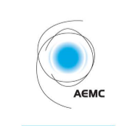
AEMC decision
In November 2017, the AEMC made a final rule change altering the settlement period to 5 minutes, aligning with dispatch period
The industry “go-live” is 1 July 2021
Purpose of rule change is to:
  remove the anomaly that exists between the 5 minute and 30 minute periods, which has been identified as a contributing factor to disorderly bidding
  provide a clearer price signal for investment in fast response technology, including batteries and demand response
Key areas affected:
  Metering
  Settlement calculation
  Dispatch and market information

Slide 11
What is required to implement 5MS?
From 1 July 2021, following processes need to change to 5 minute basis:
  Bidding and offering into the NEM
  Settlement
  Intervention pricing
  Calculation of trading amounts and the cumulative price threshold
This means that AEMO and market participants will need to:
  upgrade metering to provide 5 minute data (where required)
  upgrade IT systems to store and process 5 minute data
  review/update existing contract terms and conditions
AEMO also has to update its procedures by December 2019

Slide 12
Global settlement recap
On 6 December 2018, the AEMC finalised a rule to implement Global Settlement (GS)
GS is an alternative methodology for settling electricity within a distribution area. It will replace settlement-by-difference. GS will:
  remove any inequity between retailers
  provide visibility of the unaccounted for energy (UFE) within distribution areas
More information is provided in the Global Settlement fact sheet: http://www.aemo.com.au/-/media/Files/Electricity/NEM/5MS/Program-Information/2018/5MS_What-is-global-settlement.pdf

Slide 13
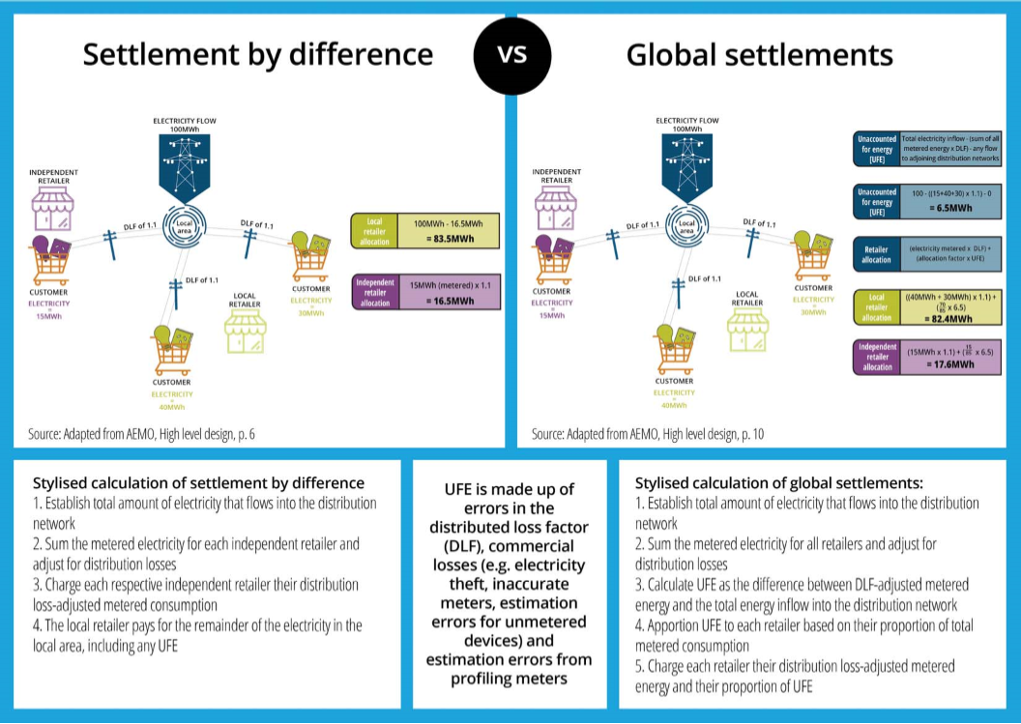
Settlements by Difference vs Global Settlements

Slide 14
Key areas affected by global settlement
GS is being implemented in parallel with 5MS
Some market procedures – these are being consulted on as part of the metering and settlements packages
AEMO and participants’ IT systems – changes across both retail and wholesale systems
Additional data:
  NSPs/MDPs required to provide information on non-contestable unmetered loads
  MDPs required to provide metering data for all connection points
AEMO will begin publishing UFE from 1 July 2021:
  no financial impact to retailers from UFE allocation from 1 July 2021 to 5 February 2022
  UFE allocation will be financial from 6 February 2022

Slide 15
Global settlement implementation timeline
1 December 2019
AEMO procedures updated for both 5MS and GS
1 July 2021
5MS begins
AEMO starts publishing UFE data (‘soft start’)
6 February 2022
GS begins
1 March 2022
AEMO’s first annual report on UFE trends
New procedure required
[NER 3.15.5(d) and 11.112.5]
New annual report
[NER 3.15.5B] and new reporting guidelines [NER 3.15.5B(d) and 11.112.6]

Slide 16
AEMO’s 5MS & GS Implementation Plan and Program Update
Graeme Windley

Slide 17
Program Scope (IT Focus)
Dispatch
Metering
Settlements
Function
Manages demand forecasting and the dispatch price every 5-minutes (and aggregates spot price every 30 minutes). Ensures electricity demand is met.
Function
Manages receipt and storage of market data (metering and standing data). Metering prepares data for market settlement and enables market reporting.
Function
Manages the calculation of financial liabilities and credits between market participants daily and settles all trade in the NEM on a weekly basis.
IT Workstreams
Scope of change
Increase daily bidding intervals from 48 to 288.
New data structures required to receive, use and store five-minute bids and offers.
Changes required to calculate the floor price and price cap.
AEMO to publish five-minute data.
Scope of change
Enable receipt of metering data every 5 minutes.
Enable management of >2 trillion data points by 2028.
Change profiling algorithms to derive 5 minute energy data.
Enable energy allocation to be at 5, 15 and 30 minute intervals.
Scope of change
Enable settlement on 5 min granularity, 5 min price, and Marginal Loss Factors (MLF)
Settlement estimations will calculate energy transactions per 5 min period.
Additional calculations (i.e. market ancillary services, FACS), to be calculated with 5-minute data.
Solution Path
Enhance Legacy Systems
Solution Path
Build New Solution using Strategic Technologies
Solution Path
Enhance Legacy Systems
Infrastructure / External Web Development / Internal webMethods Integration
Remainder 5MS & GS Program
Market Procedures, Stakeholder engagement and market/industry readiness
Process Mapping, Change and Training, Cutover and Transition
Program Management

Slide 18
5MS & GS Implementation Approach
AEMO has developed and implemented a Milestone Management Framework
Key elements of the framework:
  Defined milestones with associated dates
  Reporting process
  Change management and impact assessment
Milestones
  Level 1 milestones: key milestones that apply to the overall Program
  Level 2 milestones: milestones by workstream that show key dates relevant for participants
  Defined in Microsoft Project, available for sharing with participants
  Timeline published on the 5MS website homepage monthly

Slide 19
5MS & GS Program Timeline
Current as at 17-01-2020

Slide 20
5MS Program Timeline (Jan ‘20 to Jul ‘21)
Level 1 and External Level 2 Milestones
Current as at 17-01-2019

Slide 21



Program Update (1/2)
Dispatch
  AEMO Internal - Internal work on track, 90% of development now completed. System Testing in progress.
  All Technical Specifications are finalised and published on AEMOs website.
  The 5MS Staging Environment has web bidding and other 5-min functionality available for use.
Settlements
  AEMO Internal – Development work is on track, with the Settlements Engine approx. 80% complete. System Testing is in progress.
  The Reallocations, Settlements and Billing Technical Specifications are finalised and published on AEMOs website, with the Prudentials and Estimations technical specifications to be delivered Q1 2020.
Metering
  AEMO Internal – Development is tracking as on schedule to complete by 30 June 2020. Initial 30-min like-for-like solution to be deployed December 2020.
  All Technical Specifications are finalised and published on AEMOs website.
  The 5MS Staging Environment can receive MDFF submissions.

Slide 22


Program Update (2/2)
Procedures
All 70 Market Procedures now updated and published on the AEMO website by 01 December 2019
Industry Procedures Working Group (PWG) now dormant.
Readiness
  Readiness Working Group up and running.
  The Market Readiness Strategy, the Transition and Go Live Strategy and the Industry Testing and Market Trail Strategy are finalised and published on the AEMO website.
  Go-Live contingency meetings are being held with Market Participants.

Slide 23
Procedures Workstream Update
Emily Brodie

Slide 24
Procedures - overview
Approximately 50 AEMO documents are directly affected by 5MS and GS
Around 20 of these are ‘rules consultation’ procedures, usually requiring 2 rounds of formal consultation
Work packages were progressively considered by the Procedures Working Group:
  AEMO provided an impact assessment for each procedure and the proposed consultation approach for review and discussion
  Focus groups were used to provide input into procedure development
  Procedure changes were then subject to consultation
Metering | Settlements | Dispatch | Operations
Metering data Metrology, MSATS procedures & service levels Miscellaneous | SRA Estimation Reallocations Prudentials TNSP Miscellaneous | Bids/Offers Spot market Pricing Miscellaneous | No packages – one minor procedure change

Slide 25
Procedures prioritisation and completion
*no rules consultation required

Slide 26
Managing Emerging 5MS/GS Procedures Issues (1/3)
Anticipate that procedure changes will emerge as Participants’ and AEMO’s 5MS/GS implementations and testing ramp-up
 | Timeframe | Approach
Stage 1 | up to August 2019 | Active engagement through PWG on managing 5MS procedure changes (July 2018 to August 2019)
Stage 2 | from August 2019 to 2021 | Transitioning to BAU through structured and supported engagement on procedural issues that arise from 5MS/GS implementation e.g. during industry testing and market trials
Stage 3 | 2021 onwards | BAU - procedure changes are managed through those AEMO teams responsible for the relevant procedures.

Slide 27
Managing Emerging 5MS/GS Procedures Issues (2/3)
As 5MS/GS procedures workstream in hibernation, approach to managing procedures issues is to:
  Use AEMO’s BAU processes to:
    consider procedure change requests
    process these changes where appropriate
  Communicate AEMO’s responses to procedure change requests via 5MS/GS engagement channels in addition to BAU channels
  5MS program to track 5MS/GS procedures issues/changes via an action log. For transparency, log will be shared at RWG, SWG, ERCF and B2B meetings.

Slide 28
Managing Emerging 5MS/GS Procedures Issues (3)
Benefit of BAU, especially for metering, is that AEMO coordinates across all other projects and changes:
  Consults with the industry e.g. via ERCF and IEC/B2BWG
  Establishes optimal approach to bundling procedure changes and IT changes
  Considers timelines, including statutory and project milestones.
5MS procedures workstream can be reactivated on an ad-hoc basis to respond to material procedures issues if need be

Slide 29
BAU Channels for Procedures Issues
Area | Channel
Metering / metering data / standing data | B2M Electricity Retail Consultative Forum (ERCF) Follow change process B2B Information Exchange Committee Follow change process
Settlements | email: settlements@aemo.com.au
Prudentials | email: prudentials@aemo.com.au
Dispatch | NEM Wholesale Consultative Forum email: nemwcf@aemo.com.au

Slide 30
Moving towards market trial, transition and reporting – Readiness workstream update
Greg Minney

Slide 31
What is the purpose of the Readiness Workstream?
5MS / GS Market Readiness Objective:
“To implement all participant and AEMO preparatory activities required for successful 5MS and GS commencements while facilitating the uninterrupted and reliable operation of the NEM.”

Slide 32
Readiness Approach
Market readiness strategy
Industry readiness reporting plan
Metering service provider accreditation update plan
Industry transition and go-live strategy
Industry testing and market trials strategy
Market trial / industry test plans
Transition plans
Cutover plans
Industry contingency plan

Slide 33
Readiness papers - timelines

Slide 34
Readiness Plan Implementation Approach
The 5MS & GS capability will be implemented on a phased basis. This will:
  Support preparatory activity by participants
  Ensure required capability is in place prior to rule commencements
  Provide for a level of deployment flexibility for participants
Three types of testing will be utilised to support deployed capability:
  Industry testing – functionality is available in AEMO Pre-Production Environment
  Invitation industry testing – AEMO may invite groups of or individual participants to participate in specific testing with planned scenarios
  Market Trial –testing facilitated by the 5MS Program for all participants based on agreed scenarios
Metering and Metering Standing Data transition requirements for rule commencements
  meter type 1-3, 4*,7 - in place by to support 5MS commencement
  Standing Data and metering updates to support UFE reporting and Global Settlement
  5 minute activation of type 4 meters by December 1 2022

Slide 35
5MS & GS capability releases

Slide 36
Readiness Working Group
Main stakeholder forum for direct industry input into the planning and execution of readiness activities
The RWG will:
  Bring to the table individual participant views and issues
  Help coordinate, assist and prepare for the transition and cutover to 5MS and GS
  Engage with and provide expertise to AEMO on 5MS and GS market readiness activities
Engaging early and often in the 5MS/GS market readiness work will ensure the timely identification of any potential readiness issues, including potential resolution options
All deliverables from the Readiness Workstream will be available on the 5MS Website

Slide 37
5MS Staging Environment
Graeme Windley

Slide 38
5MS Staging Environment
What is the 5MS Staging Environment?
An Industry-facing Market Systems Environment which AEMO will use to drop 5MS-developed software upon completion of development, enabling interfaces with participant systems.
What is the Purpose of the 5MS Staging Environment?
Assist participants building and testing their 5MS-related system changes.
Provides test environment for participants’ 5MS system testing:
  enables participants to test their interfaces with AEMO, and
  assists their development by being able to access early versions of screens, reports etc.
Supports AEMO in assessing product quality before it is released into pre-PROD & Market Trials.
What Functions will be Available in Staging?
Releases of various functions are scheduled from November 2019 to July 2020.
Relevant RM reports:
  Will be provided in 5MS format throughout Q2 & Q3 2020.
  Participants can request, via the 5MS Mailbox, reports that they would like to receive as early as possible. AEMO will consider what is feasible with respect to internal development constraints.

Slide 39
5MS Staging Environment
Expectation Setting:
Staging is not:
  A Market Trial environment. There will be no co-ordination of Settlement Runs, Testing, Market Simulations, 7Day Pre-Dispatch, etc.
    The Market Trial approach and timing will be communicated with the Readiness approach.
  An end-to-end environment i.e. meter data information submitted won’t be reflected in a Settlement Run.
  A place to deploy functions that are not impacted by 5MS.
Performance is not guaranteed.
Defects can be raised, will be triaged and fixes scheduled into AEMO’s 5MS development work. There are no SLAs for updating software in Staging.
Input data (i.e. SCADA, demand forecasts) is likely to be static.
Access & Support
Participants arrange access to Staging by contacting AEMO Support Hub (5MS resolver group has been established in Service Now).
We encourage Participants to log defects via the AEMO Support Hub process too.

Slide 40
5MS Staging Environment - Dispatch
2019 |  |  | 2020
Oct | Nov | Dec | Jan | Feb | Mar | Apr | May | Jun | Jul
DROP ONE – 29 November 2019*
Submit 5-Min Bids, via new web interface, API and/or FTP.
Bidding Data Model changes as per technical specifications released July 2019
Participants can receive Dispatch, 5-minute Pre-Dispatch & 30-minute Pre-Dispatch data.
DROP TWO – 15 May 2020*
Trading data model changes
Administered pricing events
*Externally published deadlines. Additional features are likely to be released throughout the Staging period, and some may be earlier than the published dates.

Slide 41
5MS Staging Environment - Metering
2019 |  |  | 2020
Oct | Nov | Dec | Jan | Feb | Mar | Apr | May | Jun | Jul
DROP ONE – 1 December 2019*
Allow MDPs to confirm the connectivity of their test environments with the AEMO 5MS Staging Environment.
Allow MDPs to confirm that MTRD CSV MDFF created by their systems for Market Settlements are able to pass new AEMO validations (30 min and 5 min).
Allow MDPs to validate FTP hokey pokey protocol for MTRD exchange with the NEMMCO participant ID.
DROP TWO – 31 July 2020* (note some content will be delivered earlier)
Meter Data Ingestion of MTRD (NEM13) and MDMT
Support for API Meter Data Ingestion
MSATS Browser screens
B2M CATS, NMID, and MDM transactions and B2B message exchange supported
RM Reports
*Externally published deadlines. Additional features are likely to be released throughout the Staging period, and some may be earlier than the published dates.

Slide 42
5MS Staging Environment – Settlement
2019 |  |  | 2020
Oct | Nov | Dec | Jan | Feb | Mar | Apr | May | Jun | Jul
DROP ONE – 1 November 2019*
Reallocations: available at both 30 and 5-min intervals; new Web UI; Calendar selection; Alerts
DROP TWO – 31 January 2020*
Completed Data Model: New UFE tables, additional UFE columns.
DROP THREE – 16 March 2020* (note tracking ahead of schedule)
Settlements & Billing, including 5-min & Global Settlements. New invoice templates. Decommission of Mandatory Restrictions in NEM Settlements.
*Externally published deadlines. Additional features are likely to be released throughout the Staging period, and some may be earlier than the published dates.

Slide 43
5MS Web User Interface
Madhuri Malhotra

Slide 44
5MS Web User Interface
Web bidding and Reallocations
Accommodated 5 minute intervals
Feedback incorporated
Staging 5MS webpage: https://portal.5ms.staging.test.marketnet.net.au/

Slide 45
Web bidding

Slide 46
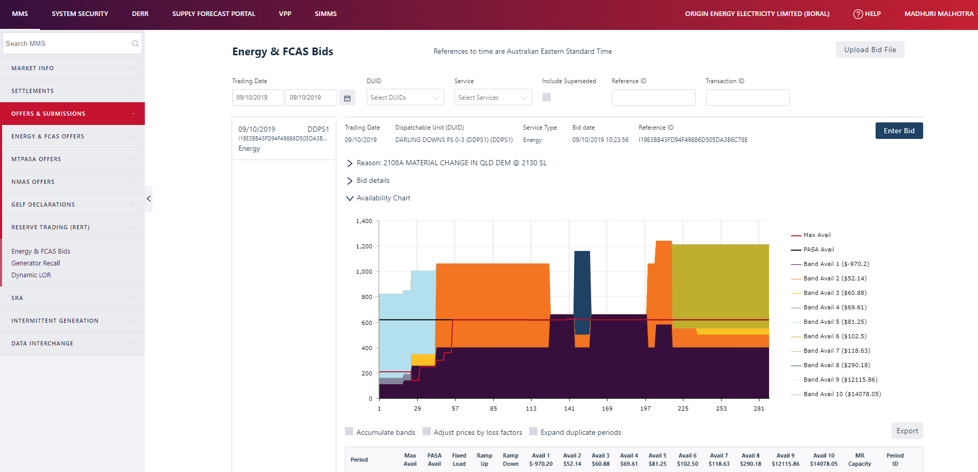
What’s new
Quickly retrieve and revise an effective bid
Easily edit 5 minute bids
Reflect a change in availability, e.g. a unit trip
Upload a submission prepared for the FTP or APIs interfaces

Slide 47
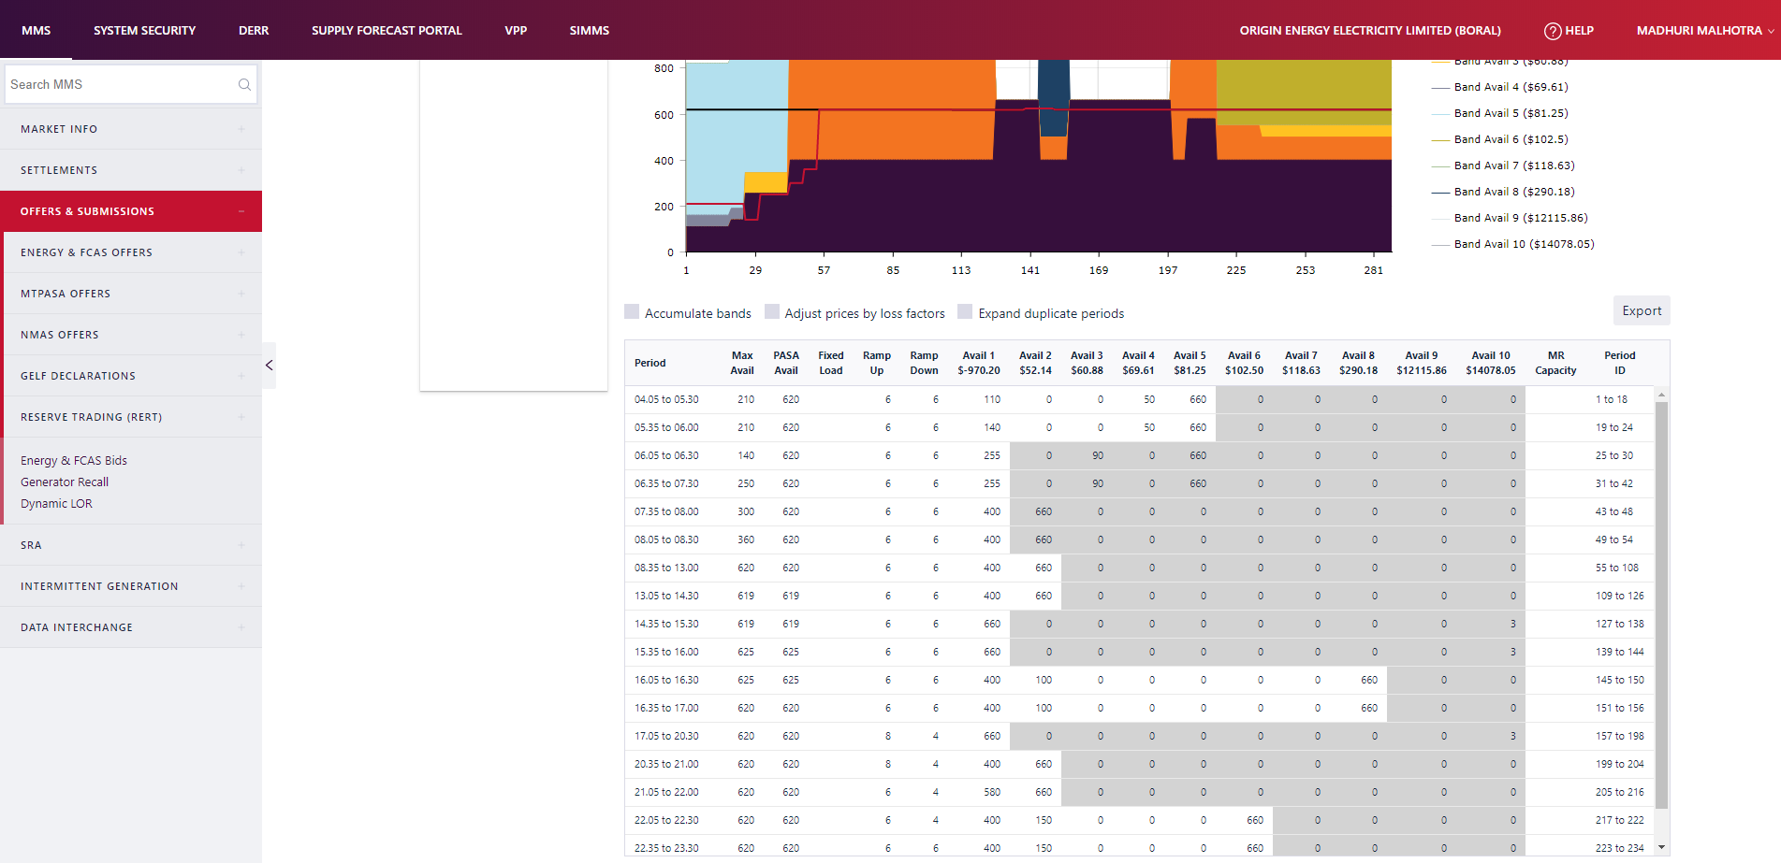
Bid sheet
New Compressed view
Know accumulated values
Prices adjusted by loss factor
Bid availability greys out if values greater than max avail
Export bid to CSV for further use
Notes:
No multiple side nav options. Fewer clicks to reach bidding.
See bids by a single click
Compressed view don’t have to see duplicated value
Know accumulated values, Better
Know loss factor
Important information upfront
Better/clearer picture of overall bids
Tooltips// may be
Bid visualization.
Helps make decisions efficiently

Slide 48
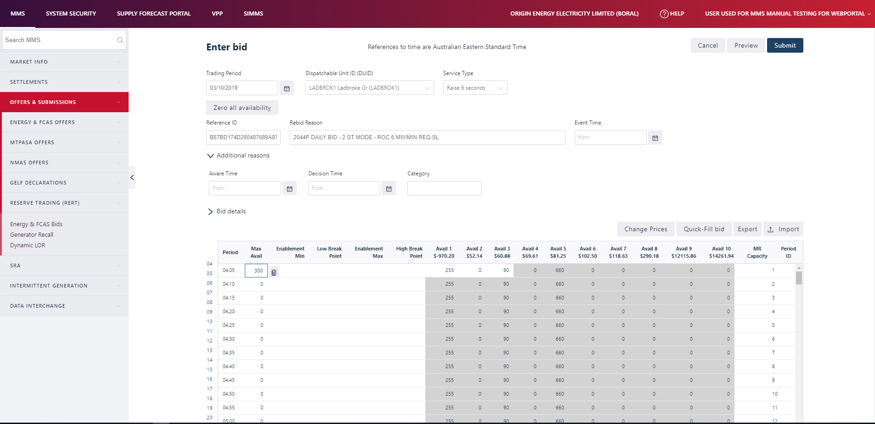
Bid creation
Web bidding interface will have 288, 5-minute intervals
Quick-fill functionality helps in bid filling
New feature – Zero availability/stop generation
Easy to navigate in the bid sheet
Upload and download bid sheet

Slide 49
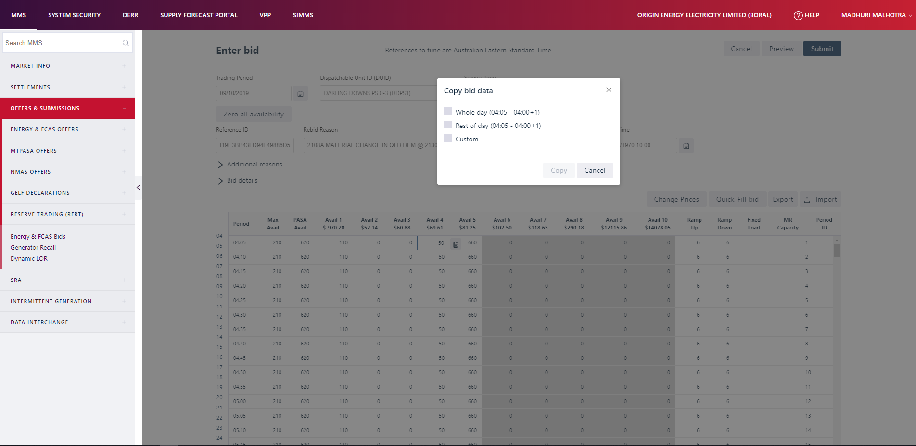
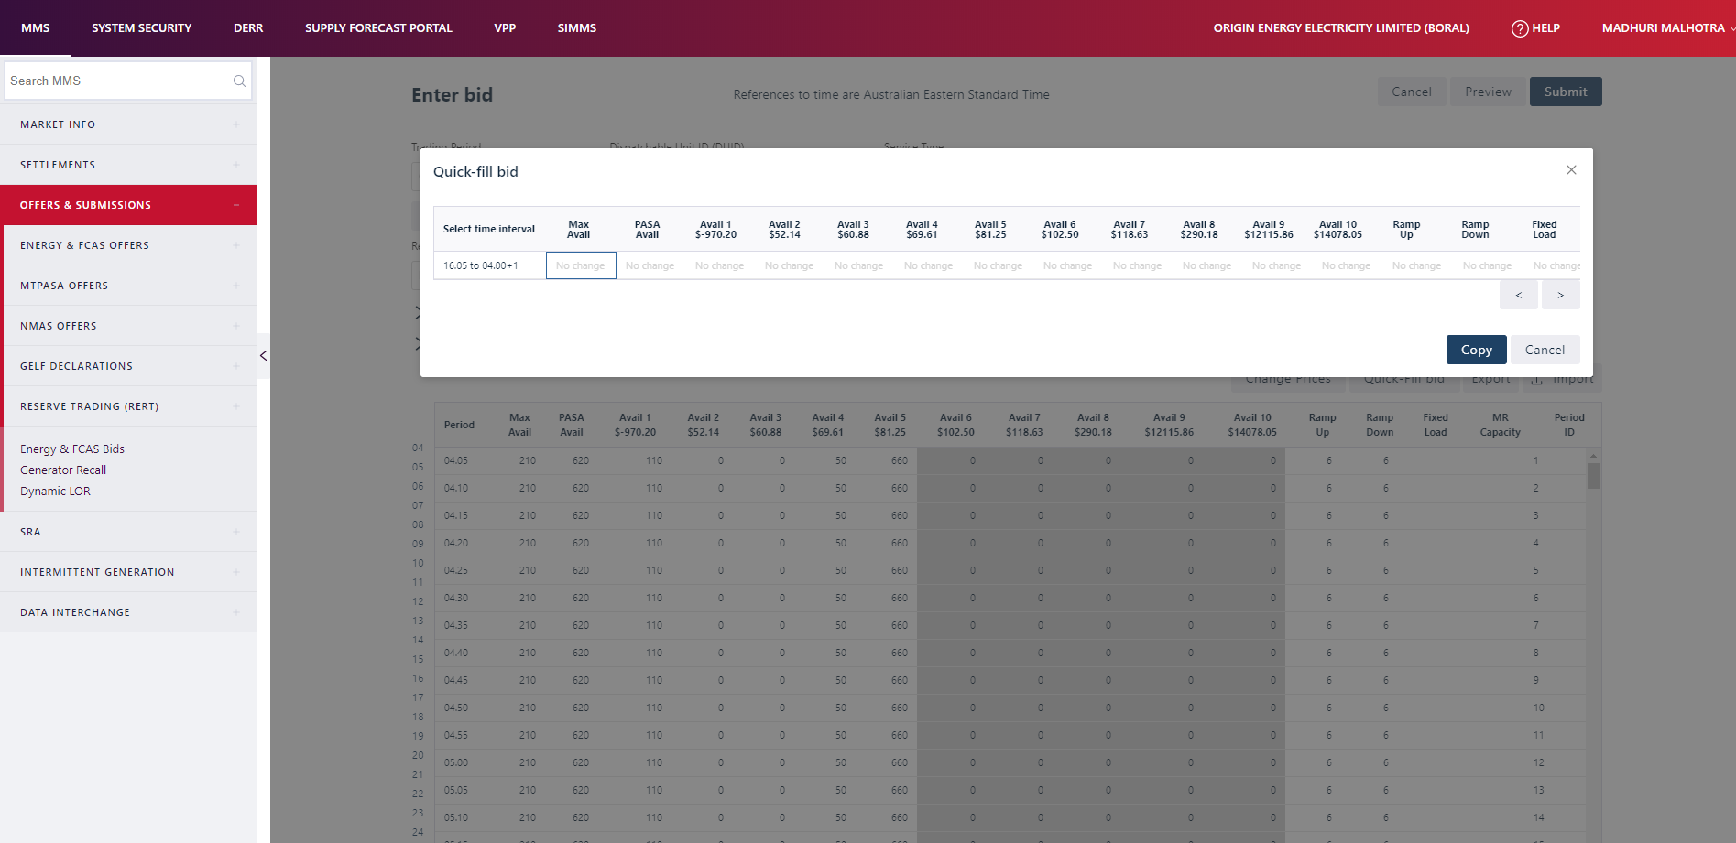
Quick-Fill bids/ offers

Slide 50
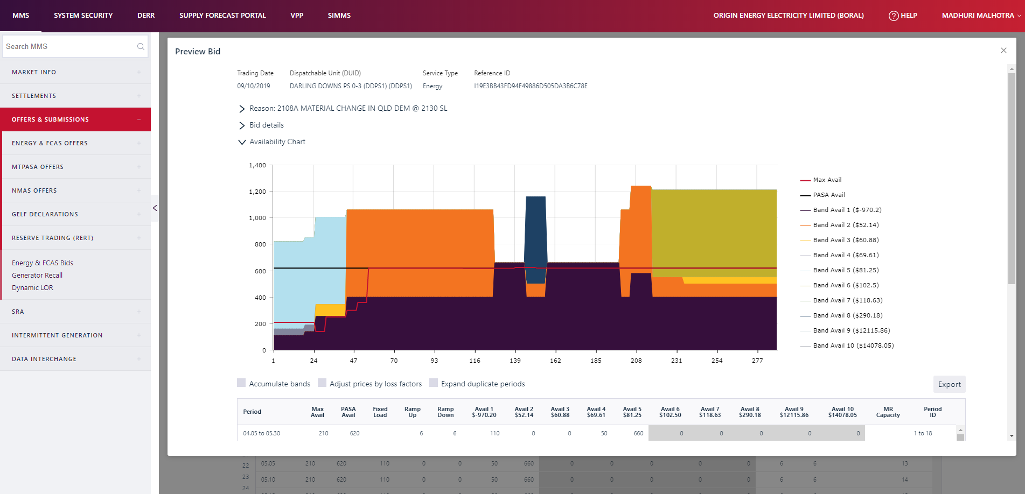
Preview
Preview bids before submission
View condensed form before submission

Slide 51
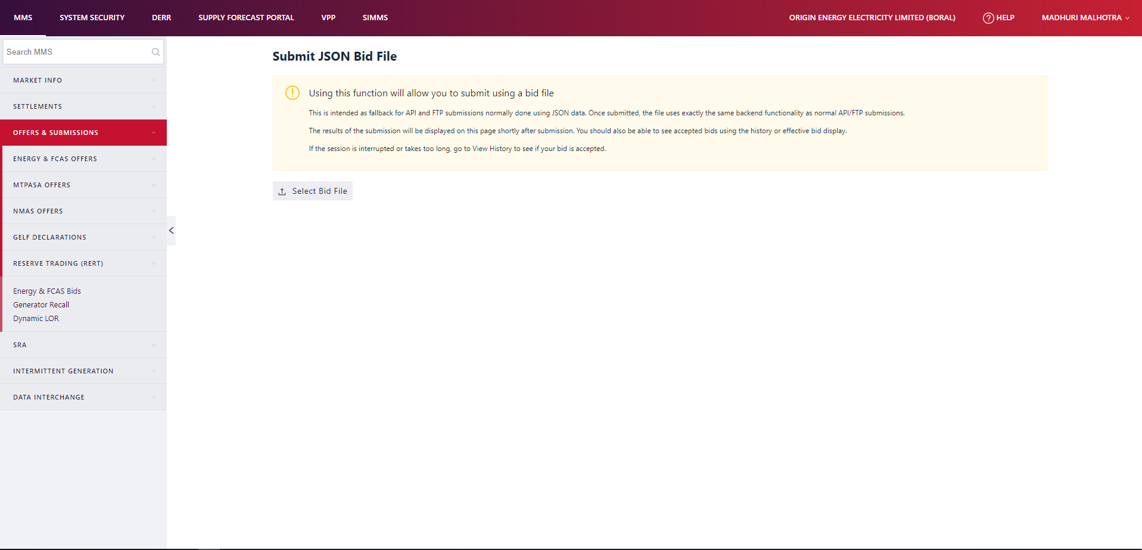
Submit JSON bid file
Fallback for API and FTP submissions normally done using JSON data
Allows multiple bids
Submits directly

Slide 52
Reallocations

Slide 53
Major updates
New system supports 5-min intervals
Ability to download and upload to and from CSV file format
Improved authorisation confirmation
Authorising party can now reject a submitted reallocation
Selection of a calendar for applicable Public holidays
Reverse or duplicate a reallocation
Shape Reallocations
Two new alerts: changes to reallocations and warning dates in production
Notes:
No multiple side nav options. Fewer clicks to reach bidding.
See bids by a single click
Compressed view don’t have to see duplicated value
Know accumulated values, Better
Know loss factor
Important information upfront
Better/clearer picture of overall bids
Tooltips// may be
Bid visualization.
Helps make decisions efficiently

Slide 54
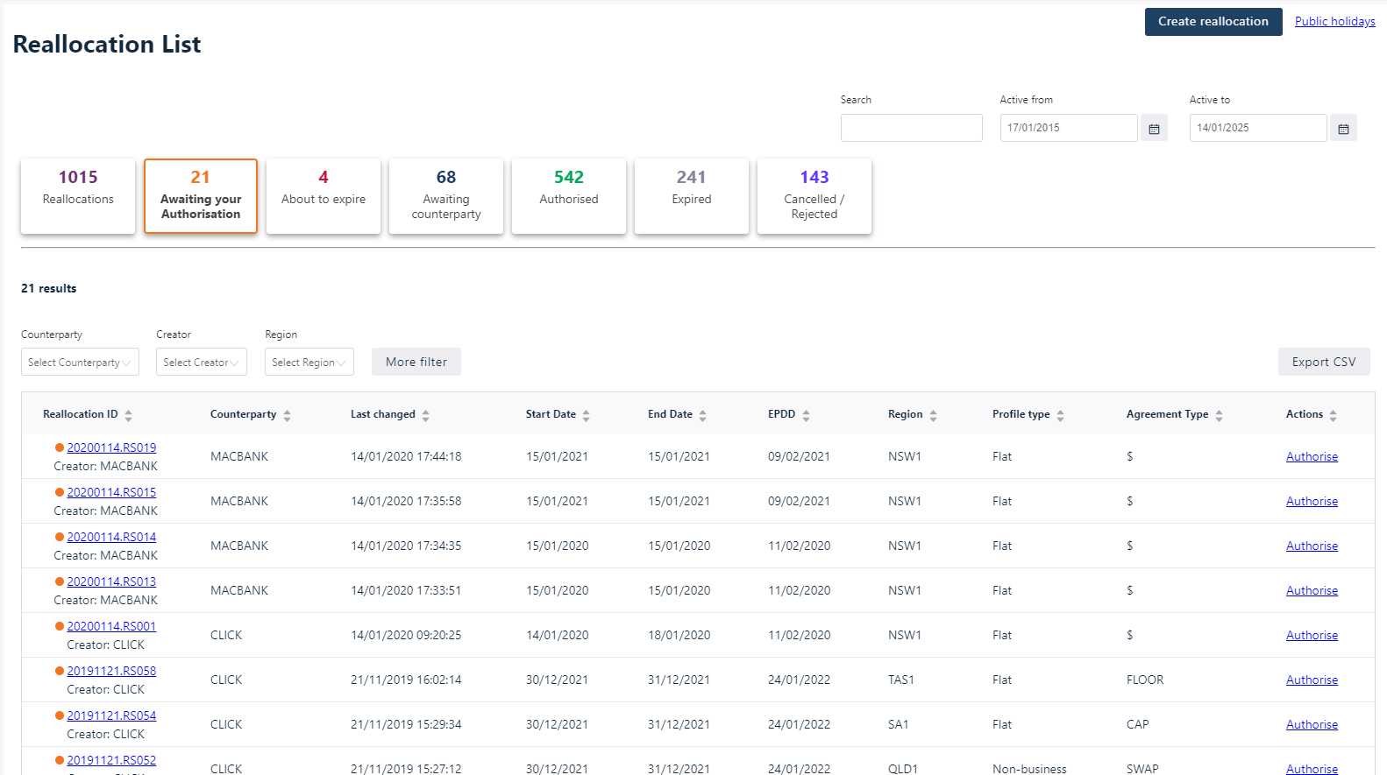
Reallocation listing
All reallocations at one place
Easily find reallocations by their status
Filter reallocations by creator, Region, agreement etc.
Search reallocations
Access public holiday calendars
Export reallocation listing to CSV
Notes:
No multiple side nav options. Fewer clicks to reach bidding.
See bids by a single click
Compressed view don’t have to see duplicated value
Know accumulated values, Better
Know loss factor
Important information upfront
Better/clearer picture of overall bids
Tooltips// may be
Bid visualization.
Helps make decisions efficiently

Slide 55
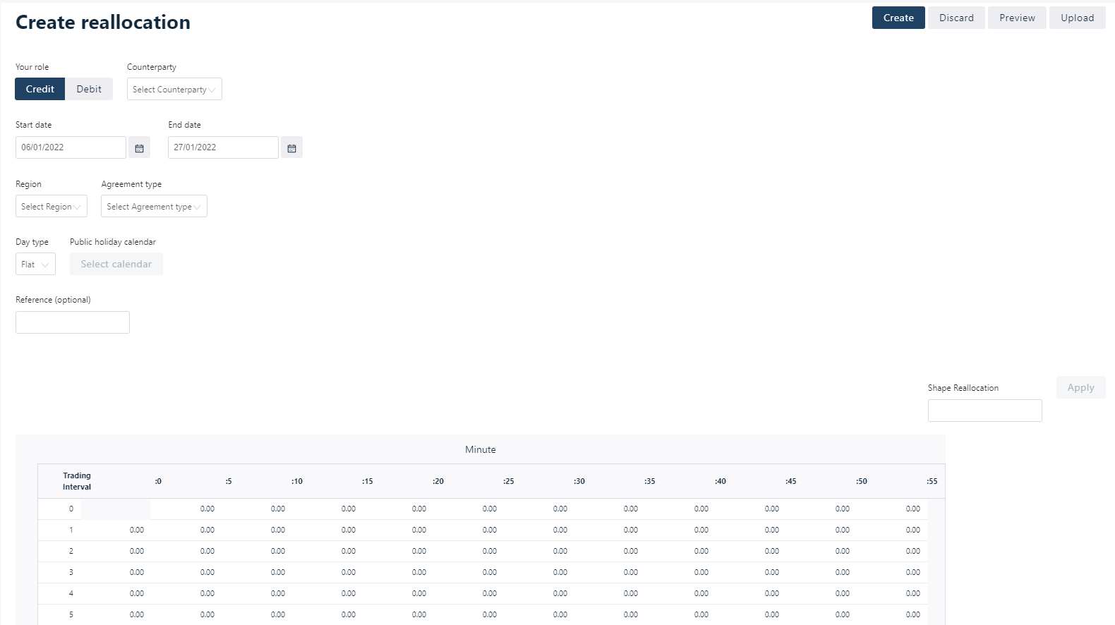
Create reallocation
5-min – 288 intervals
Upload reallocations
Quick-fill functionality to easily fill reallocation
Preview reallocation before submitting – Have collapsed view
Select public holiday calendar
Shape reallocation
Notes:
Participants can use a profile or shape of any reallocation in order to create a new one based on that “shape”. With this functionality the daily amount of energy for a reallocation can be distributed at each trading interval using the same proportions that any other reallocation can provide.

Slide 56
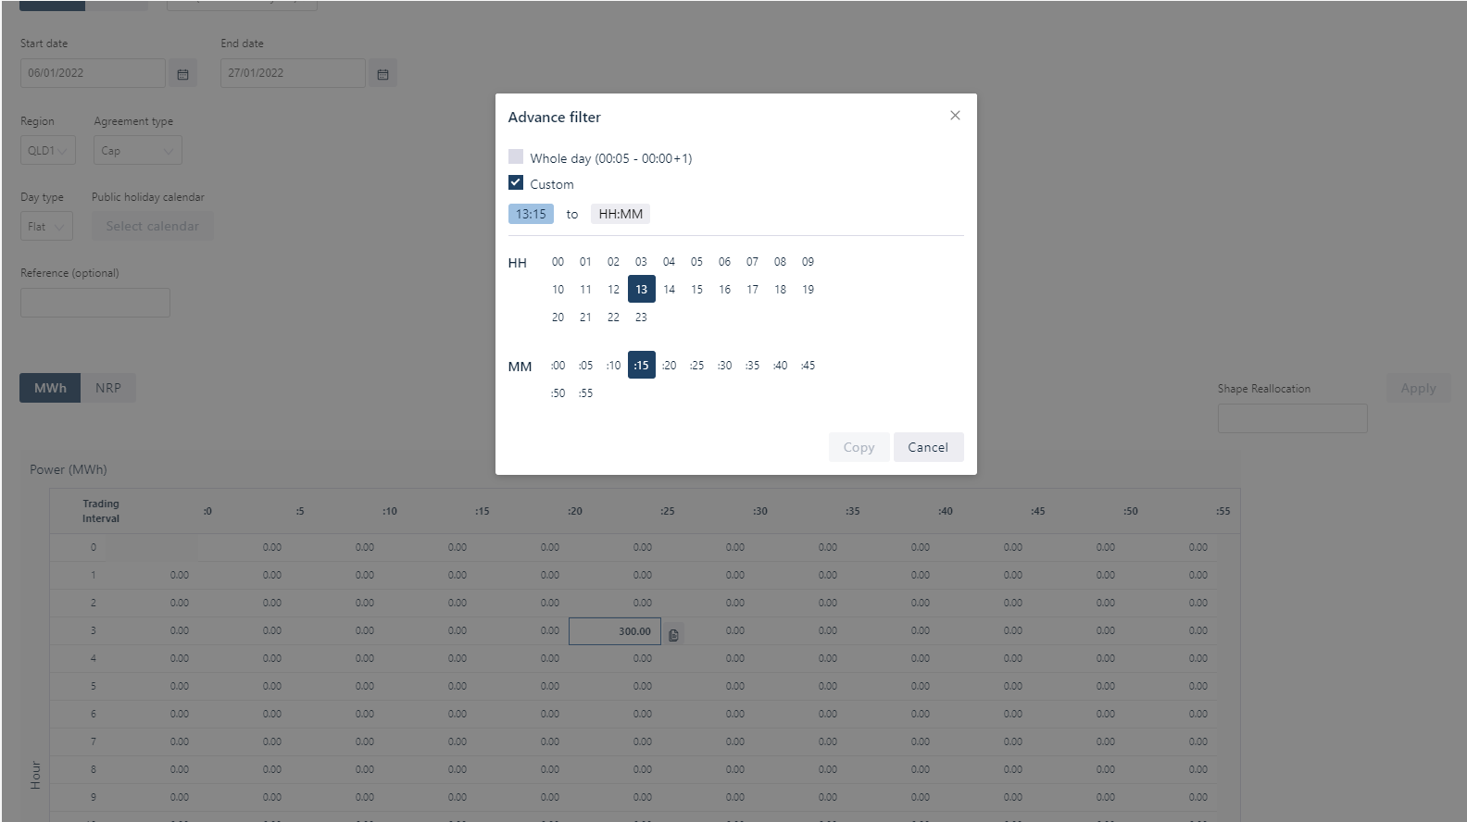
Authorise reallocation

Slide 57
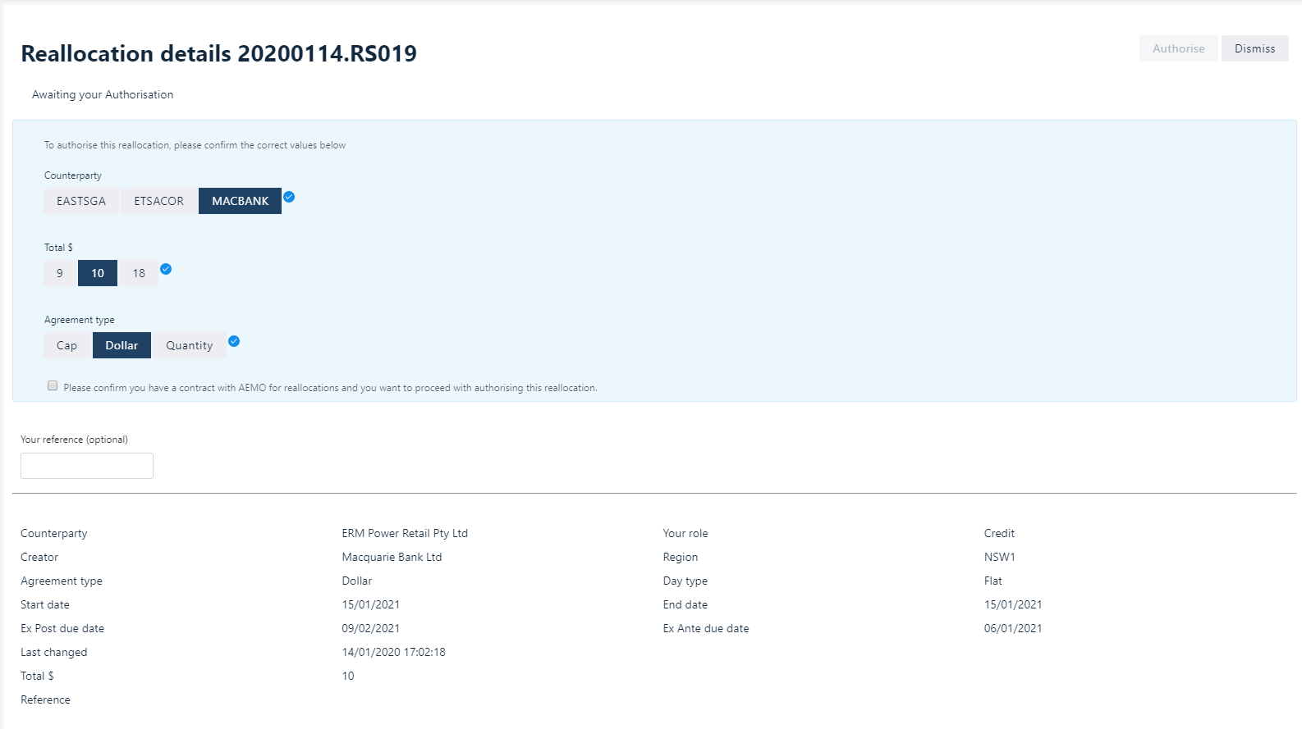
Authorise reallocation

Slide 58
Web user interface feedback
We encourage further feedback:
  Available in Staging from 29 November for use and feedback
  Email us at 5ms@aemo.com.au
Feedback to date has been:
  From Dispatch Focus group
  Suggestions from participants at various platforms
  From the Clean Energy Council Webinar for small renewables

Slide 59
Readiness Reporting – how will we understand market readiness?
Greg Minney

Slide 60
Readiness reporting approach
Objective:
  To facilitate readiness reporting throughout the implementation phase of 5MS and GS so that AEMO, NEM participants and other interested stakeholders have an accurate assessment of industry’s readiness for the various 5MS and GS market system “go-lives”, transitional activities and commencements.
Key Principles:
  Industry participation in the readiness reporting process is voluntary but strongly encouraged and in the interest of all participants.
  Participants are responsible for establishing their own appropriate project schedule baselines and reporting their status against these.
  Participants will submit open and honest self-assessments of their readiness status, following a framework and format set out in the Industry readiness reporting plan.
  Readiness reporting information will be collated and submitted by an authorised person on behalf of their organisation.
  AEMO will develop and seek input from the RWG on readiness reporting criteria.
  Readiness reporting will be on a regular basis, following a defined calendar developed in collaboration with the RWG. In developing the reporting calendar, the effort of reporting will be balanced with the value of reporting.
  As far as practicable, changes to the readiness survey questionnaire will only occur where further detail is required on key criteria.
  AEMO will aggregate survey responses and prepare a Market Readiness Report following the approach defined in the readiness reporting plan
  All responses will be treated as strictly confidential in-line with AEMO policies. The results from any analysis will be reported in aggregate and no individual organisations will be identified or identifiable.

Slide 61
Reporting Criteria
General Readiness Criteria:
  Program establishment and progress
  Overall governance
  Common to all participants
Specific Readiness Criteria
  Implementation of capability for 5MS/GS
  Specific to participant type, including AEMO
  Required for the successful operation of the market in 5MS/GS scenario
Metering Transition Plan monitoring
  Monitors the status of metering transition activities defined in the Metering transition plan

Slide 62
Timeframes
Month | Milestone
Jan-20 | Release of detailed readiness reporting calendar
Feb-20 | Readiness Assessment Questionnaire - Release 1
Mar-20 | Industry readiness reporting plan - Review point 1
May-20 | Readiness Assessment Questionnaire - Release 2
Jun-20 | Industry readiness reporting plan - Review point 2
Jul -20 | Readiness Assessment Questionnaire - Release 3
Sep-20 | Readiness Assessment Questionnaire - Release 4
Oct-20 | Industry readiness reporting plan - Review point 3
Nov-20 | Readiness Assessment Questionnaire - Release 5
Jan-21 | Readiness Assessment Questionnaire - Release 6
Mar-21 | Readiness Assessment Questionnaire - Release 7
Apr-21 | Industry readiness reporting plan - Review point 4
May-21 | Readiness Assessment Questionnaire - Release 8
Future reporting dates to be determined at Review point 4
Frequency of reporting reflects proximity to key milestones and go-lives

Slide 63
Reporting calendar - 2020
Readiness reporting calendar dates for 2020:
Readiness reporting | Survey released | Survey responses due | Distribute results
Round #1 | 05-Feb-20 | 14-Feb-20 | 28-Feb-20
Round #2 | 14-Apr-20 | 23-Apr-20 | 07-May-20
Round #3 | 07-Jul-20 | 16-Jul-20 | 30-Jul-20
Round #4 | 01-Sep-20 | 10-Sep-20 | 24-Sep-20
Round #5 | 03-Nov-20 | 12-Nov-20 | 26-Nov-20

Slide 64
Reporting and risk management
Reporting Coverage:
  Overall Initiative status and risk rating
  Aggregated readiness of each participant group
  Readiness for each rule / market commencement
Reporting Format
Assessment and risk management with Readiness Working Group
  Risk mitigation activities
  Contingency management
  Critical participant status

Slide 65
How can you engage?
Anne-Marie McCague

Slide 66
Where can you find more information?
AEMOs website provides background information, and factsheets
https://www.aemo.com.au/Electricity/National-Electricity-Market-NEM/Five-Minute-Settlement
Details of the Procedures, Systems and Readiness Workstreams:
  Including Procedures information
  Technical Specifications
  User Guides
  Meeting notes and slide packs for all Working Groups

Slide 67
What else can I find on the website?
Industry Risks and Issues Register – updated quarterly
Industry Action Log – updated monthly
Program timeline with current status – update monthly
2020 Meetings Calendar
Helicopter guide to the 5MS Program – coming soon

Slide 68


5MS Working Groups
Executive Forum
Executive-level representatives of impacted organisations
Escalation of risks and issues from Working Groups
Project Consultative Forum (PCF)
Program management from impact organisations
Program status
Risks and Issues
Overview of Working Groups
Readiness Working Group (RWG)
Contribute to the development of key market readiness planning deliverables
Market readiness risks and issues
Readiness reporting

Slide 69


5MS Working Groups
Systems Working Group (SWG)
Targeted, technical discussions on defined project deliverables
Procedures Working Group (PWG)
Contribute to the development of procedure amendments
In hibernation
Industry Testing Working Group (ITWG)
Contribute to the approach and scope of releases
Collaborate on the development of test plans for each of the releases
Discuss key industry concerns relating to testing activities
Meeting notes and slide packs published on website

Slide 70
Other ways to stay informed
Monthly newsletter
General Information Session – twice a year
Mailing list – contact us to be added to the general mailing list
5MS@aemo.com.au

Slide 71
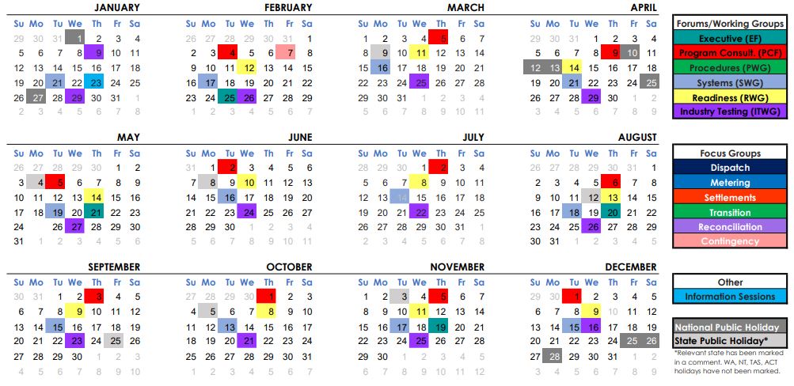
Forward Calendar & Engagement
Available at:
http://www.aemo.com.au/Electricity/National-Electricity-Market-NEM/Five-Minute-Settlement

Slide 72
Questions?

