Slide 1
ERCF Meeting #4
28 April 2022
This meeting is being recorded for the purpose of minute taking.

Slide 2
Attendees
Aakash Sembey
Adrian Honey
Blaine Miner
Carla Adolfo
Chantal Wright
Christophe Bechia
Damien Tillig
Dan Hillier
Daniel Evans
Daniel Hoolihan
Dean Knight
Dino Ou
Ellie Carey
Emille Kueh
Graeme Ferguson
Greg Szot
Hadi Mostafavi
Helen Vassos
Jackie Krizmanic
Jeff Roberts
Jo Sullivan
Justin Betlehem
Kamal Kisto
Kambiz Vessali
Karel Mallinson
Kate Gordon
Kevin Boutchard
Mamta Madan
Mark Leschke
Mark Riley
Matthew Giampiccolo
Mussan Larnach
Paul Greenwood
Richard Metherell
Robert Lo Giudice
Sagar Shah
Shaun Cupitt
Shaun Hooper
Steven Thomson
Sue Richardson
Wayne Turner
Zahara Magriplis

Slide 3
Online forum housekeeping
Please mute your microphone, this helps with audio quality as background noises distract from the information being shared.
Video is optional, but having it turned off helps with performance and minimises distractions.
We ask that you utilise the Chat function for any questions or comments you may have. This aids note keeping and keeps discussions flowing smoothly.
Raise your hand if you wish to speak to an item. This keeps conversations orderly.
If you have dialled in via phone, please email ERCF@aemo.com.au your name and organisation for our records.
If you name appears abbreviated on Teams, please add your name and organisation to the chat for our records.
Be respectful of all participants and the process.

Slide 4
AEMO Competition Law Meeting Protocol
AEMO is committed to complying with all applicable laws, including the Competition and Consumer Act 2010 (CCA). In any dealings with AEMO regarding proposed reforms or other initiatives, all participants agree to adhere to the CCA at all times and to comply with this Protocol. Participants must arrange for their representatives to be briefed on competition law risks and obligations.
Participants in AEMO discussions must:
Ensure that discussions are limited to the matters contemplated by the agenda for the discussion
Make independent and unilateral decisions about their commercial positions and approach in relation to the matters under discussion with AEMO
Immediately and clearly raise an objection with AEMO or the Chair of the meeting if a matter is discussed that the participant is concerned may give rise to competition law risks or a breach of this Protocol
Participants in AEMO meetings must not discuss or agree on the following topics:
Which customers they will supply or market to
The price or other terms at which Participants will supply
Bids or tenders, including the nature of a bid that a Participant intends to make or whether the Participant will participate in the bid
Which suppliers Participants will acquire from (or the price or other terms on which they acquire goods or services)
Refusing to supply a person or company access to any products, services or inputs they require
Under no circumstances must Participants share Competitively Sensitive Information. Competitively Sensitive Information means confidential information relating to a Participant which if disclosed to a competitor could affect its current or future commercial strategies, such as pricing information, customer terms and conditions, supply terms and conditions, sales, marketing or procurement strategies, product development, margins, costs, capacity or production planning.

Slide 5
Agenda
Welcome & agenda
ICF Register Update
Subgroup Updates
Consultations Update
General Business​ and Next Steps
Procedures and documents published to AEMO’s website
Appendix
ERCF Release Summary

Slide 6
ICF Register Update
Blaine Miner

Slide 7
ICF Register Update
Issue/Change Title | Short Description | Proponent | ICF Ref# | Current Status/Update
ADWNAN Reporting changes | Assignment of Interval ADWNANs to MDP in AEMO Performance Reports | Jane Hutson, EQ | 017 | Final feedback being sought from MDPs prior to the report being implemented in Production (request sent out 26 Apr)
Child NMI standing data quality - TNI and DLF | ENM compliance requirement includes maintenance of standing data of Child NMIs – TNI and DLF I. Child NMI TNI and DLF is directly inherited from parent NMI TNI and DLF for all child NMIs except Child NMIs with site specific TNIs. ENMs currently do not have visibility on parent NMI standing data and to any changes made on the parent NMI standing data (CRs raised on Parent NMIs). This results in an issue as the Child NMI TNI and DLF becomes inaccurate when a parent NMI TNI and DLF are changed in the market but not updated to the ENMs. This affects the Child NMI billing in the market resulting in incorrect billing of consumers. * This also directly affects the SDQ report in MSATS and in turn our ENM compliance report from AEMO. | intelenm@energyintel.com.au | 032 | Awaiting advice from AEMO’s IT area re implementation, targeting May 2023 release.

Slide 8
ICF Register Update
Issue/Change Title | Short Description | Proponent | ICF Ref# | Current Status/Update
New Substitution method | Currently MDP’s are largely limited to the substitution methodologies in the Metrology Procedure Part B which can drive an inaccurate consumption. MDPs need a substitution / estimation methodology which allows them the ability to adjust metering data by factors to ensure that it aligns with actual consumption without the need to obtain all participants permissions. | Mark Riley (AGL) Shaun Cupitt (Alinta) | 044 | MDP Working Group feedback: The proposed methodology was not supported by most MDPs. MDPs believe that the existing Substitution Types specified in Met Part B can accommodate the scenarios mentioned in the ICF.
Updating Network Tariff for a Greenfield NMI | Configuration change to validation in MSATS on the CR3101 to allow the CR3101 to continue rather than reject on a Greenfield NMI. | Laura Peirano (UE) | 047 | Awaiting advice from AEMO’s IT area re implementation, targeting May 2023 release.
NMI Status Updates | Proposes more explicit obligations regarding LNSPs reflecting NMI status energisations/de-energisations in MSATS regardless of the mechanism that triggered the status and this trigger point being from when LNSPs are advised of said status. | Helen Vassos (PLUS ES) | 052 | Refer to subgroup update
Substitution Review | The review requires consideration for new substitution rules to be implemented for interval metering data to replicate substitution rules derived from Manually Read Interval Meters and Accumulative Meters. | Mark Riley (AGL) | 054 | MDP Working Group feedback: ICF updated to remove Type 23, as this is ultimately the same as Type 15, and changed some wording for the existing Type 20.
Clarifying when an embedded network code must be issued | Clarifying EN interpretations of the relevant clause, so the clauses are applicable regardless of the Distributor’s embedded network application process. | Dino Ou (Endeavour) | 055 | Awaiting additional information from ENMs

Slide 9
ICF Register Update
Issue/Change Title | Short Description | Proponent | ICF Ref# | Current Status/Update
Clarification of End Date in Inventory Table | Some MDPs are using NCONUML Inventory Table End Date to identify when the metering data is last calculated, updating it each month. Proposal is to clarify the end-date be when there is a change to consumption or abolishment. If not, the End Date should be reflected as 31.12.9999. | Mark Riley (AGL) | 056 | Refer to subgroup update
NCONUML GPS Location | Some customers cannot confirm ownership of or locate unmetered assets. Proposal is to introduce 7-decimal point GPS obligations for NCONUML meters. M for Greenfield, R for Brownfield sites, which would also help with sample testing. | Aakash Sembey (Origin) | 057 | Refer to subgroup update
Review of NMI Classifications | Some NMI Classifications are defined according to consumption, while some are defined according to throughput. The descriptions should be updated for consistency and to better accommodate for new connection arrangements (EG: those associated with IESS) | Mark Riley (AGL) | 059 | Refer to subgroup update
‘Spikes’ in settlement volumes within a 30-minute period | Following the introduction of 5MS, participants have witnessed peculiar ‘spikes’ in settlement volumes. These spikes occur within a 30-minute period and are a consequence of using the methodology outlined in AEMO’s Metrology Procedures Part B. | Shaun Hooper (Powershop) | 060 | Refer to subgroup update

Slide 10
ICF Register Update
Issue/Change Title | Short Description | Proponent | ICF Ref# | Current Status/Update
Incorrect ‘Meter Manufacturer’ and ‘Meter Model’ obligations associated to CR305x transactions in CATS Procedures v5.3 | From 7 Nov 2022, ‘Meter Manufacturer’ and ‘Meter Model’ will become Mandatory fields in MSATS. An issue has been identified in the application of this obligation associated to situations where a new MPB needs to remove a meter from MSATS where these fields have not been previously populated. CATS Procedures v5.3, effective date 7 Nov 2022, states that for CR3004/5 transactions that ‘Meter Manufacturer’ and ‘Meter Model’ are only required when the status code is ‘C’ (Current), however, this is not stated for CR305x transactions, the procedure currently states that these fields must always be supplied, even for a removal. AEMO is recommending for this misalignment to be fixed as part of the next REMP consultation. | Jackie Krizmanic (AEMO) | 061 | Included in the CDR Consultation
GPS Coordinates Value where no GPS coverage is available at the metering installation. | PLUS ES proposes the following to mitigate unnecessary handling of GPS Coordinates. • All MPBs must use a specific value which will indicate to the industry that GPS coverage was not available at the metering installation • The proposed value is 0.00000 (5-7 decimal places) to align with the format specified in the NMI Standing Data Procedure. • GPSCoordinatesLat, GPSCoordinatesLong field description to be updated in the NMI Standing Data Procedure to reflect the proposed value and prerequisite for its use. | Helen Vassos (PLUS ES) | 062 | Included in the CDR Consultation
Additional Transformer Valid Values | There are several values missing from the transformer enumerated field lists in the “STANDING DATA FOR MSATS V5.2” document. Some are common values which will impact most metering participants, e.g., CT Ratio (Connected) = 3000:5 | Steven Thomson (Intellihub) | 063 | Included in the CDR Consultation

Slide 11
Notes
Blaine spoke to the ‘ICF Register Update’ slides
Jane Hutson (EQ) asked if there was an indicative go live date for ICF-017
Jackie Krizmanic (AEMO) suggested June 2022, to allow for MDM requirements and any final feedback being received and considered – an email will be sent out to MDPs prior to its implementation
Jackie Krizmanic (AEMO) spoke to ICF-044 and ICF-054.
Jackie stated that for ICF-044, MDPs were sceptical of including a scaling of data substitution type, stating there was concern that is wouldn’t be used. They believed there was no benefit for type 6 & 7 metering data. The MDPs believe it may sit better with CT and VT sites. 10 to 12 of the MDPs stated they would not use the new sub type. MDPs with larger sites said they may use the code.
Shaun Cupitt (Alinta) stated that part of the reason it was raised was due to the impact of COVID-19, as there was a strong likelihood that consumption from 12 months ago wouldn’t be indicative of what consumption is being used now as more people are working from home etc.
Blaine Miner (AEMO) stated that there is already a provision in Metrology Part B that allows a variation to the more common types e.g. ‘Agreed’ sub type
Shaun Cupitt (Alinta) mentioned that the Agreed type created a large overhead due to agreement being required between all parties
Jackie Krizmanic (AEMO) noted that the MDPs were not keen on splitting out some of the reasons and that the majority of them were in favour of not having an agreement.
Shaun Cupitt (Alinta) suggested, and the ERCF agreed, for ICF-044 to be closed and for ICF-054 to cover the intent of both ICF-044 and ICF-054
Action:
AEMO to send out a call for nominations and agenda items to the ERCF to attend a ‘Substitution Type review’ workshop.
Potential agenda items
Holistic review/background
Confirmation of the current issue/pain points for Retailers and MDPs
Possible solutions/next steps
AEMO to close ICF-044, noting that the issue will be considered as part of ICF-54
AEMO to send out the updated ICF-054 as part of the notes, following feedback for the MDP WG

Slide 12
Notes
ICF0-63 – Dino Ou (Endeavour) questioned why CT ratios required a consultation to change the values whereas values such as Meter Manufacturer does not?
Blaine Miner (AEMO) noted that the Standing Data for MSATS document is not a NER Procedure, meaning that changes to the document don’t require a full consultation under NER 8.9.
Jackie Krizmanic (AEMO) noted that the typical distinction between the treatment of enumerated values in the procedure is the potential impact to customer billing outcomes i.e. does the list support a billing outcome or is it for information purposes only
Dino Ou (Endeavour) asked if the transformer values could be managed in a similar manner to network tariff code?
Jackie Krizmanic (AEMO) noted that the different is that tariffs are in tables, not just a drop down list, and retailers have the ability to look up a tariff code in the table, but are unable to look up transformer values anywhere except in the Standing Data for MSATS document
Action:
ERCF members to provide suggestions/preferences as to how to best manage Standing Data for MSATS enumerated lists, being conscious of list efficiency vs potential impacts to participants systems
AEMO to confirm contact details for ENMs, to request for further information to progress ICF-055
May be able to use the reporting contact details AEMO currently has
AEMO to update the proponent of ICF-054 to Mark Leschke

Slide 13
Subgroup Updates
Proponents

Slide 14
Subgroup Updates
Issue/Change Title | Short Description | ICF Ref# | Status | Proponent | Current Status/Update
NMI Status | PlusES is proposing that the NMI status must be updated by the LNSP when they become aware that the supply status to the connection point is different from what is recorded in MSATS. i.e. the updating of the NMI status should not only occur when the LNSP has effected an energisation service. | 52 | Active | Helen Vassos (PlusES) | Subgroup met on 7 April 2022
NCONUML GPS Coordinates | Origin is proposing that the ‘GPS Lat and Long’ (1 location per NMI) requirements for NCONUML sites follow the same rules as remotely read meters (i.e., For NMIs with remotely read meters: MANDATORY for new NMIs established from the effective date of these Procedures and all NMIs when they have a physical field site visit, REQUIRED for all other NMIs. | 57 | Active | Aakash Sembey (Origin) | Subgroup met for the second time on 18 March – Origin assessing their position
Incorrect Assignment of the MC | PlusES is engaging members of the ERCF to consider how the Incorrect nomination of contestable MCs can be better managed. | TBD | Active | Helen Vassos (PlusES) | Subgroup met on 31 March 2022
Clarification of End Date in Inventory Table | AGL has raised the issue that Inventory Tables are being populated and maintained inconsistently between DNSPs and that the data being provided by some DNSPs are seen as being inadequate. | 56 | Active | Mark Riley (AGL) | Subgroup met on 6 April 2022
Review of NMI Classifications | AGL is proposing that the basis of, and the NMI classifications themselves, be reviewed to ensure they appropriately communicate the service a NMI represents. | 59 | Active | Mark Riley (AGL) | Proponent considering next steps
‘Spikes’ in settlement volumes within a 30-minute period | Following the introduction of 5MS (1 Oct 2021), Powershop has witnessed peculiar ‘spikes’ in settlement volumes. This subgroup is being established to discuss and consider potential long-term solutions to address this issue. | 60 | Active | Shaun Hooper (Powershop) | Subgroup met on 25 March 2022. Second meeting scheduled for Friday 6 May.

Slide 15
Notes
NMI Status (ICF-052)
Helen Vassos (Plus ES) stated that notes from the last subgroup meeting will be sent out shortly and noted that a meeting invite will be sent for the next subgroup meeting in the coming week
NCONUML GPS Coordinates (ICF-057)
Aakash Sembey (Origin) gave an update on ICF-057 and noted the result of the subgroup was that there was not a one size fits all solution. Aakash recommended that the ICF should be withdrawn/closed and that Participants should continue to work with the Networks to work through issues on an adhoc basis.
Mark Riley (AGL) requested to wait until the next ERCF to withdraw/close this ICF, to allow additional time for Mark and Aakash to consider new connections only.
Action: Mark and Aakash to consider if a solution is possible for ICF-057 for new NCONUMLs only
Incorrect Assignment of the contestable MC (no current ICF)
Helen Vassos (Plus ES) stated that notes from the last subgroup meeting will be sent out shortly and noted that a meeting invite will be sent for the next subgroup meeting in the coming week
Clarification of End Date in Inventory Tables (ICF-056)
The subgroup agreed that the current headings in the inventory table are interpretable and may not contain all of the information preferred by Retailers:
Action is now with Mark to:
Update the current ICF to focus on the consistent population of the existing table content
Raise a new ICF to support the proposed new content to add to the inventory tables
Review of NMI Classifications (ICF-059)
Mark Riley (AGL) suggested that ICF059 should be placed on hold until associated NER consultations have commenced
‘Spikes’ in Settlement Volumes within a 30-minute period (ICF-060)
Shaun Hooper gave an update on ICF60. Meeting with AEMO representatives scheduled for Friday 6 May to discuss analysis and possible long term solutions.

Slide 16
Consultations Update
Blaine Miner

Slide 17
Consultations Updates
Consultation | Short Description | Current Status/Update
B2B Procedures v3.8 | The changes (Changes) which are proposed (Proposal) are intended to: Determine the more efficient and effective method of managing re-energisation by an incoming retailer when there are two service providers (DNSP and MC) who may have undertaken or will undertake the deenergisation, to better mitigate the risk of customers being left off supply Deliver uniformity and process efficiencies in B2B communications for shared fuse arrangements to support the Metering Coordinator Planned Interruption (MCPI) rule change, which introduced new obligations on Retailers and MCs to provide information to the DNSP regarding the shared fuse status at a site. | Indictive dates: 18 May 2022 - Publication of Draft Report and Determination 1 June 2022 - Submissions in response to Draft Report due 5 July 2022 - Publication of Final Report and Determination The B2BWG has provided its recommendations to the IEC, based on the Initial consultation responses. The IEC met on Friday 22 Apr to determine which Coincident Service Order option will be included in the Draft Report.
Standalone Power Systems (SAPS) | AEMO has prepared this Issues Paper to facilitate informed debate and feedback by industry about the most efficient way to meet the objectives for implementing the SAPS Framework in AEMO Retail Electricity Market and Settlement procedures. AEMO has considered three options so that a participant can identify in MSATS a NMI that is connected to a SAPS. | Indictive dates: 9 May 2022 - Publication of Draft Report and Determination 24 May 2022 - Submissions in response to Draft Report due 5 July 2022 - Publication of Final Report and Determination Majority of respondents preferred Option #2 - TNI Codes with special convention or format for SAPS TNI Codes
Consumer Data Right (CDR) | Consumer Data Right (CDR) is Australian Government legislation, introduced in November 2017, to give more control and choice to consumers on how their data is shared and used. CDR has been introduced as an amendment to the Competition and Consumer Act under Australian Commonwealth legislation. AEMO has published an Issues Paper regarding the most efficient way to meet AEMO’s Consumer Data Right (CDR) obligations and other matters which require modification (including ICF 061, ICF 062 and ICF 063). | Indictive dates: 26 April 2022 - Issues Paper published 2 June 2022 - Submissions due on Issues Paper 30 June 2022 - Draft Report published 15 July 2022 - Submissions due on Draft Report 26 August 2022 - Final Report published
IESS | High-level impact assessments currently occurring, covering both B2M and B2B procedures/documents | Q3 or Q4 2022

Slide 18
Notes
Daniel Hoolihan (EQ) stated that the SAPS consultation was focused on the identification of TNIs and questioned where the conversation was in regards to the settlement process
Blaine Miner (AEMO) took it on notice to confirm this information with other parts of AEMO and forward to the ERCF.
Rob Lo Giudice (Alinta) raised a question re CDR, if consideration had been given to the fact that the information is already shared via the B2B platform and as AEMO has access to this platform could make themselves a notified party. Rob stated this would be more efficient and more readily available and asked why an MSATS solution was decided since the information is delayed in MSATS.
Blaine Miner (AEMO) stated that any preferred options or alternatives should be provided via participant submissions
Kate Gordon (AEMO) reached out to Luke Barlow re this question and Luke provided the following response:
The Customer contact details service order was previously considered however contact details cannot able be used as a proxy under the CDR definitions.
The Reenergise service order was also considered however this option was seen as inadequate as properties can be deenergised then reenergised for commercial reasons with the same customer
The ‘Move in’ CR (not B2B) was also considered however concerns were raised about the periodic misuse of this CR and therefore this option was deemed unreliable
Action: AEMO to consider running a CDR workshop, similar to SAPS, to provide broader information/context re CDR e.g. MSATS and Retailer onboarding

Slide 19
General Business and Next Steps
Blaine Miner

Slide 20
AEMO Website Updates
AEMO has/are in the process of publishing the following documents to its website:
Procedure | Version # | Effective Date
B2B eHub Accreditation | 1.4 | 1 May 2022
MDFF Specification NEM12 NEM13 | 2.5 | 1 May 2022
Metrology Procedure Part A | 7.4 | 1 May 2022
Metrology Procedure Part B | 7.3 | 1 May 2022
MSATS Procedures - CATS | 5.1 | 1 May 2022
MSATS Procedures - WIGS | 5.1 | 1 May 2022
MSATS Procedures - MDM Procedure | 4.3 | 1 May 2022
NEM RoLR Processes Part A and Part B | 2.3 | 1 May 2022
Retail Electricity Market Procedures – Glossary and Framework | 3.5 | 1 May 2022
Standing Data for MSATS | 5.11 | 1 May 2022
Exemption Procedure Meter Installation Malfunctions | 1.2 | 1 May 2022

Slide 21
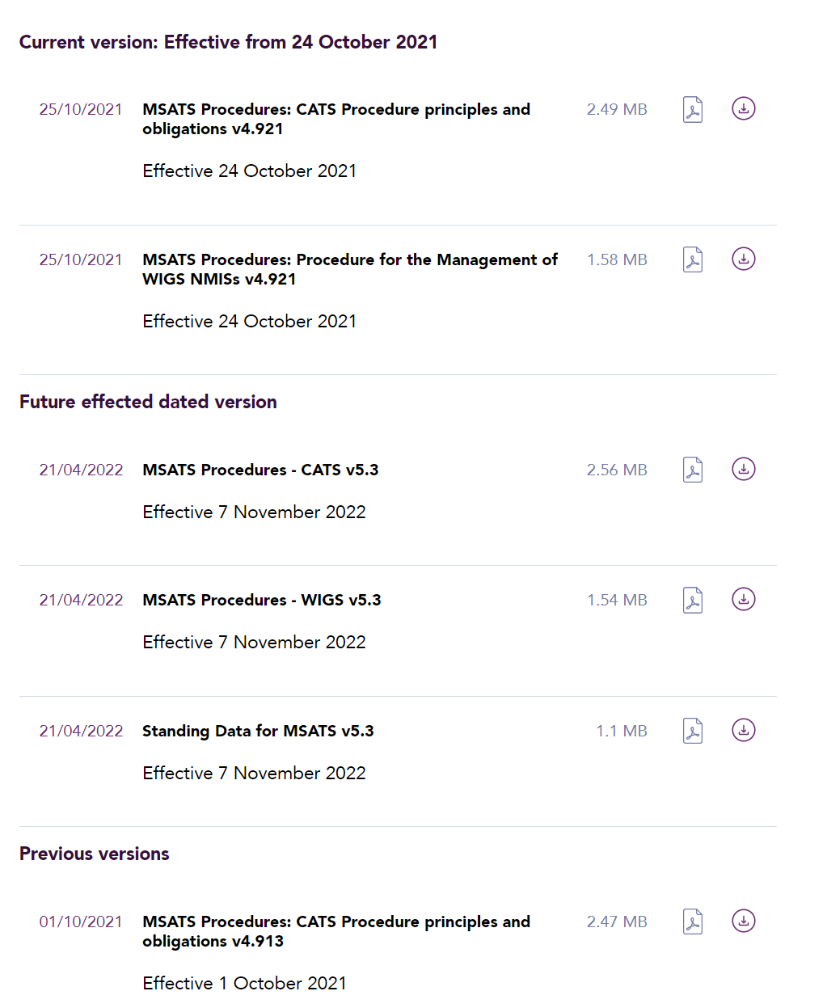
AEMO Website Updates
Under a new banner of ‘Future effected dated versions’
MSATS Procedures: CATS Procedure Principles and Obligations v5.3
MSATS Procedures: Procedure for the Management of Wholesale, Interconnector, Generator and Sample (WIGS) NMIs v5.3
Standing Data for MSATS v5.3
Below the ‘Current version: Effective from 1 May 2022’ section
Published to https://aemo.com.au/energy-systems/electricity/national-electricity-market-nem/market-operations/retail-and-metering/market-settlement-and-transfer-solutions-msats

Slide 22
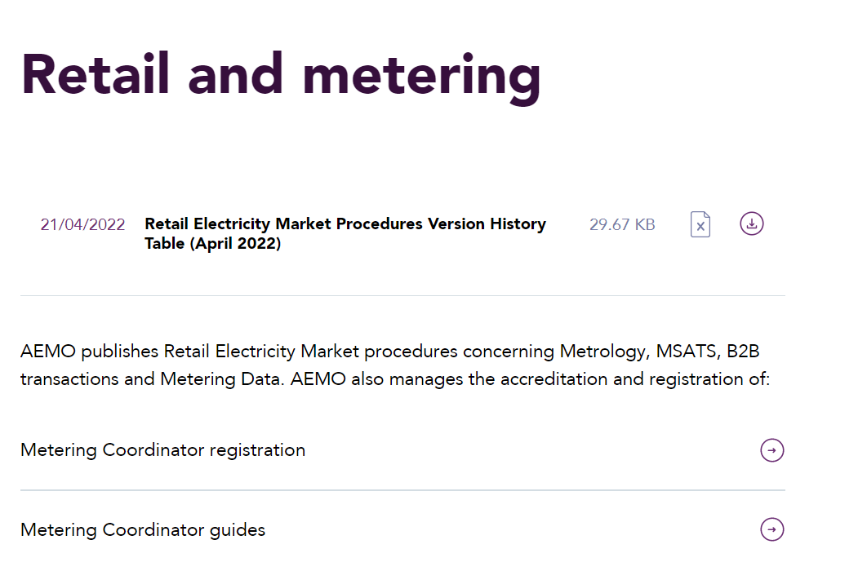
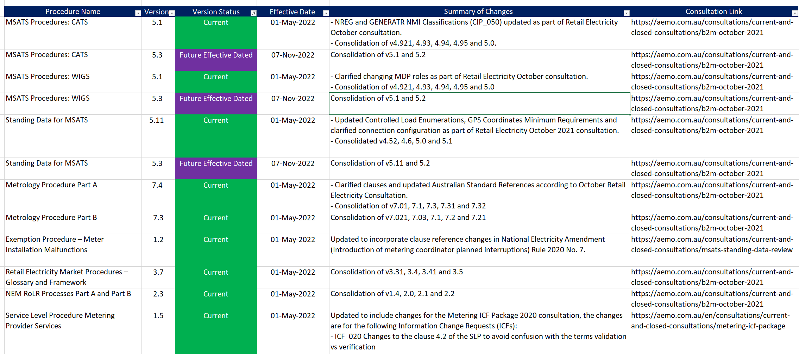
AEMO Website Updates
The latest ‘Retail Electricity Market Procedures Version History Table (April 2022)’ document
Published at the top of the https://aemo.com.au/energy-systems/electricity/national-electricity-market-nem/market-operations/retail-and-metering webpage

Slide 23
Notes
Blaine Miner (AEMO) noted the new procedures coming into effect as of 1 May 2022
Blaine Miner (AEMO) walked through changes to the AEMO website, to make procedures more easily accessible and visible
Blaine Miner (AEMO) called for any other business
Kamal Kristo (Origin) noted that there is a requirement to send notification to the LNSP of shared fuse noted a difficulty in consolidating email addresses that would have those notifications sent to across the LNSP’s. Kamal asked if there were thoughts on how this could be better managed.
Helen Vassos (PlusES) noted that the B2B working group is considering adding the LNSP email addresses in the B2B Guide as a potential option
Update - The B2B Working group has decided against adding the LNSP email address in the B2B Guide
Action: LNSPs to send their preferred email address for shared fused notifications to the ERCF inbox.

Slide 24
Next Steps
Actions and notes to be circulated asap
Next meeting currently scheduled for Thursday 26 May
Please send through any proposed agenda items, questions or comments to ERCF@aemo.com.au

Slide 25
Appendix

Slide 26
ERCF Release Summary

Slide 27
ERCF Release Summary
May 2022:
ICF ID | Description | Document Impacted
019 | Verification of Metering Data for Meters with Remote Capabilities | Metrology Procedure Part A
020 | Clarification of Use of Terms Validation and Verification | Metrology Procedure Part B SLP MP
021 | Removal of End User Details from the Inventory Table | Metrology Procedure Part B
023 | Process when remote collection of metering data fails | Metrology Procedure Part A SLP MDP Services
025 | Removal of ‘N’ Metering Data Quality Flag | Metrology Procedure Part B Metering Data File Format Specification NEM12 & NEM 13 (MDFF Specification)
027 | Average Daily Load at Datastream | Standing Data for MSATS Glossary and Framework
028 | Remove Failed Retailer MSATS User Access | RoLR Processes
029 | Amendment or Reversion of Definition of Register ID Field in MSATS | CATS Procedure WIGS Procedure; Standing Data for MSATS
ICF ID | Description | Document Impacted
030 | Configuration of data channels and meter data obligations | SLP MDP Services
042 | New Reason Code for extreme events | MDFF Specification
045 | B2B Accreditation Procedure Clarification | B2B E-Hub Participant Accreditation and Revocation Process (B2B Process)
046/048 | Clarification of Metrology Part A Clause 12.5. Reference to AS60044 | Metrology Procedure Part A
050 | NREG and GENERATR NMI Classifications | CATS Procedure
M001 | Process to detect energy data | SLP MDP Services
* Please note that the above summary only contains ERCF initiated changes and does not include other initiatives such as MCPI, MSDR, GS, etc.

Slide 28
ERCF Release Summary
November 2022:
ICF ID | Description | Document Impacted
013 | Change Cancellation Timeframe for CR6800 | CATS Procedure
016 | Reinstatement of MC Objection of BadParty” for Victorian SMALL NMIs | CATS Procedure
031 | Revision of definitions of SMALL and LARGE NMI Classifications | CATS Procedure
049 | Controlled Load Enumerations | Standing Data for MSATS
053 | GPS Coordinates Minimum Requirements. Connection configuration clarification | Standing Data for MSATS
* Please note that the above summary only contains ERCF initiated changes and does not include other initiatives such as MCPI, MSDR, GS, etc.

