Slide 1
AEMO Consumer Forum
Consultation Forum
22 February 2021
Guideline

Slide 2
We acknowledge the Traditional Owners of country throughout Australia and recognise their continuing connection to land, waters and culture.
We pay our respects to their Elders past, present and emerging.

Slide 3
AEMO Competition Law
Meeting Protocol
AEMO is committed to complying with all applicable laws, including the Competition and Consumer Act 2010 (CCA). In any dealings with AEMO regarding proposed reforms or other initiatives, all participants agree to adhere to the CCA at all times and to comply with this Protocol. Participants must arrange for their representatives to be briefed on competition law risks and obligations.
Participants in AEMO discussions must:
Ensure that discussions are limited to the matters contemplated by the agenda for the discussion
Make independent and unilateral decisions about their commercial positions and approach in relation to the matters under discussion with AEMO
Immediately and clearly raise an objection with AEMO or the Chair of the meeting if a matter is discussed that the participant is concerned may give rise to competition law risks or a breach of this Protocol
Participants in AEMO meetings must not discuss or agree on the following topics:
Which customers they will supply or market to
The price or other terms at which Participants will supply
Bids or tenders, including the nature of a bid that a Participant intends to make or whether the Participant will participate in the bid
Which suppliers Participants will acquire from (or the price or other terms on which they acquire goods or services)
Refusing to supply a person or company access to any products, services or inputs they require
Under no circumstances must Participants share Competitively Sensitive Information. Competitively Sensitive Information means confidential information relating to a Participant which if disclosed to a competitor could affect its current or future commercial strategies, such as pricing information, customer terms and conditions, supply terms and conditions, sales, marketing or procurement strategies, product development, margins, costs, capacity or production planning.
Notes:
Welcome everyone. While you have a look at this slide, I want to remind you that this is an opportunity to raise issues and share perspectives across the industry ahead of the first-stage submission date.
May I remind you that this is not the only opportunity to raise issues in the consultation. If you wish to discuss matters further with AEMO, please request a meeting in your formal first-stage submission.
Also, please use the raise your hand option if you would like to speak on the issue at hand as by default you will be muted as a participant.

Slide 4
Today’s meeting
Time | Duration | Item | Speaker
9:30am | 10 minutes | Welcome and overview | Antara Mascarenhas
9:40am | 45 minutes | Integrated System Plan (ISP) Methodology & ISP Consumer Panel | Oliver Derum
10:25am | 30 minutes | VPP Demonstration Knowledge Sharing report | Jacqui Mills
10:55 am | 5 minutes | Break
11:00am | 45 minutes | Quarterly Energy Dynamics report presentation | Jonathon Myrtle
11:45am | 20 minutes | AEMOs energy education program | Cameron Setchell
12:05pm | 10 minutes | 2021 the year ahead- upcoming engagements for consumer advocates Forward dates for next forums Consumer knowledge sharing sessions Upcoming major work programs | Stakeholder relations team
12:15pm | 15 minutes | Other business & close Call out for future agenda items and presentations | Antara Mascarenhas

Slide 5
Integrated System Plan (ISP) – Overview, Consumer Panel and Methodology
AEMO Consumer Forum

Slide 6
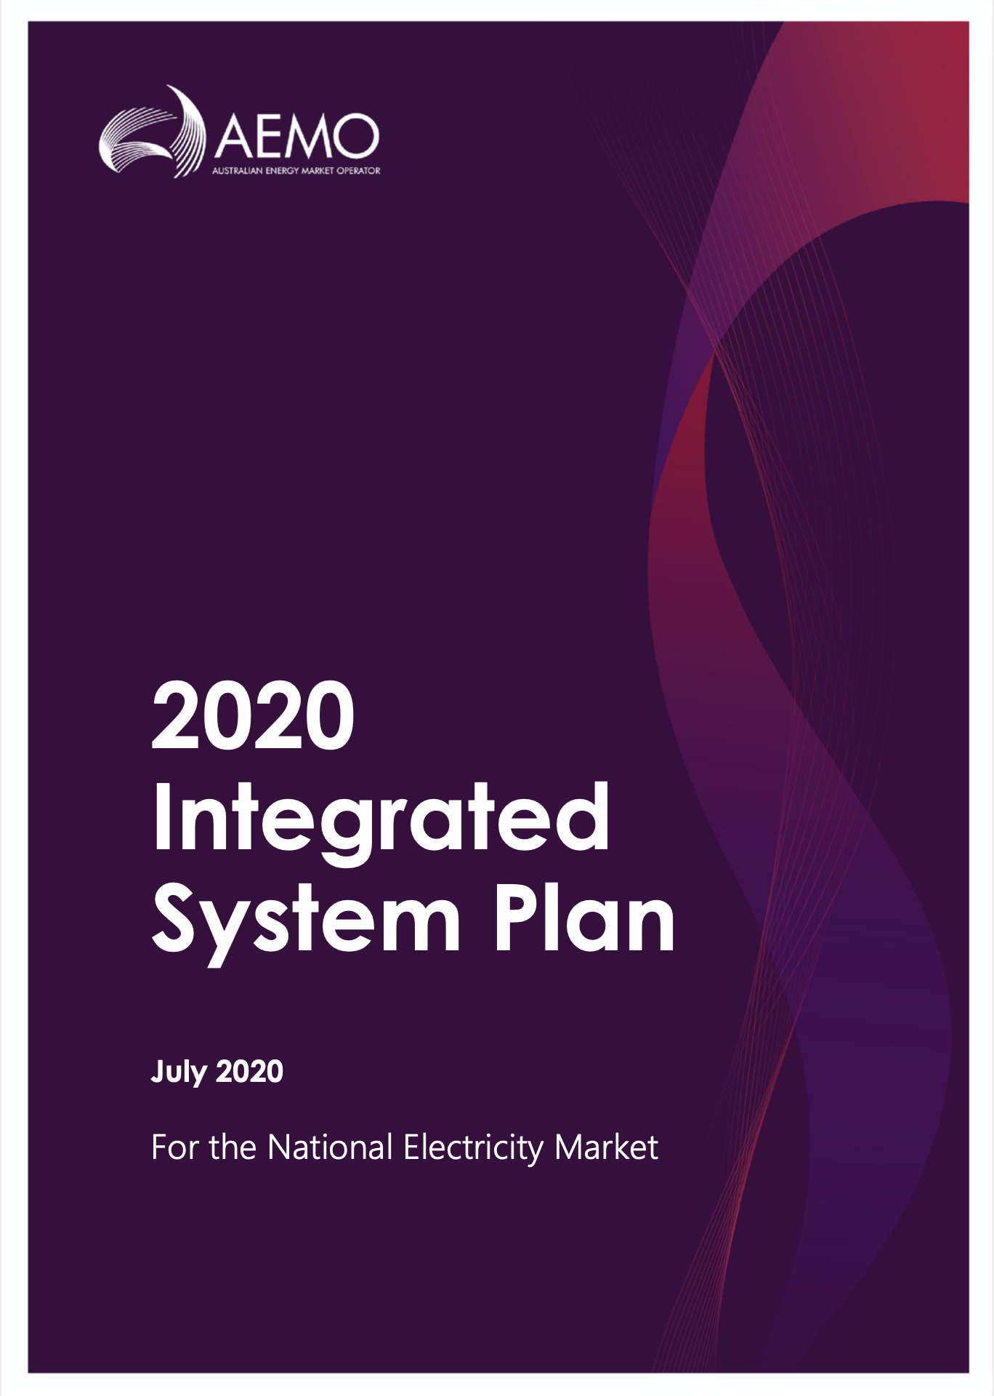
What is the ISP?
A whole-of-system integrated energy plan and roadmap for transformation of the energy system
  That maximises value to end consumers
  That utilises the opportunities provided from existing technologies and anticipated innovations
  And provides end to end wholistic energy systems planning, including, in particular, assessing engineering needs
It aims to inform policy makers, investors, consumers, researchers and other energy stakeholders

Slide 7
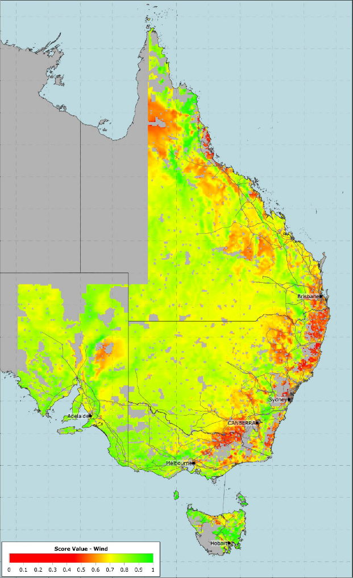
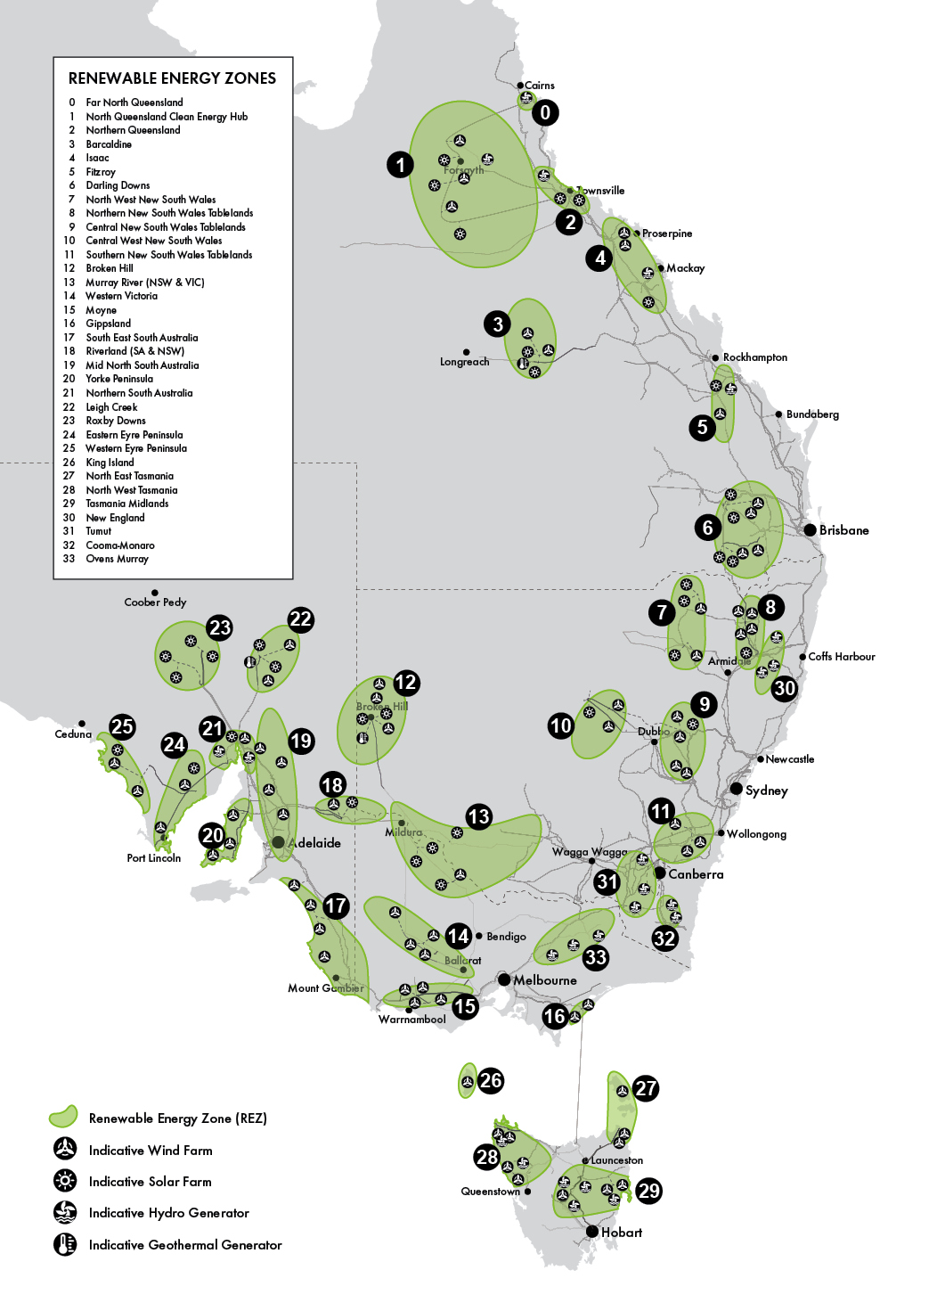
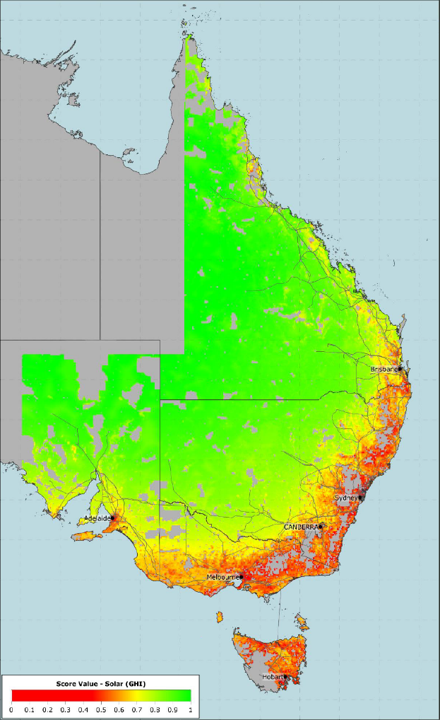
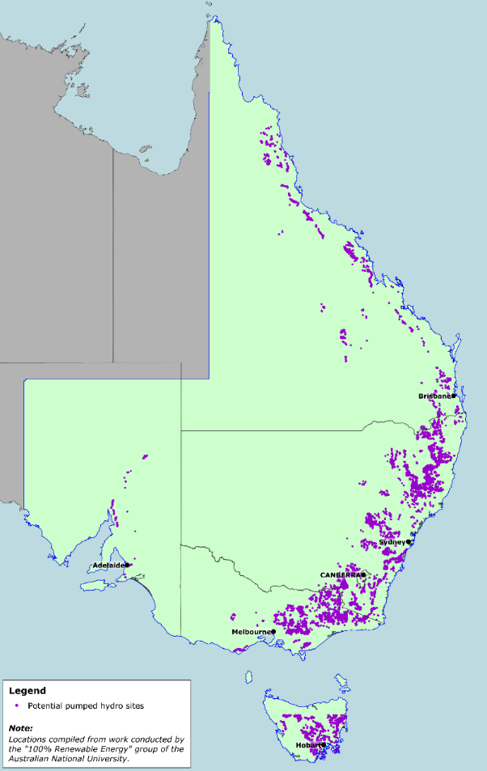
Renewable energy zones assessed for the 2020 ISP
Wind
Solar
Pumped hydro

Slide 8
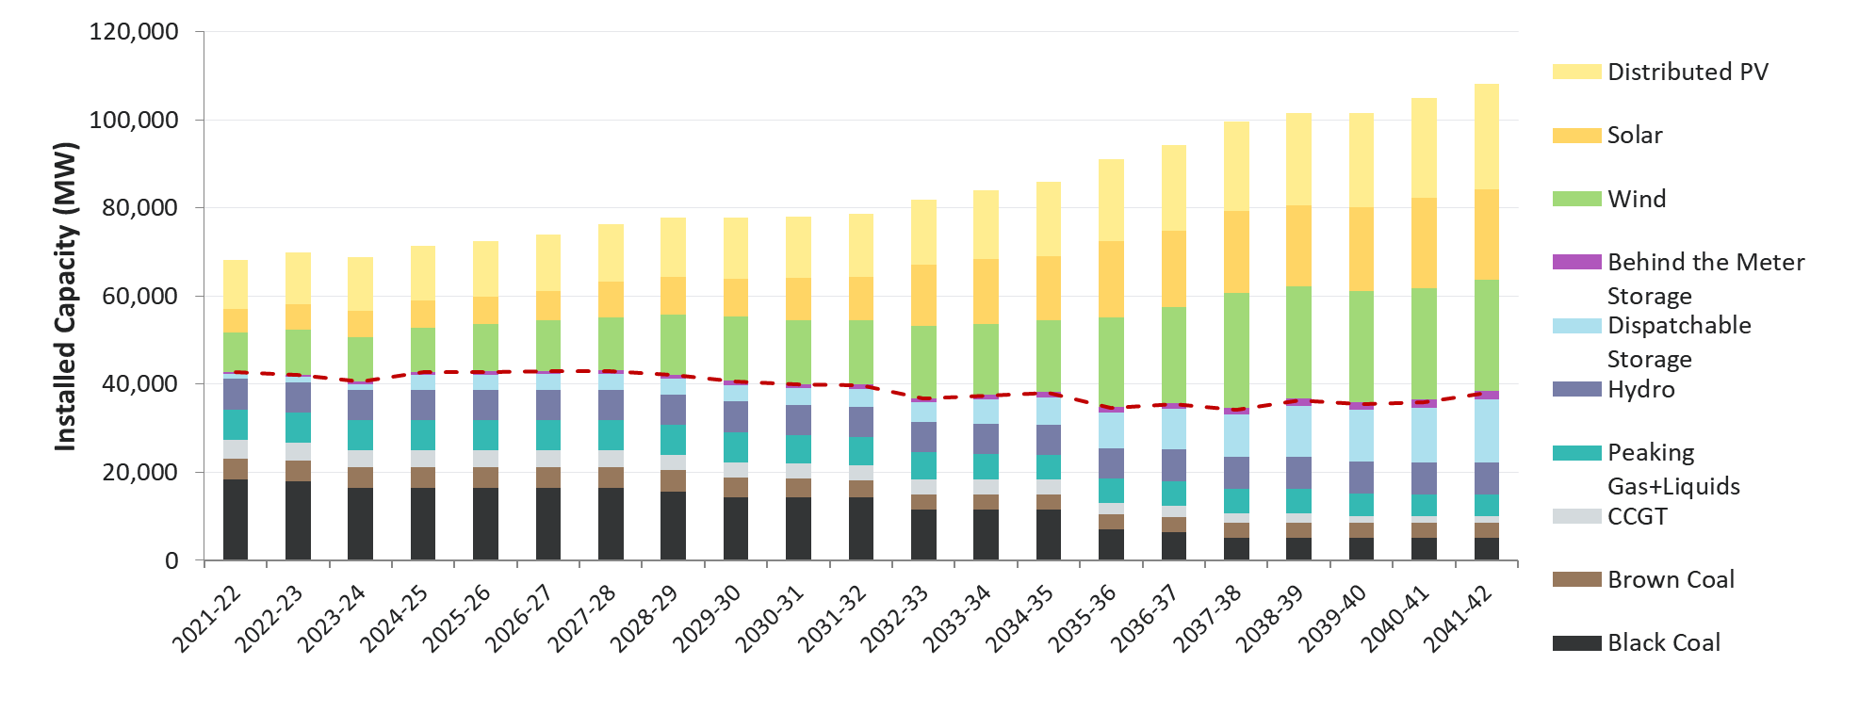
Generation mix, Optimal development path (central scenario) – 2020 ISP

Slide 9
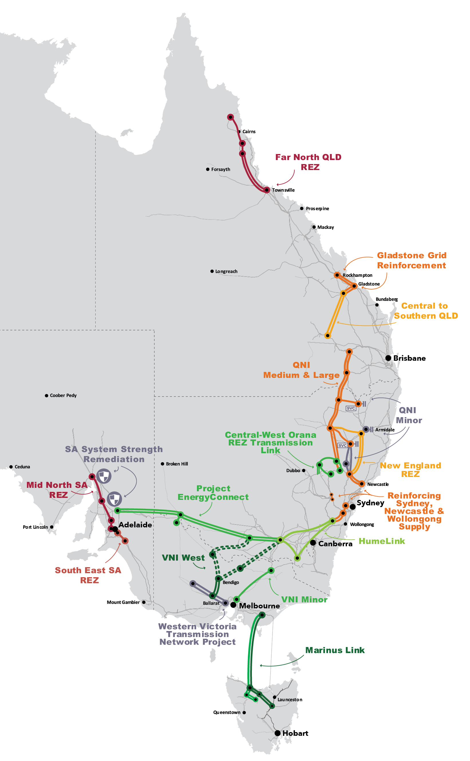
Necessary transmission upgrades
QNI: improve resource sharing, unlock REZs and provide grid resilience
Project EnergyConnect: improve resource sharing, unlock REZs and provide grid resilience.
Central-West Orana REZ Transmission Link: unlock a priority REZ identified in NSW Electricity Strategy
HumeLink: enable Snowy 2.0 to support NSW as coal-fired power stations close.
VNI West: provide Victoria with access to Snowy 2.0 and unlock REZs.
Marinus Link: enable Battery of the Nation and facilitate the TRET.
Source: AEMO 2020 ISP

Slide 10
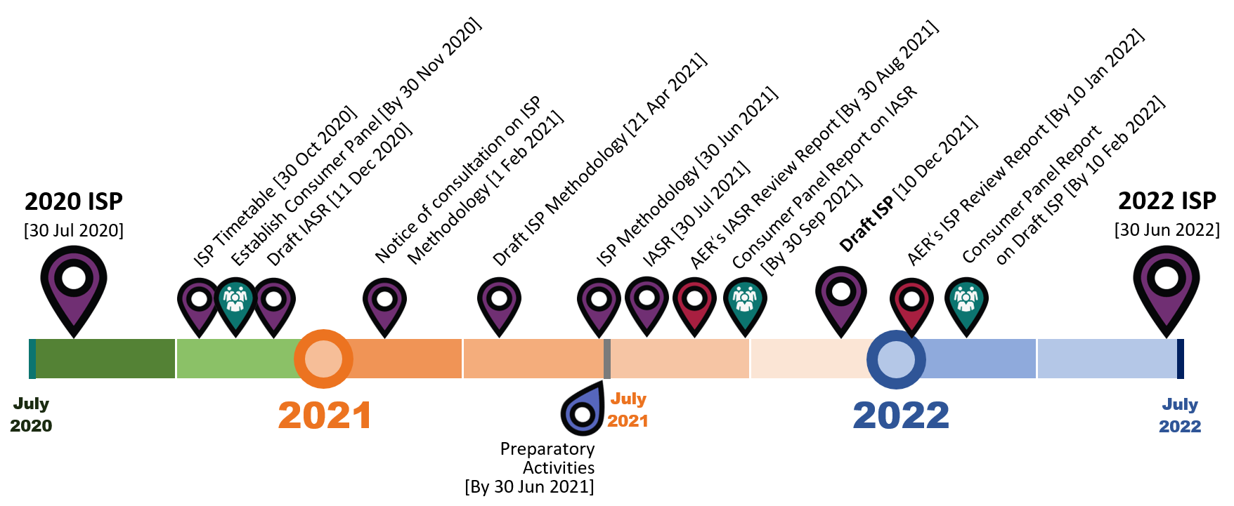
2022 ISP Timetable

Slide 11
ISP Consumer Panel – Creation and operations
The ISP Consumer Panel (the Panel) was created as part of the Actionable ISP regulatory framework.
The Panel must consist of at least three members, who are selected following a call for expressions of interest.
The NER stipulates that the Consumer Panel must prepare, and provide to AEMO, a report on the Inputs, Assumptions and Scenarios Report (IASR) and Draft ISP
Each report provides the Panel’s assessment of the evidence and reasons supporting the relevant AEMO publication.
In preparing its reports, the panel must have regard to the long-term interests of consumers. Each report must be provided within two months of the corresponding AEMO publication, and the Panel must seek to give reports by consensus.
The NER empowers the Panel to carry out its activities “in the way it considers appropriate”. The NER also states that AEMO “must have regard to a consumer panel report but is not obliged to give effect to any recommendations.”
The Panel will work to promote consumers’ interest in the ISP development process but is not a substitute for engagement with consumers.

Slide 12
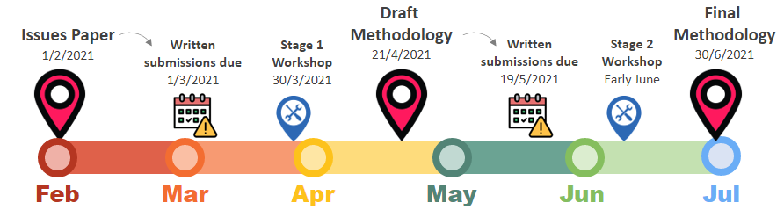
Overview of Methodology process
The ISP Methodology Issues Paper was published on 1 February, with submissions called for by 1 March.
The Issues Paper covers two broad areas:
    The modelling methodology
    The cost-benefit analysis methodology.
Notes:
The Methodology is being developed through a two-stage consultation process. The draft Methodology will be published on 21 April, with submissions due by 19 May, and the Final ISP on 30 June 2021.

Slide 13
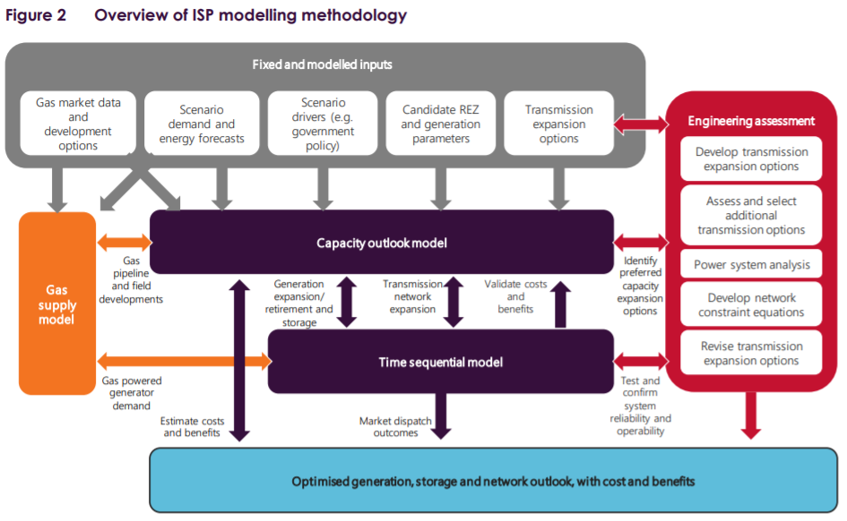
Modelling methodology
Notes:
The inputs are consulted on via the IASR consultation.

Slide 14
Questions on ISP?
Jacqui Mills
Virtual Power Plant Lead, Markets
AEMO

Slide 15
AEMO’s Virtual Power Plant (VPP) Demonstration program
Jacqui Mills
Virtual Power Plant Lead, Markets
AEMO

Slide 16
Overview
VPP Demonstration overview
VPP Demonstration general update
Knowledge Sharing Report #1 & 2 - Overview
Knowledge Sharing Report #3 and Consumer Insights report – Key insights
Next Steps
Q&A

Slide 17
What is a VPP
Notes:
A VPP broadly refers to an aggregation of resources coordinated to deliver services for power system operation and markets. This includes:
storage (e.g. home battery)
controllable loads (e.g. pool pump, air-conditioner
decentralised generation (e.g. diesel generators)

Slide 18
VPP Demonstrations Objectives
Primary objective = allow VPPs to deliver contingency Frequency Control Ancillary Service (FCAS), obtain operational visibility, and use learnings to inform changes to regulatory and operational frameworks
Participants demonstrate basic control and orchestration capability for VPPs providing real time energy and Frequency Control Ancillary Services (FCAS)
Develop systems to deliver operational visibility of VPPs via new AEMO APIs
Assess current regulatory and operational arrangements affecting market participation of VPPs
Provide insights on how to improve consumers’ experience of VPPs in future.
Understand what cyber security measures VPPs currently implement, and whether they should be augmented in future.

Slide 19
VPP Demonstration Participants
 | EnergyLocals (Tesla) | AGL | Simply Energy | sonnen | ShineHub | Energy Locals (SolarSG/ Members Energy) | Hydro Tas
Employees | Tesla - 48,016 (2019) | 3,714 (2018) | Engie Global - 160,000 (2018) | 300 (2017) | 55 (2020) | ME – 18 (2020) SolarSG – 90 (2020) | 1,300 (2019)
DUID | VSSEL1V1 | VSSAEV1 | VSSSE1V1 | VSNSN1V1 | VSSSH1S1 | VSVEL2S1 VSNEL2S1 | VSQHT1V1
Jurisdiction | SA | SA | SA | NSW | SA | Vic and NSW | QLD
Registration type | Market Customer | Market Customer | Market Customer | MASP | MASP | Market Customer | MASP
Battery technology | Tesla PowerWalls | Tesla PowerWalls | Tesla PowerWalls | sonnen | AlphaESS | Alpha ESS Saj/Everready | Tesla PowerPack
Controller type | Proportional | Proportional | Proportional | Switched | Switched | Switched | Proportional
Size, market | 13MW All 6 cont FCAS | 3MW Raise 2MW Lower All 6 cont FCAS | 3MW All 6 cont FCAS | 1MW, All 6 cont FCAS | 1MW, All 6 cont FCAS | 1MW All 6 cont FCAS, except L6 | 1MW All 6 cont FCAS
Notes:
AEMO has onboarded an additional five participants since July 2020, bringing the total to seven and increasing valuable diversity in technology and location of the VPPs.

Slide 20
Knowledge sharing
#1 and #2
Tesla
Published March and July 2020, respectfully

Slide 21

Key insights
  VPPs are foundational capability to enable AEMO to operate the power system with high levels of Distributed Energy Resource (DER).
  VPPs have demonstrated their effective capability to respond to power system and market events
  The capability of VPPs to respond instantly to changing price signals reinforces the view that VPPs should be more visible to AEMO in the future (as a kind of scheduled resource).
  VPPs continue to create data for AEMO operational and planning teams to learn about DER behaviour. This data is called for in the
  Renewable Integration Study (RIS).
Notes:
Tie in with ISP preso

Slide 22
Knowledge sharing #3
Published February 2021

Slide 23
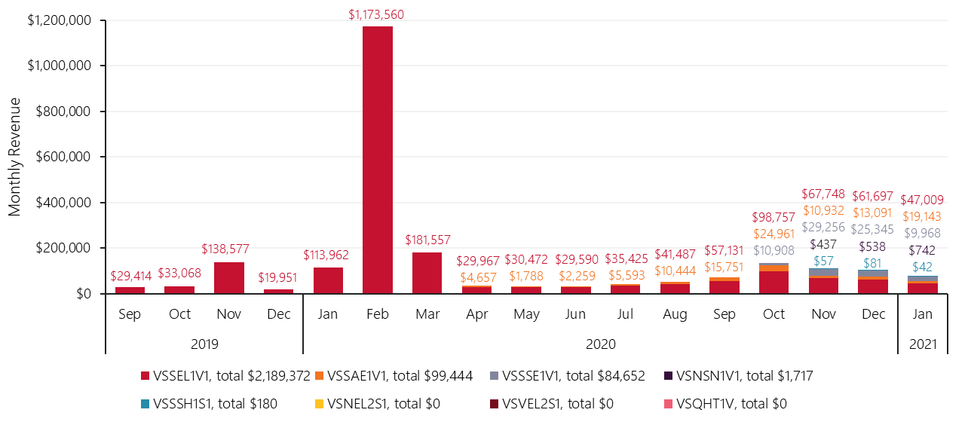
VPP earnings to the end of January 2021
Notes:
All current VPP Demonstrations participants have been able to earn revenues in the six contingency FCAS markets.
Higher prices typically occur during the summer months when there are more plant outages causing contingency events.
Energy Locals (Tesla) has steadily grown its portfolio by ~1 MW per month, which is also reflected in the earnings.

Slide 24
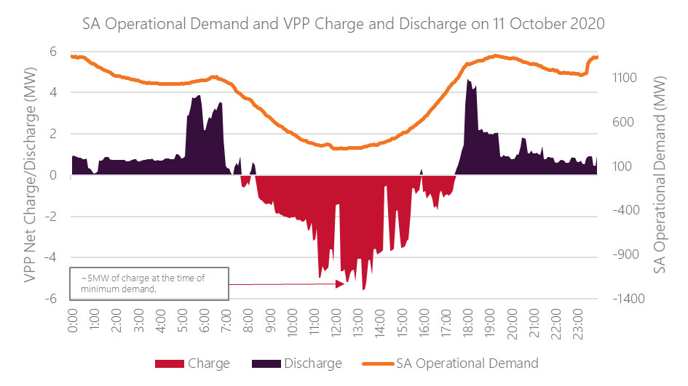
VPP response to record minimum demand
South Australian operational demand and VPP net charge and discharge, 11 October 2020
Notes:
Tie in with previous forum comment re min demand assistance
Aggregate net charge and discharge of both Energy Locals (Tesla) and AGL VPPs and South Australian operational demand on 11 October 2020, when the current (February 2021) minimum operational demand record of 300 MW was observed during the 1230 hrs trading interval.
The import/export capacity of VPPs in South Australia as at November 2020 is estimated to comprise up to 8% (~25.5 MW) of the minimum regional demand.
In this instance, VPPs assisted in elevating the South Australian operational demand by approximately 5 MW during the minimum demand period
While dispatch prices were low for most of the day prior to the evening peak, the 1330 hrs dispatch interval was the only interval where the price was negative ($-4.89).

Slide 25
Early consumer insights social research objective and methodology
Objective of the study, to answer three research questions:
What are consumers’ experiences of participating in Australia’s early stage VPPs?
Is VPP participation attractive enough for consumers to give up control of their assets?
How can consumers’ experience of VPP participation be improved to make it more attractive for them to sign up in future?
Methodology
Stream 1: | Baseline online survey to 75% of consumers, capturing the current market landscape, perceptions of the VPP, drivers, barriers, attraction, current attitudes and overall satisfaction with the VPP.
Stream 2: | Qualitative analysis with 50 consumers, identifying segments and underlying motivations, it involved: - 1:1, 60 minute, depth interviews - online community activities and journaling
Stream 3: | Final online survey to 75% of consumers, which will quantify and validate finding from the previous phases
Stream 4: | Consumer usage analysis, comparing market research results with AEMO’s internal data. Designed to capture: overall impact to energy bills energy imported/exported to the grid based on segments such as pre-solar, with solar, joined/exited a VPP
Report can be found at:
https://aemo.com.au/-/media/files/initiatives/der/2021/csba-vpp-customer-insights-study-report-feb-2021.pdf?la=en
Notes:
470 completed digital surveys and 23 one-on-one in depth interviews
Satisfaction with the VPP, as well as likelihood to recommend to others, was high, primary factors:
Lowering energy bills and achieving faster payback on hardware for consumers.
Willing to be part of the latest technology and pioneering in energy solution.
Opportunity to utilise more cleaner energy.
VPP positively holding very high potential for the community (e.g. avoiding outages).

Slide 26
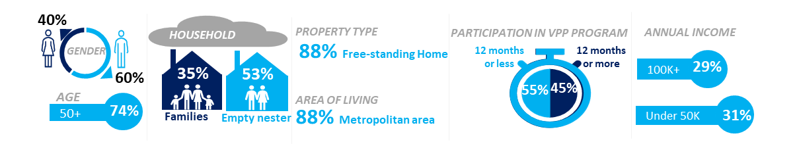
Early consumer insights social research interim findings
Satisfaction with VPP and likelihood to recommend to others is high
Consumers are motivated by a variety of factors, like saving money on their energy bills (42%), utilising governments’ subsidies/discounts on hardware (19%), and having a backup energy supply (14%), indicating that competitive offers are required to entice consumers.
Satisfaction and engagement may be improved through communications to consumers, to help them understand and appreciate the financial, environmental and societal benefits arising from their participation in the VPP.
Note: data and insights presented at this early stage may not represent the future VPP consumer cohort, because consumers to date have benefitted from government-funded programs with some of Energy Locals’ (Tesla) consumers living in social housing.
Notes:
470 completed digital surveys and 23 one-on-one in depth interviews
Satisfaction with the VPP, as well as likelihood to recommend to others, was high, primary factors:
Lowering energy bills and achieving faster payback on hardware for consumers.
Willing to be part of the latest technology and pioneering in energy solution.
Opportunity to utilise more cleaner energy.
VPP positively holding very high potential for the community (e.g. avoiding outages).

Slide 27

MASS consultation
AEMO is conducting a review of the Market Ancillary Service Specification (MASS) in the first half of 2021 to consult with the industry regarding the ongoing arrangements for DER to participate in the FCAS markets. The following arrangements are in scope for the consultation:
Measurement sampling rate requirements for Aggregated Ancillary Service Facilities participating in the Fast Contingency FCAS markets.
Location for measurement of the delivery of FCAS from controllable devices in a VPP.
Threshold to limit the new measurement requirements to smaller ancillary service units only.
Key dates:
First stage submissions 25 February 2021
Second stakeholder forum 31 March
Contact: mass.consultation@aemo.com.au for an invite
Website: https://aemo.com.au/consultations/current-and-closed-consultations/mass-consultation

Slide 28

Key takeaways
The VPP industry is becoming more sophisticated, reflected in dynamic switching controllers, response to minimum demand and diversified consumer offerings.
VPPs assisted in elevating the South Australian operational demand by approximately 5 megawatts (MW) during the record minimum demand period on 11 October 2020, which
reduced the severity of the event.
AEMO has initiated a DER MASS consultation with the industry regarding the ongoing arrangements for FCAS participation.
AEMO notes the intent of the ESB Directions Paper to evolve the SGA framework to allow participation in ancillary services
Ongoing collaboration with industry and development of operational visibility, forecast-ability and dispatchability of VPPs will be critical to ensuring efficient integration into the power system.
Notes:
Related projects:
WDR
Vic marketplace trial
WA Project Symphony
2SM
NEM2025
ESS
EVs

Slide 29
Next steps
MASS consultation, conclude May 2021
VPP Demonstration ends, 1 July 2021
Consumer Insights Study Report, July 2021
Knowledge Sharing Report #4, August 2021
MASPS -> DRSPs (24 October 2021)

Slide 30
Want to learn more?
Wealth of documentation on AEMO’s website:
VPP website
VPP Demo Final Design
VPP Demo FCAS spec.
VPP Demo Data spec.
Knowledge Sharing stage 1
Knowledge Sharing stage 2
Knowledge Sharing stage 3
Consumer insights study interim report

Slide 31
Questions?

Slide 32

Break – 5 minutes

Slide 33
Quarterly Energy Dynamics
Q4 2020
Market Insights

Slide 34
Electricity demand plunges in Q4
Lowest average NEM demand since Q4 2001
New minimum demand records in SA & VIC
2,529 MW on Christmas Day
300 MW on Sunday 11 Oct 20
Drivers:
Record uptake of distributed PV in 2020
Mild Q4 weather conditions (cooling degree days down 41%)
Notes:
~

Slide 35
Mixed results for wholesale electricity prices
SA becomes lowest priced region
Futures prices up in NSW, down in the south
NSW spot price rebounded to $64/MWh
SA spot price fell to $29/MWh, its lowest level since Q2 2012
Notes:
~

Slide 36
Q4 NEM emissions fall 7%
Record low emissions as VRE output increased by 20% in 2020
Partially limited by record high VRE curtailment
Growing impact of economic curtailment due to negative prices
Notes:
~

Slide 37
Record high negative spot prices in SA & VIC
SA prices negative 17% of the time in Q420..
..wind farms setting spot prices 8% of the time in SA
Drivers:
Very low operational demand
High VRE output - large capacity increase in VIC in 2020
Interconnector constraints (particularly VIC -> NSW) resulting in oversupply
Notes:
~

Slide 38
Electricity and gas prices diverge
SA electricity and gas price relationship
Growing separation between electricity and gas market outcomes
Notes:
~

Slide 39
Questions on QED?

Slide 40
Energy Education Program
Cameron Setchell

Slide 41

Electricity and gas market courses
Entry-level
eLearning (NEM & Gas)
Advanced & Technical
Network and FCAS Constraints in the NEM
Understanding MSATS
Fundamentals webinars (NEM & Gas)
Broad
NEM Overview
Metrology for the NEM
STTM Overview
DWGM Overview
WEM Introduction
Reserve Capacity Mechanism
WEM: Power Systems and Energy Markets
Network Connections (under development)
Notes:
2 eLearning courses
11 instructor-led courses on topics for NEM, WEM and East Coast gas
Webinars are currently planned to transition from live delivery to recorded and available on-demand
In 2019-20
77 courses throughout the year
Some postponements due to COVID-19 restrictions
NEM Overview is the most frequent (24 times)
Approx. 1,400 attendees at instructor–led courses (some overlap for people doing multiple courses)
Approx 2,700 enrolments in eLearning (some overlap for people doing these and instructor-led courses)

Slide 42

Instructor-led courses
Electricity
NEM Overview
Network and FCAS Constraints in the NEM
Network Connections (under development)
Understanding MSATS
Metrology for the NEM
WEM Introduction
Reserve Capacity Mechanism (WEM)
WEM: Power Systems & Energy Markets
Gas
Overview of the Short Term Trading Market (STTM)
Overview of the Declared Wholesale Gas Market (DWGM)
NEM – National Electricity Market FCAS – Frequency Control Ancillary Services
WEM – Wholesale Electricity Market (WA only) MSATS – Market Settlement and Transfer Solution

Slide 43
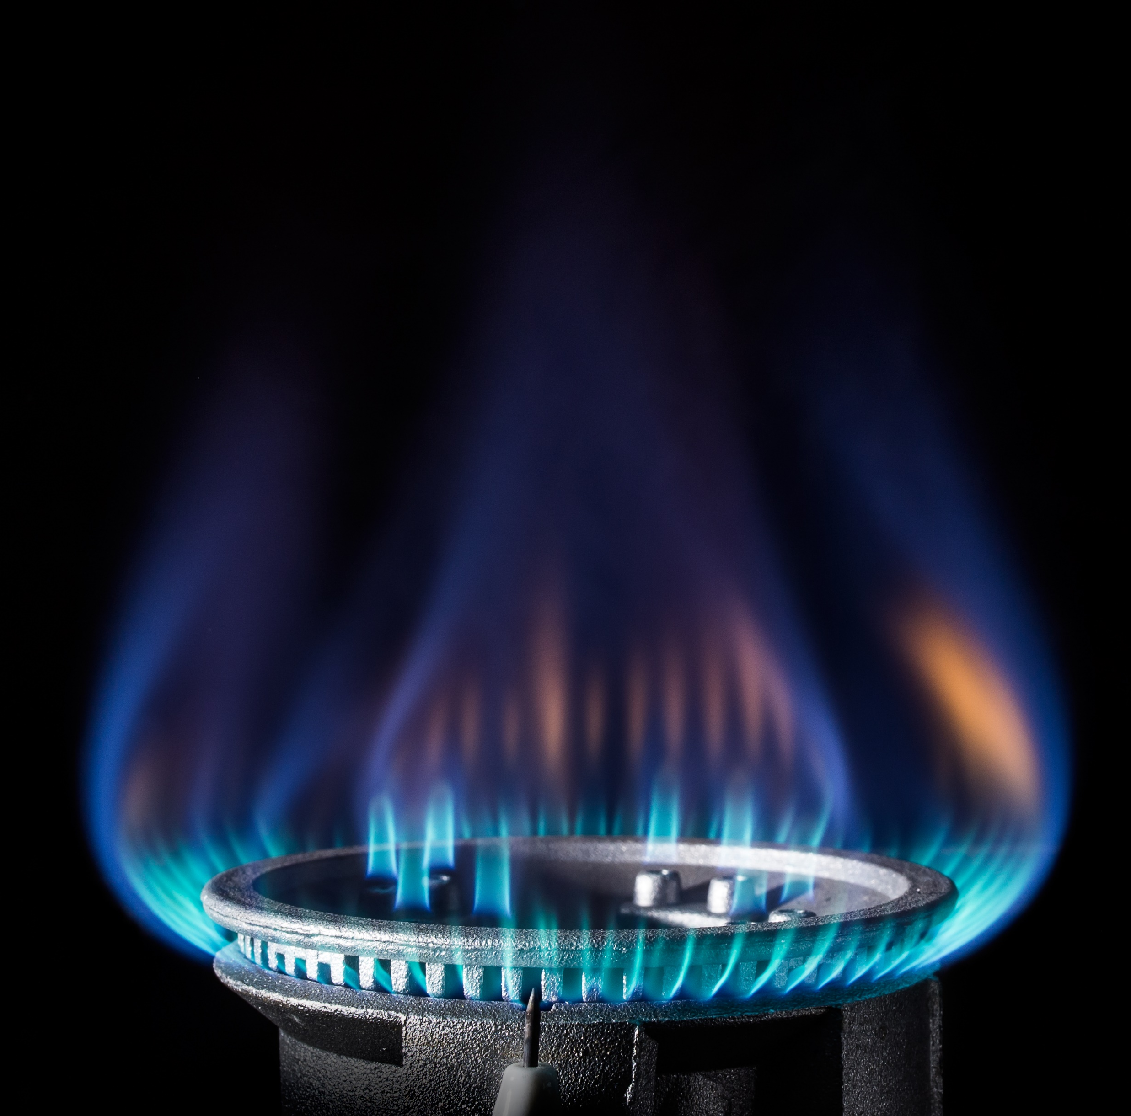
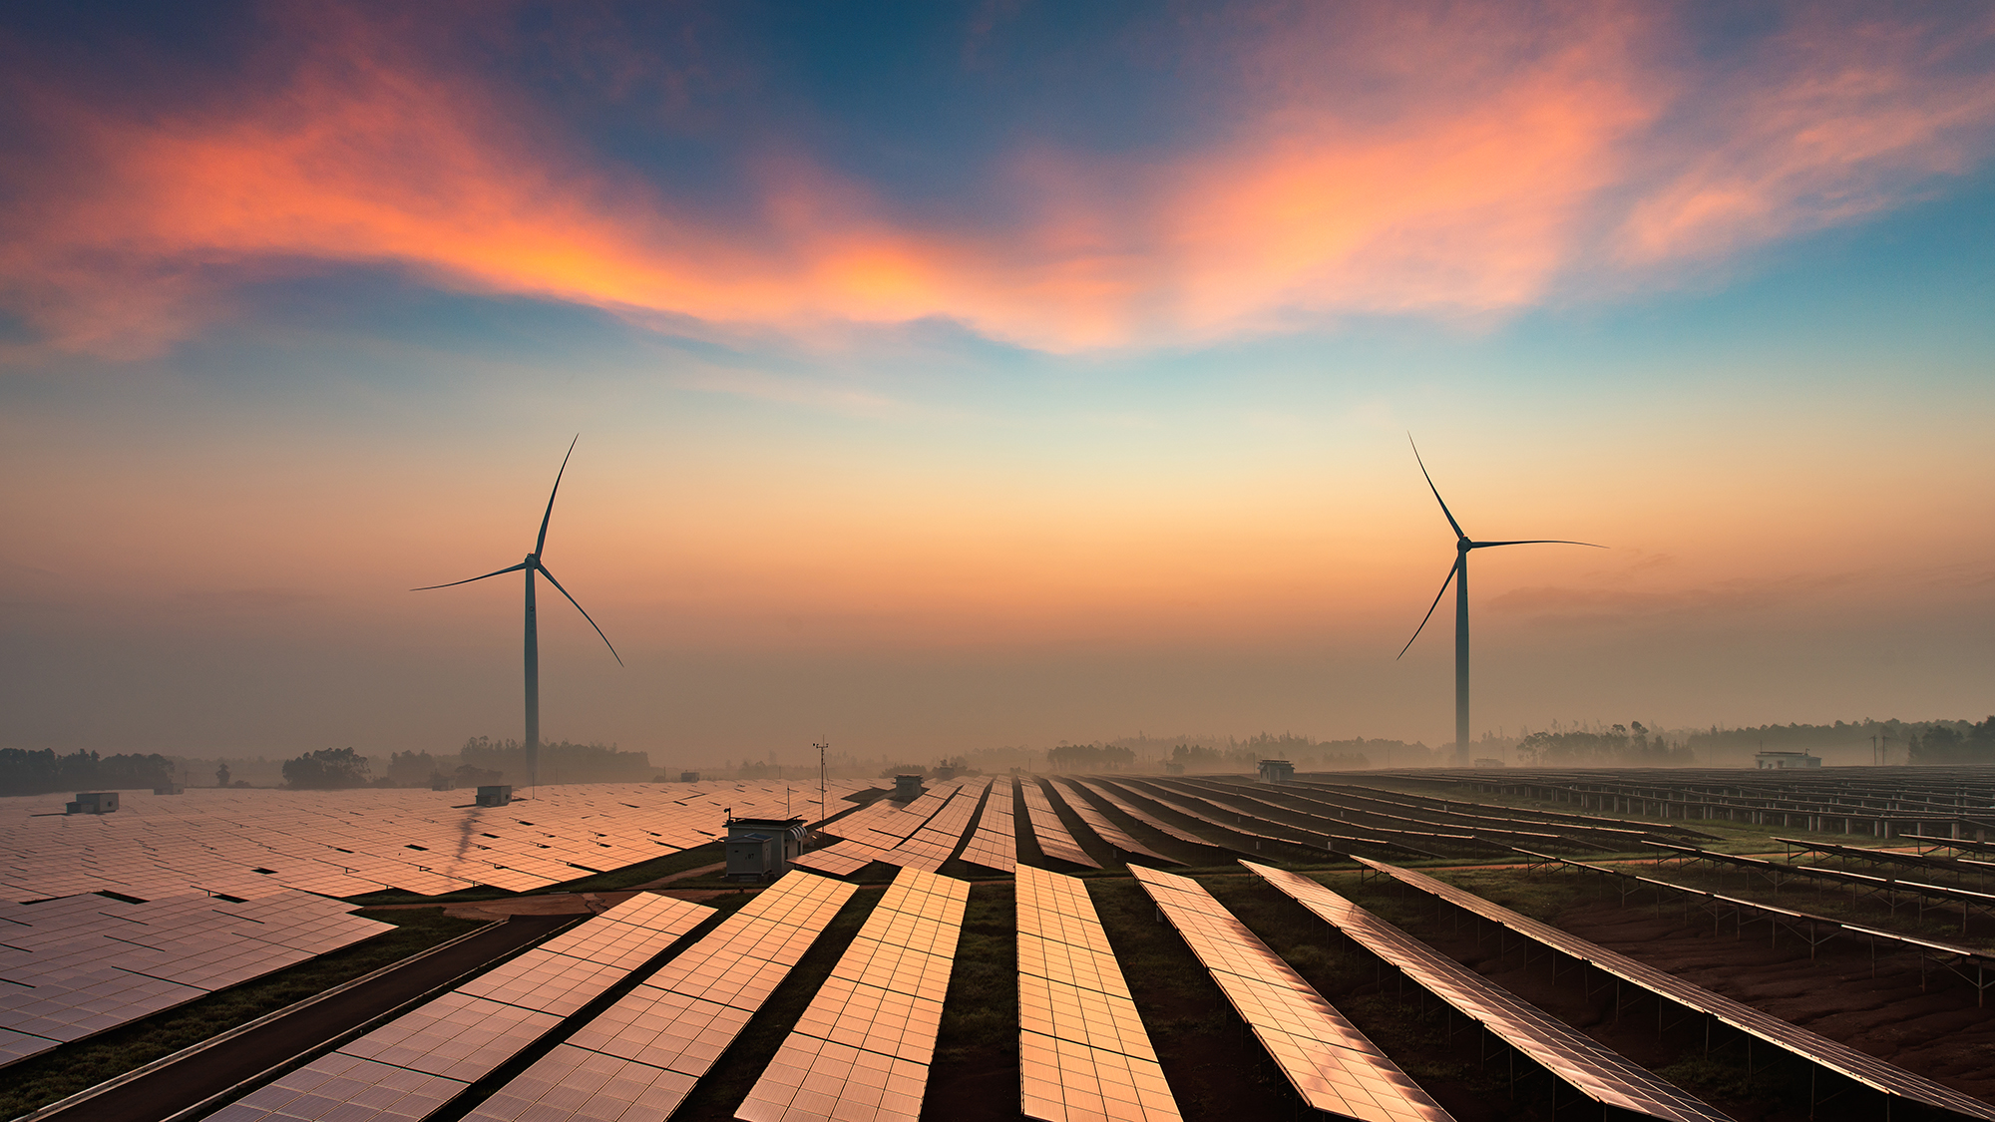
eLearning
National Electricity Market (NEM) Foundations
Introduction to the NEM
NEM Rules and Regulations
The Network
The Power System
Spot Pricing and Dispatch
Ancillary Services
Metering
Settlements & Prudentials
Financial Markets
Integrating Distributed Energy Resources
Gas Market Foundations
Introduction to the Gas Markets
Short Term Trading Market
Declared Wholesale Gas Market
Settlement and Prudentials
Gas Supply Hub

Slide 44
Webinars
NEM Fundamentals
Energy regulatory structure and responsibilities
How the power system operates
Case Study: What happens when things go wrong
Market fundamentals
AEMO’s initiatives in the new energy landscape
Gas Market Fundamentals
Energy regulatory structure and responsibilities
Fundamentals of gas
Transmission, Storage and the Distribution of Gas
Introduction to the Declared Wholesale Gas Market (DWGM), Short Term Trading Market (STTM) and the Gas Supply Hub

Slide 45
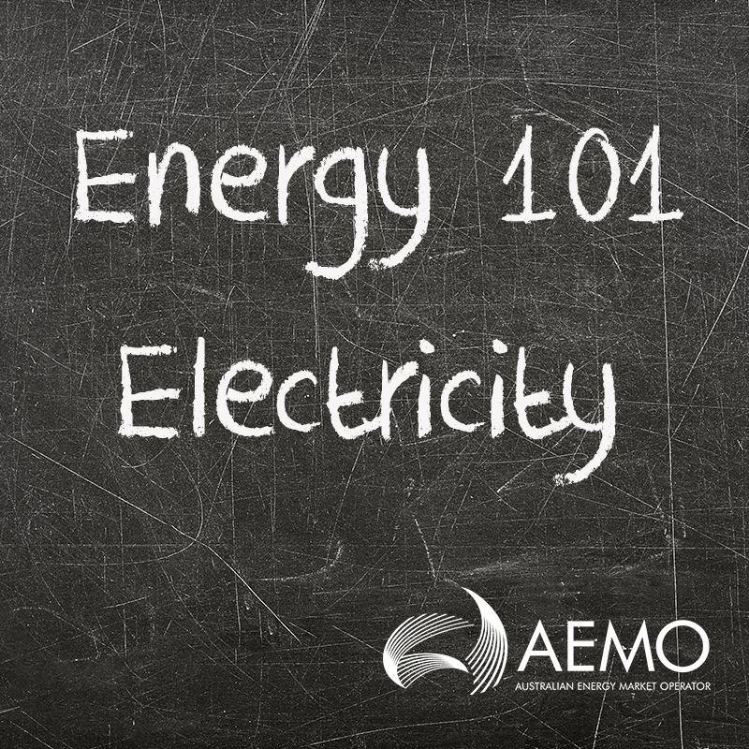




Other resources
Energy Explained
  https://aemo.com.au/en/learn/energy-explained
Fact sheets
Energy 101 series – complex topics in simple language
Social Media

Slide 46
More information
For further information on Industry Education Courses refer to:
AEMO Website
    www.aemo.com.au/learn/industry-courses
AEMO Learning Academy
    https://www.aemolearningacademy.aemo.com.au/
Contact the Energy Education team
  energyeducation@aemo.com.au
For Consumer Forum Representatives wishing to enrol in the eLearning or webinars:
Contact Stakeholder Relations
StakeholderRelations@aemo.com.au
Energy Education will enrol you

Slide 48
Looking ahead:
Consumer Engagement in 2021

Slide 49
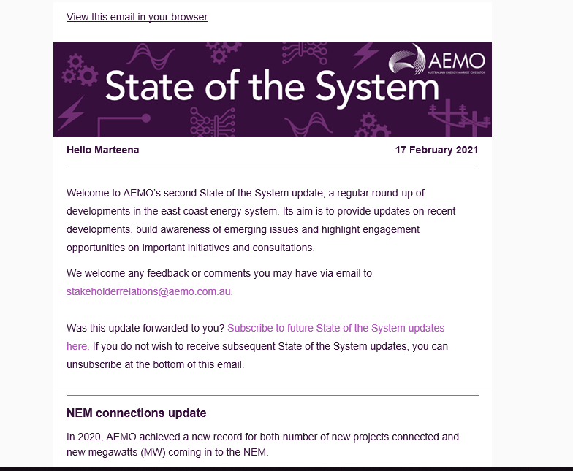
Overview
Forward dates for next forums
  May 2021
  July 2021
  October 2021
  December 2021
Agenda items:
  We welcome suggestions for presentations on work streams of interest to consumer advocates
  We would also like to hear about consumer advocate organisations work in this sector- please let us know if you would like to present at an upcoming forum
Consumer knowledge sharing sessions (Neale update)
Update on forum review project- implementation stage (Alicia update)
Upcoming engagement opportunities of interest:
  State of the System- opportunity to subscribe and attend the Q&A

Slide 50
Other business & close

