Slide 1
5MS Settlements Focus Group
Monday 26th November
Karstens
123 QUEEN STREET, MELBOURNE

Slide 2
Agenda
NO | Time | AGENDA ITEM | Responsible
Preliminary Matters
1 | 10:00am – 10:10am | Welcome, introduction and apologies | Chris Muffett (AEMO)
Matters for Noting and Discussion
2 | 10:10am – 10:20am | Overview of settlement implications of 5MS | Chris Muffett (AEMO)
3 | 10:20am – 10:35am | Settlement Revisions: Update on approach | Christine Kang (AEMO)
4 | 10:35am – 10:55am | Settlement Estimation: Update on approach | Katalin Foran (AEMO)
5 | 10:45am – 11:05am | Credit Limit Procedure: Update on approach | Katalin Foran (AEMO)
6 | 11:05am – 12:05pm | Reallocations | Pedro Riveros Gutierrez (AEMO)
 | 12:05pm – 12:45pm | LUNCH
7 | 12:45pm – 1:10pm | Transition to five-minute settlement | Bhanu Rajan (AEMO)
8 | 1:10pm – 2:10pm | AEMO settlement interfaces | Scott Maskiel (AEMO)
Other Business
9 | 2:10pm – 2:30pm | General questions and next steps | Chris Muffett (AEMO)

Slide 3
Overview of settlement implications of 5MS
Chris Muffett

Slide 4
Current settlement arrangements
The NEM dispatch process determines an energy price every 5 minutes, however the energy market is only settled on the basis of 30-minute energy volumes
To accommodate the different timeframes, the “spot” price in the NEM is the average of 6 dispatch prices
This gives rise to the 5/30 minute problem
The AEMC considered that this is resulting in negative consequences for the wholesale market (which ultimately impacts consumers)

Slide 5
Five-minute settlement
The AEMC has determined that from 1 July 2021, the NEM will be directly settled using 5-minute prices (i.e. the current 5-minute dispatch price will become the trading or “spot” price)
To support this, metering will progressively change to 5-minute:
All type 1-3, type 7, and some type 4 connection points must be 5-minute prior to go-live
New meters installed after 1 December 2018 must be 5-minute capable
Bids/offers are also changing:
Scheduled participants must submit bids/offers with 5-minute granularity

Slide 6
Impact to participants
 | Prior to July 2021 | From July 20201
Generators / SGAs | Review/update procedures Review/update contracts Review/upgrade IT systems | Submit five minute granularity offers into the NEM
Large customers |  | Submit five minute granularity bids into the NEM
Retailers |  | Consider developing new products and services using 5 minute data to value dynamic generation / demand response for small and large consumers
Networks |  | Calculate charges for distribution services from either metering data or settlements ready data for type 4 meters Calculate type 7 unmetered loads on a 5 minute basis.
Metering coordinators | Upgrade types 1, 2 and 3 metering installations, and some type 4, to be capable of recording and providing five minute data. Ensure that new and replacement metering installations are capable of recording and providing 5 minute data Review/upgrade IT systems | By 1 December 2022 at the latest, ensure that all new and replacement metering installations record and provide 5 minute data
Metering data providers | Review/upgrade IT systems | By 1 July 2021, ensure that type 1, 2 and 3 and some type 4 metering installations record and provide five minute data. By 1 July 2021, ensure that type 7 unmetered loads are calculated on a five minute basis. By 1 December 2022 at the latest, ensure that all new and replacement metering installations record and provide 5 minute data
Information Exchange Committee | Consult and recommend to AEMO any changes to the B2B procedures

Slide 7
AEMO’s 5MS Program
To facilitate implementation and support the industry, AEMO has established a Five-Minute Settlement (5MS) program
The key activities within the program are:
Procedures workstream – implement changes to AEMO procedures and supporting documentation required to give effect to the new rules
Systems workstream – build and test changes to AEMO market systems
Readiness workstream – coordinate activities necessary to transition to the new procedures and systems, particularly around industry testing and cutover
Stakeholder engagement – communicate and collaborate with industry participants and other interested parties on the changes

Slide 8
Procedure workstream
Approximately 70 procedures and supporting documents have been identified as directly impacted by 5MS, across the following areas:
Metering
Settlements (including Prudentials)
Dispatch
Operations
Metering | Settlements | Dispatch | Operations
Metering data Metrology, MSATS procedures & service levels Miscellaneous | SRA Estimation Reallocations Prudentials Miscellaneous | Bids/Offers Spot market Pricing Specifications Miscellaneous | No packages – progressive release

Slide 9
Systems workstream
5MS has a significant IT impact on AEMO’s NEM market systems and participant systems, in particular:
Meter data management
Settlement
Dispatch
Metering | Settlements | Dispatch / Pricing | Operations
MSATS Meter Data Energy Profiling Energy Allocation OPDMS MLF determination | EMMS Settlement Billing Estimation/Prudential Management Reallocations | EMMS 5 min Bids/Offers Registration default offers Market Suspension Administered Pricing | DS/PD/ST PASA MIAMI/SOMMS Negative Residue Management EDM (Data Lake) NEO Reports EMMS Data Model

Slide 10
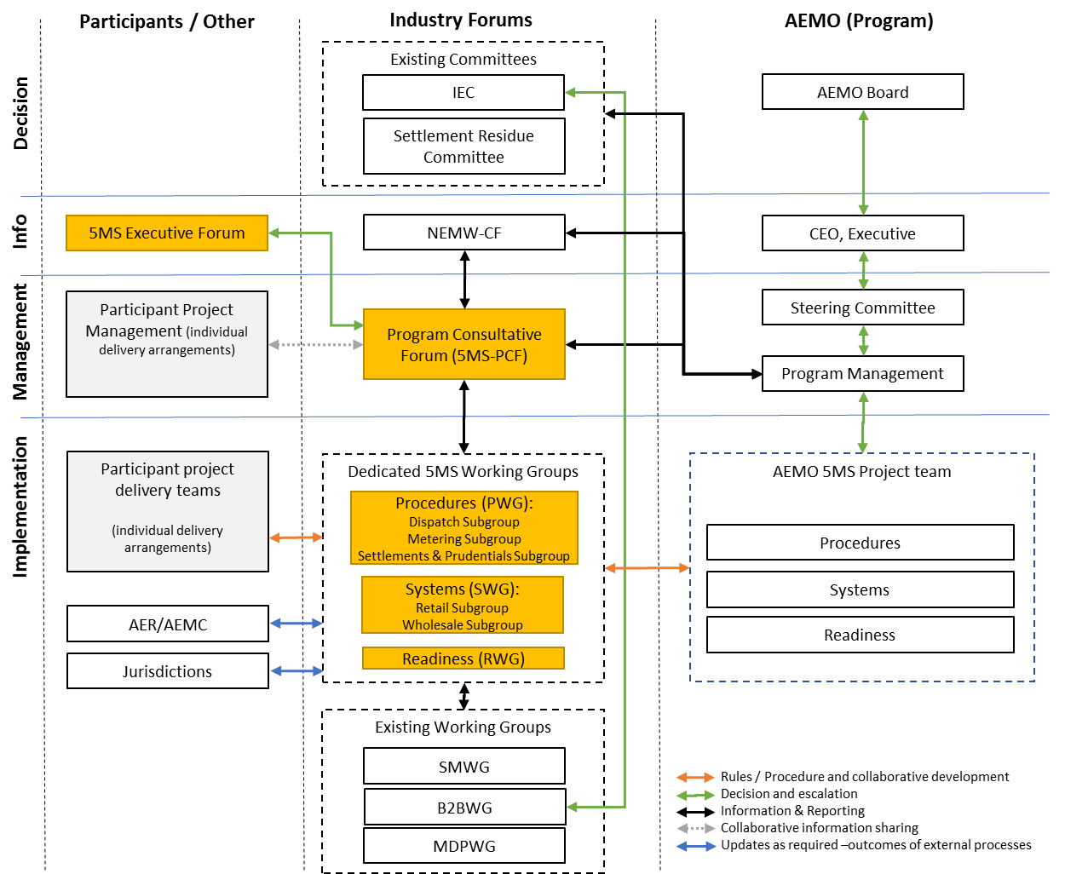
Stakeholder engagement
AEMO is engaging with stakeholders regularly at multiple levels to ensure:
Awareness and escalation of issues/risks
Coordination of AEMO and industry programs
Consultation on changes to procedures
Input on process and system options

Slide 11
Global settlement
AEMO lodged a rule change with the AEMC, proposing that global settlement be implemented to replace settlement-by-difference in the NEM: https://www.aemc.gov.au/rule-changes/global-settlement-and-market-reconciliation
If the rule is made, the change will be accommodated in the 5MS program. It primarily involves:
The local retailer role no longer being required i.e. all retailers have the same settlement arrangements
AEMO requiring meter data for all connection points
AEMO calculating unaccounted for energy (UFE) which is recovered from retailers operating in each area
The AEMC has made a draft determination to implement global settlement, and a final determination is expected on 6 December 2018

Slide 12
Settlement impact of 5MS/GS
SRA – changes the basis of inter-regional settlement residue calculation
Settlement estimation – used to support prudentials
Reallocations – in particular, reallocations that are based on spot price
Prudentials – Credit Limit Procedures for determining prudential settings for participants
Other supporting information and user guides
Settlement/billing/prudential systems, and participant interfaces

Slide 13
Settlement Revision
Christine Kang

Slide 14
NEM Settlements Revisions Policy
The policy outlines detailed procedures around how AEMO prepares and issues routine and special revised statements under the National Electricity Rules (NER) 3.15.19.
Published policy link: https://www.aemo.com.au/-/media/Files/Electricity/NEM/Settlements_and_Payments/Settlements/2017/NEM-Settlement-Revisions-Policyv11.pdf

Slide 15
Changes due to 5MS
Content changes due to the 5MS to include:
Insert a new chapter 5MS transition to clearly outline that any routine and special revised statements for billing weeks and trading days until 1 July 2021 will be based on 30-minutes.
Clarify that any 30-minute to five-minute price change will not entitle market participants a dispute or a special revised statements

Slide 16
Other changes
Other changes to include:
Current content transfer to the new AEMO external procedure template
Amend the policy to clearly reflect the NER and streamline to remove any unnecessary content
Amend the chapter 5.2 Principles to clearly note the NER requirement for the policy
Delete NEM calendar as the figure provides old information and the source calendar link has been corrected and provided

Slide 17
Changes due to GS
Insert a new chapter GS transition to clearly outline that any routine and special revised statements for billing weeks and trading days until 1 July 2021 will be based on ‘settlement by differencing’. Also, to clarify that any settlement statement amount change arising from ‘settlement by differencing’ to GS framework will not entitle market participants a dispute or a special revised statement
Reviews of unaccounted for energy (UFE) volumes, as envisaged under the draft rule, may result in settlement revisions. As these would need to be handled in the same way as revisions resulting from other input changes, specific amendments to address UFE should not be necessary.
AEMO will re-evaluate the guide after the final determination

Slide 18
Proposed consultation approach
NEM Settlements Revisions Policy | Comments | Indicative date
Focus group |  | Monday, 26 November
AEMO publish first stage notice, draft policy and draft consultation paper |  | Friday, 14 December 2018
PWG first stage notice submissions due | Extended initial submission to compensate holiday period | Friday, 22 February 2019
AEMO publish second stage notice, updated draft policy, draft report and non-confidential submissions |  | Friday, 22 March 2019
PWG second stage notice submissions due |  | Friday, 5 April 2019
AEMO publish final stage notice, final policy, final report and non-confidential submissions |  | Monday, 13 May 2019

Slide 19
Settlement Estimation
Katalin Foran

Slide 20
The two areas of settlement estimation
Settlement estimation for when normal processing is not available
only undertaken under the sustained failure of AEMO systems
has never been invoked
2. Settlement estimation for prudential purposes
estimations required to calculate outstandings
estimation is undertaken daily

Slide 21
1. Settlement estimation – system failure
This part of the policy will be updated to reference other defined procedures that document the protocol in the event of system or communications failure.
Update outline:
If incidents are less than two weeks:
Data in the preliminary statements are used as the basis of final statements
Failures of more than two weeks derive estimates from:
Historical metering for Market Customers
Dispatch results for Market Generators as stored in a server separate to the Electricity Market Management System (EMMS)
There are no changes related to GS or 5MS.

Slide 22
2. Settlement estimation for prudentials
Average 30-day outstandings period
Typically 2 days estimated using the scaled like-day energy method.
Rest made up of interim meter data and preliminary and final settlements data.
Scaled like-day energy estimation
Accuracy - approximately 95% of the total like-day energy estimates were accurate to +/- 25%.
Implementing 5MS - methodology to remain unchanged but calculations performed at a five-minute level.
Will review methodology for accuracy once 5MS is in place.
Effect of Global Settlements
Where initial metering data and/or preliminary and final settlement data is available, the UFE component will be included.
For the scaled like-day estimate component (i.e. 2 days out of 30) the UFE component will be zero.

Slide 23
Consultation process/timelines
Deliverable | Indicative date
Consultation Paper published | 26 November 2018
Submissions due on Consultation Paper | 21 January 2019
Draft Report published | 19 February 2019
Submissions due on Draft Report | 5 March 2019
Final Report published | 4 April 2019

Slide 24
Credit Limit Procedure
Katalin Foran

Slide 25
Credit Limit Procedures (CLP) - initial approach
CLP – the methodology by which AEMO determines the prudential settings for each Market Participant - i.e. the Maximum Credit Limit (MCL).
Initial thinking (articulated at PWG September 13)
Update all refences in the CLP referring to half hourly load, price and reallocations to reference five minute load, price and reallocations.
Methodology (and formulas) for calculation of market participant prudential settings remain unchanged, with only the level of data granularity changing.
We were aiming start CLP consultation in late November/early December, with the Reallocation Procedures consultation starting early 2019.

Slide 26
CLP & Reallocations
Reallocations and the time period they apply for are expressly discussed in the CLP.
We need to consult on how reallocations will work in light of 5MS before we can update the CLP.
New approach and order of consultation:
First will consult on, an agree on reallocation procedures (to be discussed after this).
Will update CLP accordingly to what was agreed on re reallocations.
Still expect methodology to remain unchanged and with all other calculations to be conducted at 5 minute granularity.

Slide 27
Reallocations
Pedro Riveros Gutierrez

Slide 28
Initial assumptions on 5MS and reallocations
Will have 5 minute reallocations from July 2021 (NER clause 3.15.11 refers to reallocation transaction happening at TI level).
In AEMO system, will still have to deal with 30 minute reallocations beyond July 2021 (i.e. due to ex-ante reallocations and revisions).
Beyond July 2021, any 30-minute reallocations will be evaluated at a 5-minute level.
Types of reallocations to remain as current.
Calculations and methodology will remain unchanged.

Slide 29
Issues for discussion
What transition period issues could arise for reallocations?
What issues should participants consider in relation to their reallocation contracts?
How long before July 2021 would participants want to enter in 5 minute reallocations?
Should we keep ability for participants to enter in 30 minute reallocations past July 2021, to allow for reversing reallocations? For how long ?
Should other types of reallocations be considered?
Previously suggested - energy reallocations based either a DUID or a NMI

Slide 30
Interface and data
Current reallocation web interface - what works now/what doesn’t?
Consider all aspects - registering, authorising, cancelling and reversing reallocations.
What should change on the current interface – for 5MS or other functionality?
Entering reallocations
Same interface for 5 minute as for 30 minute?
Is manual entry even an option for 5 minutes reallocations?
What about file upload/data transfer – what are choices/preferences?

Slide 31
Reallocation Procedures consultation
This is the first step in the consultation process.
Will bring refined understanding of changes to the reallocation procedures to PWG in early 2019.
Aim for consultation to be finalised by end of Q1 2019.
CLP consultation will follow.

Slide 32
Transition to five-minute settlement
Bhanu Rajan

Slide 33
Transition Overview (IT)
From 1 July 2021 at 00:00 am, AEMO’s Settlements system will start performing processes based on 5-min energy data volumes.
First Settlement Run with 5-min energy data volumes is scheduled to run on 2 July 2021 (wholesale settlement systems processes always run for previous day).
AEMO’s systems handling Settlements, Billing, Invoicing and Prudentials functions will go-live with the 5MS changes sometime prior to the go-live date of 1 July 2021, the exact date is TBC.
This means there is a period where AEMO will support both 30-min and 5-min energy data volumes:
Settlement Runs for Settlement Days from 1 July 2021 will be settled at 5-min resolution.
Settlement Runs for Settlement Days prior to 1 July 2021 will be settled at 30-min resolution.
This allows for a smoother transition from 30-min to 5-min on 1 July 2021.

Slide 34
Settlements Transition (IT)
A few key areas to highlight:
Billing:
1 July 2021 is mid billing week.
AEMO’s Current Position: design being developed will handle both 30-min and 5-min energy volumes processed across different settlement runs within the billing week of 27 June 2021 to 3 July 2021 (transitional week).
Settlement Estimates:
Dependant on Procedure Consultation.
AEMO’s Current Position: all estimate runs from 1 July 2021 onwards will produce 5-min based estimates rather than 30-min.

Slide 35
Settlements Transition Schedule
Prior to July
Nov 2020
2021
Jul 2021
Pre-prod
Prod
Market Go
Retire MDMF
Release
Release
Live
November 2020
Pre-prod Release
Prior to July 2021 (Exact Date TBC)
Production Release
27 June 2021 - 3 July 2021
Billing week with a mix of 30-min and 5-min energy volumes
Settlements processes only use 5-min energy volumes from 1 July 2021
1 July 2021
From 1 July 2021, provision of an optional 30-min settlement feed for DI Reports (based on a transitional arrangement)

Slide 36
AEMO settlement interfaces
Scott Maskiel

Slide 37
Data interchange
A key design principle for 5MS DI changes is to ease transition and mitigate impact to industry.
AEMO is proposing that 5-minute settlement DI reports will use the same table names and structures as existing 30-minute feeds, with the definition of “PeriodId” changing from a 30-minute period (1 to 48) to a 5-minute period (1 to 288).
DI data for settlement runs prior to July 2021 (e.g. Revisions) will retain a 30-minute PeriodId. The granularity for any given settlement run could be determined through an “Interval Length” column in one of the settlements DI tables.

Slide 38
Data interchange (continued…)
AEMO is considering the provision of a 30-minute settlement feed in the current DI format to ease participant transition into 5-minute settlement data.
Payment/recovery data would be a simple aggregation of 5 to 30 minute granularity.
Other reconciliation data would not be consistent with settlement outcomes, e.g. energy components in recovery tables.
The 30-minute feed would be considered a transitional arrangement only, and would not receive updates for future settlement changes
…how much value would this provide to the industry?

Slide 39
API’s
HTTP-based API services through the AEMO e-Hub are one way in which AEMO is reducing friction and complexity in accessing our systems.
The proposed approach for 5MS is to always provide an accompanying API where a significant change to a web application occurs in the EMMS Markets Portal. Other API’s will be considered on a case-by-case basis for functions that are considered high-value to the industry.
Settlement Web applications likely to be affected by the 5MS rule change are:
Reallocations
Prudential Dashboard
Other settlement related web applications / API’s under active consideration are:
Settlements Direct
NMAS Offers

Slide 40
Publication of UFE
The final determination on Global Settlements has not yet been published by the AEMC – accordingly some assumptions have been made that are subject to change.
Publication of UFE data is likely to occur prior to Global Settlement becoming active in the NEM weekly settlement cycle.
UFE (Unaccounted for Energy) will be calculated on a profile area basis as part of AEMO’s energy allocation function, and subsequently published in-line with other settlement DI reports.
Settlement DI data feeds for UFE would include:
A non-confidential report for total UFE in all profile areas, for each interval in the settlement run.
A non-confidential report for profile area to TNI mappings, for each day in the settlement run.
A confidential report for UFE allocated to each TNI for a FRMP, and the dollar value of the UFE allocation, for each interval in the settlement run. For settlement days prior to the go-live of Global Settlements, the dollar value will be zero.
All of the above would also be included in the legacy 30-minute settlement DI feed, should industry agree to the benefit of the transitional DI arrangements for 5MS.
Other issues:
Publication of UFE/GS on the SR, or other text-based reports
Publication of UFE/GS on the Tax Invoice, RCTI, Adjustment Note, etc

Slide 41
General questions and next steps
Chris Muffett

Slide 42
General questions – parking lot
Profiling
Next steps:
AEMO will distribute workshop outcomes as an updated slide pack
Debrief to PWG and SWG
Potential for further focus group workshops:
Discuss specific outcomes of GS Final Rule, including UFE calculation and publication
Are there particular areas that participants want to discuss in more detail?

