Slide 1
MLF methodology review 2020
Draft Determination Briefing - 17 November 2020

Slide 2
Agenda
No | TIME (AEDT) | AGENDA ITEM | PRESENTER
1 | 12:00pm – 12:20pm | Welcome and introduction Session objectives Consultation timing High level summary of draft determination | Hugh Ridgway
2 | 12:20pm – 12:30pm | Overview of new issues raised in the draft determination | Shantha Ranatunga
3 | 12:30pm – 1:00pm | Stakeholder questions

Slide 3
Welcome and introduction
Hugh Ridgway

Slide 4
Session objectives
The purpose of this session is to allow stakeholders to:
Gain a high-level understanding of AEMO’s draft determination.
Discuss additional issues raised in draft determination that have not been raised previously.
Ask questions on the draft determination.

Slide 5
Consultation timing
As required by the National Electricity Rules (NER), AEMO is consulting on the methodology for
Forward-Looking Transmission Loss Factors (FLLF) in accordance with the Rules consultation process in rule 8.9 of the NER.
AEMO’s indicative timeline for this consultation is outlined below. Dates may be adjusted depending on the number and complexity of issues raised in submissions and any meetings with stakeholders.
Deliverable | Date/Indicative Date
Issues Paper published | 20 August 2020
Submissions due on Issues Paper | 25 September 2020
Draft Report published | 6 November 2020
Submissions due on Draft Report | 27 November 2020
Final Report published | 21 December 2020

Slide 6
Key issues being considered
Issue | Initial position | Draft report
Reference Data | Retain existing period | No change
MNSP rule change implementation | Consider options at more dynamic approach | No change
Generator capacities | Change to use typical summer capacity | Change has been incorporated
New generation profiles | Updated to implement proposal | Change has been incorporated
Minimum stable operation levels of thermal plant | Consider options to improve | Updated methodology to better reflect process
Minimal extrapolation theory | Consider options to improve | No change
Extrapolation capping | Consider options to improve | No change
Parallel AC/DC interconnectors | Change to use split based on actual flows | Change has been incorporated
Intra-regional limits | Change to better incorporate | Change has been incorporated
Transparency of MLFs | Change to reflect new reports | Change has been incorporated
Intra-year revisions | Change to formalise in methodology | Change has been incorporated to reporting. Proposing to clarify the rule requirement for modified connection points (not in draft)
Energy generation forecast study | Extend study to report renewables | Change has been incorporated
Treatment of problematic historical data | Consider options to improve | No change
Treatment of connected loads in close proximity to interconnectors | Suggestion from ERM to improve this, however requires rule changes | No change
Net energy balance and dual MLFs | Not raised | Proposing to make a change

Slide 7
Intra-year revisions – clarification of modified connection points
AEMO must revise the MLF for an existing connection point under clause 3.6.2(i)(2), where:
Material change in capacity of the connection point
Related to establishing or modifying connection under clause 5.3
Methodology deals with new connection points (section 5.10), but not modified connection points
Proposing to include add an additional section to reflect the rule requirement

Slide 8
New Issue – NEB threshold
Shantha Ranatunga

Slide 9
NEB threshold - Overview
The threshold for considering the application of dual MLFs is described as the ‘NEB test’ and is intended to identify those bi-directional connection points where the application of a single volume weighted average MLF is likely to result in a markedly inaccurate representation of marginal electrical energy losses.
AEMO proposes the following changes to the dual MLF application threshold:
1. Increase the existing NEB test threshold from 30% to 50%.
2. Add a new test: Where the NEB is between 50% and 90% and the difference between the dual MLFs are more than 0.1, dual MLFs will apply.
3. Add a new test: Where the NEB is between 50% and 90% and the single MLF would be either greater than 1.1 or less than 0.9, dual MLFs will apply.

Slide 10
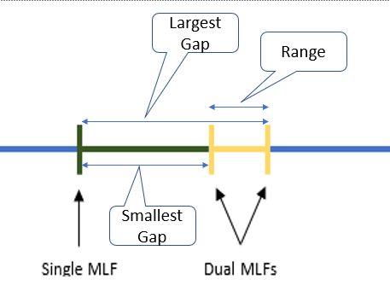
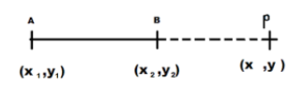
Impact of Net Energy Balance
Line section formula
If m is negative
For a bi-directional trace, we can show that
Dual MLFs were introduced when the extrapolated single MLF were observed to be very high or very low
With NEB 0.3 Small Gap = 2.33 x Range
With NEB 0.5 Small Gap = Range

Slide 11
Summary
The closing date for second stage submissions is 27 November 2020
Submissions are to be sent via email to mlf_feedback@aemo.com.au
Stakeholders seeking clarification or additional information may submit queries to mlf_feedback@aemo.com.au

Slide 12
Stakeholder questions

