Slide 1
NEM Local Temperature Alerts
19 November 2020

Slide 2
Market advice on ambient temperature – current process
When the forecast temperatures are equal to or greater than the regional reference temperatures, AEMO publishes a market notice
The market notice reminds Generators/MNSP to:
Review the weather forecast in the local area where their plant are located and,
If required, update the available capacities in their dispatch/MNSP offers consistent with the forecast temperatures.
Generation Capacity Reference Temperatures:
QUEENSLAND - BRISBANE AREA 37 °C
NEW SOUTH WALES - SYDNEY AREA 42 °C
VICTORIA - MELBOURNE AREA 41 °C
SOUTH AUSTRALIA - ADELAIDE AREA 43 °C
TASMANIA - GEORGE TOWN 30 °C
BASSLINK- Latrobe Valley Airport 43 °C
and GEORGE TOWN 33 °C

Slide 3
Improvements to the process
Representative weather stations for generation clusters in the NEM
Sixteen zones where generation clusters are located
A weather station for each zone has been selected
Temperature alert levels for each zone have been determined – they are called NEM Local Temperature Alert Levels
AEMO business process simplified
A market notice will be issued if forecast temperatures exceed any of the Local Temperature Alert Levels
Market notice will cover five days
New market notice on every business day if forecast temperatures exceed any of the Local Temperature Alert Levels

Slide 4
Alerts for Tasmania
Local Temperature Alert for Tasmania will be based on Basslink power transfer capability
Launceston (Ti Tree Bend) weather station will be used for this purpose

Slide 5
Weather Stations and NEM Local Temperature Alert Levels
Region(s) | Weather Station | Local Temperature Alert Level
TAS1 | Launceston (Ti Tree bend) | 33 °C
QLD1 | Dalby Airport | 37 °C
QLD1 | Rockhampton Airport | 39 °C
QLD1 | Townsville Airport | 39 °C
NSW1 | Armidale Airport | 39 °C
NSW1 | Canberra Airport | 39 °C
NSW1 | Mudgee Airport | 39 °C
NSW1 | Sydney Observatory Hill | 39 °C
Region(s) | Weather Station | Local Temperature Alert Level
VIC1/NSW1 | Mildura Airport | 39 °C
VIC1 | Ararat Prison | 39 °C
VIC1 | Latrobe Valley Airport | 39 °C
VIC1 | Melbourne Olympic Park | 39 °C
SA1/VIC1 | Mt Gambier Airport | 39 °C
SA1 | Adelaide West Terrace | 39 °C
SA1 | Clare High School | 39 °C
SA1 | Port Augusta Airport | 39 °C

Slide 6
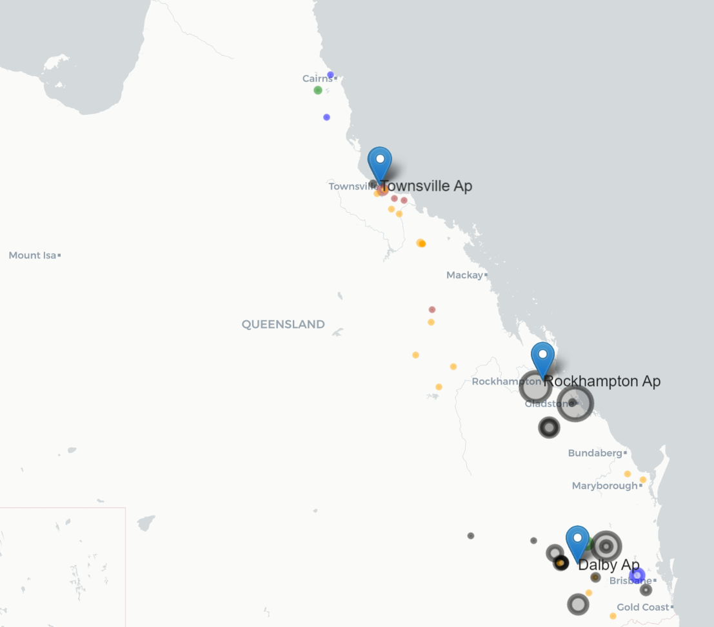
QLD
Fossil
Wind
Solar
Hydro
Size indicates Capacity

Slide 7
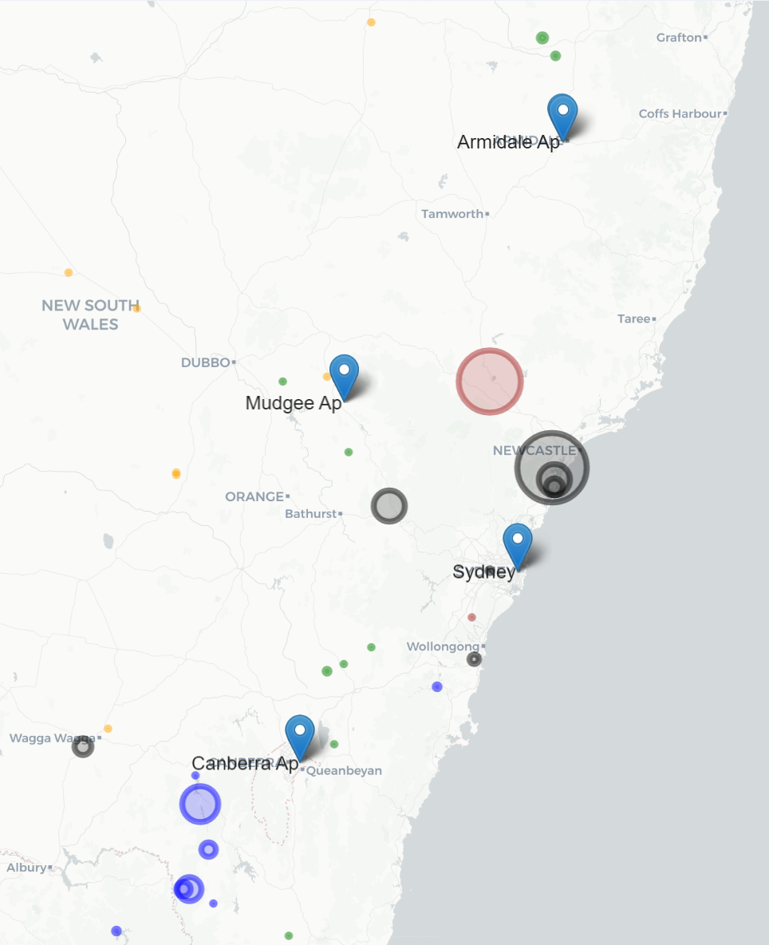
NSW
Fossil
Wind
Solar
Hydro
Size indicates Capacity

Slide 8
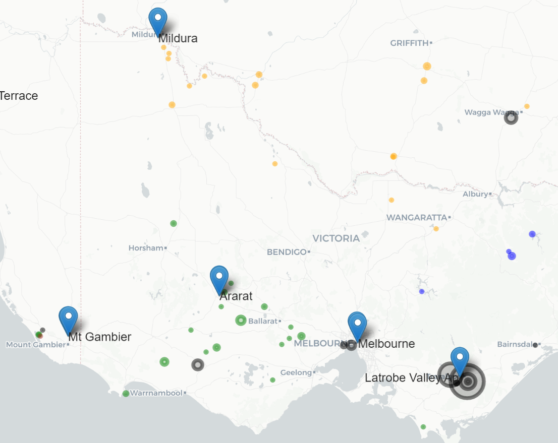
VIC
Fossil
Wind
Solar
Hydro
Size indicates Capacity

Slide 9
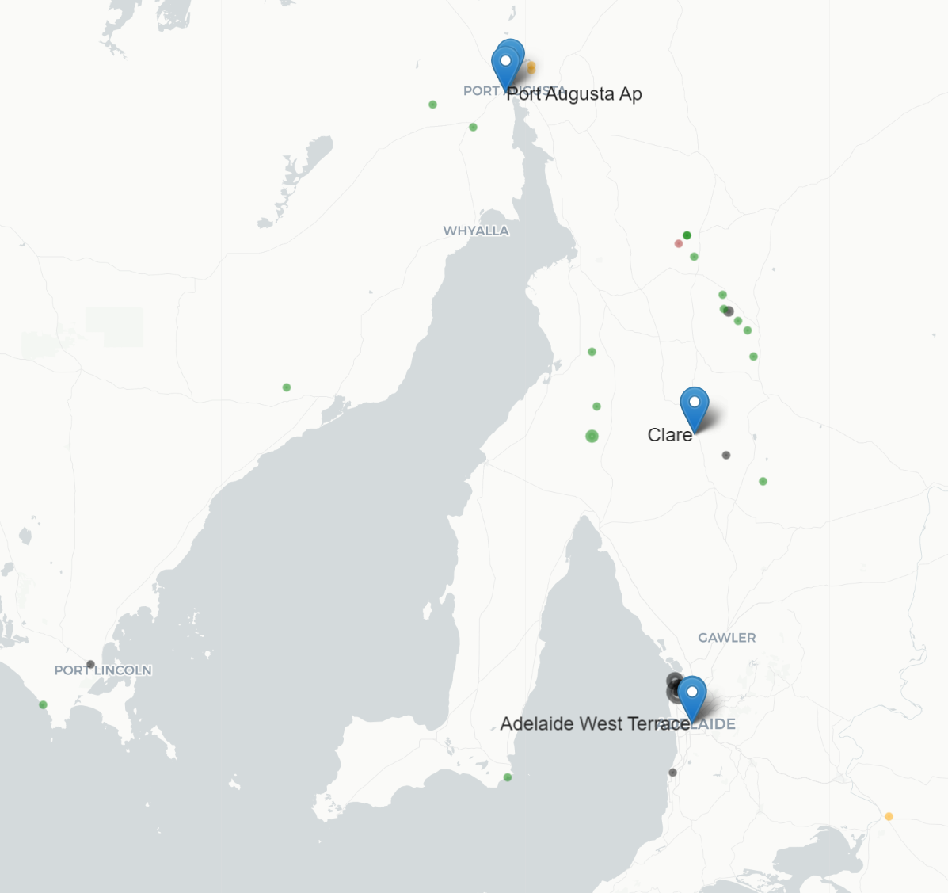
SA
Fossil
Wind
Solar
Hydro
Size indicates Capacity

Slide 10
Sample Market Notice
NEM Local Temperature Alerts for SA, VIC from 19 Nov 20 to 23 Nov 20 AEMO ELECTRICITY MARKET NOTICE 19 Nov to 23 Nov AEMO's weather service provider has issued forecast temperatures equal to or greater than the NEM Local Temperature Alert Levels for listed weather stations below. SA Port Augusta Ap (39+ Deg C): 19th Nov, 21st Nov VIC Mildura Ap (39+ Deg C): 21st Nov The NEM Local Temperature Alert Levels are: Launceston (Ti Tree Bend): 33 Deg C, Dalby Airport: 37 Deg C, for all other selected weather stations: 39 Deg C. AEMO requests Market Participants to: 1. review the weather forecast in the local area where their generating units / MNSP converter stations are located and, 2. if required, update the available capacity in their dispatch offers or availability submissions consistent with the forecast temperatures. Further information is available at: https://aemo.com.au/energy-systems/electricity/national-electricity-market-nem/nem-forecasting-and-planning/forecasting-and-reliability/projected-assessment-of-system-adequacy
AEMO Operations Planning

Slide 11
Further Information and Questions
Further information is available at:
https://aemo.com.au/energy-systems/electricity/national-electricity-market-nem/nem-forecasting-and-planning/forecasting-and-reliability/projected-assessment-of-system-adequacy

